Slide 1
Treehut
March 2025

Slide 2
Summary
Post with most comments (3k!) : 2025 PR List application (March 21)
Post with most mentions (991): Spring Break Giveaway (March 10)
Post with most hashtags (6): Spring Break Giveaway (March 10)
Post with most treehut mentions (70): Spring Break Giveaway (March 10)
Most non-treehut mentions in March: @paulreactss (7), @anaduran1415 (4), @niquenow (4), @colleen_stevenson76 (4)

Slide 3
Actionable Insights
Drive comments up – do a 2025 PR List application post
Drive hashtag and mentions up – do a Spring Break Giveaway post

Slide 4
To do:
Do sentiment analysis on posts, to further split comments into positive, negative and neutral. Will need NLP for this. Will then focus on positive comments.
Do higher order mention analysis. For example, analyze if a mention in a post further drives more comments in a second post. I saw that on the day of a post, comments are also entered into older posts. It seems some users re-engage on older posts.

Slide 5
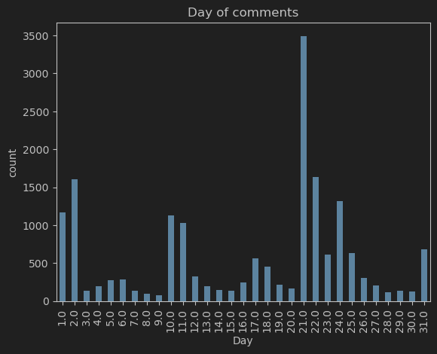
Instagram
5 significant posts in March (1st, 10th, 21st, 24th and 31st):

Slide 6
Most Commented
March 21st - 2025 PR List application - Most Comments (3,289)
March 10th – Spring Break Giveaway - 2nd Most Comments (967)
March 24th - Lotus Water Giveaway - 3rd Most Comments (913)

Slide 7
Hashtags and mentions
2025 PR List Application (March 21st)
No hashtags in comments
Mentions:
96 total mentions
Top 8:
@treehut | 35
@lovealwaysjeane | 2
@coastinwithcee | 2
@_ | 1
@puffsparklyy | 1
@maddiemarie1919 | 1
@madifalteisek | 1
@makeitacombo23 | 1

Slide 8
Hashtags and mentions
Spring Break Giveaway (March 10th)
Hashtags (Complete list):
Mentions:
991 total mentions
Top 8:
#stories | 2
#share | 2
#OBSESSED | 2
@treehut | 70
@anaduran1415 | 4
@niquenow | 4
@a | 3
@fa1th | 2
@lgproductionsus | 2
@bella | 2
@carmen_barajas97 | 2

Slide 9
Hashtags and mentions
2025 PR List Application (March 24th)
No hashtags in comments
Mentions:
952 total mentions
Top 8:
@treehut | 12
@colleen_stevenson76 | 4
@amydudiak | 2
@filmed | 2
@alaynaroseberger | 2
@the | 2
@mari_mari_559 | 2
@ii | 2

