Slide 1
Ch. 4 User input & Java Libraries
Marjon Santiago

Slide 2
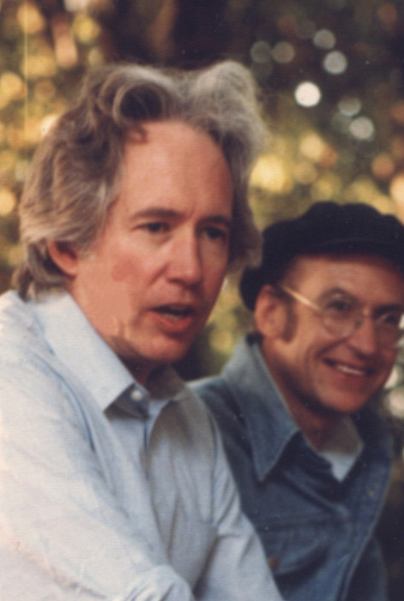
The world changed from having the determinism of a clock to having the contingency of a pinball machine.
- Heinz R. Pagels

Slide 3

User Input
A program is only as good as the data it receives.
What your program can do so far
Create variables
Assign values
Output data and messages
What your program can’t do so far
Take in user input
Fix your teenage anxiety
Tuck you in at night

Slide 4

Scanner
Enter the Scanner class!!!
Scanner can get text input from the command line
You can assign variable values dynamically
Your program can now change its output on runtime!

Slide 5
Using the Scanner class
Scanner is part of the Java.util Package.
Import java.util.Scanner
Initialize a Scanner object

Slide 6
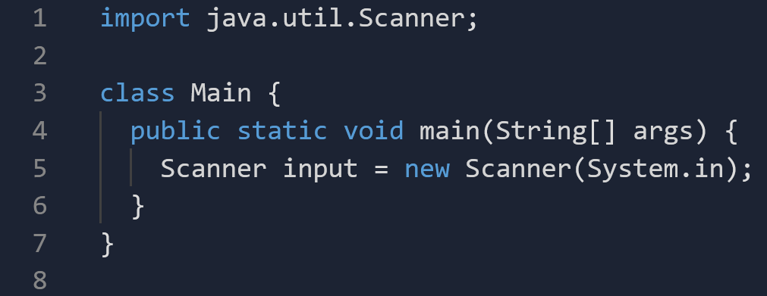
Using the Scanner class pt.2

Slide 7
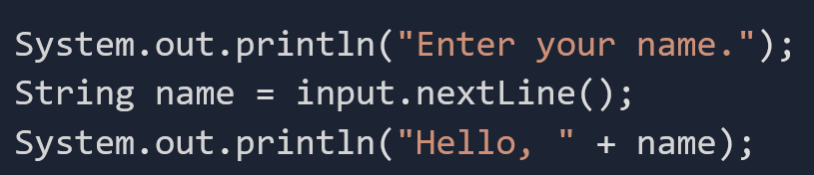
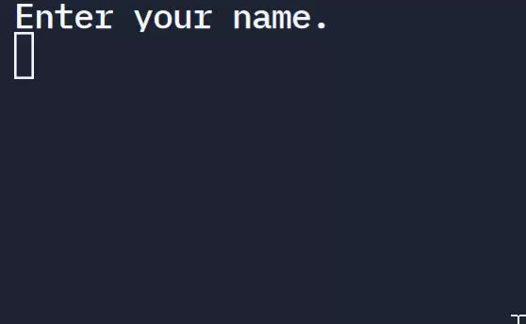
Using the Scanner class pt.3
User input is stored into String name

