Slide 1
Ch. 2 Print statements
Marjon Santiago

Slide 2
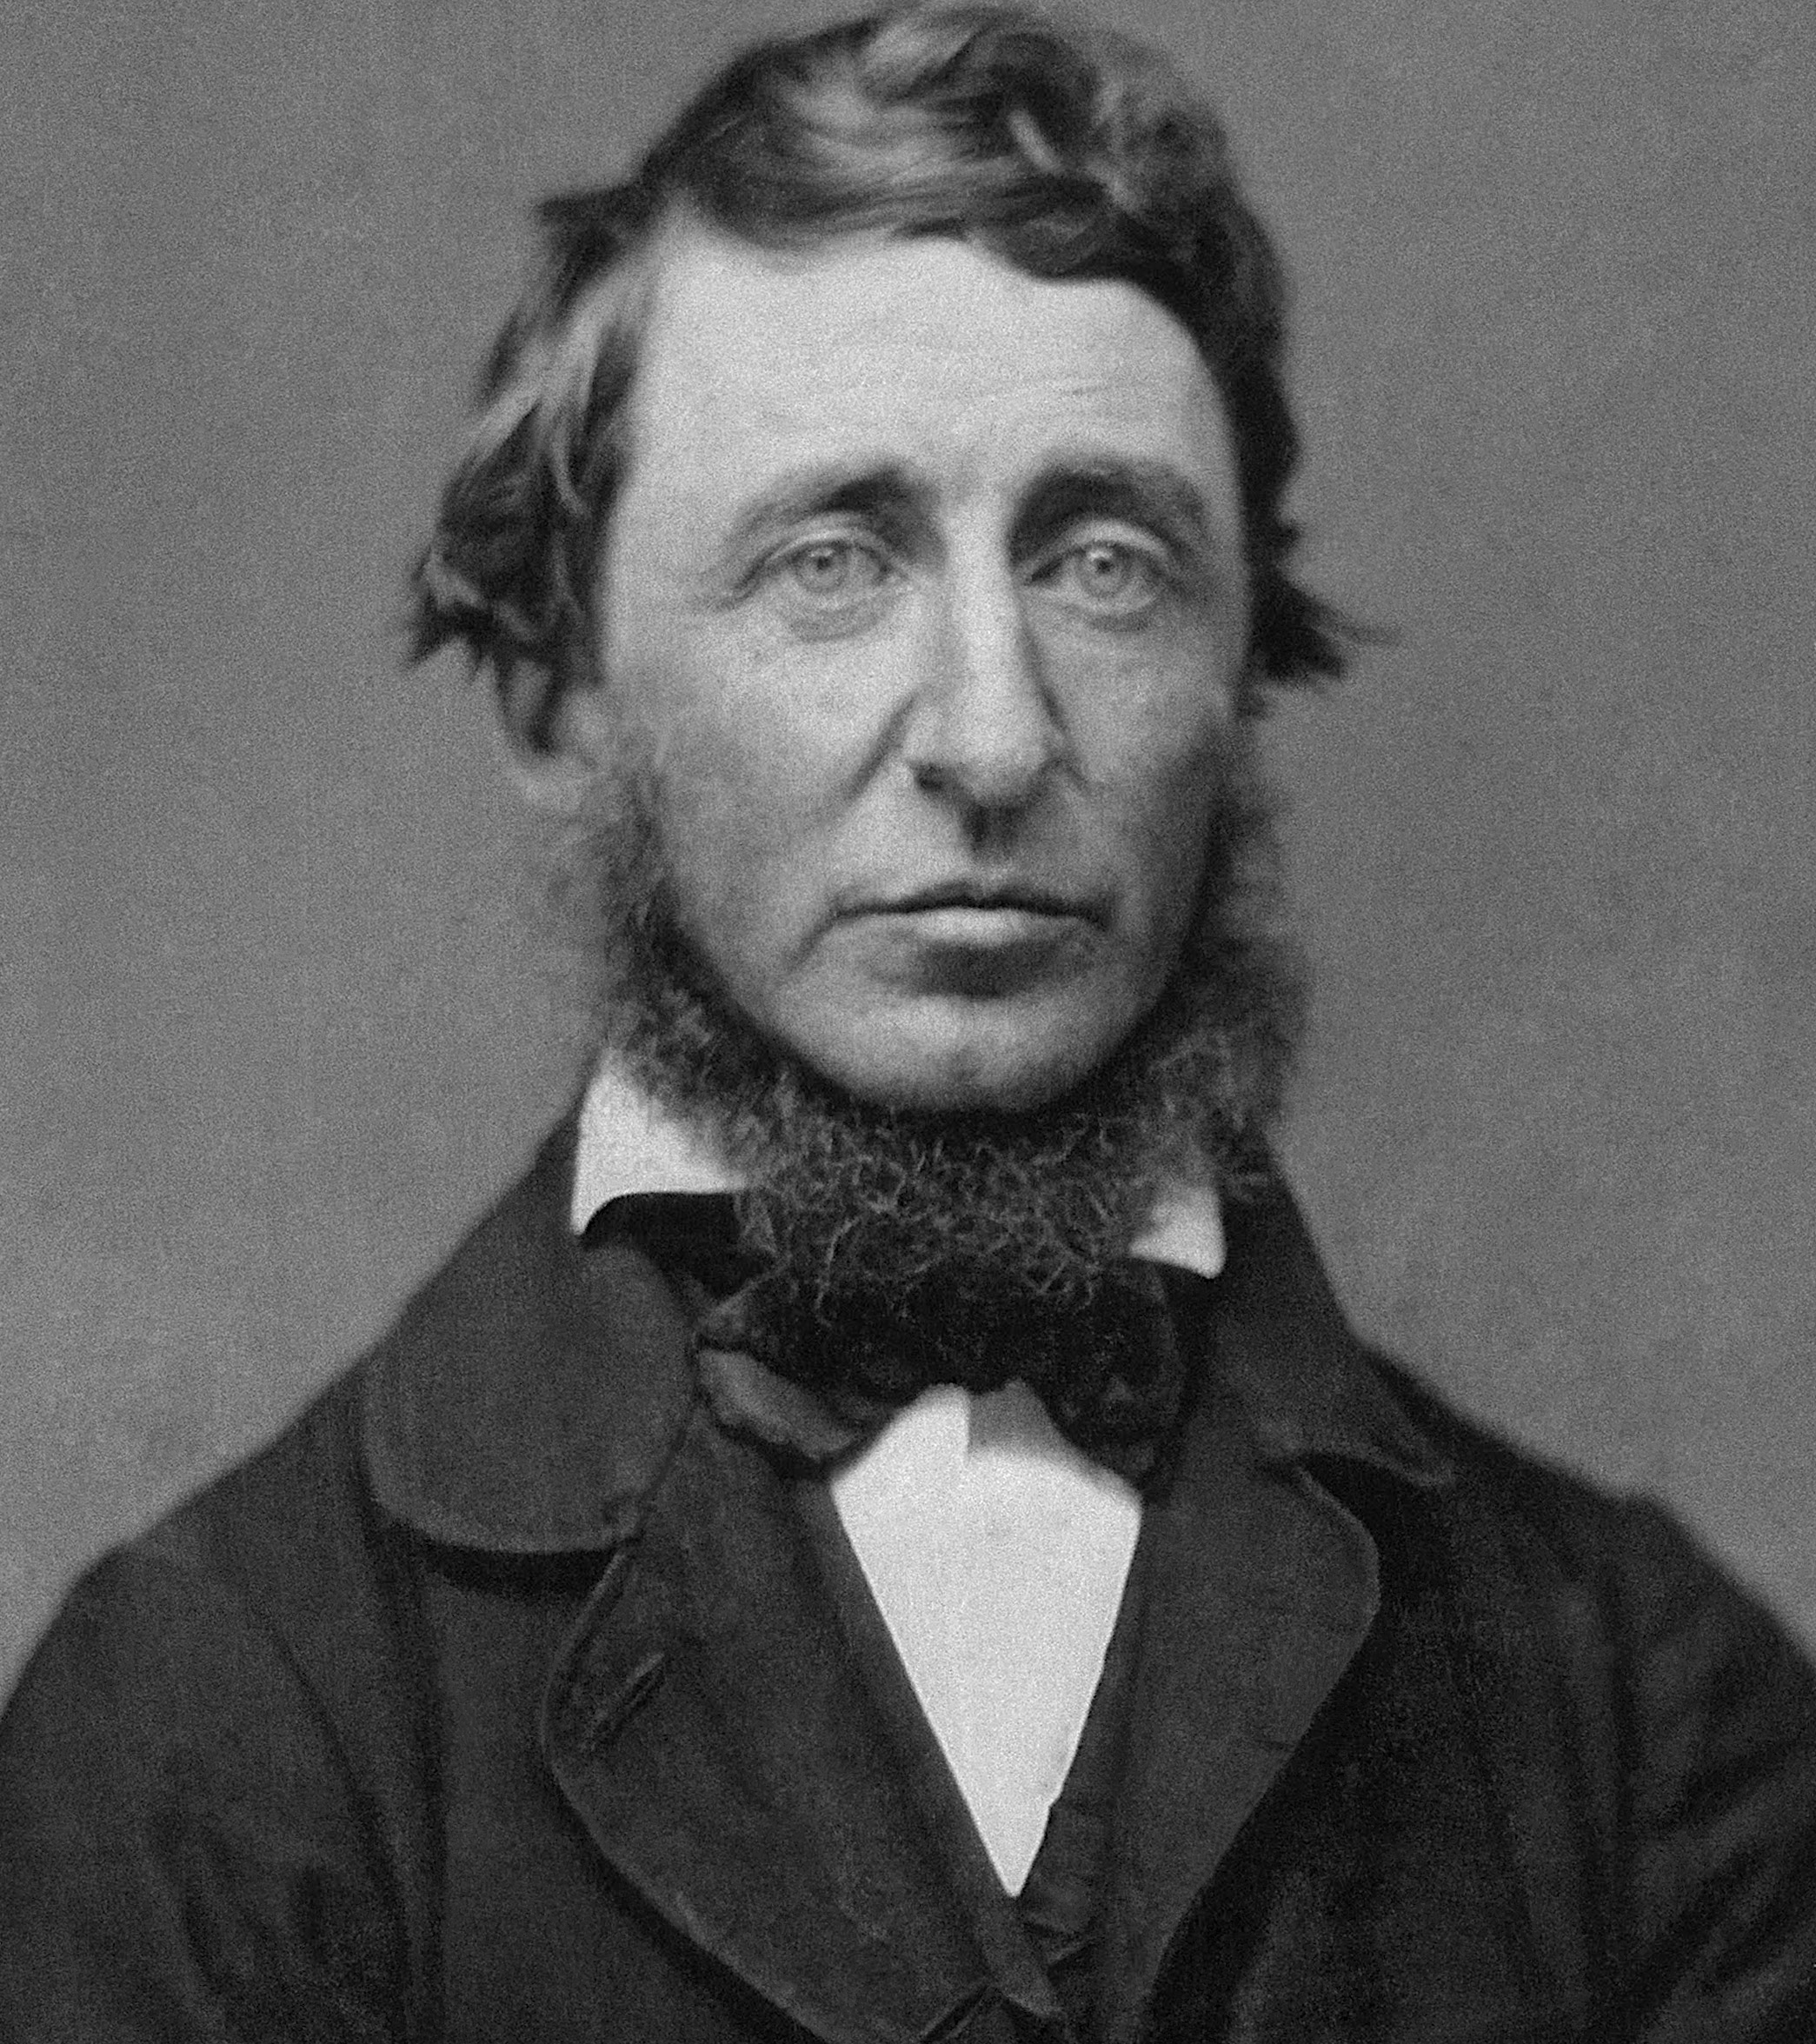
Before printing was discovered, a century was equal to a thousand years.
- Henry David Thoreau

Slide 3
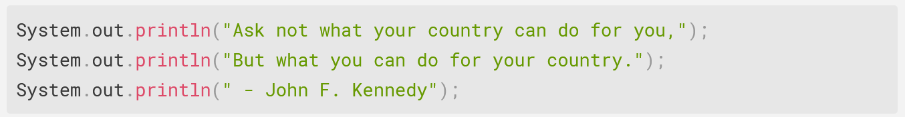
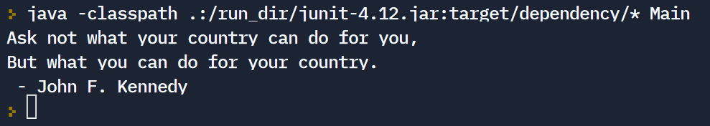
System.out.println()
This command prints a message to standard output.

Slide 4

Escape Characters
(A.K.A. escape sequences)
Allow you to print special characters to output
Begin with backslash \

Slide 5
A Few Escape Characters…
Escape Character | Output
\n | New Line
\t | Tab
\’ | Single Quote
\” | Double Quote
\\ | Backslash
\u | Unicode

Slide 6
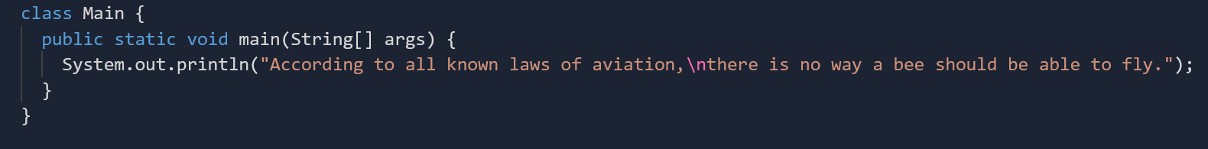
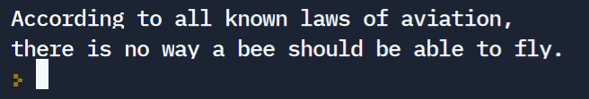
Examples - \n (new line)

Slide 7
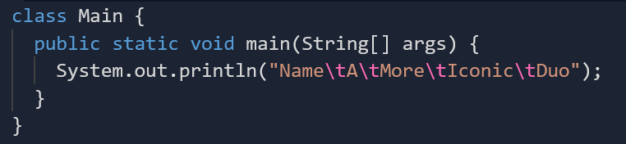

Examples - \t (tab)

Slide 8

Examples - \’ and \”

Slide 9
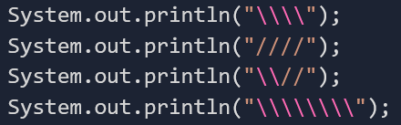

Examples - \\
Two back slashes = One back slash outputted
Two forward slashes = Two forward slashes outputted!
Back slash is a special character.
Forward slash is NOT.
(except for comments)

Slide 10
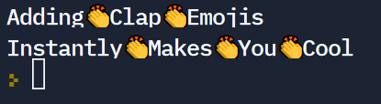
Examples - \u (unicode)
Clapping Emoji (👏) in Java Escape: \ud83d\udc4f
Refer to http://dplatz.de/blog/2019/emojis-for-java-commandline.html for more.

Slide 11
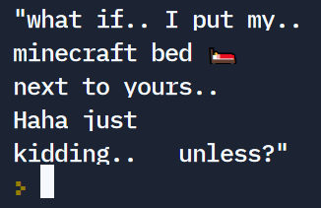

Example – Putting it all together
What is the output of the following print statement?

Slide 12
System.out.println() VS System.out.print
System.out.println(“Hello, World!”);
is functionally equivalent to
System.out.print(“Hello, World!\n”);

Slide 13

Why is this detail important?
Take this as an example…
Output:

Slide 14
Other Print Statements
System.out.printf(message, arguments); prints and formats
System.err.println(message); prints to standard error output

Slide 15

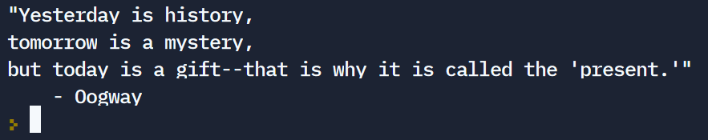
Your next task
With only one println statement, create the following output:

