Slide 1
Chapter 3 – Variables and Primitive Types
Marjon Santiago

Slide 2
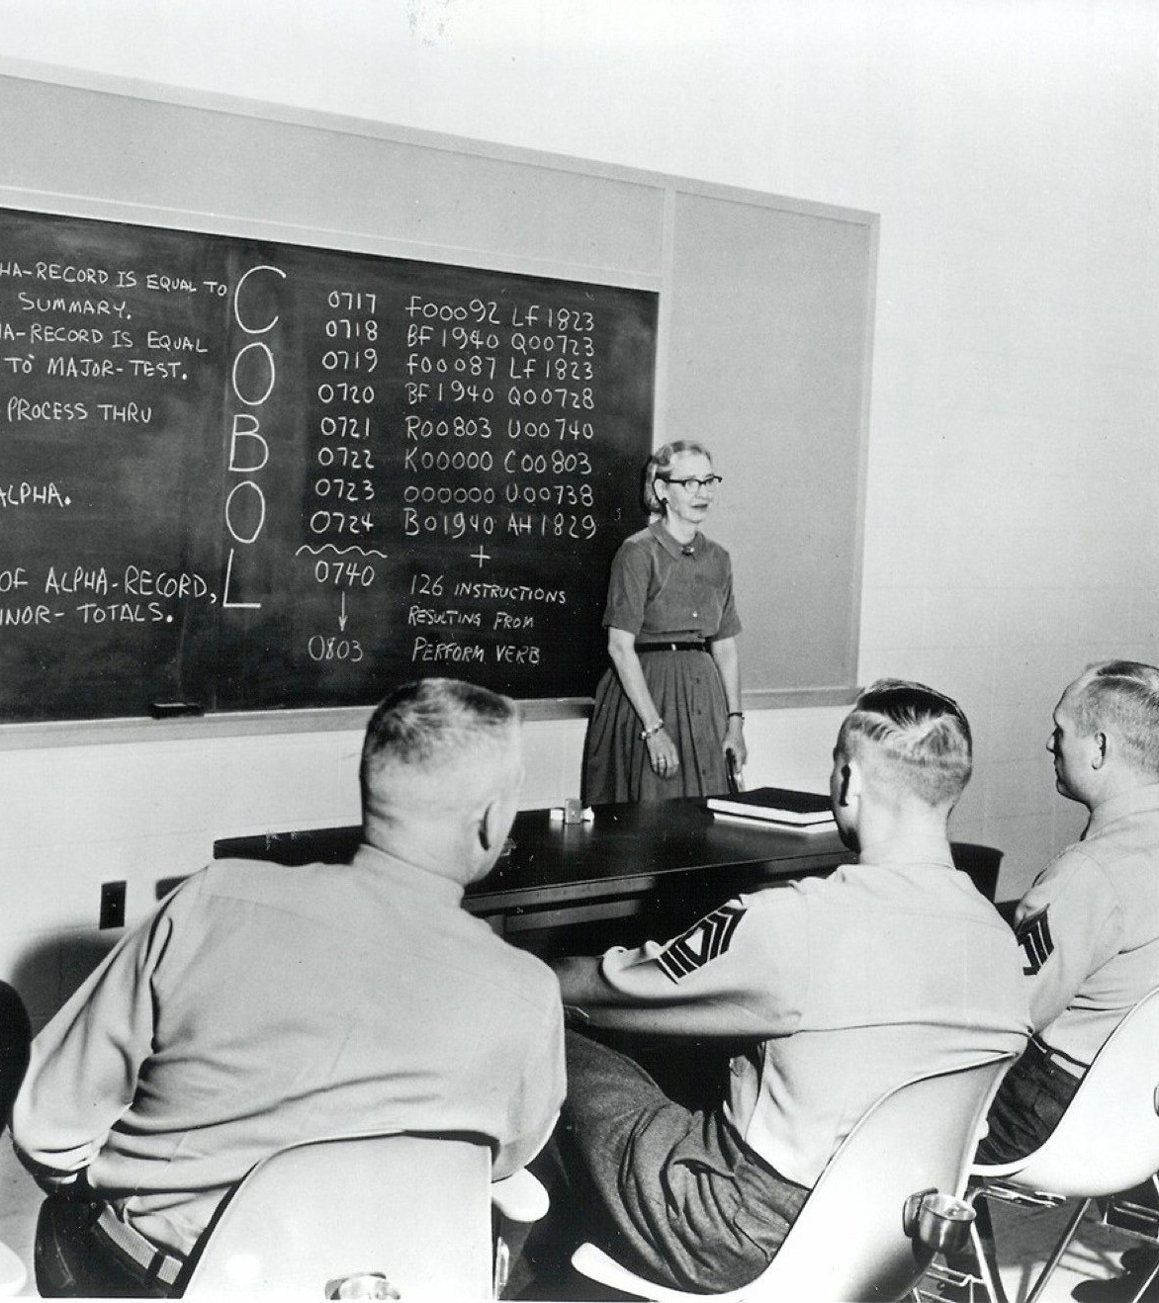
The most damaging phrase in the language is… “it's always been done this way”
- Grace Hopper

Slide 3
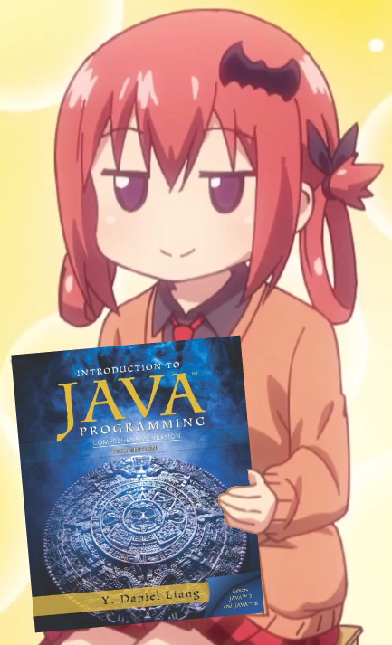
There’s more to Print Statements!
We have been working with printing messages.
However, you can print other types of data.
Understanding data types in Java will be essential.

Slide 4
Data Types
Two classifications:
Primitive data types – a data type that stores a simple value, has no methods (functions)
Class data types – more complex data types that can contain methods AND primitives/other classes
Naming conventions:
primitive types are lowercase while class names are PascalCase; you are expected to name your variables in camelCase

Slide 5
In any case…
We will focus on Primitive data types for now, so the distinction and naming conventions are not important right now.

Slide 6
Variables
Variable – Something that has a value that can change
Variables in Java have data type, a variable name, and a value.
Assigning a variable: [data-type] [variable-name] = [value];
EXAMPLE: int x = 16;

Slide 7
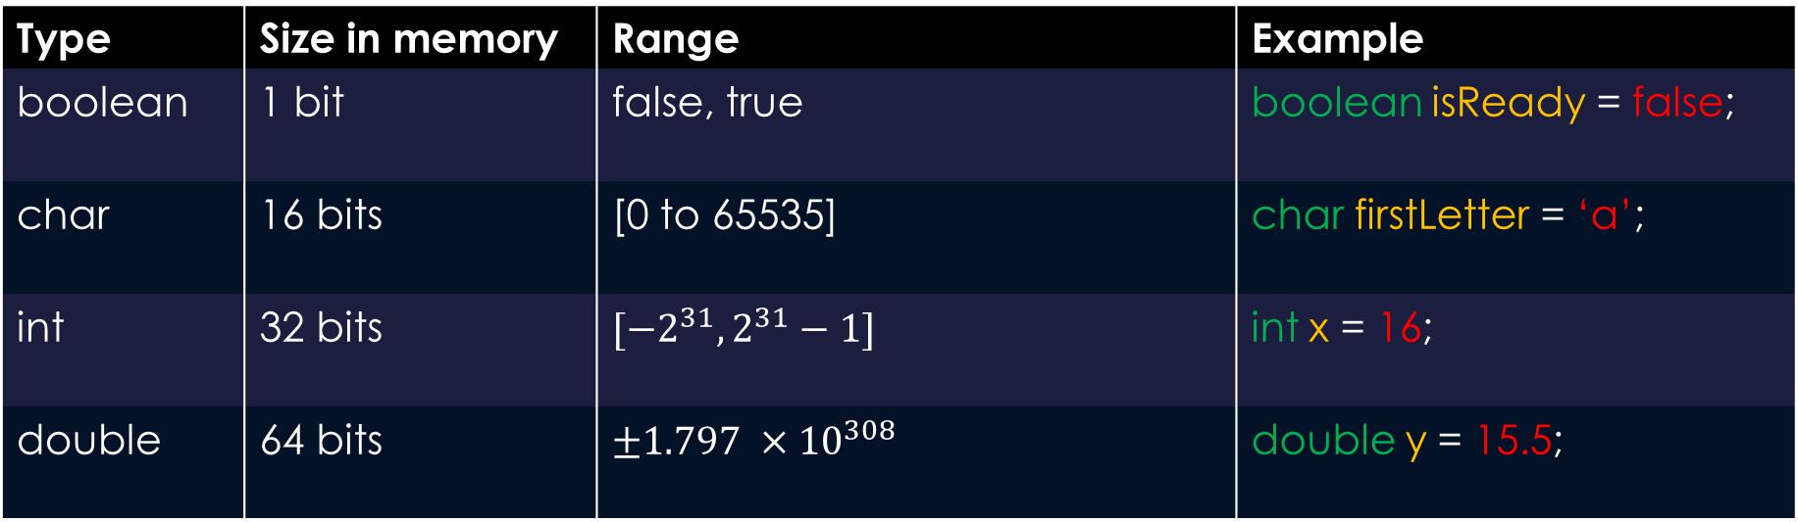
Java Primitives
Type | Size in memory | Range | Example
boolean | 1 bit | false, true | boolean isReady = false;
char | 16 bits | [0 to 65535] | char firstLetter = ‘a’;
int | 32 bits | $$[−2^{31},2^{31}−1]$$ | int x = 16;
double | 64 bits | $$±{1.797 ×10}^{308}$$ | double y = 15.5;

Slide 8
Assignment Statement
boolean a = true;
double profit = 100.02;
As mentioned before, these are assignment statements.
The variable a points to a location in memory storing the supplied value (true).
The size of the variable in memory depends on its type…
Some variables take up more space than others!

Slide 9
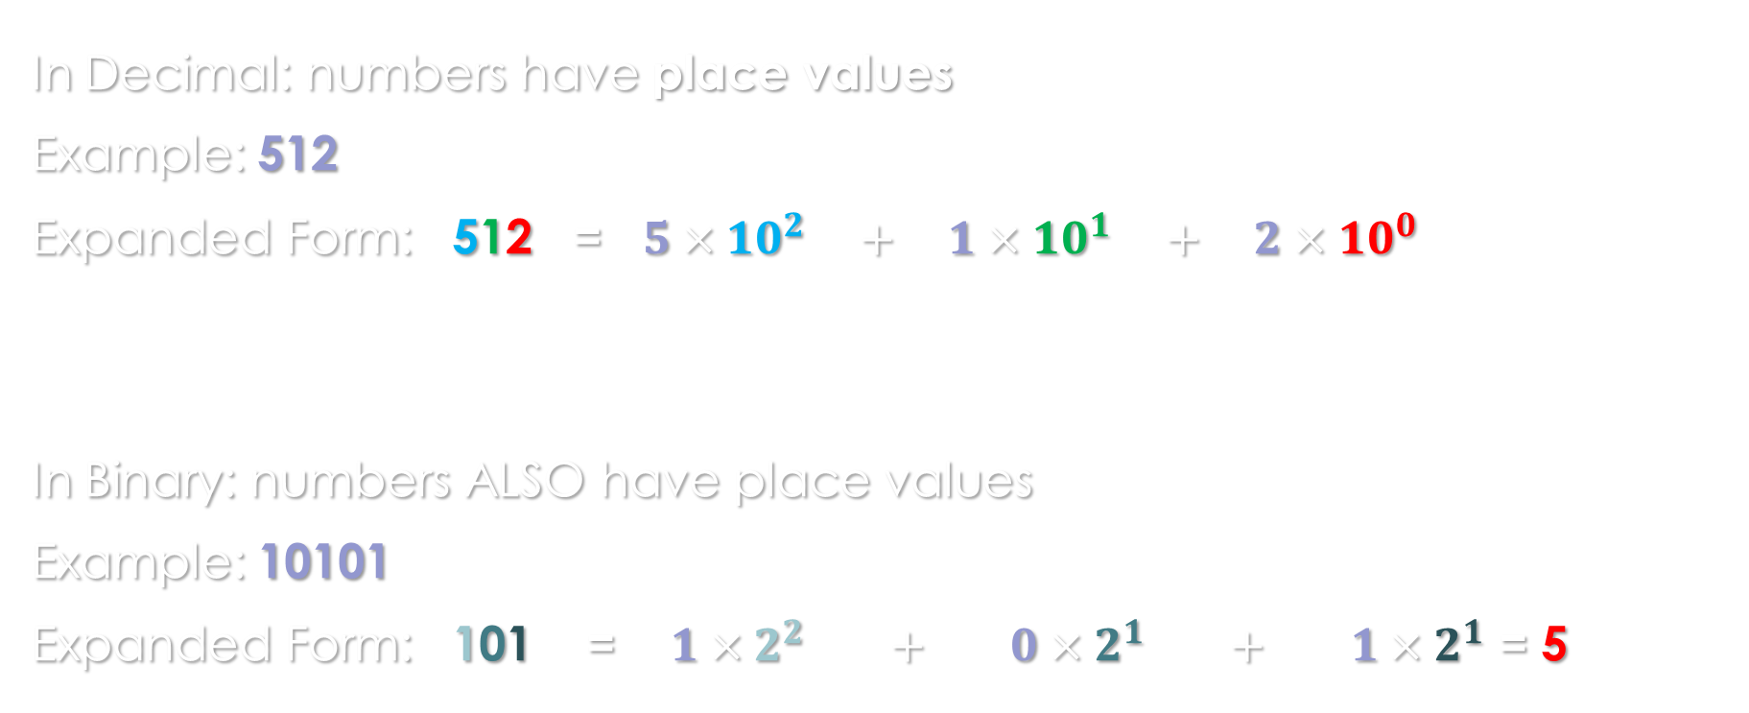
A very quick recap on Binary
In Decimal: numbers have place values
Example: 512
Expanded Form: 512 = $5×10^{2} + 1×10^{1} + 2×10^{0}$
In Binary: numbers ALSO have place values
Example: 10101
Expanded Form: 101 = $1×2^{2} + 0×2^{1} + 1×2^{1}$ = 5

Slide 10
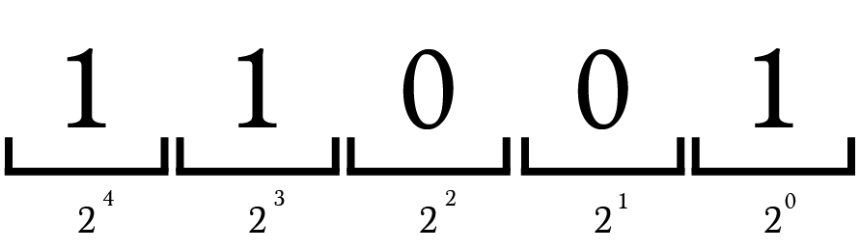
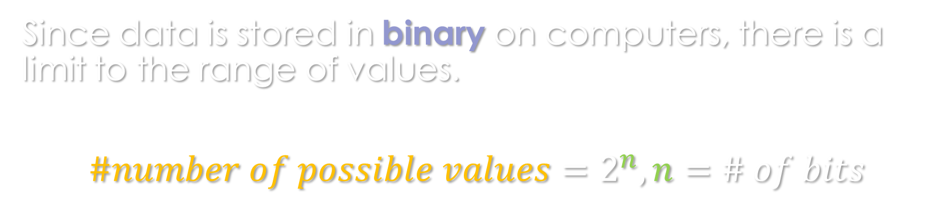
What this means for memory
Since data is stored in binary on computers, there is a limit to the range of values.
$$\#number of possible values=2^{n}, n=\# of bits$$

Slide 11
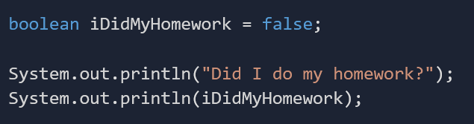
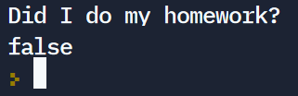
boolean
Holds only one of two different values: true or false
Useful for stating if something has occurred or some condition has been met

Slide 12
boolean logical operators
Suppose you need to purchase bread.
Two conditions need to be present:
You have money to buy bread
There is bread at the store

Slide 13
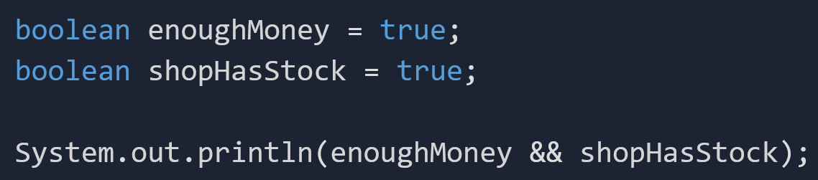
And operator (&&)

Slide 14
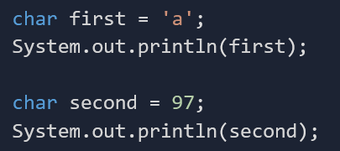

char
A data type that stores a single character
Chars have a numerical representation on top of their character value called their “ASCII” value

Slide 15
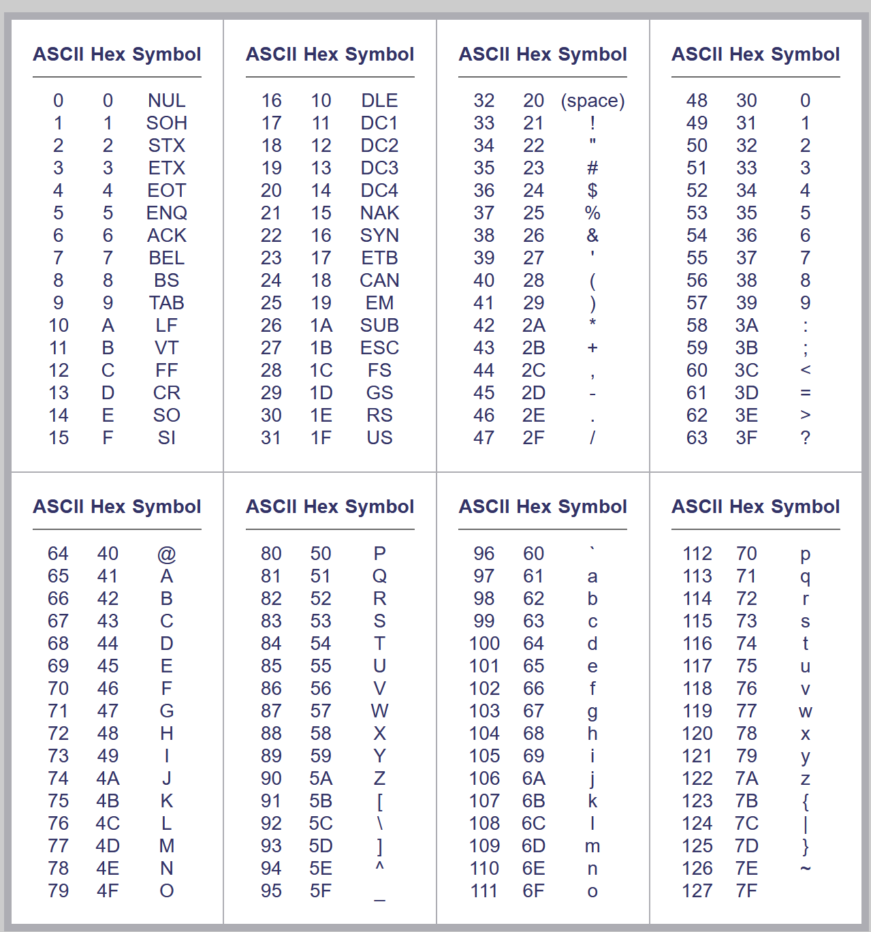
ASCII Table
You can find the ASCII table here: https://www.asciitable.com/
Notice how the 97 is the ASCII value of the letter ‘a’

Slide 16

On a side note… Strings!
String – a sequence of characters (chars)
Example:
String quote = “No one cared who I was until I put on the mask”;
System.out.println(quote);
Truth: You have been working with Strings this entire time.

Slide 17
Strings are NOT primitive data types
They are complex pieces of data (arising from a list of chars)
They have methods—you can do advanced things to Strings that you cannot do on primitive types
Therefore, they are known as class data types.

Slide 18
int
Stands for “integer”
Stores an integer value (negative and positive in Java, aka signed integer)
Can be used in many mathematical operations

Slide 19
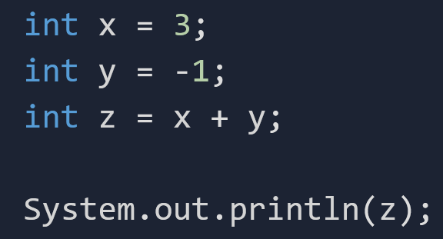
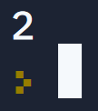
Adding ints

Slide 20
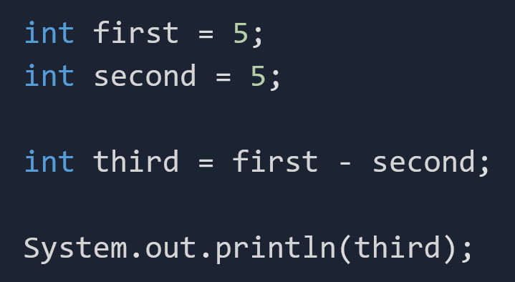
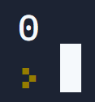
Subtracting ints

Slide 21
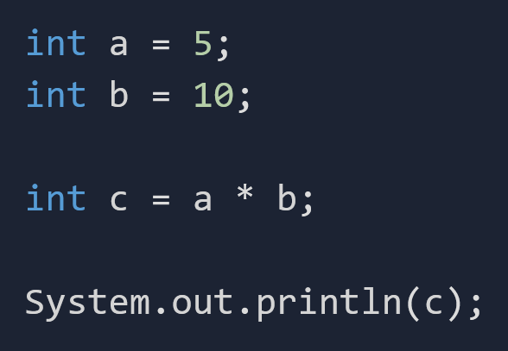
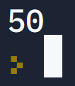
Multiplying ints

Slide 22
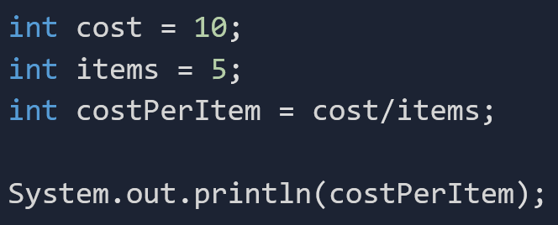

Dividing ints

Slide 23
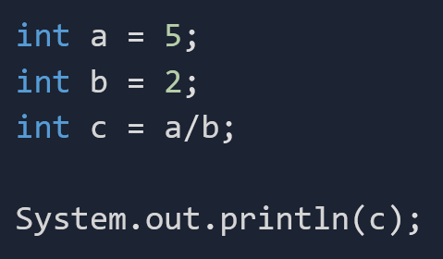
Integer Precision
BE CAREFUL!!!!
What is the output of THIS operation?

Slide 24
5 divided by 2 = 2???
Why do you think it’s not 2.5 as expected?
Answer: ints are whole numbers—they do NOT store the decimal information.

Slide 25



More Examples
$$\frac{5}{2}=2$$
$$\frac{10}{3}=3$$
$$\frac{1}{10}=0$$
$$NOT 2.5, 3.\overline{3}, 0.1$$

Slide 26
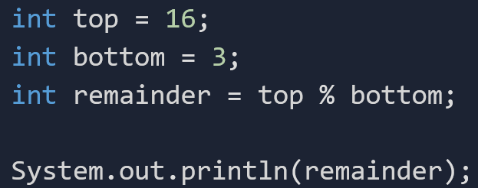

Modulus (%)
The modulus operator (mod operator) returns the remainder of a division operation.

Slide 27
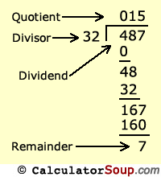
One way to think about it…
When dealing with integer division, you can think of it like how they do it in elementary school:
Quotient and Remainder
“487 divided by 32 is 15 remainder 7.”

Slide 28
More Examples (Modulus)
5 / 3 = 1
5 % 3 = 2
10 / 3 =
10 % 3 =
3
1

Slide 29
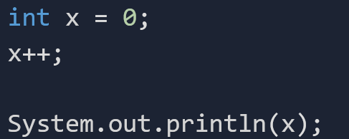
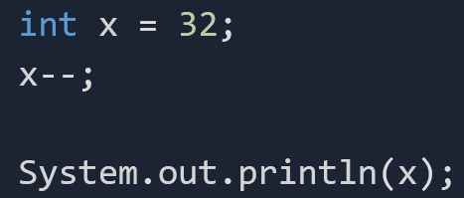

Increment (++)/Decrement (--) Operators
++ is the increment operator. It adds 1 to the current value.
-- is the decrement operator. It subtracts 1 from the current value.

Slide 30
double
A data type that holds decimal places.
Examples: 2.5 1.62 3.0 2.718.

Slide 31
The amazing thing about doubles
Recall that ints can take on a value between, roughly, plus or minus 2 billion.
This is because of memory constraints—an int can only occupy 32 bits in memory (2^32 possible values)

Slide 32
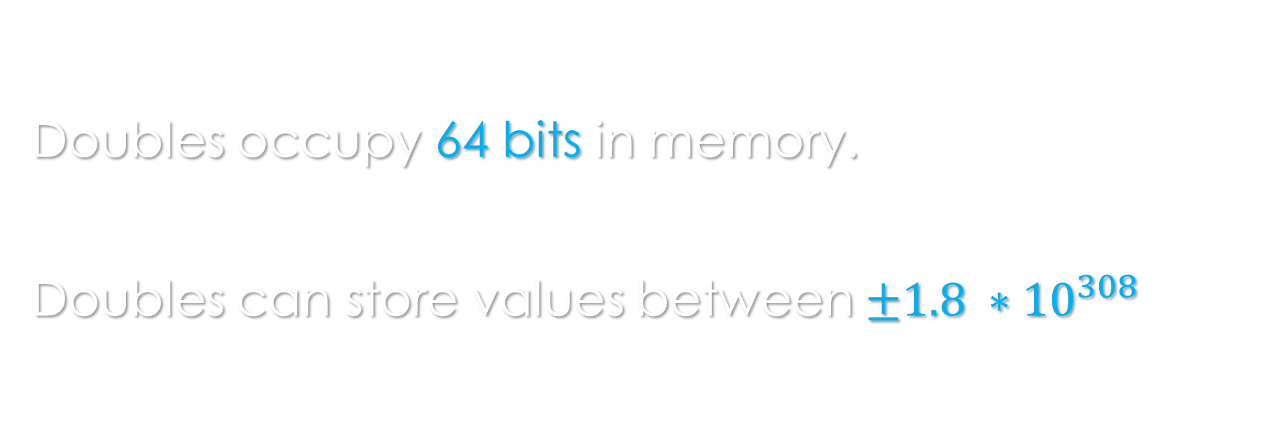
So, what about doubles?
Doubles occupy 64 bits in memory.
Doubles can store values between $±1.8 ∗{10}^{308}$

Slide 33
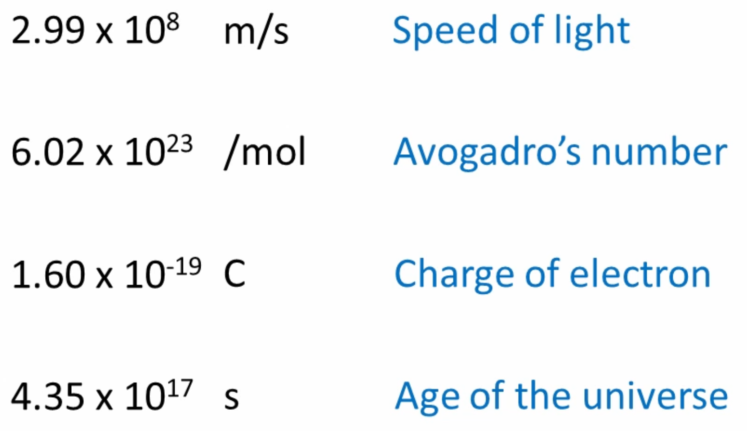
Doubles can store these values:
These values are either EXTREMELY large or EXTREMELY tiny.
How can we efficiently store these in memory though?

Slide 34
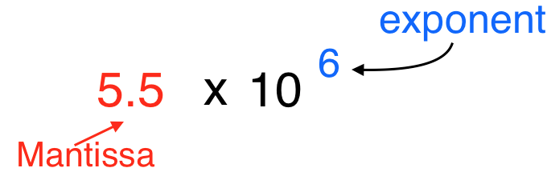
Doubles in memory
Scientific Notation:
A concise way to represent large or small numbers

Slide 35
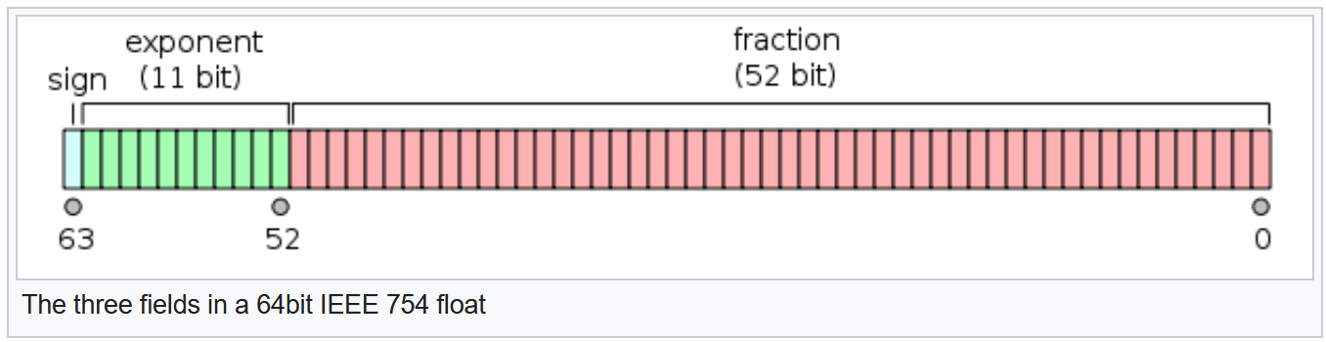
Doubles in memory pt.2
IEEE 754 format—with scientific notation, we can store the exponents, the mantissa, and the sign in their own bits, allowing us to store massive or tiny values in a small memory address.

Slide 36
Exercise
Tell me what data type you should use to describe these.
Boolean? Char? Int? Double?
Pi
The number of dwarves that were in Thorin Oakenshield’s company
Your middle initial
Whether or not Tony Stark dies in Avengers: Endgame
The number of papers (in US dollars) that I stack to the ceiling while riding on my 24-inch chrome
Your full name
My “y-level” in Minecraft, so I know if I am at diamond-layer.
double
int
char
boolean
int
String
double

Slide 37
Exercise
Tell me what data type you should use to describe these.
Boolean? Char? Int? Double?
double
int
char
boolean
int
String
double
Pi
The number of dwarves that were in Thorin Oakenshield’s company
Your middle initial
Whether or not Tony Stark dies in Avengers: Endgame
The number of papers (in US dollars) that I stack to the ceiling
while riding on my 24
-
inch chrome
Your full name
My “y
-
level” in Minecraft, so I know if I am at diamond
-
layer.

Slide 38
Task
Go to https://replit.com/@msantiago9/Primitives
Fork the repl
Follow the instructions

