Slide 1
Ch. 4 User input & Branching
Marjon Santiago

Slide 2
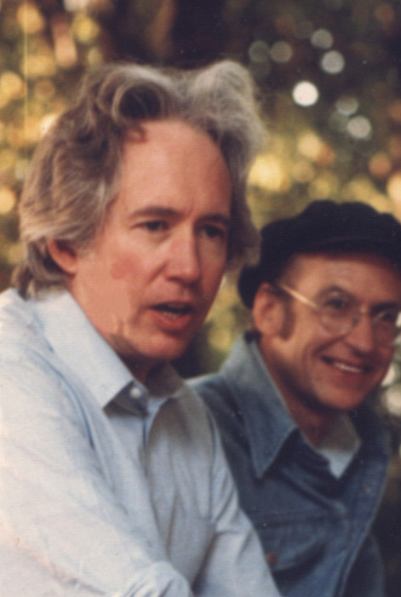
The world changed from having the determinism of a clock to having the contingency of a pinball machine.
- Heinz R. Pagels

Slide 3

User Input
A program is only as good as the data it receives.
What your program can do so far
Create variables
Assign values
Output data and messages
What your program can’t do so far
Take in user input
Fix your teenage anxiety
Tuck you in at night

Slide 4
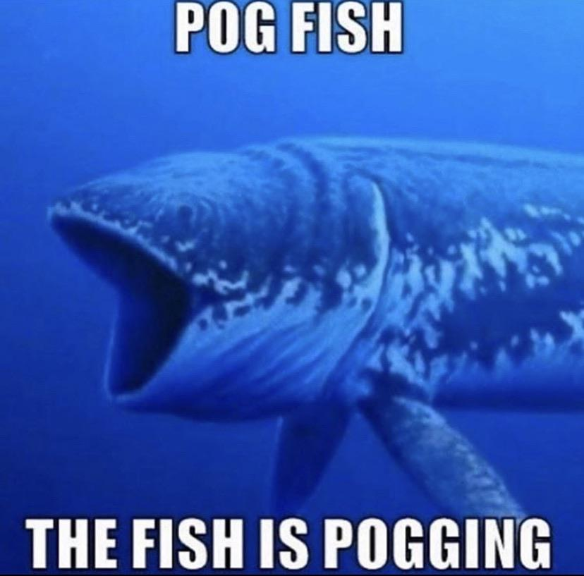
Scanner
Enter the Scanner class!!!
Scanner can get text input from the command line
You can assign variable values dynamically
Your program can now change its output on runtime!

Slide 5
Using the Scanner class
Scanner is part of the Java.util Package.
Import java.util.Scanner
Initialize a Scanner object

Slide 6
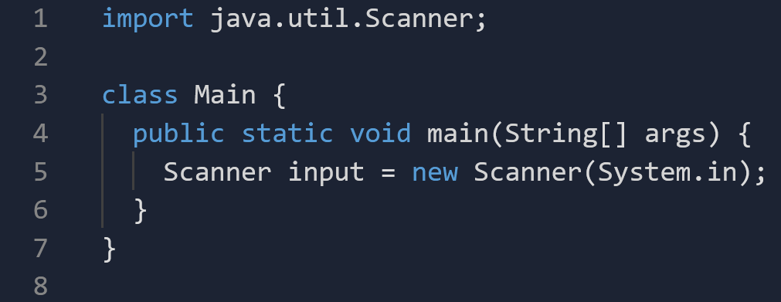
Using the Scanner class pt.2

Slide 7
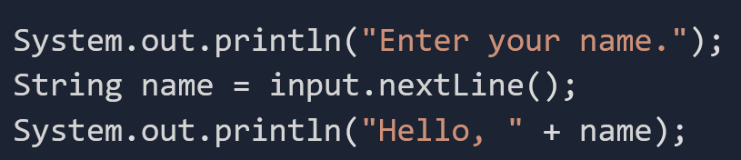
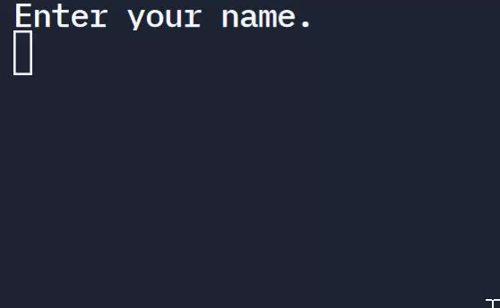
Using the Scanner class pt.3
User input is stored into String name

Slide 8
Scanner methods
Input.nextLine() -> For strings
To read other data types we use other methods.

Slide 9
Scanner methods
Method/Command | Example
Scanner.nextLine() | String message = input.nextLine();
Scanner.nextInt() | int x = input.nextInt();
Scanner.nextDouble() | double money = input.nextDouble();
Scanner.nextBoolean() | boolean completed = input.nextBoolean();

Slide 10
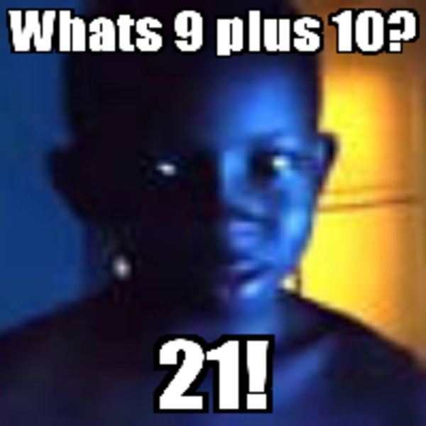
Demo 1 - Calculator
Goal: Create a calculator that takes two numbers and adds them together.

Slide 11
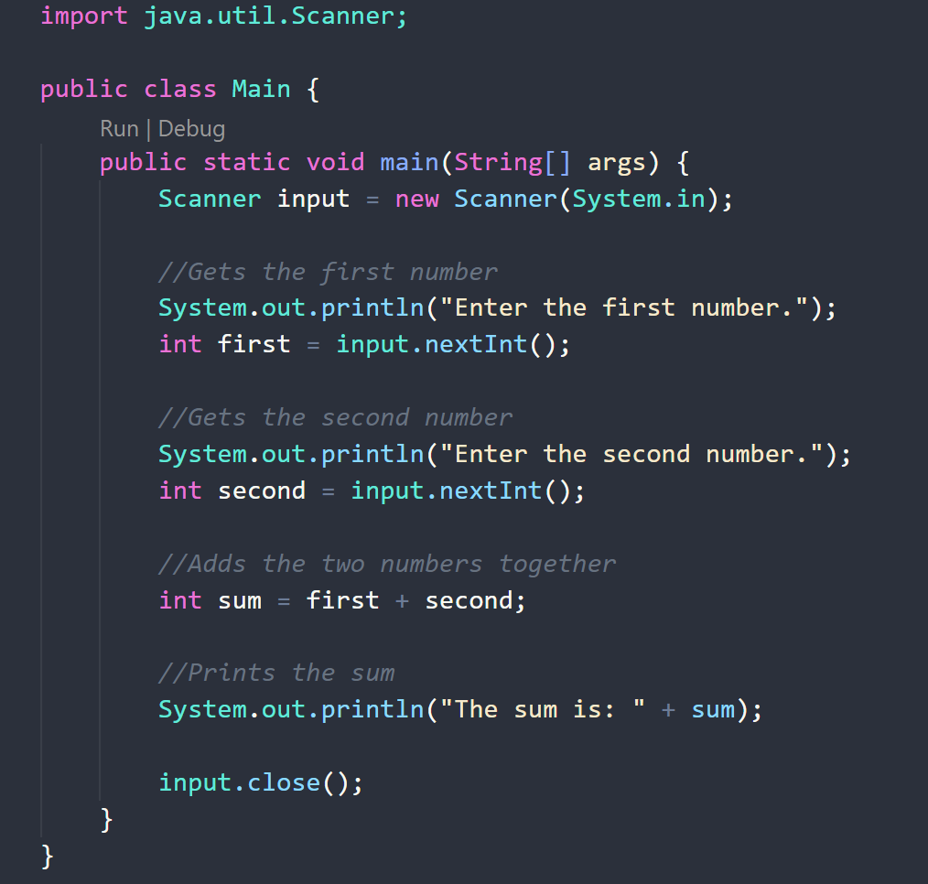
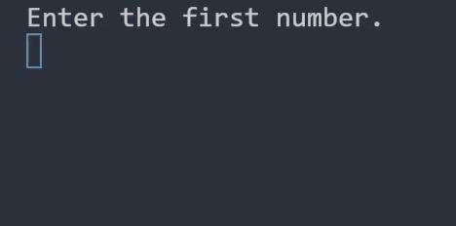

Slide 12
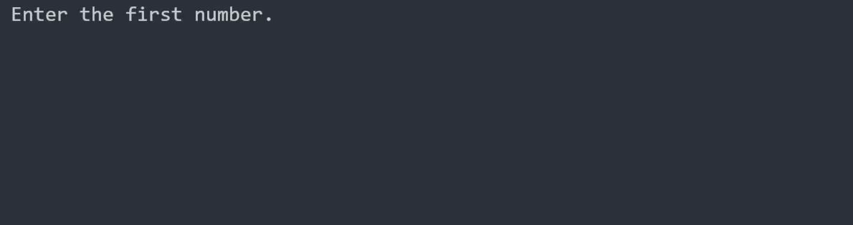
FLAG…
If you try to input a non-integer…
An error appears!

Slide 13
Solution?
Many exist
We will cover them later, but what we have works for now
¯\_(ツ)_/¯

