Slide 1

PHYS 5211
Introduction to Scientific Computing
in the Era of AI
Fall 2026 · Tuesday & Friday, 3:25–5:05 PM · West Village?
Why do scientists and engineers still need to understand numerical methods when AI can generate code in seconds?
Prof. Mauricio Santillana | m.santillana@northeastern.edu
1

Slide 2




WHEN ALGORITHMS FAIL
Opening the Conversation
The Stakes Are Higher Than You Think
Real disasters. Real consequences. Why precision in scientific computing is a matter of life, death, and billions of dollars.
34+
$2.3B+
4 Years
Lives Lost
Financial Damage
Scientific Progress Delayed
Space Exploration
Military Defense
Medical Treatment
Critical Infrastructure
Rockets destroyed and Mars missions lost to computational errors
Missile defense systems failing when lives depend on split-second accuracy
Radiation therapy machines delivering lethal doses to patients
Billion-dollar offshore platforms lost to modeling errors
2

Slide 3
WHEN ALGORITHMS FAIL
A History Lesson
Three Decades of Preventable Disasters
1985–87
Therac-25 Radiation Overdoses
Six patients killed by a race condition in medical software
1991
Patriot Missile Failure
28 soldiers killed after a floating-point timing error
1991
Sleipner A Platform Collapse
$1B offshore platform sinks from a finite-element analysis error
1996
Ariane 5 Explosion
$370M rocket destroyed 37s after launch by an integer overflow
1999
Mars Climate Orbiter Lost
$327M spacecraft lost to a metric/imperial unit mismatch
3

Slide 4
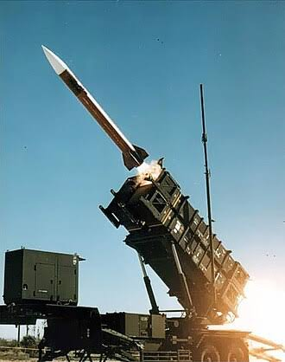

CASE STUDY 1 · FLOATING-POINT ARITHMETIC
Dhahran, Saudi Arabia · Feb 25, 1991
Patriot Missile System Failure
The deadliest single attack on U.S. forces during the Gulf War
THE DISASTER
A Patriot missile battery failed to intercept an incoming Iraqi Scud missile. The Scud struck an Army barracks, killing 28 soldiers and wounding about 100 others.
YOUR IMAGE HERE
Suggested: a Patriot missile battery,
or a Gulf War-era air defense photo
THE TECHNICAL CAUSE
Accumulated floating-point rounding error in a time calculation. After 100+ hours of continuous operation, the timing error reached 0.34 seconds — enough for the Scud to drift outside the tracking window.
1/10 in binary never terminates; the 24-bit register truncates it. After 100 hours, the drift reached 0.34s — about 570 meters at Scud velocity.
4

Slide 5
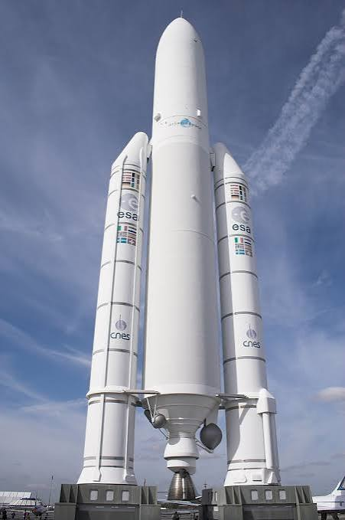
CASE STUDY 2 · INTEGER OVERFLOW & CODE REUSE
French Guiana · June 4, 1996
Ariane 5 Maiden Flight Explosion
Europe's most powerful rocket, self-destructed on its first flight
THE DISASTER
Ariane 5 self-destructed 37 seconds after launch. The $370M loss destroyed the satellites onboard and delayed European space missions for years.
YOUR IMAGE HERE
Suggested: an Ariane 5 launch photo,
or a rocket exhaust/liftoff image
THE TECHNICAL CAUSE
A 64-bit velocity value overflowed a 16-bit signed integer during a unit conversion carried over from Ariane 4's guidance software — code that was never re-tested for Ariane 5's steeper, faster trajectory.
A 16-bit signed integer only holds -32,768 to +32,767. Ariane 5's horizontal velocity exceeded that range — both guidance computers crashed simultaneously.
5

Slide 6
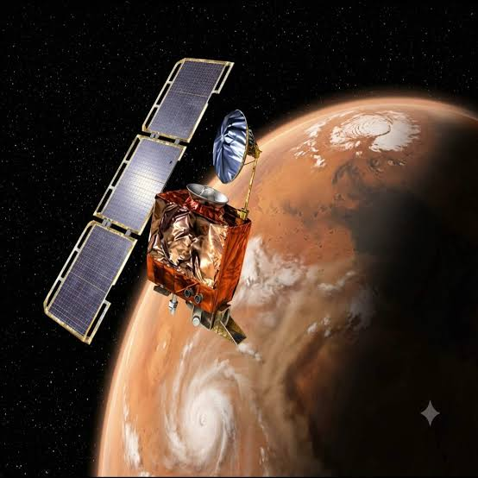
CASE STUDY 3 · UNIT CONVERSION & INTERFACES
Mars Orbit · September 23, 1999
Mars Climate Orbiter Mission Loss
A $327M NASA mission lost approaching Mars
THE DISASTER
The orbiter approached Mars at roughly 57 km altitude instead of the planned 140–150 km, and either burned up in the atmosphere or ricocheted back into space.
YOUR IMAGE HERE
Suggested: Mars from orbit,
or a spacecraft/NASA mission render
THE TECHNICAL CAUSE
One team's software calculated thruster force in pound-force-seconds (Imperial units); NASA's navigation software expected newton-seconds (metric). The 4.45x mismatch accumulated over a nine-month voyage.
Lockheed Martin's ground software used lbf·s; NASA's navigation software expected N·s. No interface check ever verified the units actually matched.
6

Slide 7
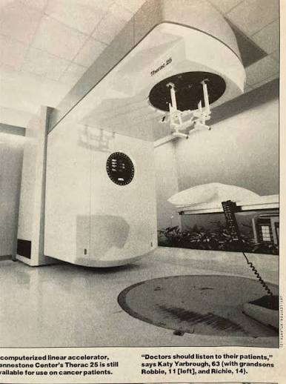
CASE STUDY 4 · RACE CONDITIONS, SAFETY-CRITICAL CODE
Multiple sites, North America · 1985–1987
Therac-25 Radiation Overdoses
A cautionary tale for every safety-critical system we now trust to software
THE DISASTER
A radiation therapy machine delivered massive overdoses to at least six cancer patients — in some cases, over 100 times the intended dose — causing severe injury and death.
YOUR IMAGE HERE
Suggested: a radiation therapy machine,
or a medical-device control room
THE TECHNICAL CAUSE
A race condition let a fast-typing operator override a safety interlock. Removing hardware safety mechanisms present in earlier models — and trusting software alone — turned a rare timing bug into a lethal one.
“It hasn’t failed yet” is not the same as “it has been validated.” A bug occurring once in thousands of uses is still a bug in a life-critical system.
7

Slide 8


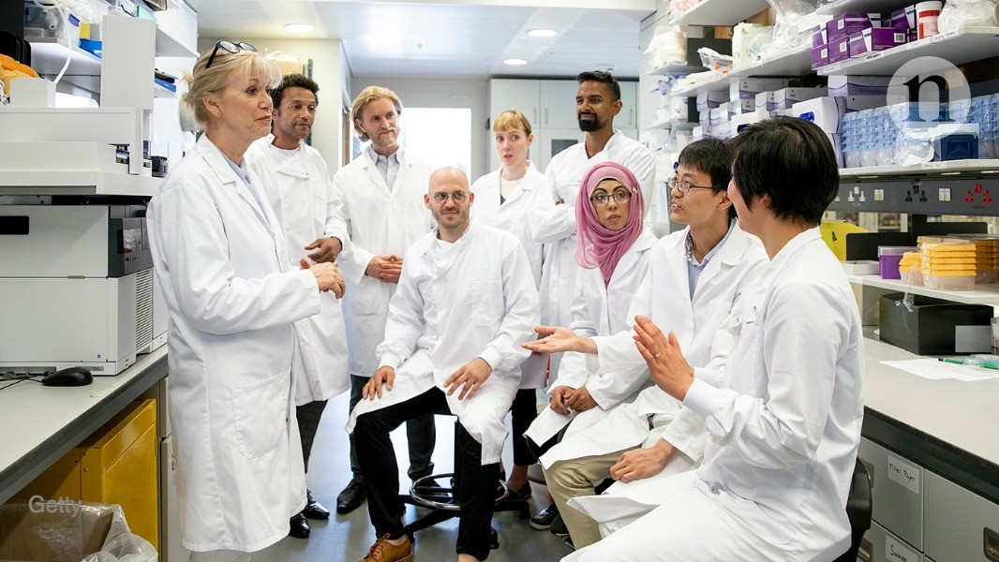




REMEMBERING THE HUMAN IMPACT
Behind Every Bug
Behind Every Bug: Real Human Consequences
Engineers & Scientists
Families & Communities
Organizations
Society
Careers, reputations, and legal liability — and the weight of knowing your code contributed to harm
Sudden loss, and long-term grief from failures that were preventable
Lawsuits, lost public trust, and years spent rebuilding credibility
Delayed scientific progress and stricter regulation that can slow beneficial innovation
8

Slide 9


Why This Matters More Than Ever
YOUR IMAGE HERE
Suggested: an abstract AI / neural
network visual, or server & data imagery
AI can now write scientific computing code in seconds. That doesn't remove the risk of catastrophic failure — it changes who has to catch it.
9

Slide 10




CONTEMPORARY IMPLICATIONS
The Stakes Keep Escalating
The Same Failure Modes, at a New Scale
AI & Machine Learning
Autonomous Systems
Medical AI & Diagnostics
Bias in high-stakes predictions, poisoned training data, and unvalidated model outputs
Sensor-fusion errors and split-second, life-or-death decisions in unpredictable environments
Misdiagnosis from biased training data and over-reliance on algorithmic recommendations
Climate Modeling
Financial Systems
Scientific Reproducibility
Policy decisions built on computational predictions — uncertainty must be quantified, not assumed
Algorithmic trading and risk models that can move — or crash — markets in milliseconds
A growing crisis of results that can't be reproduced due to fragile, unvalidated software
10

Slide 11




THE NEW FAILURE MODE
Setting Up the Course
When AI Code Looks Right — But Isn't
The next computational disaster may not come from a typo. It may come from code that compiles, runs, and produces a plausible-looking wrong answer.
AI assistants generate working code fast — but “runs without error” is not the same as “numerically correct.”
Silent failure modes — ill-conditioning, unstable recursion, overflow — rarely throw an exception. They just quietly hand you the wrong number.
Someone still has to ask: is this algorithm stable? Where will it fail? What test would prove this result is trustworthy?
That someone is you. This course trains the validation mindset an AI-augmented world urgently needs.
11

Slide 12
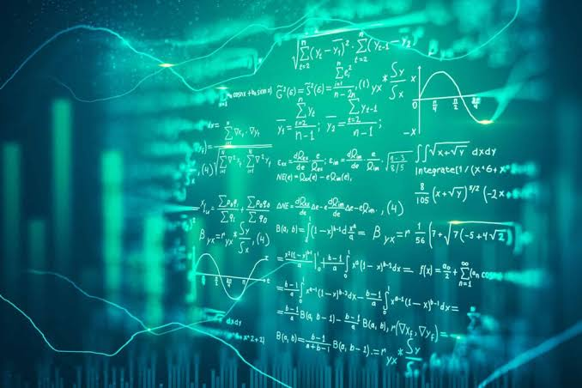
Introducing PHYS 5211
YOUR IMAGE HERE
Suggested: a lecture hall, chalkboard
of equations, or a campus photo
Scientific Computing, taught for the world we actually compute in today
12

Slide 13




PHYS 5211 · FALL 2026
Course Logistics
The Essentials
Instructor
Meeting Time
Location
Prof. Mauricio Santillana
m.santillana@northeastern.edu
Tuesday & Friday
3:25 PM – 5:05 PM
West Village F
Room 108
Office Hours
Core Text
Tools
Tue & Fri, 5:00–6:00 PM
Same room, or by appointment
Heath, Scientific Computing:
An Introductory Survey
MATLAB (primary) or Python
+ an AI coding assistant
13

Slide 14
COURSE DESCRIPTION
Why This Course, Why Now
The Computational Guardian
In an era where AI assistants can generate scientific computing code in seconds, this course prepares you to be the critical validator in an AI-augmented computational world — the engineer or scientist who knows not just how to generate code, but how to verify it won't fail catastrophically.
Is this algorithm numerically stable?
Where, specifically, will this code fail?
How do I verify a result an AI assistant handed me?
What test would prove this computation is trustworthy?
This isn't about replacing AI tools — it's about becoming the person who ensures they work correctly when lives and billions of dollars are on the line.
14

Slide 15




STUDENT LEARNING OUTCOMES
By the End of the Semester, You Will...
What You'll Be Able to Do
Evaluate the numerical stability of an algorithm — whether a human or an AI wrote it
Diagnose sources of computational error: floating point, conditioning, instability
Design a systematic validation framework to verify a computation is correct
Implement robust numerical algorithms with real error handling and convergence checks
Weigh accuracy vs. efficiency trade-offs for a given scientific computing application
Assess and validate code generated by AI assistants before you trust it
15

Slide 16



COURSE CONTENT · PART 1
The Mathematical Foundations
Core Topics: Foundations Through Transforms
Computational Foundations
Floating-point arithmetic, condition numbers, error propagation, backward/forward error analysis — including the numerically stable softmax trick used in every ML library
Linear Algebra Computing
Direct & iterative solvers, LU/QR/SVD/Cholesky decompositions, eigenvalues, ill-conditioned systems
Transform Methods
Fast Fourier Transform, spectral analysis, aliasing and leakage, time-frequency analysis
16

Slide 17
COURSE CONTENT · PART 2
Data Methods and Optimization
Core Topics: Data Methods & Optimization
Data-Driven Methods & ML
Least squares, regularization (ridge/LASSO), splines, cross-validation, and detecting overfitting
Root Finding & Optimization
Newton-Raphson convergence, basins of attraction, constrained optimization, global optimization challenges
Differential Equations
Initial value problems, stiffness and stability regions, adaptive step-size control, boundary value problems
17

Slide 18
COURSE CONTENT · PART 3
Making the Course Current
Core Topics: Automatic Differentiation & the AI Era
Automatic Differentiation
Reverse-mode autodiff (backpropagation) vs. forward-mode; the chain rule as a computational graph — how every deep learning library actually computes gradients
Gradient Validation & Stability
Gradient checking against finite differences; vanishing/exploding gradients; why they happen numerically and how to detect them
Modern Deployment Realities
Mixed-precision & quantization error, reproducibility failures in ML pipelines, and validating AI-generated code before you trust it
18

Slide 19
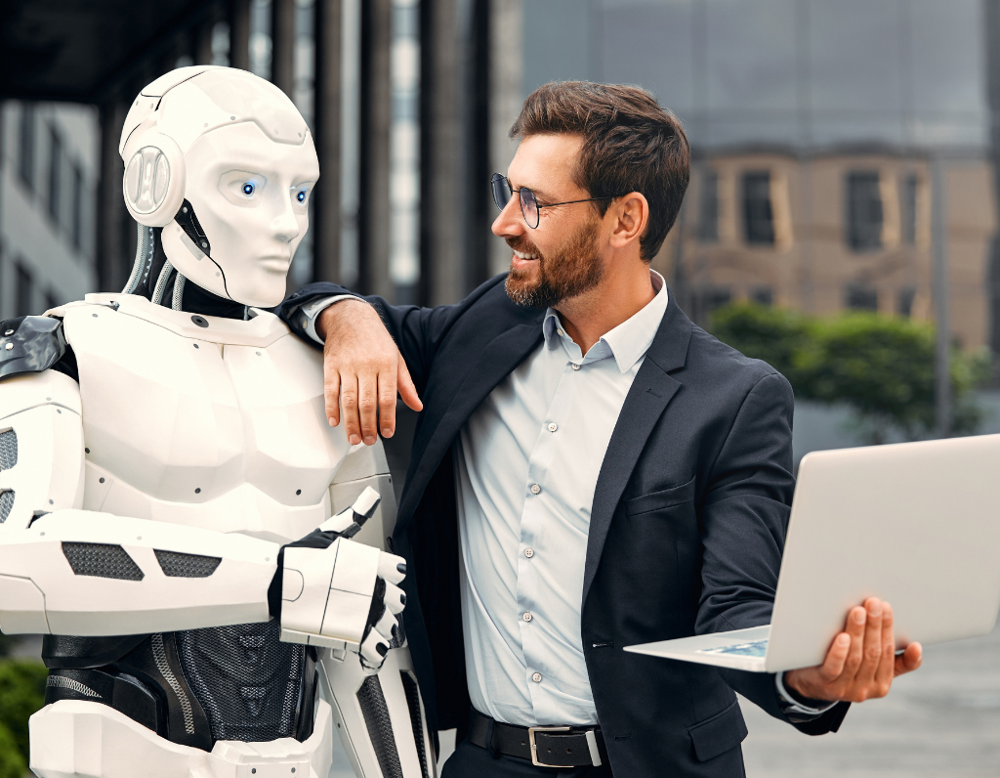
How We'll Learn
YOUR IMAGE HERE
Suggested: students collaborating,
or a whiteboard discussion photo
A new way of doing homework — built around AI-assisted problem solving and deepening your own understanding
18

Slide 20



PROBLEM SETS, REIMAGINED
The AI-Augmented Workflow
Solve It Yourself. Then Put AI to the Test.
1. Implement It Yourself
2. Generate an AI Solution
3. Validate & Compare
4. Explain What You Learned
Solve the problem the traditional way in MATLAB or Python — your own code, your own thinking
Ask Claude, ChatGPT, or a similar tool to solve the same problem — with full attribution
Test both implementations. Where do they agree? Where does the AI version quietly go wrong?
Present your reasoning and findings to me and your peers — this is where the real learning shows
19

Slide 21
THE HEART OF THIS COURSE
It's Not Just About the Right Answer
What Matters Most: Explaining What You Learned
You will solve every homework problem on your own. But the most important part of each assignment is explaining — to me and to your peers — what you learned, where you struggled, and why.
Oral Explanations
Peer Discussion
Instructor Check-ins
Deeper Understanding
Be ready to walk me and your classmates through your reasoning — not just your final code
Comparing notes with classmates surfaces the failure modes any one person might miss
I'll probe whether you truly understand the code you submitted — AI-assisted or not
Teaching an idea back is the fastest way to discover what you don't yet understand
20

Slide 22

COURSE ACTIVITIES
Beyond Problem Sets
Workshops, Case Studies, and a Final Project
In-Class Validation Workshops
Analyze human- and AI-written code together, hunt for numerical issues, and design test cases live
Failure Case Study Presentations
Present a historical computational disaster: root cause, why it went undetected, how validation could have caught it
Final Validation Project
A real-world problem, solved with both manual and AI-assisted code, backed by a rigorous validation framework
21

Slide 23
ASSESSMENT
How Your Grade Is Built
Grade Breakdown
No traditional exams — assessment is built entirely around applied validation skills.
Up to +10% bonus available for in-class participation and workshops.
22

Slide 24
FINAL PROJECT
Key Dates This Semester
Key Dates to Plan Around
Oct 15, 2026
Project Proposal Due
One page: problem description, validation strategy, success metrics
Nov 15, 2026
Progress Report Due
Preliminary results and validation findings
Dec 7, 2026
Final Report & Code Due
Full write-up, implementation, and validation framework
Dec 11–13, 2026
Project Presentations
Live demonstration of your validation techniques
23

Slide 25
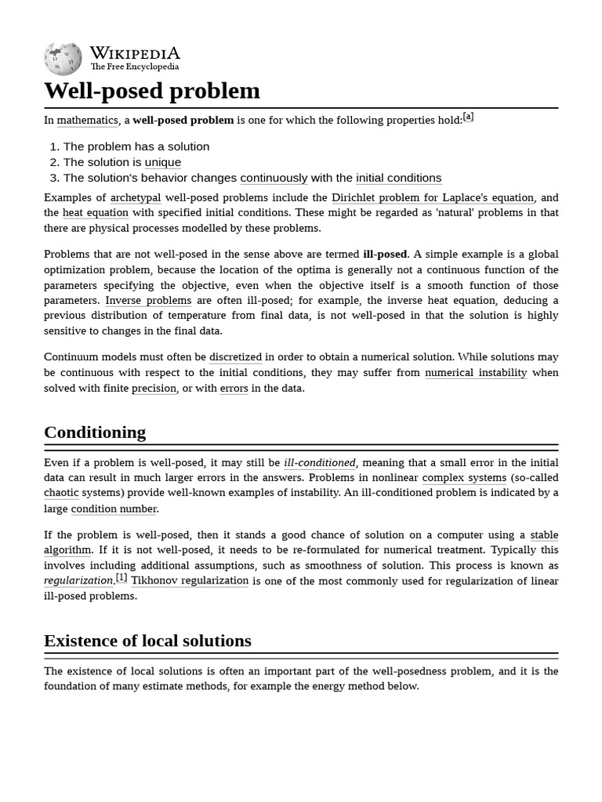
Framing Problems Like a Scientist
YOUR IMAGE HERE
Suggested: a chalkboard of equations,
or an elegant mathematical diagram
Before we compute anything — human-written or AI-generated — we must ask whether the problem itself is well-posed
24

Slide 26
HEATH, CH. 1 · MATHEMATICAL FOUNDATIONS
A Concept That Comes Before Any Code
What Makes a Problem “Well-Posed”?
Hadamard's three conditions — every computation implicitly assumes them, and every validator must check them
A Solution Exists
The Solution Is Unique
It Depends Continuously on the Data
The problem must actually have an answer — not every equation we write down does
There should be exactly one answer; multiple valid solutions signal an underspecified problem
A small change in the input should produce only a small change in the output — not a wild swing
If a problem violates any one of these, it is ill-posed — and no amount of clever code, human or AI-written, can make an ill-posed problem trustworthy to solve.
25

Slide 27

HEATH, CH. 1 · CONDITIONING
From Well-Posedness to Conditioning
Well-Posed Isn't the Same as Well-Behaved
A problem can be well-posed in theory and still be practically dangerous to compute
WELL-CONDITIONED
ILL-CONDITIONED
A small perturbation in the input data — measurement noise, rounding, an AI-generated approximation — produces a proportionally small change in the answer.
The same tiny perturbation gets amplified — sometimes enormously — into a huge change in the answer. Nearly-singular matrices and Runge's phenomenon are classic examples.
Trustworthy to compute, even with imperfect data.
Dangerous to compute — the condition number tells you how dangerous.
26

Slide 28
TYING IT TOGETHER
The Question to Ask Before You Trust Any Result
Well-Posedness Is Your First Validation Check
Before running any algorithm — yours or an AI's — ask: is the underlying problem even well-posed?
If it's ill-posed or ill-conditioned, a correct-looking implementation can still return a meaningless number.
AI assistants will confidently produce an answer either way — they don't know to ask whether the question was fair to ask.
You do. That judgment — knowing when to distrust a plausible answer — is what this course is built to train.
27

Slide 29

GETTING SET UP
Materials & Tools
What You'll Need
Textbook
Programming
Heath, Scientific Computing: An Introductory Survey (course reference, no purchase required — provided on Canvas)
MATLAB (campus license, ~2 hr tutorial required) or Python with NumPy/SciPy
AI Assistants
Canvas
Required: ChatGPT, Claude, Copilot, or similar — free tiers are acceptable
Primary hub for materials, submissions, announcements, and the detailed weekly schedule
28

Slide 30
TENTATIVE SCHEDULE
The Semester at a Glance
Weekly Roadmap (Tentative)
Weeks 1–3
Foundations: floating point (incl. stable softmax), error analysis, condition numbers & stability
Weeks 4–7
Linear systems, matrix decompositions, and eigenvalue computation
Weeks 8–10
Least squares, interpolation, and the Fast Fourier Transform
Week 11
Root finding and optimization: convergence and basins of attraction
Week 12
Ordinary differential equations: stiffness, stability, adaptive methods
Weeks 13–14
Automatic differentiation & backpropagation, reproducibility, and uncertainty quantification
Week 15
Final project presentations & course synthesis
30

Slide 31
GROUND RULES
The AI Policy That Makes This Work
Required to Use AI. Required to Validate It.
REQUIRED
PROHIBITED
Use AI tools as part of your learning process — it's required, not optional
Submitting AI code you can't explain or haven't validated
Document which tools you used and for what purpose
Copying any code — peer, internet, or AI — without attribution
Validate every AI-generated result through testing and understanding
Fabricating or skipping validation results
30

Slide 32
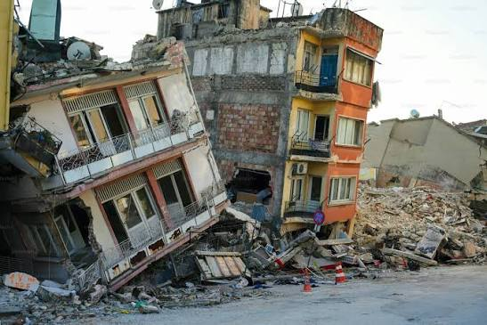
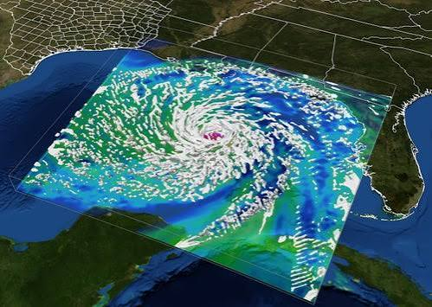
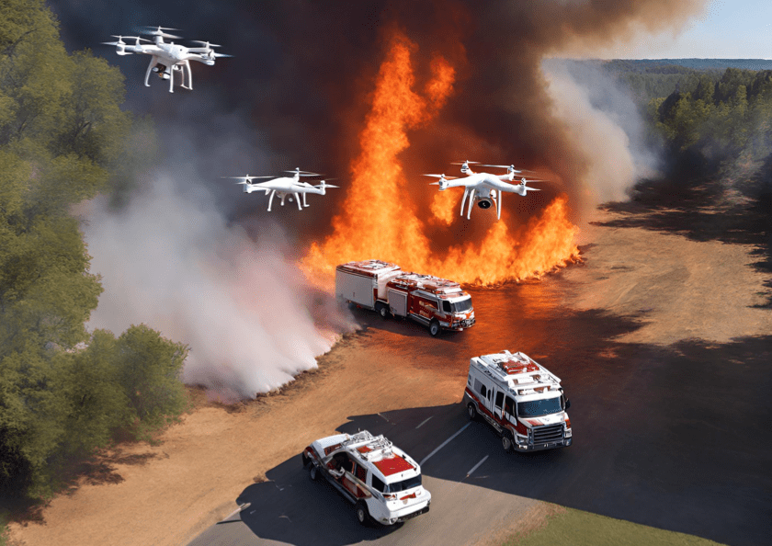

Prevent the Next Disaster
Master scientific computing not merely to earn a grade — but to become someone whose validation others can trust with their lives.
Think Deeply
Validate Rigorously
Document Thoroughly
Build Safeguards
Understand the mathematics behind every algorithm
Test every assumption and intermediate result
Write code others can trust with their lives
Protect the people your code ultimately serves
Ready to become a guardian of computational integrity?
Let's begin.
31

Slide 33

Questions? Let's Talk.
Prof. Mauricio Santillana
m.santillana@northeastern.edu (include “PHYS 5211” in your subject line)
Office Hours: Tuesday & Friday, 5:00–6:00 PM, Room 207
1 Belvidere Ave
32

