Slide 1
Ramsey–Cass–Koopmans Model
with Government
Steady State and Transition Dynamics with Utility-Yielding Government Spending
An intertemporal neutrality result for utility-yielding government spending.
Mike Santos, Muhong Zhang, Yan He, Jude Ikemefuna Iziga
MOMA 624 · Final Project · May 2026
Section 1: Introduction
Notes:
Open with a one-sentence hook: the RCK model is the workhorse for analyzing fiscal policy when households save optimally. The key result we'll establish is that utility-yielding government spending in this canonical setup affects only the within-period split between c and G, not the intertemporal margin — an intertemporal neutrality result. Hand off: 'In the next slide I'll set up the analytical framework. Then Mike will walk through how we model government spending and what we find.'

Slide 2
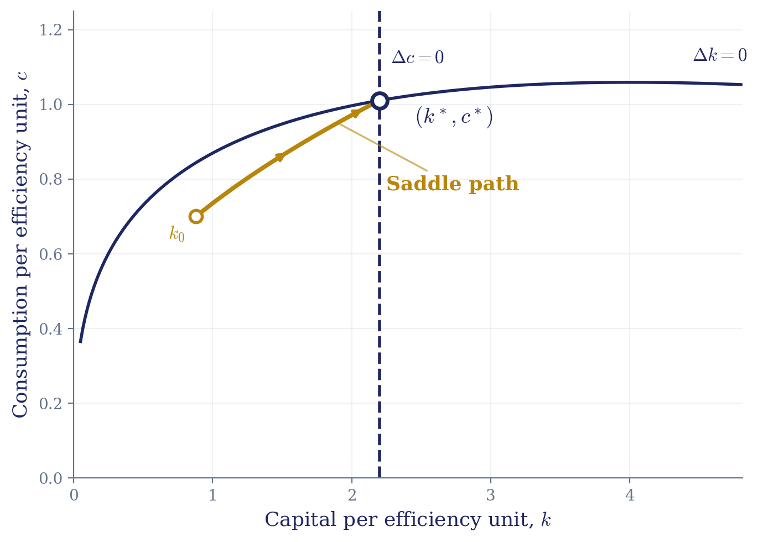
Intro：From the RCK Baseline to Our Question
Three analytical features
1
Saddle path → equilibrium determinacy
2
Transition dynamics → short- and medium-run effects
3
Steady state → long-run comparative statics
Open question
Existing work treats G as exogenous.
How does utility-yielding G, chosen optimally by the planner, interact with the intertemporal margin?
We establish an intertemporal neutrality result for utility-yielding G.
Baseline RCK phase diagram: the saddle path is the unique stable manifold to (k*, c*).
→ Section 2 (Literature Review): how prior work has incorporated government into RCK
Notes:
Talking points (~60–75 seconds):
1. The phase diagram on the left is the canonical RCK setup. Two dynamic variables, k and c, but only k is predetermined; c jumps to land on the saddle path. This single one-dimensional manifold connects every initial k_0 to the steady state.
2. This gives us three analytical features that form a toolkit. (point to 1) The saddle-path property gives equilibrium determinacy. (point to 2) Off the steady state, transition dynamics are the natural object for short- and medium-run policy effects. (point to 3) Steady-state shifts give long-run comparative statics.
3. The baseline abstracts from government. The literature has extended RCK with fiscal instruments, but most work treats G as exogenous and focuses on steady-state implications.
4. Our question (read the question slowly): how does endogenously chosen, utility-yielding G interact with the intertemporal margin?
5. Punchline (read the gold card): we establish an intertemporal neutrality result. Malone will set up the model and walk through the proof.
Hand off: 'For the literature setup, I'll pass it over to [Malone or J.].'

Slide 3
Background
Basic RCK with government models assume exogenous G(t) and ignore impact of public goods on utility
“Government purchases are assumed not to affect utility from private consumption; this can occur if the government devotes the goods to some activity that does not affect utility at all, or if utility equals the sum of utility from private consumption and utility from government-provided goods.”
Romer (2012)
Section 2: Literature Review

Slide 4



Modeling Technique
Extension: Endogenous Government Spending
Planner chooses ct​ and Gt
Utility:
Key Result:
ϕ↑ ⇒ G↑, c↓
Resource allocation between private and public goods
Section 3: Modeling Technique

Slide 5
Methodology
Methodology
Calibrate baseline parameters
Solve steady state
Phase diagram analysis
Simulate transition dynamics
Welfare analysis for different ϕ
What we find:
Higher φ → higher optimal G*
Welfare is hump-shaped in government spending G
Optimal government size exists
Section 5: Methodology

Slide 6
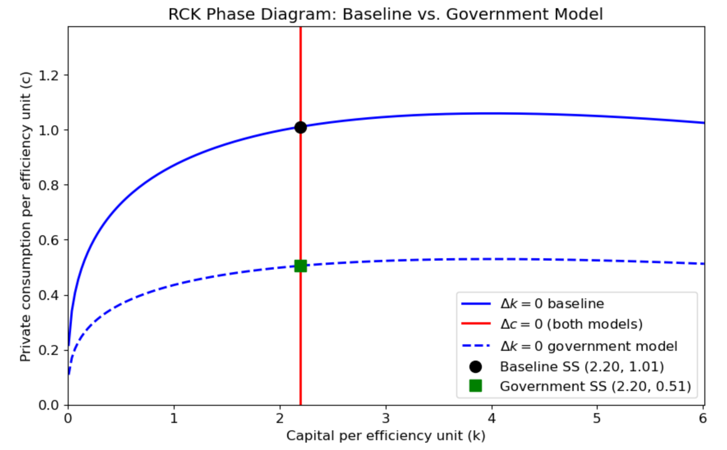
Economic Implications: Effect of Government Spending
Phase Diagram Insights
Resource constraint shifts down (Δk = 0)
Intertemporal condition unchanged (Δc = 0)
Government spending crowds out private consumption but does not affect capital accumulation
Section 4: Economic Implications

Slide 7
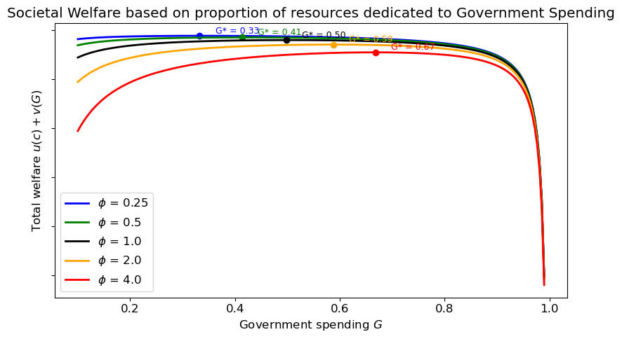
Optimal Government Spending
Optimal split between private consumption and government spending on public goods depends on the preference weight assigned to public goods
Higher φ means higher G* (and thus lower c*)
Key takeaway: for the social planner, some non-zero government spending is optimal for all non-zero φ.
Section 6: Optimal Government Size

Slide 8
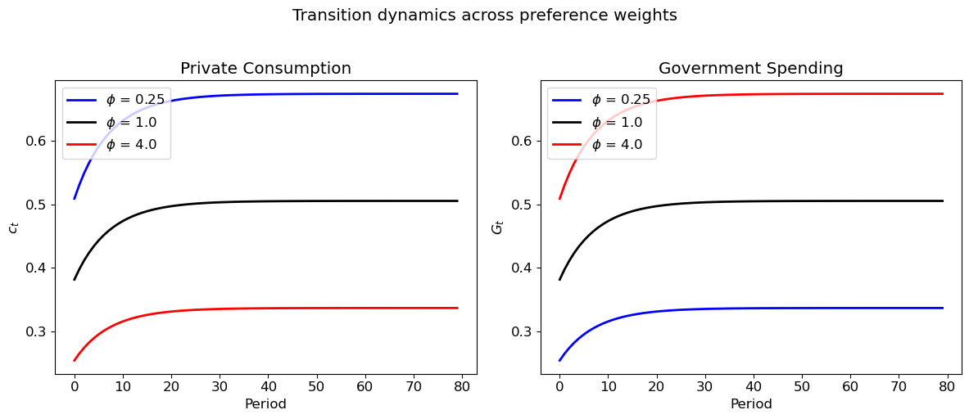
Results
We still observe the same saddle-path dynamics for both consumption and Government spending - there is a single value of c₀ and G₀ for a given k₀ that leads to convergence to steady state c*, G*, and k*
Regardless of the value of φ, c_{t} and G_{t} converge to c* and G* at the same rate
Section 7: Results

Slide 9
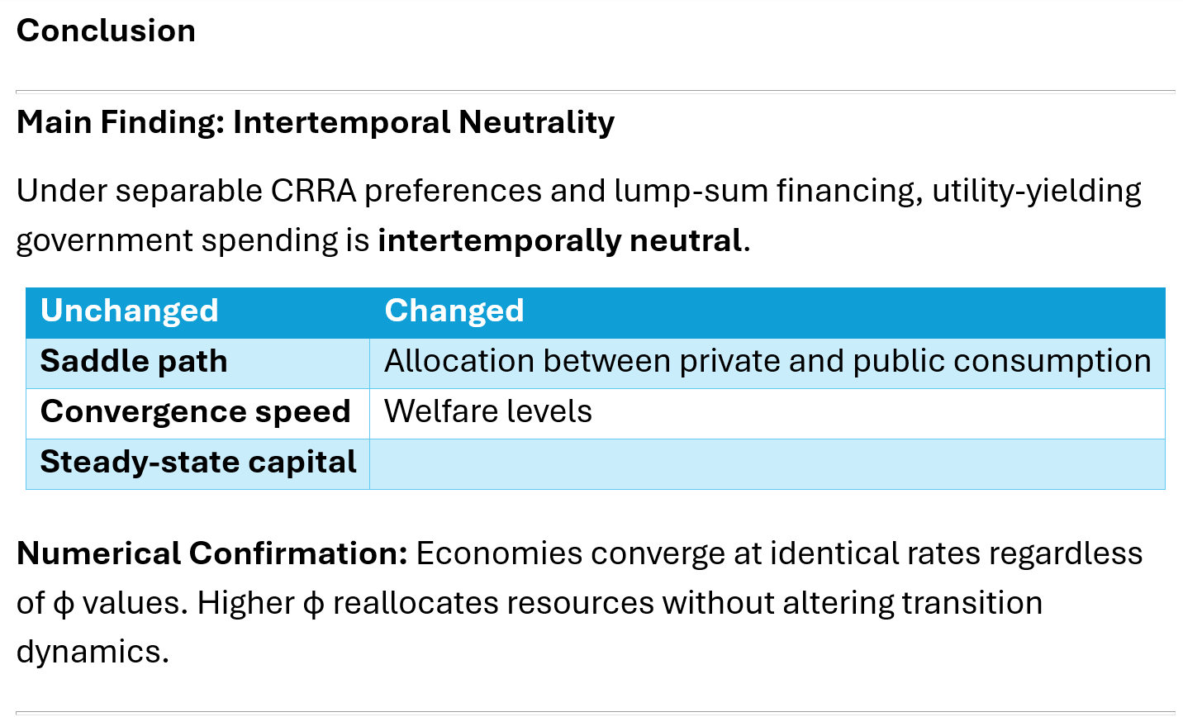

Slide 10
