Slide 1
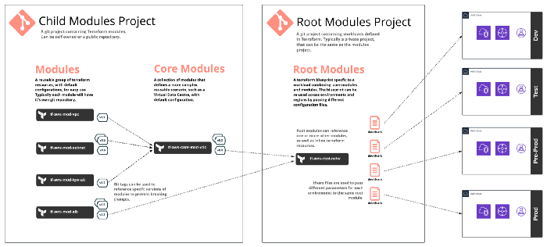
https://medium.com/version-1/terraform-in-real-life-writing-modules-c0b6b5335218

Slide 2
