Slide 1

iso maintenance Hell – Solved… Finally
manish.sapariya@kpoint.com | @manishsapariya

Slide 2

Mein iso maintain karate hue bahut pareshan tha……

Slide 3



Fir meri jindagi main vagrant, packer aur serverspec aaye…

Slide 4

Ab main bahut khush hooon….

Slide 5
Ok jokes apart… but that’s the story of a person maintaining custom iso or that was my story before a month or two ☺

Slide 6
what is Vagrant
Vagrant is a lightweight/portable tool for building complete, reproducible development environments
Automate VM creation with
Virtualbox
VMWare
Hyper-V
AWS
Integrates well with configuration management tools
Shell, Ansible, chef, puppet
Works on windows, linux

Slide 7
what is Packer
Packer is a tool for creating identical machine images for multiple platforms from a single source configuration.
Virtualbox
Vmware
AWS
Can take a iso/ami and create vagrant box

Slide 8
what is serverspec
RSpec tests for your servers configured by Puppet, Chef or anything else.
With Serverspec, you can write RSpec tests for checking your servers are configured correctly.
Serverspec tests your servers' actual state by executing command locally, via SSH, via WinRM, via Docker API and so on. So you don't need to install any agent soft wares on your servers and can use any configuration management tools.

Slide 9
And all this automated using hudson/jenkins
Ingredient of iso creation and verification setup
Build machine with vagrant/packer/serverspec installed
Repository of the holding stuff to create customized iso.
Packages
Custom iso configuration
Shell script to build box
Test script to start vagrant box and run server specs
Server specs to verify the state of final machine, thus created

Slide 10
Script to create iso and vagrant box
mkisofs -r -N -L -d -J -T -joliet-long -V 'kPoint Server Installer' -b isolinux/isolinux.bin -c isolinux/boot.cat -no-emul-boot -boot-load-size 4 -boot-info-table -o $ISO_OUTPUT_FILE .
scp $ISO_OUTPUT_FILE $REMOTE_SERVER:$REMOTE_PATH
cd ..
cd packer
rm -rf output-virtualbox-iso #Clean up remains of last failed attempt to create box...if any
/opt/packer/packer build kpoint_iso.json
mv packer_virtualbox-iso_virtualbox.box $BOX_OUTPUT_FILE
scp $BOX_OUTPUT_FILE $REMOTE_SERVER:$REMOTE_PATH
rm -rf packer_cache
rm -f $BOX_OUTPUT_FILE
rm -f $ISO_OUTPUT_FILE
cd ..
echo "kPoint vagrant box build done and copied $BOX_OUTPUT_FILE to $REMOTE_SERVER:$REMOTE_PATH"

Slide 11
Script to create vm and verify its state
vagrant box add kpoint_ut_vm $BOX_URL
cd serverspec
#Bring the build vm up
vagrant up build
#tell server spec to use vm named 'build'
export TARGET_HOST=build
#Run server spec tests here
rake spec
#Destroy the VM
vagrant destroy build --force
#cleanup for next run
vagrant box remove kpoint_ut_vm --force
echo "iso test completed."

Slide 12
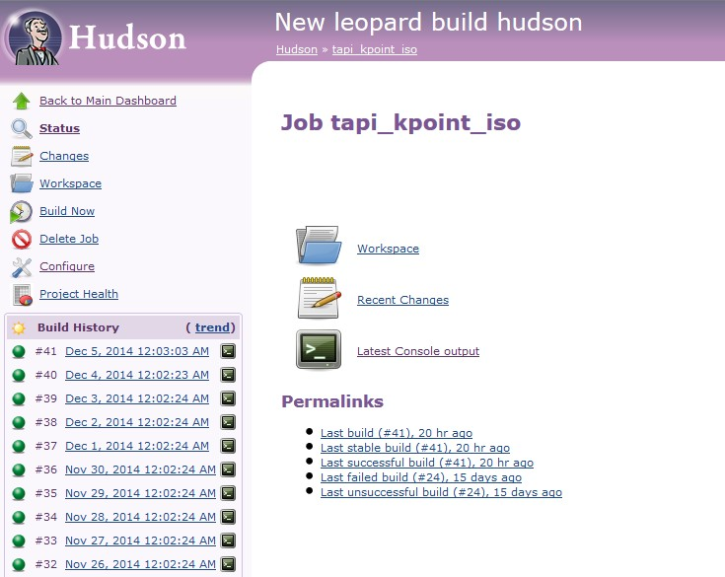
Hudson is happily creating iso, box, vm and running tests..… everyday!!!

Slide 13
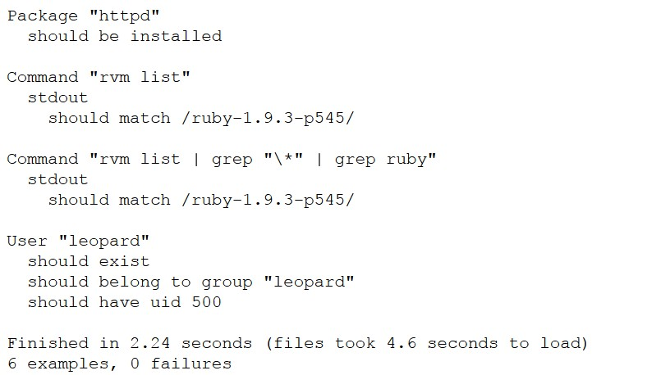
Typical serverspec results

Slide 14
What next?
Of course, automate AWS AMI creation and testing. ☺
Use vagrant extensively to run puppet system tests.
Browser based system test automation.

Slide 15
Do drop me a mail or tweet, to tell me
Would you like to know more about vagrant?
Suggest specific topic on vagrant, or puppet for that matter, that you would like to know more about.
manish.sapariya@kpoint.com | @manishsapariya

Slide 16


Slide 17


