Slide 1


Slide 2

DEEP DIVE Into Vagrant
manish.sapariya@kpoint.com | @manishsapariya

Slide 3
At glance
Vagrant basics
Vagrant use cases
Deep dive
Vagrant configuration with respect to what we do in Virtualbox or any other virtualization tool
Creating vagrant friendly images
Packer
Creating image for Linux and windows

Slide 4
Vagrant value proposition
Right from the hoses mouth
Vagrant is a tool for building complete development environments. With an easy-to-use workflow and focus on automation, Vagrant lowers development environment setup time, increases development/production parity, and makes the "works on my machine" excuse a relic of the past.

Slide 5
what is Vagrant
Vagrant is a lightweight/portable tool for building complete, reproducible development environments
Automate VM creation using
Virtualbox
VMWare
Hyper-V
AWS/OpenStack/Docker/LXC
Supports various configuration management tools
Shell, Ansible, chef, puppet, Salt
Works on Windows, Linux, Mac

Slide 6
terminology
Box
Provider
Provisioner
Synced Folders

Slide 7
What is Box
A complete OS packaged in a single file
More like a ghost image
Only much more flexible and programmable
Readymade boxes on vagrant cloud
Create from running VM
Create one of your own from scratch using Packer

Slide 8
What is Provider
virtualization platform for managing VMs
Virutalbox is supported out of the box
For others need to be installed using plugin
VMWare (Commercially available)
Also support AWS/OpenStack
Also support containers using LXC/Docker

Slide 9
What is Provisioner
Something which provisions the VM
Shell, Chef, Puppet, Ansible, Salt
Provisioners in Vagrant allow you to automatically install software, alter configurations, and more on the machine as part of the vagrant up process.

Slide 10
Synced folders
Allows to share data between host and guest
Enables you to use the development environment on your host machine, but build and execute on guest machine

Slide 11
Vagrant use cases
Reproducible/consistent environment for dev/test/devops
iso test automation (@kPoint)
system test for browser matrix coverage (@kPoint)
System tests for your infrastructure code (Soon @kPoint)
Puppet beaker uses vagrant
You can automate chef recipes testing

Slide 12
Let’s Dive Now
Look at something that we do manually
Then look at the way how we will do it using vagrant
For each step we will look at the Vagrant config file

Slide 13
Create a new VM from scratch (Virutalbox)
Obtain iso
Create a new VM (We will look at detailed configuration)
Install OS and Shutdown
Select VM and click on start

Slide 14
Create a new VM from scratch (vagrant)
Obtain a box (Assuming one is available) (If not, be prepared to have tough time)
vagrant init (Can be combined with above step)
Vagrant up

Slide 15
Create a new VM from scratch (vagrant config file)
VAGRANTFILE_API_VERSION = "2"
Vagrant.configure(VAGRANTFILE_API_VERSION) do |config|
# All Vagrant configuration is done here. The most common configuration
# options are documented and commented below. For a complete reference,
# please see the online documentation at vagrantup.com.
# Every Vagrant virtual environment requires a box to build off of.
config.vm.box = “mybox"
# The url from where the 'config.vm.box' box will be fetched if it
# doesn't already exist on the user's system.
config.vm.box_url = "http://abcd.pqr/kpoint.box"
end

Slide 16
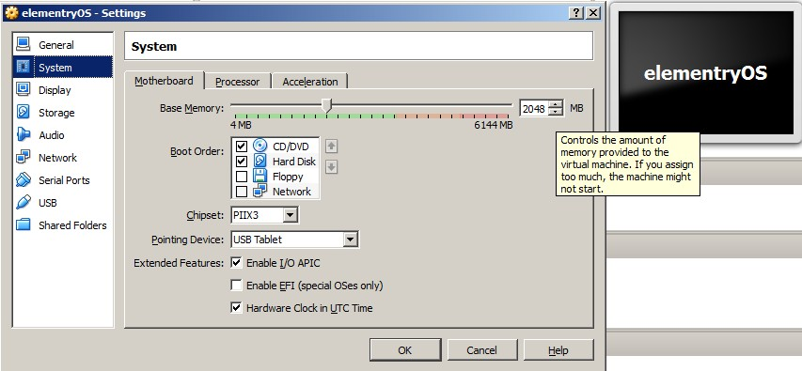
More RAM (Virtualbox)

Slide 17
More RAM (vagrant config file)
VAGRANTFILE_API_VERSION = "2"
Vagrant.configure(VAGRANTFILE_API_VERSION) do |config|
…
config.vm.provider "virtualbox" do |vb|
# Use more memory
vb.memory = 2048
end
…
end

Slide 18
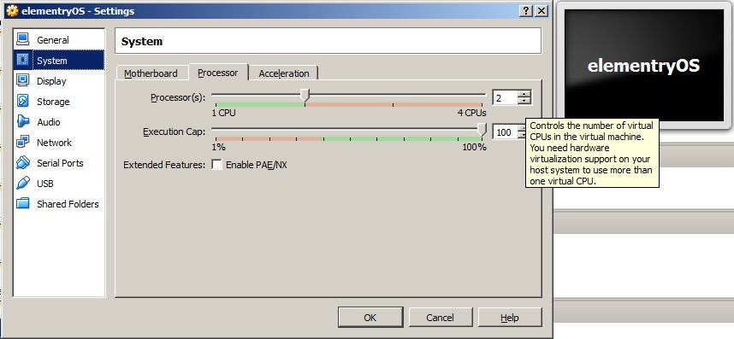
More CPU (Virtualbox)

Slide 19
More CPU (vagrant config file)
VAGRANTFILE_API_VERSION = "2"
Vagrant.configure(VAGRANTFILE_API_VERSION) do |config|
…
config.vm.provider "virtualbox" do |vb|
# Use more cpus
vb.cpus = 2
end
…
end

Slide 20
Head less vs GUI mode (Vagrant)
VAGRANTFILE_API_VERSION = "2"
Vagrant.configure(VAGRANTFILE_API_VERSION) do |config|
…
config.vm.provider "virtualbox" do |vb|
# Don't boot with headless mode
vb.gui = true
end
…
end

Slide 21
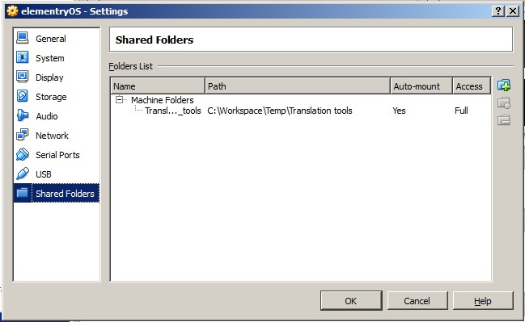
Shared folder (Virtualbox)

Slide 22
Shared folder (vagrant config file)
VAGRANTFILE_API_VERSION = "2"
Vagrant.configure(VAGRANTFILE_API_VERSION) do |config|
…
config.vm.synced_folder "src/", "/srv/website“
…
end

Slide 23
Basics of networking
NAT networking
Host Only networking
Bridged networking

Slide 24
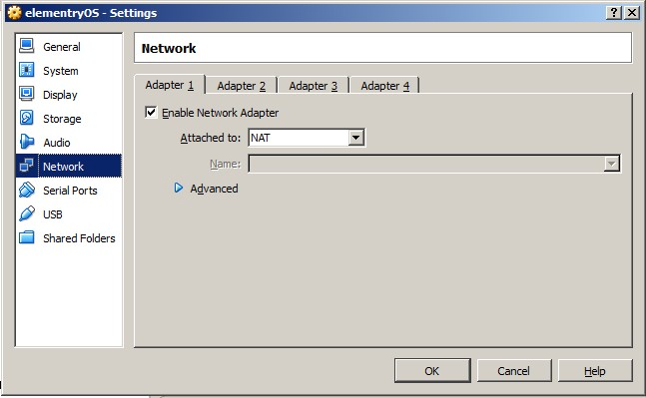
NAT (Virtualbox)

Slide 25
NAT (vagrant)
Default networking is NAT
Guest can have access to internet
You will have to use forwarded ports to access servies on VM

Slide 26
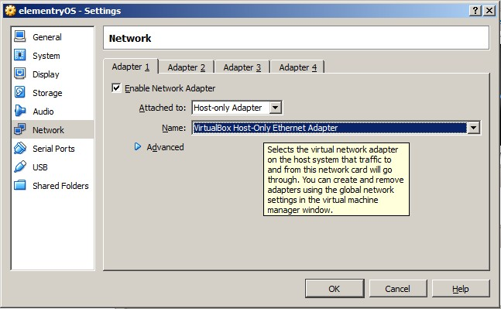
Host only (Virtualbox)

Slide 27
Host Only (vagrant)
Also known as private network in vagrant terminology
VAGRANTFILE_API_VERSION = "2"
Vagrant.configure(VAGRANTFILE_API_VERSION) do |config|
…
#sets up private network using DHCP
config.vm.network "private_network", type: "dhcp"
…
end
VAGRANTFILE_API_VERSION = "2"
Vagrant.configure(VAGRANTFILE_API_VERSION) do |config|
…
#sets up private network using Static IP
config.vm.network "private_network", ip: "192.168.50.4“
…
end

Slide 28
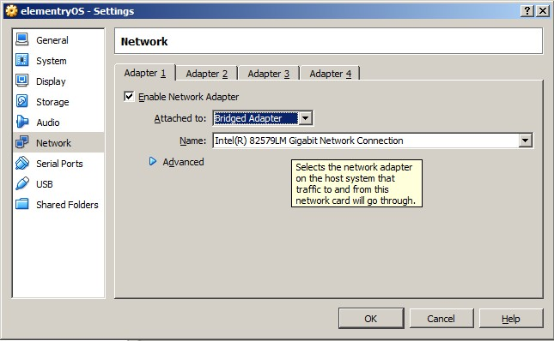
Bridged (Virtualbox)

Slide 29
Bridge (vagrant)
Also known as public network in vagrant terminology
VAGRANTFILE_API_VERSION = "2"
Vagrant.configure(VAGRANTFILE_API_VERSION) do |config|
…
#sets up public network using DHCP
config.vm.network “public_network"
…
end
VAGRANTFILE_API_VERSION = "2"
Vagrant.configure(VAGRANTFILE_API_VERSION) do |config|
…
#sets up public network using Static IP
config.vm.network "public_network", ip: "192.168.1.4“
…
end

Slide 30
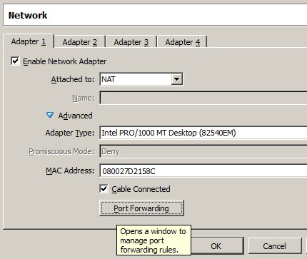
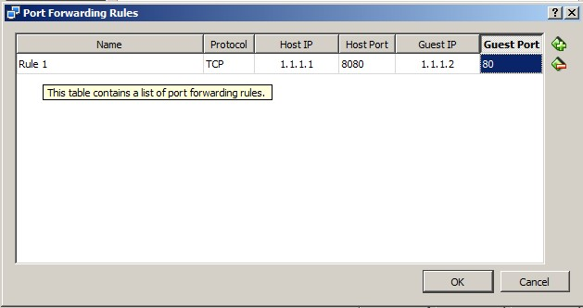
Port forwarding (Virtualbox)

Slide 31
Port forwarding (vagrant)
VAGRANTFILE_API_VERSION = "2"
Vagrant.configure(VAGRANTFILE_API_VERSION) do |config|
…
config.vm.network :forwarded_port, host: 8080, guest: 80
…
end

Slide 32
Install or setup your VM (vagrant shell provisioner)
VAGRANTFILE_API_VERSION = "2"
Vagrant.configure(VAGRANTFILE_API_VERSION) do |config|
…
config.vm.network :forwarded_port, host: 8080, guest: 80
config.vm.provision "shell", path: "./scripts/fix_image.sh"
config.vm.provision "shell", path: "./scripts/cs_start_nfs.sh"
config.vm.provision "shell", path: "./scripts/untar_puppet_build.sh"
config.vm.provision "shell", path: "./scripts/deploy_cs_puppet.sh"
config.vm.provision "shell", path: "./scripts/untar_leopard_build.sh"
…
end

Slide 33
Run networking aware multiple VMs
Vagrant.configure(VAGRANTFILE_API_VERSION) do |config|
…
config.vm.define 'cs' do |node|
node.vm.box = 'kpoint_st'
node.vm.box_url = 'http://192.168.8.204/kpoint_iso/kpoint.box'
node.vm.hostname = 'st-controller.zencite.com'
node.vm.network :private_network, ip: '192.168.42.42'
node.hostmanager.aliases = %w(st-controller beta.st-controller.zencite.com underworld.st-controller.zencite.com)
node.vm.provision "shell", path: "./scripts/fix_image.sh"
end
config.vm.define 'client' do |node|
node.vm.box = 'kpoint_st_client'
node.vm.box_url = 'http://192.168.8.204/kpoint_iso/ubuntu_client.box'
node.vm.hostname = 'st-client.zencite.com'
node.vm.network :private_network, ip: '192.168.42.44'
node.hostmanager.aliases = %w(st-client.zencite.com st-client)
end
…
end

Slide 34
Vagrant plugins
Almost everything is plugins
Providers
Virtualbox,vmware,aws,lxc,docker,kvm
Plugins that I found useful
Host manager

Slide 35
How to create boxes
manually run vm in Virtualbox, create box using ‘vagrant package’ command
Run existing vm using existing box, modify it, package it
Packer (Automate box creating using iso)

Slide 36
Packer
Automated way to create boxes
OS should support automated way to install e.g. kickstart
The installation process should not have any manual input or prompt

Slide 37
packer.json structure glance
{
"builders": [
{
"type": "virtualbox-iso",
"guest_os_type": "RedHat_64",
"iso_url": “YOUR ISO URL",
"iso_checksum_type": "none",
"ssh_wait_timeout": "30s",
"shutdown_command": "shutdown -P now",
"disk_size": 50000,
"headless": true,
"ssh_username": "root",
"ssh_password": "your password",
"ssh_port": 22,
"ssh_wait_timeout": "90m",
"boot_wait": "5s",
"boot_command":
[
"<esc><esc> vmlinuz initrd=initrd.img text ks=cdrom:/ks/centos6-vm-cd.cfg <enter><wait>"
]
}
],
"provisioners": [{
"type": "shell",
"inline": [
"echo WE WILL LOOK AT THIS SECTION IN DETAIL… SOON",
]
}],
"post-processors": ["vagrant"]
}

Slide 38
Create vagrant friendly Linux box
Vagrant assumes few things about the guest OS or Box
It has vagrant users
vagrant is a sudo user
Guest can be ssh into using vagrant user, using preconfigured keys
It is recommended to install virtualbox guest additions

Slide 39
packer.json provisioner at glance
"provisioners": [{
"type": "shell",
"inline": [
"mount -o loop /root/VBoxGuestAdditions.iso /mnt",
"cd /mnt/ ; sh VBoxLinuxAdditions.run",
"adduser vagrant",
"mkdir /home/vagrant/.ssh",
"chmod 700 /home/vagrant/.ssh",
"wget --no-check-certificate 'https://raw.github.com/mitchellh/vagrant/master/keys/vagrant.pub' -O /home/vagrant/.ssh/authorized_keys",
"chmod 600 /home/vagrant/.ssh/authorized_keys",
"chown -R vagrant /home/vagrant/.ssh",
"echo 'vagrant ALL=(ALL) NOPASSWD: ALL' >> /etc/sudoers",
]
}],

Slide 40
Create vagrant friendly Windows box
Follow the process specified in wiki page of vagrant-windows plugin
Set interface to as work type instead of public
Disable uac
Remote access
Openssh
Winrm/winrs/powershell
Vagrant file
Set guest type to windows
Set communicator to winrm
Set default network type to work
Forward port for RDP and winrm
Some references for windows
https://github.com/WinRb/vagrant-windows
http://www.developer.com/net/virtualize-your-windows-development-environments-with-vagrant-packer-and-chocolatey-part-1.html
http://tallmaris.com/using-vagrant-with-chocolatey-and-puppet-to-spin-up-virtual-machines/
https://github.com/joefitzgerald/packer-windows

Slide 41


Slide 42


