Slide 1
jMeter tutorial
By Manish Sapariya

Slide 2
Who am I?
Architect at kPoint Technologies Pvt Ltd.
At kPoint we are developing video based training platform, to create and distributed training videos with ease.
Primary responsibilities are Testing of kPoint and managing kPoint services cloud.

Slide 3

Session I
jMeter basics
Test plan components
How to record script using jMeter
Debug sampler
Regex extractor
Beanshell processor
jMeter plugins
Ultimate thread groups
Dummy sampler
Graph listeners
How to run tests in console mode
How to run tests in distributed mode

Slide 4

Session II
Hands on session

Slide 5




Session III
Walk through of “kPoint kapsule streaming test”
Brief comparison of open source performance test tools
jMeter
Grinder
Tsung
Streaming test

Slide 6
jMeter Basics
Test Plan
Thread group
Controllers
Samplers
Logical controllers
Listeners
Configuration elements
Post processors
Pre processors
Assertions
Test Script Recorder

Slide 7
jMeter basics
Debug sampler
Regex extractor
Beanshell processor

Slide 8
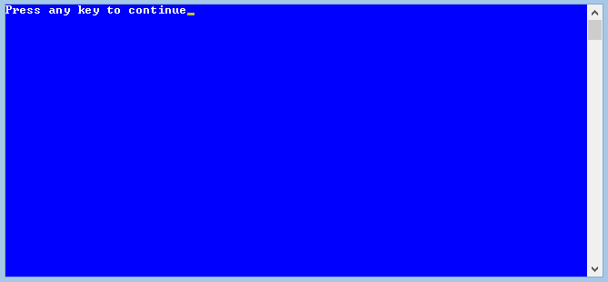
Run from console
jmeter -n -t testplan.jmx -l listener.jtl
Few things to remember
Generate log file using –l option, good for generating other test results later
Use jmeter plugins console status logger
Gives current status of tests
jMeter plugins graph listeners

Slide 9

Run in distributed mode
Why to run in distributed mode
What are the indicators to go for distributed mode
Few things to take care of
Same java version
Same jMeter version
Keep the time on all
machine synchronized
Node specific data needs to managed
appropriately in test plan
Higher duration for reporting results

Slide 10

jMeter plugins
Extra set of jMeter plugins
Needs jMeter 2.8 and JRE 1.6 or above
We will discuss
Few from Standard set
Few from Extra set

Slide 11
jMeter plugins
Ultimate thread group controller
Dummy sampler
Graph listeners

Slide 12
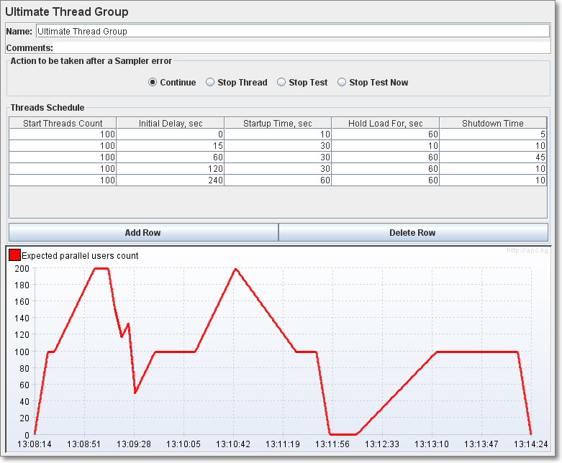
Ultimate thread group controller

Slide 13
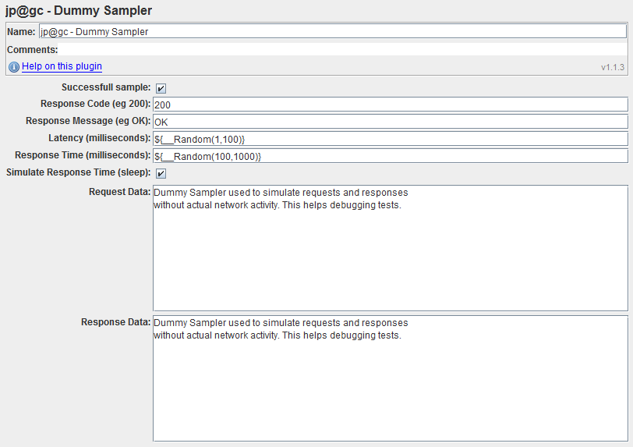
Dummy sampler
Test writer can set
What is request data
What is response code
What is response message
What is response time
What is response data
Very useful for programming tests
Very useful for debugging tests
And more importantly learning jMeter

Slide 14

Graph listeners
Graph listeners
Hits per second
Transactions per second
Response time distribution
Response time percentile
Response time vs threads
Do try out ultimate group controller with dummy sampler and various graph listener

Slide 15
Hands on time

Slide 16
kPoint kapsule streaming test
What is the test
What is involved in kapsule view test
Progressive video download
Slide and application share data on the given timeline
View progress updates
The purpose is to show you glimpse how comprehensive test can be implemented using jMeter
Let’s look at the test
Streaming test

Slide 17
Tools comparison
jMeter/Grinder/Tsung
What's similar
Open source
Good community support
Script recording support
Support for http/https
Support non-http protocols
What's different
Programming interface
jMeter -> UI based programming constructs (Underneath its XML)
Grinder -> Jython
Tsung -> XML

Slide 18
Tools comparison
Support for generating huge load
jMeter -> supports distribute mode execution and result collection
Grinder -> Very good support for running in cluster
Tsung -> Apparently best of all 3
What's good for me, well depends ☺
Ease of usage
jMeter has gui so easy to get started
Grinder does require knowledge of python and leaves lots to the test writer
Tsung is XML
Application/Protocol to be tested
jMeter has support for huge number of protocols
Grinder do not support out of the box, but all kind of java/python libraries can be used to create different protocol tests
Tsung has good enough set of protocol support
Stress to be generated
All are comparably capable

Slide 19


Slide 20


