Slide 1


Cutting Electricity Cost For Service Provider Networks
Muhammad Saqib Ilyas
FDC
Zartash Afzal Uzmi
Tariq Mahmood Jadoon
Ihsan Ayyub Qazi
Muhamad Fareed Zaffar
Aamir Qayyum

Slide 2
Agenda
Background and motivation
Opportunity and key idea
Case studies:
Data centers
Cellular networks
Conclusions and future work

Slide 3
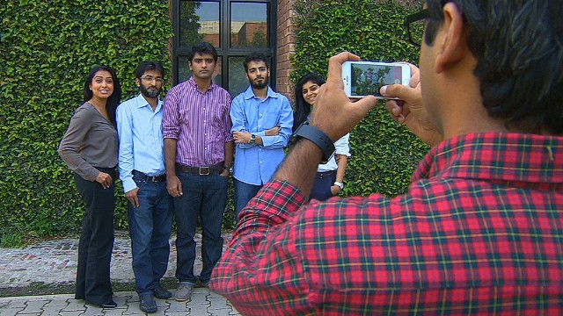
Background

Slide 4

Background
The Internet
Source: http://bit.ly/20pOBWJ

Slide 5
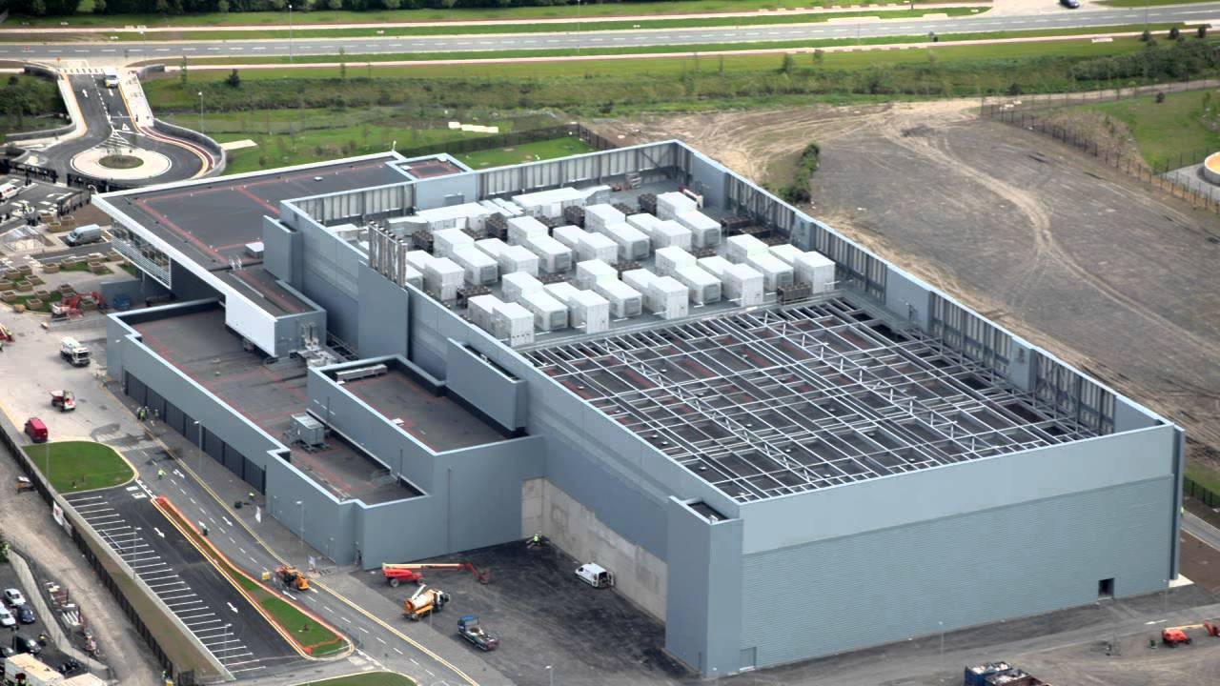
Background
A YouTube data center
The Internet
Source: http://bit.ly/1p07fEc

Slide 6
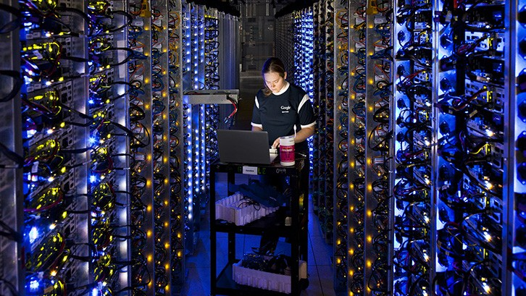
Background
The Internet
Source: http://cnet.co/1Q9SkZ0

Slide 7
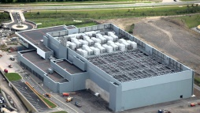
Background
The Internet

Slide 8

Background
The Internet

Slide 9
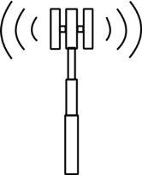

Background
The Internet
Cellular network
Source: http://bit.ly/1KGJcsg

Slide 10

Background
The Internet
Cellular network

Slide 11
Background
Federated networks empower communication
The Internet
Cellular network

Slide 12
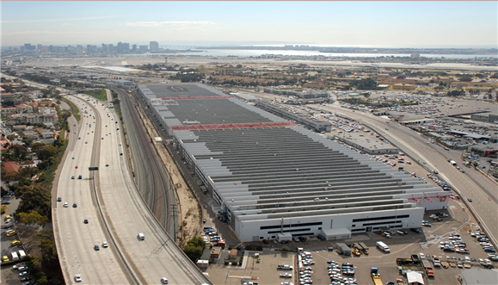
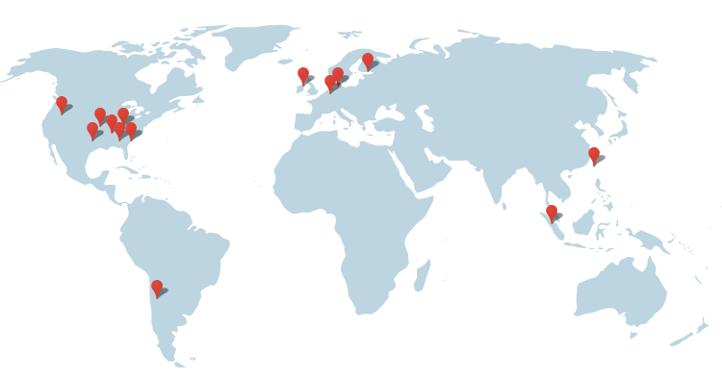
Network Scale
1 Data Center ~ 50,000 - 80,000 servers
Image source: http://bit.ly/1awWnLn
12

Slide 13
Network Scale
1 Data Center ~ 50,000 - 80,000 servers
Google’s data center locations
http://bit.ly/1WbIvbe
13

Slide 14
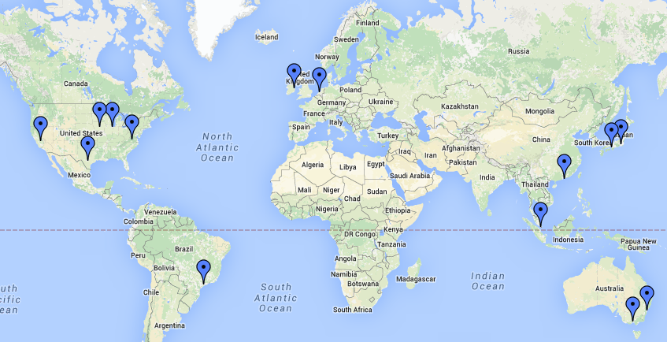
Network Scale
1 Data Center ~ 50,000 - 80,000 servers
Microsoft Azure’s data center locations
http://bit.ly/1mqvi26
14

Slide 15
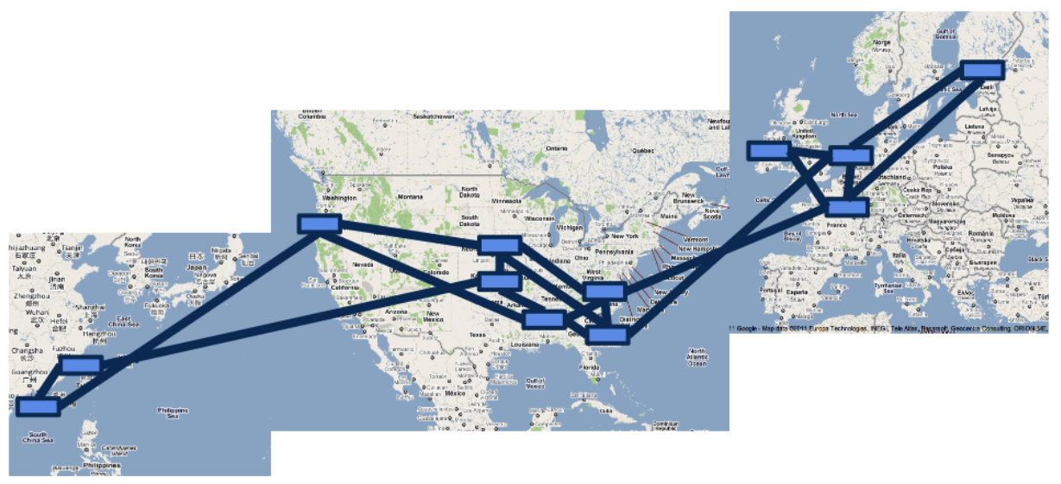
Network Scale
Google’s B4 SDN
Image Source: Jain et. al, “B4: Experience with a globally-deployed software defined WAN”, SIGCOMM 2013
15

Slide 16
Network Scale
Data Center
Google’s B4 SDN
Image Source: Jain et. al, “B4: Experience with a globally-deployed software defined WAN”, SIGCOMM 2013
16

Slide 17
Network Scale
Data Center
Inter Data Center Links
Google’s B4 SDN
Image Source: Jain et. al, “B4: Experience with a globally-deployed software defined WAN”, SIGCOMM 2013
17

Slide 18
Network Scale
Rich connectivity
Google’s B4 SDN
Image Source: Jain et. al, “B4: Experience with a globally-deployed software defined WAN”, SIGCOMM 2013
18

Slide 19
Network Scale
Amazon
19

Slide 20
Network Scale
Amazon
87 data centers
At least 2 M servers
Source: http://bit.ly/11erCWn
20

Slide 21
Network Scale
Amazon
87 data centers
At least 2 M servers
Telenor Pakistan
8000 cellular sites
Source: http://bit.ly/1T9VBqd
21

Slide 22
Network Scale
Massive infrastructure
22

Slide 23
Network Scale
Massive infrastructure
Massive power draw
23

Slide 24

Network Scale
With great power comes
24

Slide 25
Network Scale
With great power comes
great electricity bills
25

Slide 26

Motivation

Slide 27
Motivation
Annual DC Opex
$951 M
Source: datacenterknowledge.com

Slide 28
Motivation
Electricity Bill
15%
Annual DC Opex
$951 M
Electricity Cost
$143 M
Source: Greenberg et. al, “Cost of a cloud: Research Problems in Data Center Networks”, CCR 2009

Slide 29

Motivation
Electricity Bill
15%
Annual DC Opex
$951 M
Electricity Cost
$143 M

Slide 30
Motivation
Electricity Bill
15%
Annual DC Opex
$951 M
Electricity Cost
$143 M
Electricity Cost 2012
$81 M

Slide 31
Motivation
Electricity Bill
15%
Annual DC Opex
$951 M
Electricity Cost
$143 M
Electricity Bill
Upto 50%
Electricity Cost 2012
$81 M
Source: GREENNETS

Slide 32
Motivation
Electricity Bill
15%
Annual DC Opex
$951 M
Electricity Cost
$143 M
Significant electricity costs
Electricity Bill
Upto 50%
Electricity Cost 2012
$81 M

Slide 33
Agenda
Background and motivation
Opportunity and key idea
Case studies:
Data centers
Cellular networks
Conclusions and future work

Slide 34
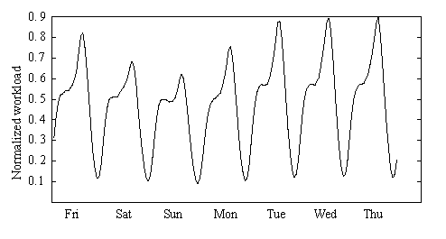
Opportunity
Network workload has systematic variations
A. Nazir et. al, “Unveiling Facebook: a Measurement Study of Social Network Based Applications”
Barroso et. al, “The Case for Energy Proportional Computing”, IEEE Computer, 2007
Peng et. al, “Traffic-Driven Power Savings in Operational 3G Cellular Networks”, MOBICOM 2011

Slide 35
Opportunity
Peaks and troughs quite pronounced

Slide 36
Opportunity
Deploy sufficient resources to handle peak

Slide 37
Opportunity
Deploy sufficient resources to handle peak
Most equipment (nearly) idle

Slide 38
Opportunity
P
0.85P
DC Idle power
75%-85% of peak power
Power consumption (Watt)
0
1
Workload
Source: Emerson, “Energy Logic: Reducing Data Center Power Consumption…”

Slide 39
Opportunity
P
0.85P
DC Idle power
75%-85% of peak power
Power consumption (Watt)
Opportunity for electricity cost savings
0
1
Workload
Source: Emerson, “Energy Logic: Reducing Data Center Power Consumption…”

Slide 40
Key Idea
Deactivate idle equipment
Notes:
Bigger. Photo of a real data center then zoom

Slide 41
Key Idea
Data Center
CA
Notes:
Bigger. Photo of a real data center then zoom

Slide 42
Key Idea
CA: California
Data Center
CA
Notes:
Bigger. Photo of a real data center then zoom

Slide 43
Key Idea
CA: California
NY: New York
TX: Texas
NY
TX
CA
Notes:
Bigger. Photo of a real data center then zoom

Slide 44
Key Idea
CA: California
NY: New York
TX: Texas
Workload
NY
TX
CA
Notes:
Bigger. Photo of a real data center then zoom

Slide 45
Key Idea
CA: California
Deactivate some equipment
NY: New York
TX: Texas
NY
TX
CA
Notes:
Bigger. Photo of a real data center then zoom

Slide 46
Key Idea
CA: California
NY: New York
TX: Texas
Resource pruning cuts electricity cost
NY
TX
CA
Notes:
Bigger. Photo of a real data center then zoom

Slide 47

Key Idea
CA: California
NY: New York
TX: Texas
NY
TX
CA
Notes:
Bigger. Photo of a real data center then zoom

Slide 48
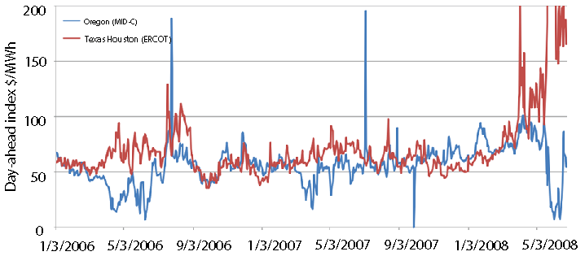
An Observation
Oregon cheaper
NY
TX
CA
A. Qureshi et. al, “Plugging into energy market diversity”, HOTNETS 2008
Notes:
Bigger. Photo of a real data center then zoom

Slide 49
An Observation
Geographic diversity in electricity prices
Oregon cheaper
NY
TX
CA
A. Qureshi et. al, “Plugging into energy market diversity”, HOTNETS 2008
Notes:
Bigger. Photo of a real data center then zoom

Slide 50
An Observation
Geographic diversity in electricity prices
Oregon cheaper
Texas cheaper
NY
TX
CA
A. Qureshi et. al, “Plugging into energy market diversity”, HOTNETS 2008
Notes:
Bigger. Photo of a real data center then zoom

Slide 51
An Observation
Geographic diversity in electricity prices
Temporal diversity in electricity prices
Oregon cheaper
Texas cheaper
NY
TX
CA
A. Qureshi et. al, “Plugging into energy market diversity”, HOTNETS 2008
Notes:
Bigger. Photo of a real data center then zoom

Slide 52
Key Idea
CA: California
NY: New York
TX: Texas
122.4
Electricity price
$/MWh
72
52
NY
TX
CA
Notes:
Bigger. Photo of a real data center then zoom

Slide 53
Key Idea
CA: California
NY: New York
TX: Texas
Most expensive
122.4
CA
Electricity price
$/MWh
72
NY
52
TX
Least expensive
Notes:
Bigger. Photo of a real data center then zoom

Slide 54
Key Idea
CA: California
NY: New York
TX: Texas
Move workload from NY to TX
122.4
CA
Electricity price
$/MWh
72
NY
52
TX
Notes:
Bigger. Photo of a real data center then zoom

Slide 55
Key Idea
CA: California
Workload relocation (WR)
NY: New York
TX: Texas
122.4
CA
Electricity price
$/MWh
72
NY
52
TX
Notes:
Bigger. Photo of a real data center then zoom

Slide 56
Key Idea
CA: California
NY: New York
TX: Texas
122.4
CA
Electricity price
$/MWh
72
NY
52
TX
Workload relocation cuts electricity cost further
Notes:
Bigger. Photo of a real data center then zoom

Slide 57
Key Idea
RP to save more
CA: California
NY: New York
TX: Texas
122.4
CA
Electricity price
$/MWh
72
NY
52
TX
Notes:
Bigger. Photo of a real data center then zoom

Slide 58
Key Idea
CA: California
As workload rises…
NY: New York
TX: Texas
122.4
CA
Electricity price
$/MWh
72
NY
52
TX
Notes:
Bigger. Photo of a real data center then zoom

Slide 59
Key Idea
When workload rises even more …
CA: California
NY: New York
TX: Texas
122.4
CA
Electricity price
$/MWh
72
NY
52
TX
Notes:
Bigger. Photo of a real data center then zoom

Slide 60
Key Idea
RP and WR can cut electricity costs
Notes:
Bigger. Photo of a real data center then zoom

Slide 61
Key Idea
RP and WR can cut electricity costs
Ain’t no such thing as a free lunch
Notes:
Bigger. Photo of a real data center then zoom

Slide 62
Transition Costs
Transition costs may be present
Examples:
Expensive inter data-center traffic

Slide 63
Transition Costs
Transition costs may be present
Examples:
Expensive inter data-center traffic
Energy spent while resuming and sleeping

Slide 64
Transition Costs
Transition costs may be present
Examples:
Expensive inter data-center traffic
Energy spent while resuming and sleeping
Relocate Energy Demand to Better Locations (RED-BL)

Slide 65
This Thesis
Towards systematic minimization of network electricity cost
using Workload Relocation (WR) and Resource Pruning (RP)
while considering transition costs
Notes:
Abbreviate. Single thesis statement
This thesis uses (boxes) WR and RP with consideration of relocation and (transition) costs by developing a systematic framework for electricity cost minimization

Slide 66
Contributions
Data centers
Cellular Networks
INFOCOM Mini-Conference 2012
GLOBECOM 2013
Optimization framework
Simulation based evaluation
Adaptation of optimization framework
Simulation based evaluation
Computer Networks, 2014
Submitted
Finer granularity
NP-Completeness
NP-Hardness proof *
Additional evaluations
* With the help of Dr. Mudassir Shabbir, ITU, Lahore

Slide 67
Agenda
Background and motivation
Opportunity and key idea
Case studies:
Data centers
Cellular networks
Conclusions and future work

Slide 68

Case Study – I : Background
Source: http://bit.ly/1mrIi7o
Notes:
Photo

Slide 69
Case Study – I : Background
Data center operator
Geographically distributed data centers
Notes:
Photo

Slide 70
Case Study – I : Background
Data center operator
Geographically distributed data centers
Data center equipment
IT Load | Non-IT Load
Servers | Lighting
Storage | Cooling
Network | Power distribution
Notes:
Photo

Slide 71
Case Study – I : Background
Data center operator
Geographically distributed data centers
Data center equipment
Power consumed is affine function of workload
IT Load | Non-IT Load
Servers | Lighting
Storage | Cooling
Network | Power distribution
Notes:
Photo

Slide 72
Case Study – I : Background
Data center operator
Geographically distributed data centers
Data center equipment
Power consumed is affine function of workload
IT Load | Non-IT Load
Servers | Lighting
Storage | Cooling
Network | Power distribution
Let’s recap how we can use WR and RP
Notes:
Photo

Slide 73
Problem Model
Interval - 1
NY
CA
TX
Electricity price driven workload assignment

Slide 74
Problem Model
Interval - 1
NY
CA
TX
Network State

Slide 75
Problem Model
Interval - 1
NY
CA
TX
12
Network State
State Cost
Sum of all data centers’ electricity cost

Slide 76
Problem Model
Interval - 1
Interval - 2
NY
TX
CA
CA
TX
NY
12
10

Slide 77
Problem Model
Interval - 1
Interval - 2
NY
TX
CA
CA
TX
NY
12
10
Data center activation

Slide 78
Problem Model
Data center deactivation
Interval - 1
Interval - 2
NY
TX
CA
CA
TX
NY
12
10
Data center activation

Slide 79
Problem Model
Data center deactivation
Interval - 1
Interval - 2
NY
TX
CA
8
CA
TX
NY
12
10
Transition cost
Data center activation

Slide 80
Problem Model
Interval - 1
Interval - 2
Interval - 3
NY
TX
TX
CA
8
6
CA
NY
TX
NY
CA
12
10
10

Slide 81
Problem Model
Interval - 1
Interval - 2
Interval - 3
NY
TX
TX
CA
8
6
CA
NY
TX
NY
CA
12
10
10
Locally optimal

Slide 82
Problem Model
Interval - 1
Interval - 2
Interval - 3
NY
TX
TX
CA
8
6
CA
NY
TX
NY
CA
12
10
10
Locally optimal
Might not be globally optimal

Slide 83
Problem Model
Interval - 1
Interval - 2
Interval - 3
NY
TX
TX
CA
8
6
CA
NY
TX
NY
CA
12
10
10
An alternative workload mapping

Slide 84
Problem Model
Interval - 1
Interval - 2
Interval - 3
NY
TX
TX
CA
8
6
CA
NY
TX
NY
CA
12
10
10
An alternative workload mapping
NY
CA
TX
14

Slide 85
Problem Model
Interval - 1
Interval - 2
Interval - 3
NY
TX
TX
CA
8
6
CA
NY
TX
NY
CA
12
10
10
State cost locally suboptimal
An alternative workload mapping
NY
CA
TX
14

Slide 86
Problem Model
Interval - 1
Interval - 2
Interval - 3
NY
TX
TX
CA
8
6
CA
NY
TX
NY
CA
12
10
10
State cost locally suboptimal
An alternative workload mapping
NY
TX
CA
CA
TX
NY
14
12

Slide 87
Problem Model
Interval - 1
Interval - 2
Interval - 3
NY
TX
TX
CA
8
6
CA
NY
TX
NY
CA
12
10
10
State cost locally suboptimal
An alternative workload mapping
NY
TX
TX
CA
CA
NY
TX
NY
CA
14
12
12

Slide 88
Problem Model
Interval - 1
Interval - 2
Interval - 3
NY
TX
TX
CA
8
6
CA
NY
TX
NY
CA
12
10
10
An alternative workload mapping
No transition costs
NY
TX
TX
CA
CA
0
NY
TX
NY
CA
14
12
12

Slide 89
Problem Model
Interval - 1
Interval - 2
Interval - 3
NY
TX
TX
CA
8
6
CA
NY
TX
NY
CA
12
10
10
Transition costs lower than local optimal scheme
An alternative workload mapping
NY
TX
TX
CA
4
CA
0
NY
TX
NY
CA
14
12
12

Slide 90
Problem Model
Interval - 1
Interval - 2
Interval - 3
NY
TX
TX
CA
8
6
CA
NY
TX
NY
CA
12
10
10
An alternative workload mapping
Total cost: 42
NY
TX
TX
CA
4
CA
0
NY
TX
NY
CA
14
12
12

Slide 91
Problem Model
Interval - 1
Interval - 2
Interval - 3
NY
TX
TX
CA
8
6
CA
NY
TX
NY
CA
12
10
10
Total cost: 46
An alternative workload mapping
Total cost: 42
NY
TX
TX
CA
4
CA
0
NY
TX
NY
CA
14
12
12

Slide 92
Problem Model
Interval - 1
Interval - 2
Interval - 3
NY
TX
TX
CA
8
6
CA
NY
TX
NY
CA
12
10
10
Optimal State Trajectory Problem
NY
TX
TX
CA
4
CA
0
NY
TX
NY
CA
14
12
12

Slide 93
Problem Model
Interval - 1
Interval - 2
Interval - 3
NY
TX
TX
CA
8
6
CA
NY
TX
NY
CA
12
10
10
Optimal State Trajectory Problem
Relocate Energy Demand to Better Locations (RED-BL)
NY
TX
TX
CA
4
CA
0
NY
TX
NY
CA
14
12
12

Slide 94

Optimization Formulation
Transition energy
Notes:
Give the objective function and the constraints

Slide 95
Optimization Formulation
State energy
Transition energy
Notes:
Give the objective function and the constraints

Slide 96
Optimization Formulation
Unit price of electricity
State energy
Transition energy
Notes:
Give the objective function and the constraints

Slide 97
Optimization Formulation
Workload
State energy
Transition energy
Notes:
Give the objective function and the constraints

Slide 98
Optimization Formulation
Workload
Data center capacity
State energy
Transition energy
Notes:
Give the objective function and the constraints

Slide 99
Optimization Formulation
Fraction of data center that is active
Workload
Data center capacity
State energy
Transition energy
Notes:
Give the objective function and the constraints

Slide 100
Optimization Formulation
State energy
Transition energy
Notes:
Give the objective function and the constraints

Slide 101
Optimization Formulation
Sum over all data centers
State energy
Transition energy
Notes:
Give the objective function and the constraints

Slide 102
Optimization Formulation
Sum over all intervals
Sum over all data centers
State energy
Transition energy
Subject to several constraints (please see the thesis)
Notes:
Give the objective function and the constraints

Slide 103
Experimental Setup
Workload from 3 popular Facebook apps
Electricity prices from 33 US locations
Simulated a week-long deployment plan
Compared RED-BL against various schemes
Notes:
To evaluate RED-BL for geo-diverse data centers, we performed a simulation study which had the following setup. We used workload from three popular Facebook applications and normalized the cumulative workload. We verified that the characteristics of the cumulative workload resemble that of the workload for thousands of servers in a Google data center. We collected day-ahead electricity prices for 33 locations across the USA and simulated a weeklong deployment plan for the data centers situated at these locations. We compared RED-BL against a number of algorithms.

Slide 104
Comparison Benchmarks

Slide 105
Comparison Benchmarks
1
3
0
2
0
2
UNIFORM: Equally distribute workload
3
1
2
1
3
15
15
20

Slide 106
Comparison Benchmarks
1
3
0
2
0
2
LO: Local Optimal Ignoring Transition Costs
3
1
2
12
1
10
10
3

Slide 107
Comparison Benchmarks
1
3
0
2
0
2
LO: Local Optimal Ignoring Transition Costs
3
1
2
12
1
10
10
3
1
3
4
2
6
2
LS: Local Optimal with Selection
3
1
2
15
1
10
10
3

Slide 108
Comparison Benchmarks
1
3
0
2
0
2
LO: Local Optimal Ignoring Transition Costs
3
1
2
12
1
10
10
3
Sometimes idling is better
1
3
4
2
6
2
LS: Local Optimal with Selection
3
1
2
15
1
10
10
3

Slide 109
Comparison Benchmarks
1
3
0
2
0
2
LO: Local Optimal Ignoring Transition Costs
3
1
2
12
1
10
10
3
Sometimes idling is better
1
3
4
2
6
2
LS: Local Optimal with Selection
3
1
2
15
1
10
10
3
Best practical variant of local optimal

Slide 110
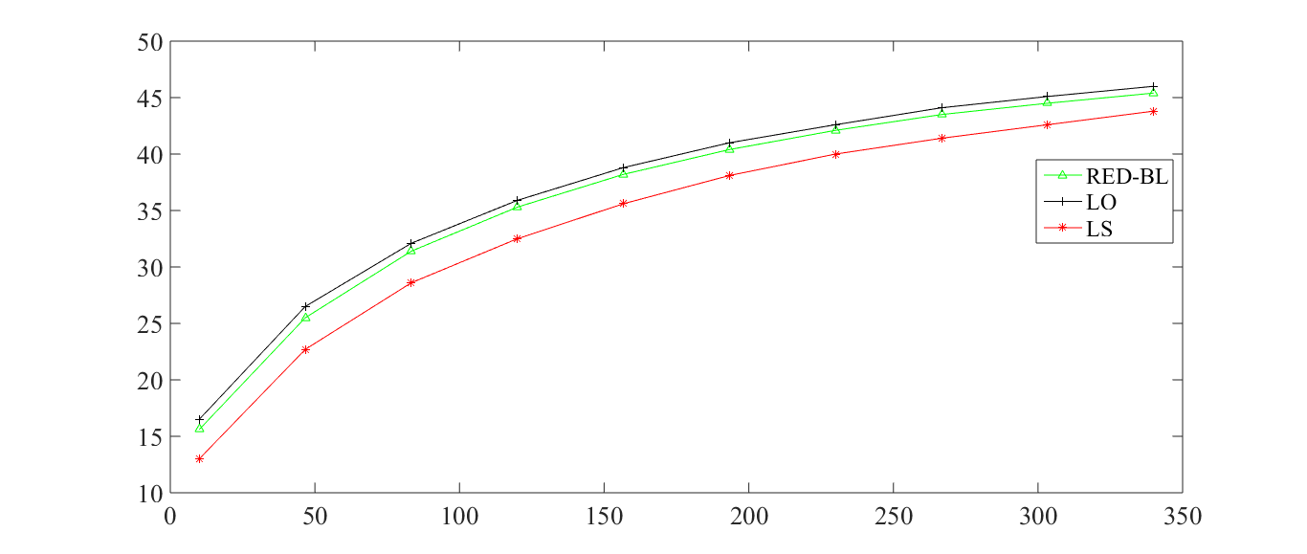
Cost Savings vs Over-provisioning
Savings over UNIFORM (%)
Overprovisioning (%)

Slide 111
Cost Savings vs Over-provisioning
Savings over UNIFORM (%)
Overprovisioning (%)
Increased over provisioning

Slide 112
Cost Savings vs Over-provisioning
Savings over UNIFORM (%)
Overprovisioning (%)
Increased over provisioning
More capacity at cheaper locations

Slide 113
Cost Savings vs Over-provisioning
Savings over UNIFORM (%)
Overprovisioning (%)
Increased over provisioning
More capacity at cheaper locations
Greater savings

Slide 114
Cost Savings vs Over-provisioning
Savings over UNIFORM (%)
Returns start to “diminish”
Overprovisioning (%)

Slide 115
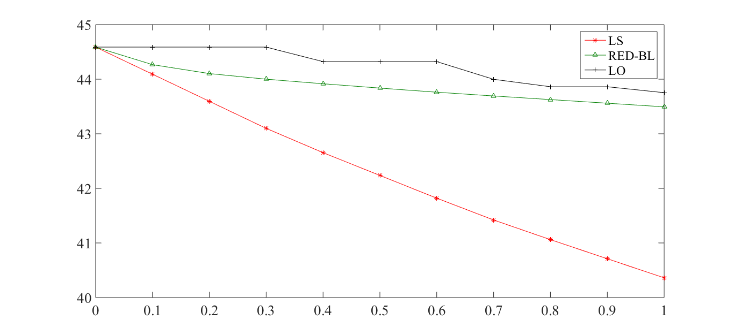
Electricity Cost vs Transition Cost
Electricity Cost Savings
vs UNIFORM (%)
Transition costs (relative magnitude)
Notes:
As the magnitude of transition overheads compared to the cost of handling workload increases, we see that the percentage savings in electricity cost decrease for all algorithms. RED-BL achieves close to the ideal lower bound electricity cost savings, whereas the best variants of the greedy algorithm scale worse than RED-BL.

Slide 116
Electricity Cost vs Transition Cost
Electricity Cost Savings
vs UNIFORM (%)
Transition costs (relative magnitude)
(De)activation overhead = energy cost
Notes:
As the magnitude of transition overheads compared to the cost of handling workload increases, we see that the percentage savings in electricity cost decrease for all algorithms. RED-BL achieves close to the ideal lower bound electricity cost savings, whereas the best variants of the greedy algorithm scale worse than RED-BL.

Slide 117
Electricity Cost vs Transition Cost
Electricity Cost Savings
vs UNIFORM (%)
Transition costs (relative magnitude)
No transition costs
(De)activation overhead = energy cost
Notes:
As the magnitude of transition overheads compared to the cost of handling workload increases, we see that the percentage savings in electricity cost decrease for all algorithms. RED-BL achieves close to the ideal lower bound electricity cost savings, whereas the best variants of the greedy algorithm scale worse than RED-BL.

Slide 118
Electricity Cost vs Transition Cost
Electricity Cost Savings
vs UNIFORM (%)
Optimal energy savings scale well with transition costs
Transition costs (relative magnitude)
Notes:
As the magnitude of transition overheads compared to the cost of handling workload increases, we see that the percentage savings in electricity cost decrease for all algorithms. RED-BL achieves close to the ideal lower bound electricity cost savings, whereas the best variants of the greedy algorithm scale worse than RED-BL.

Slide 119
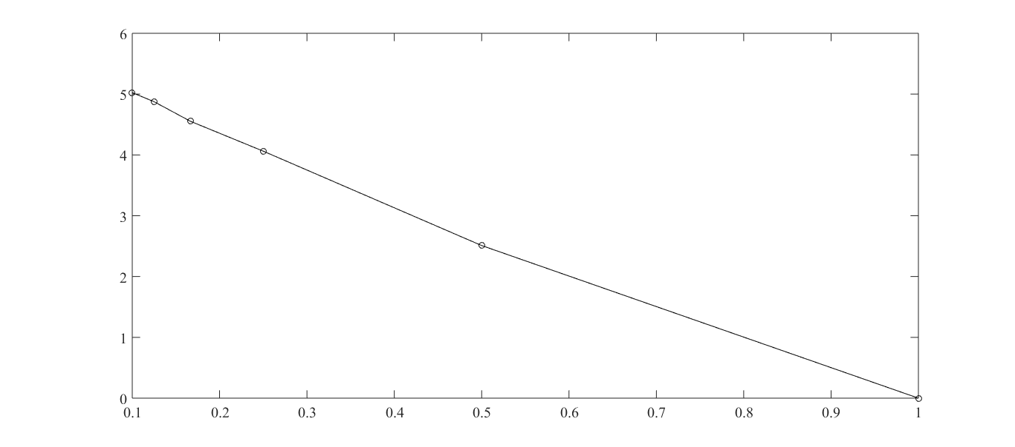
Granular (De)activation
Electricity Cost Savings Over
Full Data Center (De)Activation
Granularity of (de)activation
Can (de)activate half a data center
Can only (de)activate entire data center
Notes:
Now, let’s see how RED-BL energy savings would improve if we allowed independent (de)activation of fixed size fractions of a data center. The extreme right handside of this graph represents the case where you can only (de)activate an entire data center at a time. This is 0% better than the standard “all or nothing” RED-BL, because it is the same thing. If we were able to (de)activate half a data center at a time, we could do about 2.5% better than standard RED-BL. If we were able to independently (de)activate 10% of a data center at a time, we could do 5% better than standard RED-BL. So, there is opportunity for greater savings with granular (de)activation and it has a linear trend.

Slide 120
Granular (De)activation
Nearly linear increase in cost savings
Electricity Cost Savings Over
Full Data Center (De)Activation
Granularity of (de)activation
Notes:
Now, let’s see how RED-BL energy savings would improve if we allowed independent (de)activation of fixed size fractions of a data center. The extreme right handside of this graph represents the case where you can only (de)activate an entire data center at a time. This is 0% better than the standard “all or nothing” RED-BL, because it is the same thing. If we were able to (de)activate half a data center at a time, we could do about 2.5% better than standard RED-BL. If we were able to independently (de)activate 10% of a data center at a time, we could do 5% better than standard RED-BL. So, there is opportunity for greater savings with granular (de)activation and it has a linear trend.

Slide 121
Summary – Case Study I

Slide 122
Summary – Case Study I
Electricity cost savings can be achieved
Overprovisioning
Diversity

Slide 123
Summary – Case Study I
Electricity cost savings can be achieved
Overprovisioning
Diversity
It is important to consider transition costs

Slide 124
Summary – Case Study I
Electricity cost savings can be achieved
Overprovisioning
Diversity
It is important to consider transition costs
RED-BL has wider applicability

Slide 125
Agenda
Background and motivation
Opportunity and key idea
Case studies:
Data centers
Cellular networks
Conclusions and future work

Slide 126

Case Study II Cellular Networks
Notes:
Give the motivating example to show that WR and RP can be used in cellular networks as well.

Slide 127
Case Study II Cellular Networks
TRXs
Power amplifiers
Air conditioning
Notes:
Give the motivating example to show that WR and RP can be used in cellular networks as well.

Slide 128
Case Study II Cellular Networks
Notes:
Give the motivating example to show that WR and RP can be used in cellular networks as well.

Slide 129
Case Study II Cellular Networks
Notes:
Give the motivating example to show that WR and RP can be used in cellular networks as well.

Slide 130
Case Study II Cellular Networks
BSC
Notes:
Give the motivating example to show that WR and RP can be used in cellular networks as well.

Slide 131
Case Study II Cellular Networks
BSC
BSC
Notes:
Give the motivating example to show that WR and RP can be used in cellular networks as well.

Slide 132
Case Study II Cellular Networks
BSC
MSC
BSC
Notes:
Give the motivating example to show that WR and RP can be used in cellular networks as well.

Slide 133
Case Study II Cellular Networks
Major power consumers
BSC
MSC
BSC
Notes:
Give the motivating example to show that WR and RP can be used in cellular networks as well.

Slide 134
Case Study II Cellular Networks
Major power consumers
BSC
MSC
BSC
Source: GREENNETS Report, 2008
Marsan et. al, “Optimal Energy Savings in Cellular Access Networks”, ICC 2009
Notes:
Give the motivating example to show that WR and RP can be used in cellular networks as well.

Slide 135
Case Study II Cellular Networks
Major power consumers
Focus on BTSs to cut electricity cost
BSC
MSC
BSC
Source: GREENNETS Report, 2008
Marsan et. al, “Optimal Energy Savings in Cellular Access Networks”, ICC 2009
Notes:
Give the motivating example to show that WR and RP can be used in cellular networks as well.

Slide 136
Resource Pruning
BTS Power Consumption (kW)
δ
t_{max}
Call volume

Slide 137
Resource Pruning
BTS Power Consumption (kW)
Workload capacity
δ
t_{max}
Call volume

Slide 138
Resource Pruning
P_{max}
BTS Power Consumption (kW)
δ
t_{max}
Call volume

Slide 139
Resource Pruning
P_{max}
P_{min}
BTS Power Consumption (kW)
δ
t_{max}
Call volume

Slide 140
Resource Pruning
P_{max}
P_{min}
Low call volume
BTS Power Consumption (kW)
Deactivate some TRXs
δ
t_{max}
Call volume

Slide 141
Resource Pruning
P_{max}
P_{min}
BTS Power Consumption (kW)
Power saving threshold (δ)
δ
t_{max}
Call volume

Slide 142
Resource Pruning
No. of calls ≤ δ
P_{max}
P_{min}
BTS Power Consumption (kW)
Power saving threshold (δ)
δ
t_{max}
Call volume

Slide 143
Resource Pruning
P_{max}
P_{min}
BTS Power Consumption (kW)
δ
t_{max}
Call volume

Slide 144
Resource Pruning
P_{max}
P_{min}
Resource Pruning cuts cost
BTS Power Consumption (kW)
δ
t_{max}
Call volume

Slide 145
Does workload relocation help?

Slide 146
Does workload relocation help?

Slide 147
Does workload relocation help?
Assume that power saving is enabled if upto two calls are being served

Slide 148
Does workload relocation help?
Power saving
Assume that power saving is enabled if upto two calls are being served

Slide 149
Does workload relocation help?
Power saving
Power saving
Assume that power saving is enabled if upto two calls are being served

Slide 150
Does workload relocation help?
WR enables greater power savings
Assume that power saving is enabled if upto two calls are being served

Slide 151
Does workload relocation help?
WR enables greater power savings

Slide 152
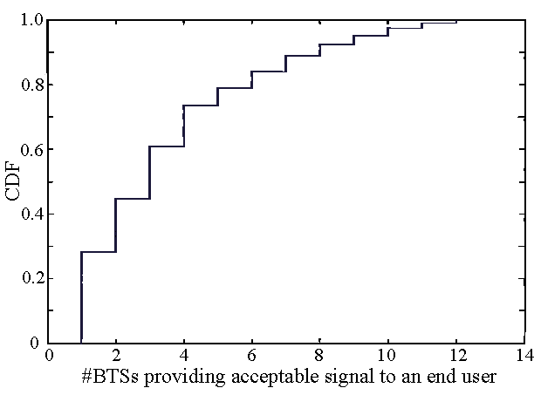
Is Workload Relocation Possible?
40% users receive signal from more than three BTSs

Slide 153
Optimization Formulation

Slide 154
Optimization Formulation

Slide 155
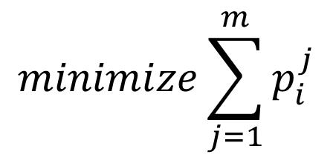
Optimization Formulation
$$minimize\sum_{j=1}^{m}{p_{i}^{j}}$$
For every interval, minimize # TRXs

Slide 156
Optimization Formulation
$$minimize\sum_{j=1}^{m}{p_{i}^{j}}$$
Seemingly simple formulation

Slide 157
Optimization Formulation
$$minimize\sum_{j=1}^{m}{p_{i}^{j}}$$
Seemingly simple formulation
NP-Hard

Slide 158
Experimental Setup

Slide 159
Experimental Setup
Call volume traces for 2 days at 26 urban BTSs

Slide 160
Experimental Setup
Call volume traces for 2 days at 26 urban BTSs
Trace driven simulation:
Periodically obtain optimal call placement
Place BTSs with low-traffic in power-saving mode

Slide 161
BTS Power Consumption Models
Parameter | Value
 | Model 1 | Model 2 | Model 3
Idle Power (W) | 1425 | 2401.8 | 2341.5
Peak Power (W) | 1500 | 3887.5 | 2973.9
Power Saving per TRX (W) | 20 | 50 | 100

Slide 162
Results: Power-Saving Feature Only
Energy savings | Model 1 | Model 2 | Model 3
Percentage | 4.73% | 5.43% | 12.89%
Daily energy savings (kWh) | 43.28 | 109.68 | 217.12
Country-wide daily savings -31000 sites (MWh) | 51.6 | 130.77 | 258.87

Slide 163
Results: Power-Saving Feature Only
Energy savings | Model 1 | Model 2 | Model 3
Percentage | 4.73% | 5.43% | 12.89%
Daily energy savings (kWh) | 43.28 | 109.68 | 217.12
Country-wide daily savings -31000 sites (MWh) | 51.6 | 130.77 | 258.87

Slide 164
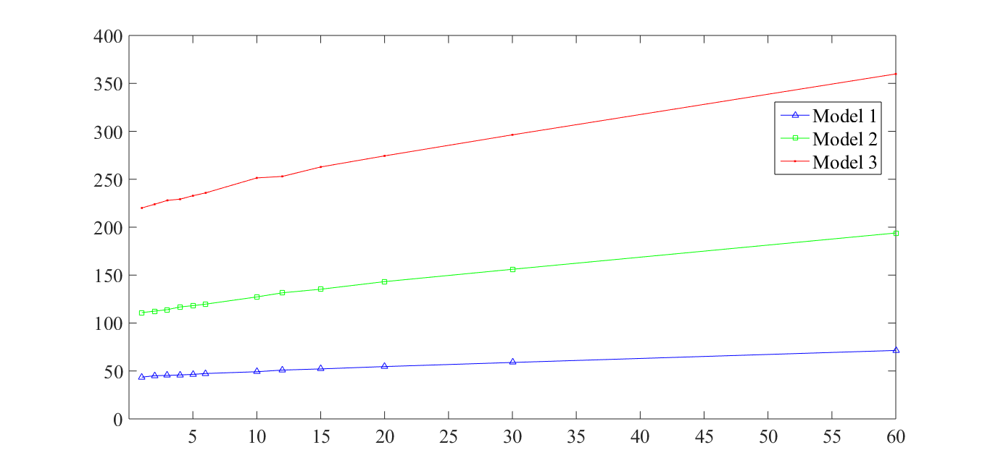
Energy Savings (kWh) RP + WR
Average Daily Energy savings (kWh)
Number of re-optimizations in an hour
At least 9.8% lower power consumption

Slide 165
Effect of Granular Deactivation
Granularity | Model 1 | Model 2 | Model 3
2-state | 5.38% | 6.29% | 14.94%
3-state | 6.81% | 7.73% | 18.62%
6-state | 8.70% | 9.65% | 23.37%

Slide 166
Effect of Granular Deactivation
Granularity | Model 1 | Model 2 | Model 3
2-state | 5.38% | 6.29% | 14.94%
3-state | 6.81% | 7.73% | 18.62%
6-state | 8.70% | 9.65% | 23.37%
Savings increase with finer granularity

Slide 167
Case Study II - Summary
Overlaps in signal coverage
Some geo-flexibility in workload
Built-in power saving feature
Significant cost reduction through WR + RP

Slide 168
Drawing Parallels With Case Study I
Parameter | Cellular network | Data centers
Notes:
Identify the similarities and differences between the two networks and observe how abstractions can be made.

Slide 169
Drawing Parallels With Case Study I
Parameter | Cellular network | Data centers
Network resource
Notes:
Identify the similarities and differences between the two networks and observe how abstractions can be made.

Slide 170
Drawing Parallels With Case Study I
Parameter | Cellular network | Data centers
Network resource
Servers
Notes:
Identify the similarities and differences between the two networks and observe how abstractions can be made.

Slide 171
Drawing Parallels With Case Study I
Parameter | Cellular network | Data centers
Network resource
TRX
Servers
Notes:
Identify the similarities and differences between the two networks and observe how abstractions can be made.

Slide 172
Drawing Parallels With Case Study I
Parameter | Cellular network | Data centers
Network resource
TRX
Servers
Workload relocation
Notes:
Identify the similarities and differences between the two networks and observe how abstractions can be made.

Slide 173
Drawing Parallels With Case Study I
Parameter | Cellular network | Data centers
Network resource
TRX
Servers
Workload relocation
Client redirect
Notes:
Identify the similarities and differences between the two networks and observe how abstractions can be made.

Slide 174
Drawing Parallels With Case Study I
Parameter | Cellular network | Data centers
Network resource
TRX
Servers
Workload relocation
Call hand off
Client redirect
Notes:
Identify the similarities and differences between the two networks and observe how abstractions can be made.

Slide 175
Drawing Parallels With Case Study I
Parameter | Cellular network | Data centers
Network resource
TRX
Servers
Workload relocation
Call hand off
Client redirect
Resource pruning
Notes:
Identify the similarities and differences between the two networks and observe how abstractions can be made.

Slide 176
Drawing Parallels With Case Study I
Parameter | Cellular network | Data centers
Network resource
TRX
Servers
Workload relocation
Call hand off
Client redirect
Resource pruning
Server shutdown / idle / hibernate
Notes:
Identify the similarities and differences between the two networks and observe how abstractions can be made.

Slide 177
Drawing Parallels With Case Study I
Parameter | Cellular network | Data centers
Network resource
TRX
Servers
Workload relocation
Call hand off
Client redirect
Resource pruning
Server shutdown / idle / hibernate
BTS Power Saving
Notes:
Identify the similarities and differences between the two networks and observe how abstractions can be made.

Slide 178
Drawing Parallels With Case Study I
Parameter | Cellular network | Data centers
Network resource
TRX
Servers
Workload relocation
Call hand off
Client redirect
Resource pruning
Server shutdown / idle / hibernate
BTS Power Saving
Transition costs
Notes:
Identify the similarities and differences between the two networks and observe how abstractions can be made.

Slide 179
Drawing Parallels With Case Study I
Parameter | Cellular network | Data centers
Network resource
TRX
Servers
Workload relocation
Call hand off
Client redirect
Resource pruning
Server shutdown / idle / hibernate
BTS Power Saving
(De)activation overheads
Transition costs
Notes:
Identify the similarities and differences between the two networks and observe how abstractions can be made.

Slide 180
Drawing Parallels With Case Study I
Parameter | Cellular network | Data centers
Network resource
TRX
Servers
Workload relocation
Call hand off
Client redirect
Resource pruning
Server shutdown / idle / hibernate
BTS Power Saving
(De)activation overheads
Transition costs
Negligible
Notes:
Identify the similarities and differences between the two networks and observe how abstractions can be made.

Slide 181
Agenda
Background and motivation
Opportunity and key idea
Case studies:
Data centers
Cellular networks
Conclusions and future work

Slide 182
Future Work
Adaptation and application to 3G, 4G, 5G and beyond
Factor in other forms of transition costs:
Cost of change in latency
Cost of increase in call blocking probability
Experimentation on a real testbed
Incorporation into an OA&M framework
Interplay with energy markets

Slide 183
Conclusions
RED-BL: an electricity cost reduction framework
Systematic application of WR and RP
Can significantly reduce electricity costs
Data centers
Cellular networks
Reduction in power consumption
Positive ecological impact

