Slide 1


Cutting Electricity Cost For Service Provider Networks
Muhammad Saqib Ilyas
FDC
Zartash Afzal Uzmi
Tariq Mahmood Jadoon
Ihsan Ayyub Qazi
Muhamad Fareed Zaffar
Aamir Qayyum

Slide 2
Agenda
Background and motivation
Opportunity and key idea
Case studies:
Data centers
Cellular networks
Conclusions and future work

Slide 3
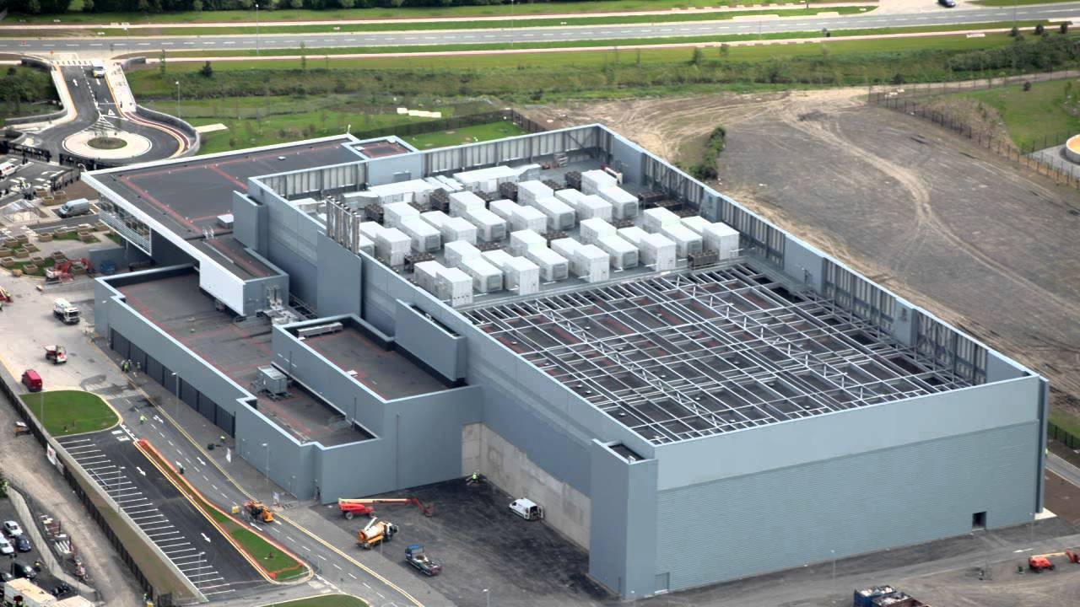
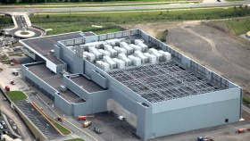


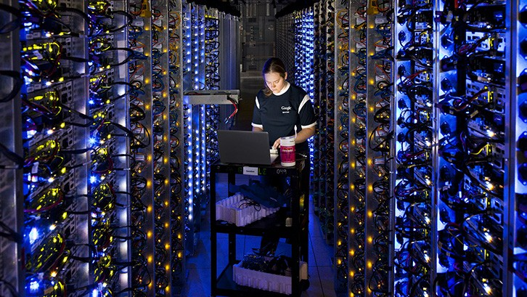
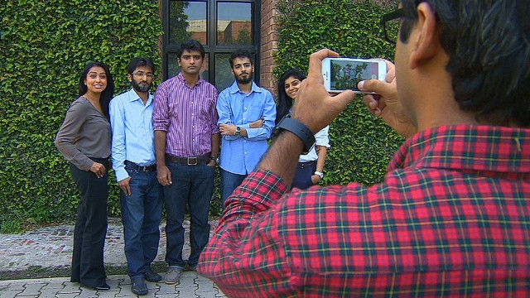
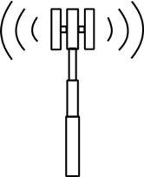

Background
Federated networks empower communication
A YouTube data center
The Internet
Cellular network
Source: http://bit.ly/1p07fEc
Source: http://bit.ly/20pOBWJ
Source: http://bit.ly/1KGJcsg
Source: http://cnet.co/1Q9SkZ0
Source: http://bit.ly/20pOYR1

Slide 4
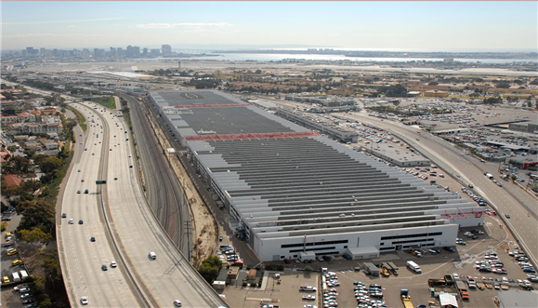
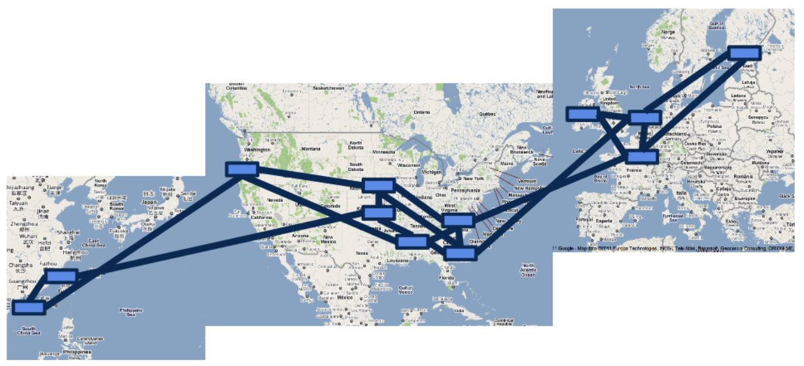
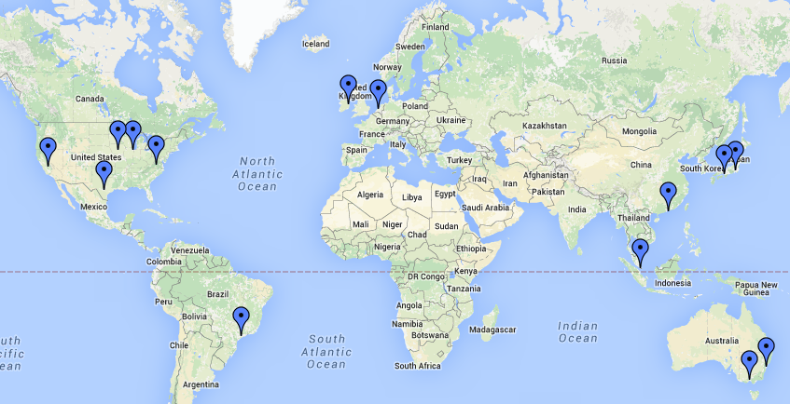
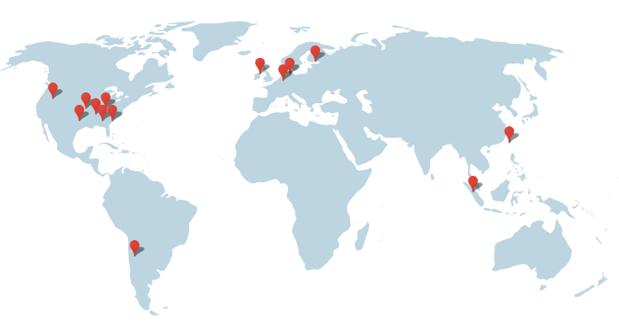

Network Scale
1 Data Center ~ 50,000 - 80,000 servers
Rich connectivity
Amazon
87 data centers
At least 2 M servers
Telenor Pakistan
8000 cellular sites
With great power comes
Data Center
Inter Data Center Links
Massive infrastructure
Massive power draw
great electricity bills
Google’s data center locations
http://bit.ly/1WbIvbe
Google’s B4 SDN
Image Source: Jain et. al, “B4: Experience with a globally-deployed software defined WAN”, SIGCOMM 2013
Microsoft Azure’s data center locations
http://bit.ly/1mqvi26
Source: http://bit.ly/11erCWn
Source: http://bit.ly/1T9VBqd
Image source: http://bit.ly/1awWnLn
4

Slide 5


Motivation
Electricity Bill
15%
Annual DC Opex
$951 M
Electricity Cost
$143 M
Significant electricity costs
Electricity Bill
Upto 50%
Electricity Cost 2012
$81 M
Source: Greenberg et. al, “Cost of a cloud: Research Problems in Data Center Networks”, CCR 2009
Source: datacenterknowledge.com
Source: GREENNETS

Slide 6
Agenda
Background and motivation
Opportunity and key idea
Case studies:
Data centers
Cellular networks
Conclusions and future work

Slide 7
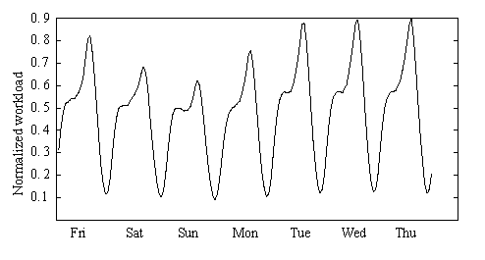
Opportunity
Deploy sufficient resources to handle peak
Network workload has systematic variations
Peaks and troughs quite pronounced
P
0.85P
DC Idle power
75%-85% of peak power
Power consumption (Watt)
Opportunity for electricity cost savings
0
1
Most equipment (nearly) idle
Workload
A. Nazir et. al, “Unveiling Facebook: a Measurement Study of Social Network Based Applications”
Barroso et. al, “The Case for Energy Proportional Computing”, IEEE Computer, 2007
Peng et. al, “Traffic-Driven Power Savings in Operational 3G Cellular Networks”, MOBICOM 2011
Source: Emerson, “Energy Logic: Reducing Data Center Power Consumption…”

Slide 8
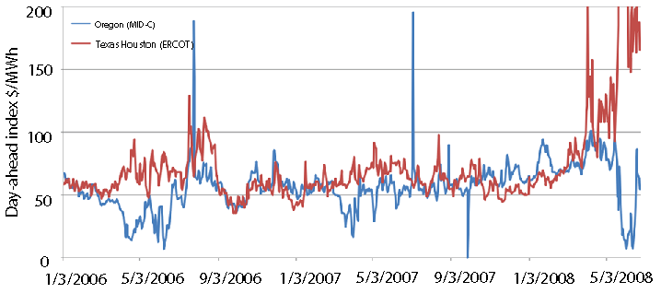

Key Idea
An Observation
Deactivate idle equipment
When workload rises even more …
RP to save more
Geographic diversity in electricity prices
CA: California
Workload relocation (WR)
Deactivate some equipment
As workload rises…
Data Center
NY: New York
TX: Texas
Workload
Move workload from NY to TX
Most expensive
Temporal diversity in electricity prices
122.4
Resource pruning cuts electricity cost
Oregon cheaper
Texas cheaper
RP and WR can cut electricity costs
Electricity price
$/MWh
72
52
NY
TX
CA
Ain’t no such thing as a free lunch
Least expensive
Workload relocation cuts electricity cost further
A. Qureshi et. al, “Plugging into energy market diversity”, HOTNETS 2008
Notes:
Bigger. Photo of a real data center then zoom

Slide 9
Transition Costs
Transition costs may be present
Examples:
Expensive inter data-center traffic
Energy spent while resuming and sleeping
Relocate Energy Demand to Better Locations (RED-BL)

Slide 10
This Thesis
Towards systematic minimization of network electricity cost
using Workload Relocation (WR) and Resource Pruning (RP)
while considering transition costs
Notes:
Abbreviate. Single thesis statement
This thesis uses (boxes) WR and RP with consideration of relocation and (transition) costs by developing a systematic framework for electricity cost minimization

Slide 11
Contributions
Data centers
Cellular Networks
INFOCOM Mini-Conference 2012
GLOBECOM 2013
Optimization framework
Simulation based evaluation
Adaptation of optimization framework
Simulation based evaluation
Computer Networks, 2014
Submitted
Finer granularity
NP-Completeness
NP-Hardness proof *
Additional evaluations
* With the help of Dr. Mudassir Shabbir, ITU, Lahore

Slide 12
Agenda
Background and motivation
Opportunity and key idea
Case studies:
Data centers
Cellular networks
Conclusions and future work

Slide 13
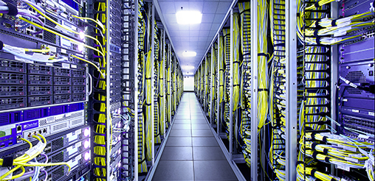
Case Study – I : Background
Data center operator
Geographically distributed data centers
Data center equipment
Power consumed is affine function of workload
IT Load | Non-IT Load
Servers | Lighting
Storage | Cooling
Network | Power distribution
Let’s recap how we can use WR and RP
Source: http://bit.ly/1mrIi7o
Notes:
Photo

Slide 14
Problem Model
Data center deactivation
Interval - 1
Interval - 2
Interval - 3
NY
TX
TX
CA
8
6
CA
NY
TX
NY
CA
12
10
10
Electricity price driven workload assignment
Transition cost
Optimal State Trajectory Problem
State cost locally suboptimal
Total cost: 46
State cost locally suboptimal
State cost locally suboptimal
Locally optimal
State Cost
Data center activation
Network State
Might not be globally optimal
Transition costs lower than local optimal scheme
No transition costs
Relocate Energy Demand to Better Locations (RED-BL)
An alternative workload mapping
Total cost: 42
Sum of all data centers’ electricity cost
NY
TX
TX
CA
4
CA
0
NY
TX
NY
CA
14
12
12

Slide 15

Optimization Formulation
Fraction of data center that is active
Unit price of electricity
Workload
Data center capacity
Sum over all intervals
Sum over all data centers
State energy
Transition energy
Subject to several constraints (please see the thesis)
Notes:
Give the objective function and the constraints

Slide 16
Experimental Setup
Workload from 3 popular Facebook apps
Electricity prices from 33 US locations
Simulated a week-long deployment plan
Compared RED-BL against various schemes
Notes:
To evaluate RED-BL for geo-diverse data centers, we performed a simulation study which had the following setup. We used workload from three popular Facebook applications and normalized the cumulative workload. We verified that the characteristics of the cumulative workload resemble that of the workload for thousands of servers in a Google data center. We collected day-ahead electricity prices for 33 locations across the USA and simulated a weeklong deployment plan for the data centers situated at these locations. We compared RED-BL against a number of algorithms.

Slide 17
Comparison Benchmarks
1
3
0
2
0
2
UNIFORM: Equally distribute workload
3
1
2
1
3
15
15
20
1
3
0
2
0
2
LO: Local Optimal Ignoring Transition Costs
3
1
2
12
1
10
10
3
Sometimes idling is better
1
3
4
2
6
2
LS: Local Optimal with Selection
3
1
2
15
1
10
10
3
Best practical variant of local optimal

Slide 18
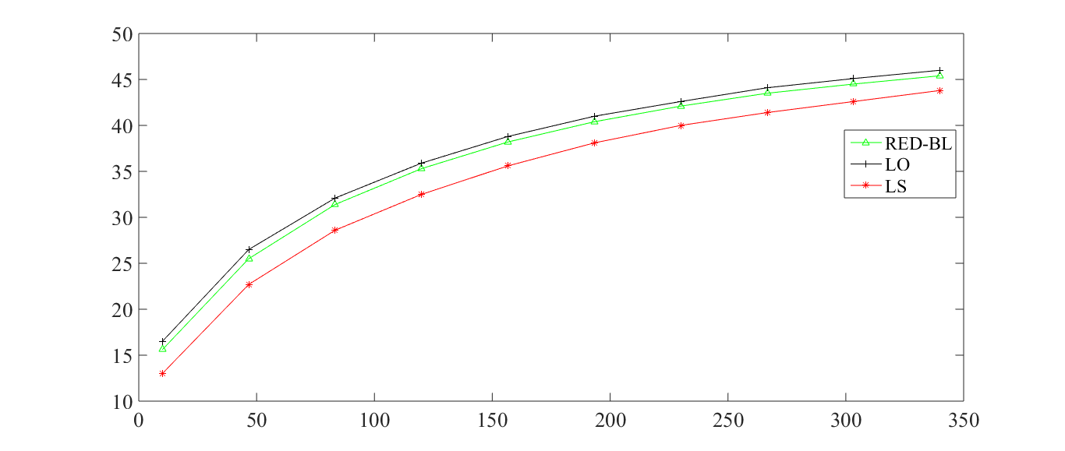
Cost Savings vs Over-provisioning
Savings over UNIFORM (%)
Returns start to “diminish”
Overprovisioning (%)
Increased over provisioning
More capacity at cheaper locations
Greater savings

Slide 19
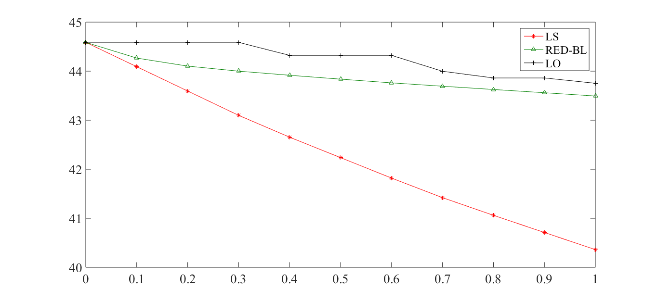
Electricity Cost vs Transition Cost
Electricity Cost Savings
vs UNIFORM (%)
Optimal energy savings scale well with transition costs
Transition costs (relative magnitude)
No transition costs
(De)activation overhead = energy cost
Notes:
As the magnitude of transition overheads compared to the cost of handling workload increases, we see that the percentage savings in electricity cost decrease for all algorithms. RED-BL achieves close to the ideal lower bound electricity cost savings, whereas the best variants of the greedy algorithm scale worse than RED-BL.

Slide 20
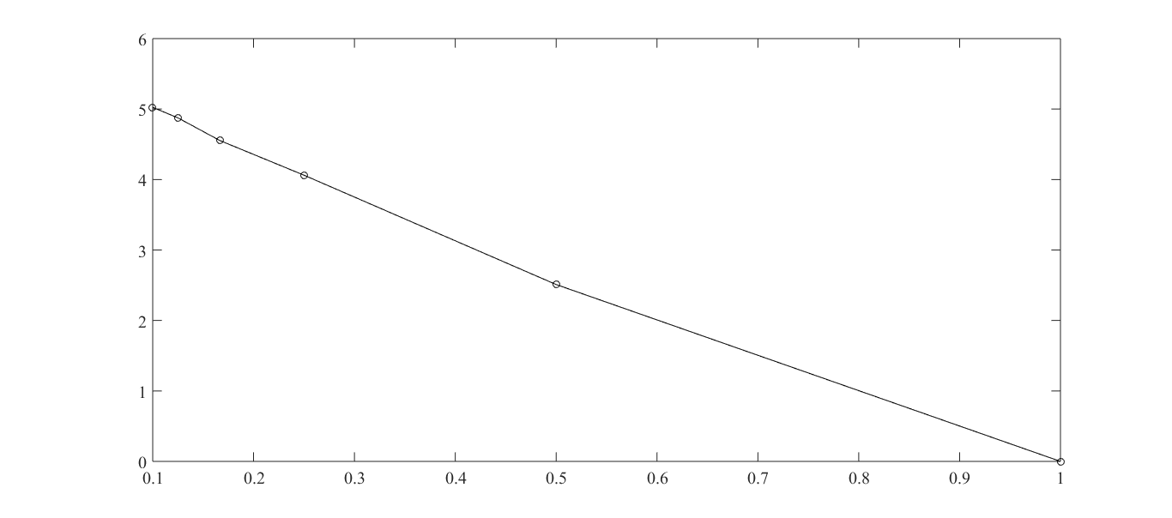
Granular (De)activation
Nearly linear increase in cost savings
Electricity Cost Savings Over
Full Data Center (De)Activation
Granularity of (de)activation
Can (de)activate half a data center
Can only (de)activate entire data center
Notes:
Now, let’s see how RED-BL energy savings would improve if we allowed independent (de)activation of fixed size fractions of a data center. The extreme right handside of this graph represents the case where you can only (de)activate an entire data center at a time. This is 0% better than the standard “all or nothing” RED-BL, because it is the same thing. If we were able to (de)activate half a data center at a time, we could do about 2.5% better than standard RED-BL. If we were able to independently (de)activate 10% of a data center at a time, we could do 5% better than standard RED-BL. So, there is opportunity for greater savings with granular (de)activation and it has a linear trend.

Slide 21
Summary – Case Study I
Electricity cost savings can be achieved
Overprovisioning
Diversity
It is important to consider transition costs
RED-BL has wider applicability

Slide 22
Agenda
Background and motivation
Opportunity and key idea
Case studies:
Data centers
Cellular networks
Conclusions and future work

Slide 23

Case Study II Cellular Networks
TRXs
Power amplifiers
Air conditioning
Major power consumers
Focus on BTSs to cut electricity cost
BSC
MSC
BSC
Source: GREENNETS Report, 2008
Marsan et. al, “Optimal Energy Savings in Cellular Access Networks”, ICC 2009
Notes:
Give the motivating example to show that WR and RP can be used in cellular networks as well.

Slide 24
Resource Pruning
No. of calls ≤ δ
P_{max}
P_{min}
Low call volume
Resource Pruning cuts cost
BTS Power Consumption (kW)
Deactivate some TRXs
Power saving threshold (δ)
Workload capacity
δ
t_{max}
Call volume

Slide 25
Does workload relocation help?
Power saving
Power saving
WR enables greater power savings
Power saving
Assume that power saving is enabled if upto two calls are being served

Slide 26
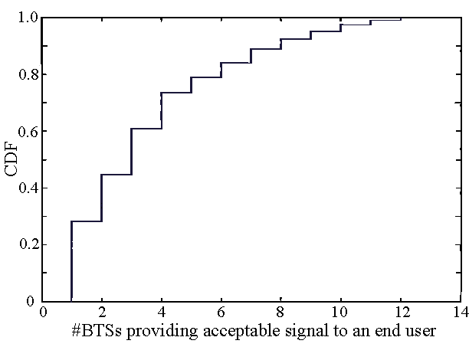
Is Workload Relocation Possible?
40% users receive signal from more than three BTSs

Slide 27
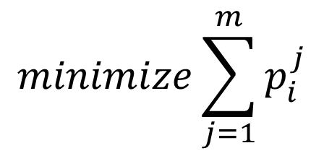
Optimization Formulation
$$minimize\sum_{j=1}^{m}{p_{i}^{j}}$$
For every interval, minimize # TRXs
Seemingly simple formulation
NP-Hard

Slide 28
Experimental Setup
Call volume traces for 2 days at 26 urban BTSs
Trace driven simulation:
Periodically obtain optimal call placement
Place BTSs with low-traffic in power-saving mode

Slide 29
BTS Power Consumption Models
Parameter | Value
 | Model 1 | Model 2 | Model 3
Idle Power (W) | 1425 | 2401.8 | 2341.5
Peak Power (W) | 1500 | 3887.5 | 2973.9
Power Saving per TRX (W) | 20 | 50 | 100

Slide 30
Results: Power-Saving Feature Only
Energy savings | Model 1 | Model 2 | Model 3
Percentage | 4.73% | 5.43% | 12.89%
Daily energy savings (kWh) | 43.28 | 109.68 | 217.12
Country-wide daily savings -31000 sites (MWh) | 51.6 | 130.77 | 258.87

Slide 31
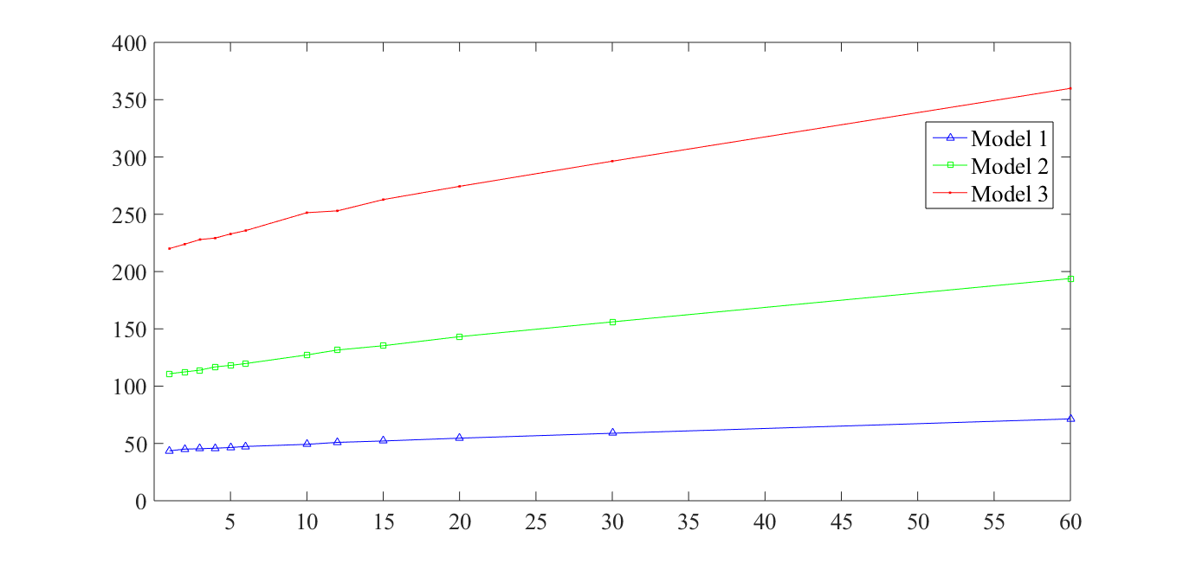
Energy Savings (kWh) RP + WR
Average Daily Energy savings (kWh)
Number of re-optimizations in an hour
At least 9.8% lower power consumption

Slide 32
Effect of Granular Deactivation
Granularity | Model 1 | Model 2 | Model 3
2-state | 5.38% | 6.29% | 14.94%
3-state | 6.81% | 7.73% | 18.62%
6-state | 8.70% | 9.65% | 23.37%
Savings increase with finer granularity

Slide 33
Case Study II - Summary
Overlaps in signal coverage
Some geo-flexibility in workload
Built-in power saving feature
Significant cost reduction through WR + RP

Slide 34
Drawing Parallels With Case Study I
Parameter | Cellular network | Data centers
Network resource
TRX
Servers
Workload relocation
Call hand off
Client redirect
Resource pruning
Server shutdown / idle / hibernate
BTS Power Saving
(De)activation overheads
Transition costs
Negligible
Notes:
Identify the similarities and differences between the two networks and observe how abstractions can be made.

Slide 35
Agenda
Background and motivation
Opportunity and key idea
Case studies:
Data centers
Cellular networks
Conclusions and future work

Slide 36
Future Work
Adaptation and application to 3G, 4G, 5G and beyond
Factor in other forms of transition costs:
Cost of change in latency
Cost of increase in call blocking probability
Experimentation on a real testbed
Incorporation into an OA&M framework
Interplay with energy markets

Slide 37
Conclusions
RED-BL: an electricity cost reduction framework
Systematic application of WR and RP
Can significantly reduce electricity costs
Data centers
Cellular networks
Reduction in power consumption
Positive ecological impact

Slide 38
Questions and Answers
If you can read this
Murphy’s law was violated

Slide 39
List of Papers
Published:
A simulation study of GELS for Ethernet over WAN, GLOBECOM 2007
RED-BL: Energy solution for loading data centers, INFOCOM Mini-Conference, 2012
Electricity cost efficient workload mapping, INFOCOM Computer Communications Workshop, 2013
Low-Carb: Reducing energy consumption in operational cellular networks, GLOBECOM 2013
RED-BL: Evaluating dynamic right sizing for data centers, Computer Networks, vol. 72, 2014
Submitted:
Low-Carb: A practical scheme for improving energy efficiency in cellular networks

Slide 40
Questions 1
Why not have one data center at the cheapest locations?
There is no single cheapest location
Diversity for:
Disaster
Latency

Slide 41
Question 2
Why can’t DVFS be used?
It can certainly be used
It does not achieve fine grained energy proportionality
Granularity of VF scaling is coarse
Other components are also energy proportional

Slide 42
Question 3
How many transitions in a day are likely?

Slide 43
Question 4
How quick is a transition?

Slide 44
DVFS Instead of Deactivation
Notes:
If, instead of shutting down an entire data center, we switch the servers into lower-power mode using DVFS techniques, the power savings might reduce, but the scheme would be more agile to workload variations. Here, we see that the power consumption drops linear as the power consumption is lowered with DVFS. If the server power consumption drops to 10% of the peak, the data center power consumption would be reduced by about 70%. Another data point is that if we put all “idle” servers at 50% power consumption, we achieve about 20% power reduction.

Slide 45
Reserve Margin
Notes:
To be prepared for some stray workload at data centers which we planned to deactivate, we’ll keep some servers on as reserve. As we increase the amount of serving capacity in reserve mode, the difference in power consumption will increase compared to the scenario where we did not keep any reserve capacity.
Exactly how much “stray” traffic we receive can’t be predicted. In this chart, the lower line shows the situation where we don’t receive any stray traffic at all. The power consumption in that case is purely due to servers idling. The upper line represents the situation where we need all the reserve capacity for handling stray traffic. The actual situation may be somewhere in between.

Slide 46
Results: Power-Saving + Handoff Absolute Energy Savings (%)

Slide 47
Effect of Late Deactivation

Slide 48
A Randomized Algorithm
Pick this
Nope
While there are BTSs in high-power mode
Pick a random BTS
For each call being handled by this BTS
Hand-over to a candidate BTS in low-power mode
Nope
Power saving
Yup!
Power saving

Slide 49
Performance of Heuristic Algorithm

