Slide 1
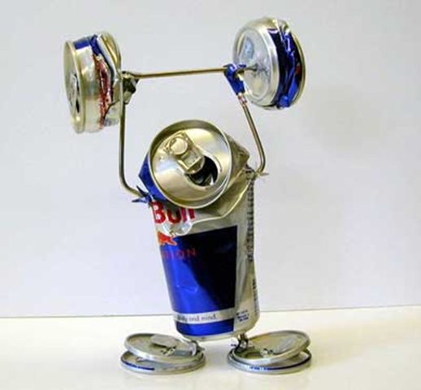


Cutting Electricity Cost For Service Provider Networks
Muhammad Saqib Ilyas
FDC
Zartash Afzal Uzmi
Tariq Mahmood Jadoon
Ihsan Ayyub Qazi
Muhamad Fareed Zaffar
Aamir Qayyum

