Slide 1


Cutting Electricity Cost For Service Provider Networks
Muhammad Saqib Ilyas
FDC
Zartash Afzal Uzmi (Advisor)
Tariq Mahmood Jadoon
Ihsan Ayyub Qazi
Muhamad Fareed Zaffar
Amir Qayyum

Slide 2
Agenda
Background and motivation
Opportunity and methodology
Case studies:
Data centers
Cellular networks
Conclusions and future work

Slide 3
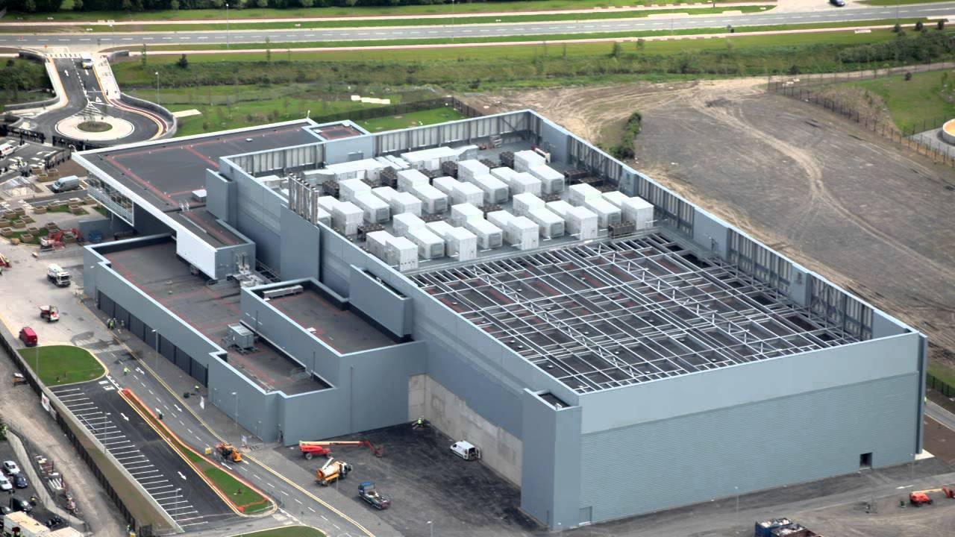
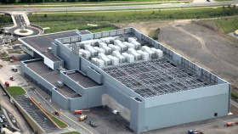


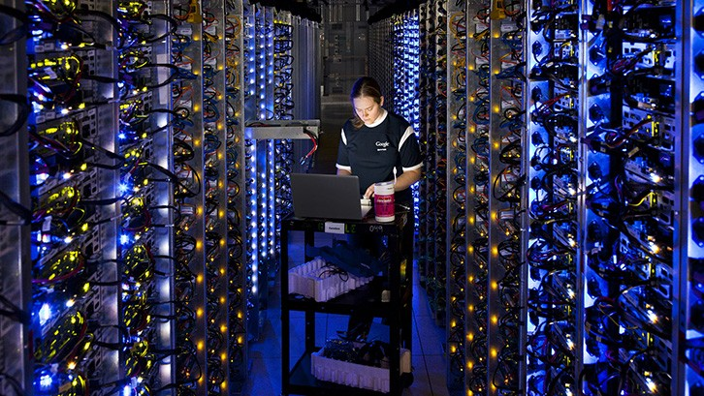
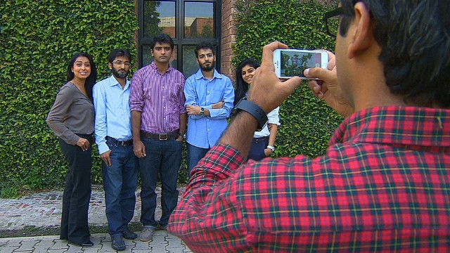
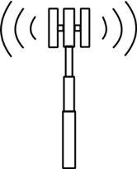

Background
Federated networks enable communication
A YouTube data center
The Internet
Cellular network
Source: http://bit.ly/1p07fEc
Source: http://bit.ly/20pOBWJ
Source: http://bit.ly/1KGJcsg
Source: http://cnet.co/1Q9SkZ0
Source: http://bit.ly/20pOYR1

Slide 4
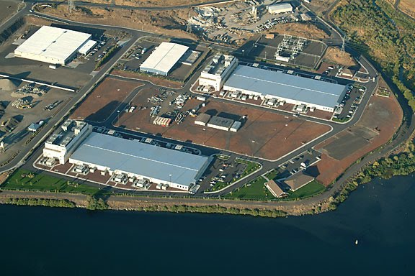
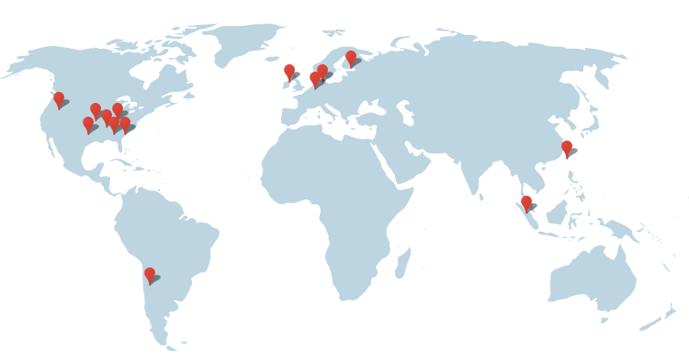
Network Scale
Amazon
87 data centers
At least 2 M servers
Telenor Pakistan
8000 cellular sites
Geographic diversity
Google’s data center locations
http://bit.ly/1WbIvbe
Source: http://bit.ly/11erCWn
Image source: http://bit.ly/1PqlC1V
Source: http://bit.ly/1T9VBqd
4

Slide 5

A Challenge Due To Network Scale
With great power comes
Massive infrastructure
Massive power consumption
great electricity bills

Slide 6


Motivation
Electricity Bill
15%
Annual DC Opex (2011)
$951 M
Electricity Cost
$143 M
Network electricity costs are significant
Electricity Bill
Upto 50%
Electricity Cost (2012)
$81 M
Source: Greenberg et. al, “Cost of a cloud: Research Problems in Data Center Networks”, CCR 2009
Source: datacenterknowledge.com
Source: GREENNETS Report Summary (2014)

Slide 7
Agenda
Background and motivation
Opportunity and methodology
Case studies:
Data centers
Cellular networks
Conclusions and future work

Slide 8
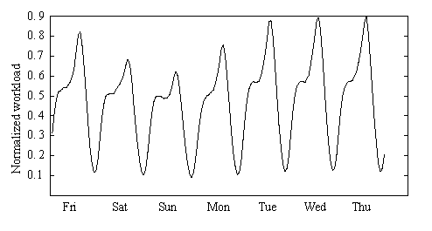
Opportunity
Deploy sufficient resources to handle peak
Lack energy proportionality
Data Center Idle Power
Between 75% and 85% of peak power
Systematic variations
Peaks and troughs quite pronounced
P
0.85P
Power consumption (Watt)
Opportunity for electricity cost savings
0
1
Most equipment (nearly) idle
Normalized Workload
Week long workload from 3 popular Facebook applications
A. Nazir et. al, “Unveiling Facebook: a Measurement Study of Social Network Based Applications”, ACM IMC 2008
Barroso et. al, “The Case for Energy Proportional Computing”, IEEE Computer, 2007
Peng et. al, “Traffic-Driven Power Savings in Operational 3G Cellular Networks”, MOBICOM 2011
Source: Emerson, “Energy Logic: Reducing Data Center Power Consumption…”

Slide 9

Resource Pruning
Deactivate idle equipment
CA: California
Deactivate some equipment
NY: New York
TX: Texas
Data Center
Workload
Resource pruning cuts electricity cost
NY
TX
CA
A. Qureshi et. al, “Plugging into energy market diversity”, HOTNETS 2008
Notes:
Bigger. Photo of a real data center then zoom

Slide 10
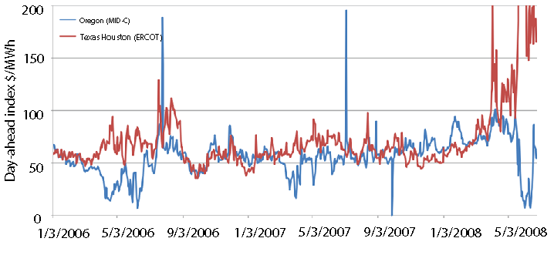
Electricity Price Diversity
Geographic diversity in electricity prices
Temporal diversity in electricity prices
Oregon cheaper
Texas cheaper

Slide 11
Workload Relocation
RP to save more
Workload relocation (WR)
CA: California
Move workload from NY to TX
NY: New York
TX: Texas
Most expensive
122.4
Electricity price
$/MWh
72
52
NY
TX
CA
Least expensive
Workload relocation cuts electricity cost

Slide 12
Recap
Resource Pruning (RP) cuts electricity costs
Workload Relocation (WR) cuts electricity costs
Are WR and RP free?

Slide 13
Transition Costs
Workload Relocation incurs cost of relocation
Ex: Inter data-center traffic are often expensive
Resource Pruning incurs cost of (de)activation
Ex: Time spent sleeping/hibernating

Slide 14
This Thesis
Systematic minimization of network electricity cost using Workload Relocation and Resource Pruning while considering transition costs
Notes:
Abbreviate. Single thesis statement
This thesis uses (boxes) WR and RP with consideration of relocation and (transition) costs by developing a systematic framework for electricity cost minimization

Slide 15
Contributions
Data centers
Cellular Networks
Optimization framework design
Evaluation using real world data from 3 large scale Facebook applications
Generalization of optimization framework to cellular networks
Analysis and evaluation using real world data
PUBLICATIONS
1- IEEE INFOCOM Mini-Conference, 2012
2- IEEE Computer Communications Workshop, 2013
3- Elsevier Computer Networks Journal, 2014
4- IEEE GLOBECOM, 2013

Slide 16
Agenda
Background and motivation
Opportunity and methodology
Case studies:
Data centers
Cellular networks
Conclusions and future work

Slide 17
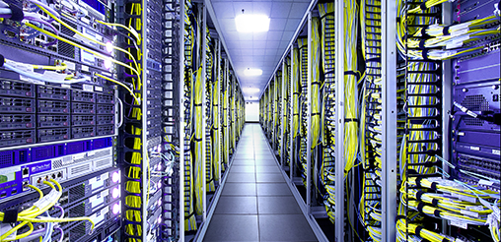
Case Study – I : Background
Data center operator
Geographically distributed data centers
Data center equipment
Power consumed is a function of workload
IT Load | Non-IT Load
Servers | Lighting
Storage | Cooling
Network | Power distribution
Source: http://bit.ly/1mrIi7o
Notes:
Photo

Slide 18
Motivating Example
Data center deactivation
Data center activation
Network State
Interval - 1
Transition cost
Interval - 2
Interval - 3
NY
TX
TX
CA
8
State Cost
6
CA
NY
TX
NY
CA
12
10
10
Electricity price driven workload mapping
State cost locally suboptimal
Optimal State Trajectory Problem
State cost locally suboptimal
Total cost: 46
State cost locally suboptimal
Locally optimal
Might not be globally optimal
Transition costs lower than local optimal scheme
No transition costs
Relocate Energy Demand to Better Locations (RED-BL)
An alternative workload mapping
Total cost: 42
Sum of all data centers’ electricity cost
NY
TX
TX
CA
4
CA
0
NY
TX
NY
CA
14
12
12

Slide 19
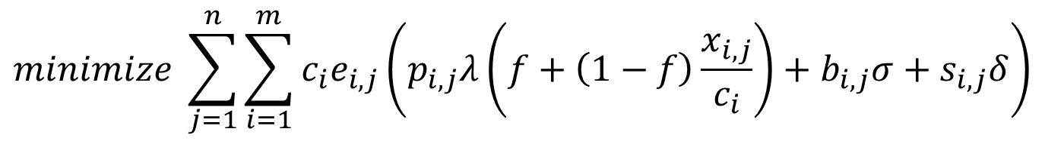
Optimization Formulation
Fraction of data center that is active
Unit price of electricity
Workload
Data center capacity
$$minimize \sum_{j=1}^{n}{\sum_{i=1}^{m}{c_{i}e_{i,j}\left(p_{i,j}λ\left(f+\left(1−f\right)\frac{x_{i,j}}{c_{i}}\right)+b_{i,j}σ+s_{i,j}δ\right)}}$$
Sum over all intervals
Sum over all data centers
State energy
Transition energy
Subject to several constraints (please see the thesis)
Notes:
Give the objective function and the constraints

Slide 20
Experimental Setup
Workload from 3 popular Facebook apps
Electricity prices from 33 US locations
Simulated a week-long deployment plan
Compared RED-BL against various schemes
Notes:
To evaluate RED-BL for geo-diverse data centers, we performed a simulation study which had the following setup. We used workload from three popular Facebook applications and normalized the cumulative workload. We verified that the characteristics of the cumulative workload resemble that of the workload for thousands of servers in a Google data center. We collected day-ahead electricity prices for 33 locations across the USA and simulated a weeklong deployment plan for the data centers situated at these locations. We compared RED-BL against a number of algorithms.

Slide 21
Comparison Benchmarks
1
3
0
2
0
2
UNIFORM: Equally distribute workload
3
1
2
1
3
15
15
20
1
3
0
2
0
2
LO: Local Optimal Ignoring Transition Costs
3
1
2
12
1
10
10
3
Sometimes idling is better
1
3
4
2
6
2
LS: Local Optimal with Selection
3
1
2
15
1
10
10
3
Best practical variant of local optimal

Slide 22
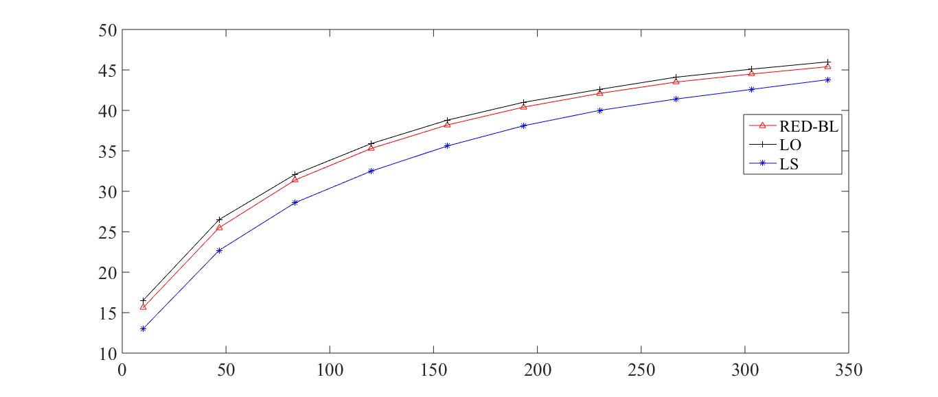
Cost Savings vs Over-provisioning
Savings over UNIFORM (%)
Over-provisioning (%)
Increased over-provisioning
More capacity at cheaper locations
Greater savings

Slide 23
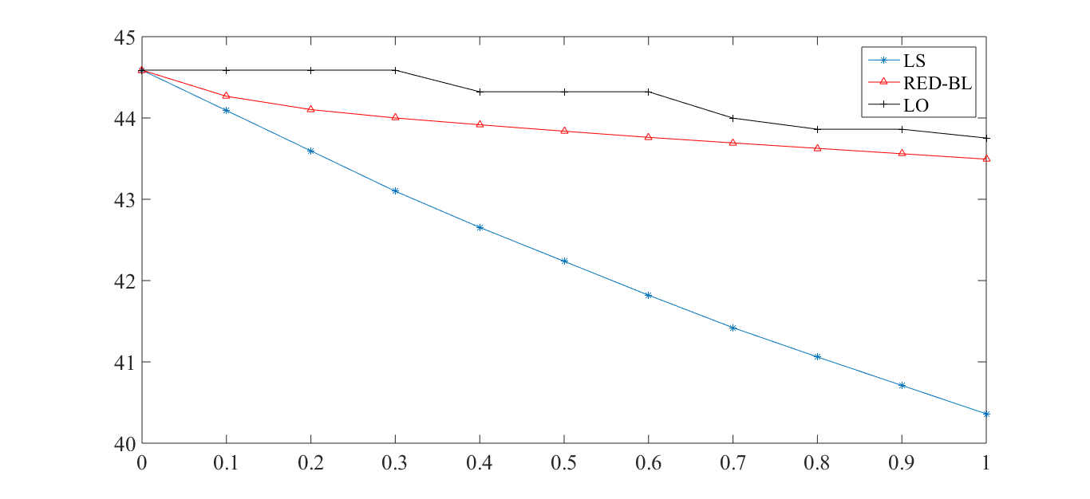
Electricity Cost vs Transition Cost
Electricity Cost Savings
vs UNIFORM (%)
RED-BL energy savings scale well with transition costs
Transition Costs (relative magnitude)
No transition costs
Transition cost = single interval idling
Notes:
As the magnitude of transition overheads compared to the cost of handling workload increases, we see that the percentage savings in electricity cost decrease for all algorithms. RED-BL achieves close to the ideal lower bound electricity cost savings, whereas the best variants of the greedy algorithm scale worse than RED-BL.

Slide 24
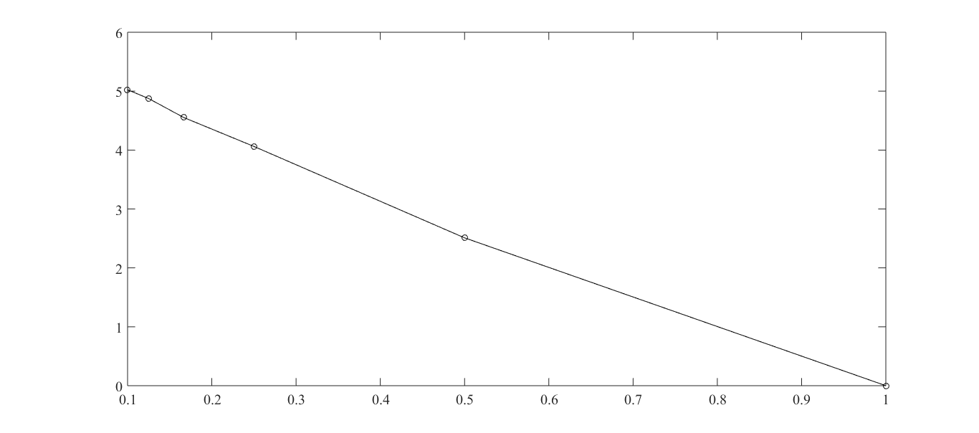
Granular (De)activation
Nearly linear increase in cost savings
Electricity Cost Savings Over
Full Data Center (De)Activation
Granularity of (de)activation
Can (de)activate half a data center
Can only (de)activate entire data center
Increasing granularity
Notes:
Now, let’s see how RED-BL energy savings would improve if we allowed independent (de)activation of fixed size fractions of a data center. The extreme right handside of this graph represents the case where you can only (de)activate an entire data center at a time. This is 0% better than the standard “all or nothing” RED-BL, because it is the same thing. If we were able to (de)activate half a data center at a time, we could do about 2.5% better than standard RED-BL. If we were able to independently (de)activate 10% of a data center at a time, we could do 5% better than standard RED-BL. So, there is opportunity for greater savings with granular (de)activation and it has a linear trend.

Slide 25
Summary – Case Study I
WR and RP are complementary
Achieve electricity cost savings
Transition costs may be significant
Must be considered in electricity cost optimization

Slide 26
Agenda
Background and motivation
Opportunity and methodology
Case studies:
Data centers
Cellular networks
Conclusions and future work

Slide 27

Case Study II Cellular Networks
TRXs
Power amplifiers
Air conditioning
Major power consumers
Focus on BTSs to cut electricity cost
BSC
MSC
BSC
Source: GREENNETS Report, 2008
Marsan et. al, “Optimal Energy Savings in Cellular Access Networks”, ICC 2009
Notes:
Give the motivating example to show that WR and RP can be used in cellular networks as well.

Slide 28
Resource Pruning
Call volume ≤ δ
P_{max}
P_{min}
Low call volume
BTS Power Consumption (kW)
Deactivate some TRXs
Resource Pruning cuts cost
Power saving threshold (δ)
Workload capacity
BTS Power Saving mode
δ
t_{max}
Call volume

Slide 29
Does Workload Relocation Apply?
Power saving
Power saving
Assume that power saving is enabled if upto two calls are being served
WR enables greater power savings
Power saving

Slide 30
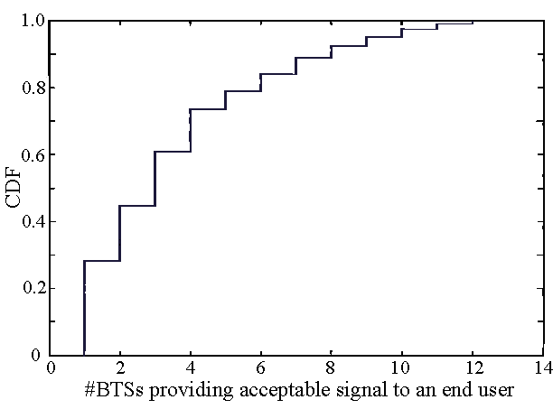
Coverage Diversity
~45% users receive signal from at least three BTSs

Slide 31
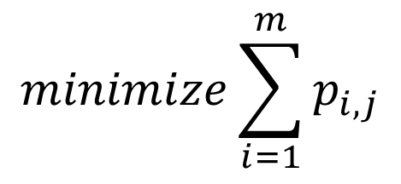
Optimization Formulation
$$minimize \sum_{j=1}^{n}{\sum_{i=1}^{m}{c_{i}e_{i,j}\left(p_{i,j}λ\left(f+\left(1−f\right)\frac{x_{i,j}}{c_{i}}\right)+b_{i,j}σ+s_{i,j}δ\right)}}$$
$$minimize\sum_{i=1}^{m}{p_{i,j}}$$
For every interval, minimize # TRXs
Seemingly simple formulation
NP-Hard

Slide 32
Experimental Setup
Call volume traces for 2 days at 26 urban BTSs
Trace driven simulation:
Periodically optimize call placement
BTSs with low-traffic go to power-saving mode

Slide 33
BTS Power Consumption Models
Parameter | Value
 | Model 1 | Model 2 | Model 3
Idle Power (W) | 1425 | 2401.8 | 2341.5
Peak Power (W) | 1500 | 3887.5 | 2973.9
Power Saving per TRX (W) | 20 | 50 | 100

Slide 34
Results: Resource Pruning Only
Energy savings | Model 1 | Model 2 | Model 3
Percentage | 4.73% | 5.43% | 12.89%
Daily energy savings (kWh) | 43.28 | 109.68 | 217.12
Pakistan-wide daily savings 31000 sites (MWh) | 52 | 131 | 259
10 MW continuous power consumption

Slide 35
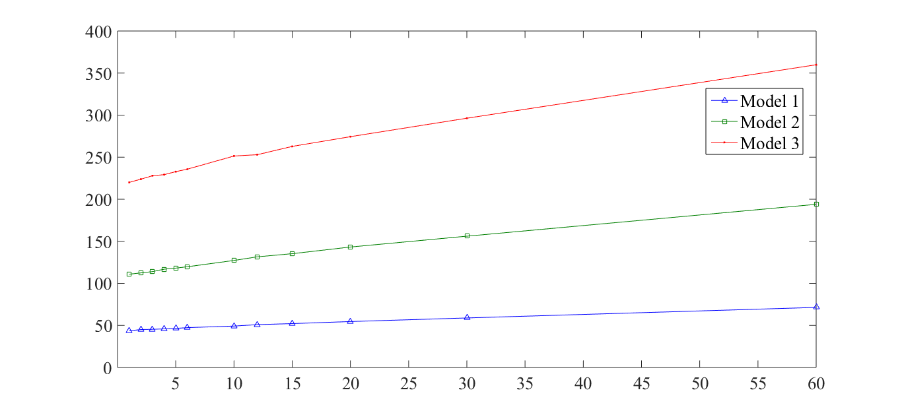
Energy Savings (kWh) RP + WR
Average Daily Energy savings (kWh)
Number of re-optimizations in an hour
From 5%-15% lower power consumption

Slide 36
Effect of Granular Deactivation
Two halves of the TRXs independently controllable
Granularity | Model 1 | Model 2 | Model 3
2-state | 5.38% | 6.29% | 14.94%
3-state | 6.81% | 7.73% | 18.62%
6-state | 8.70% | 9.65% | 23.37%
Increasing granularity
All TRXs independently controllable
Savings increase with finer granularity

Slide 37
Case Study II - Summary
Average user in range of multiple BTSs
Workload relocation can be leveraged
Resource Pruning: Built-in feature
Significant cost reduction through WR + RP

Slide 38
Drawing Parallels With Case Study I
Parameter | Cellular network | Data centers
Network resource
TRX
Servers
Workload relocation
Call hand off
Client redirect
Resource pruning
Server shutdown / idle / hibernate
BTS Power Saving
(De)activation overheads
Transition costs
Negligible
Notes:
Identify the similarities and differences between the two networks and observe how abstractions can be made.

Slide 39
Agenda
Background and motivation
Opportunity and methodology
Case studies:
Data centers
Cellular networks
Conclusions and future work

Slide 40
Future Work
Adaptation and application to 3G and beyond
Factor in other forms of transition costs:
Change in latency
Increase in call blocking probability
Experimentation on a real testbed
Interplay with energy markets

Slide 41
Conclusions
RED-BL: an electricity cost reduction framework
Systematic application of WR and RP
Can significantly reduce electricity costs
Data centers
Cellular networks
Reduction in power consumption
Positive ecological impact

Slide 42
Acknowledgements
Encouragement
Guidance
Dr. Fareed
Dr. Tariq
Dr. Naveed
Dr. Adnan
Dr. Jahan
Dr. Fahad
Dr. Mudassir
Dr. Zartash
Dr. Ihsan
Dr. Sohaib
Datasets
Dr. Atif
Dr. Bilal
My parents
My family
My wife
Fellow PhD Students
Dr. Chen-Nee
Saqib Raza
Dr. Atif
Reviewers
Prayers
Feedback

Slide 43

Acknowledgements
Questions and Answers
Speechless
Fatima
Areeha
Areeba

Slide 44
List of Papers
Published:
A simulation study of GELS for Ethernet over WAN, GLOBECOM 2007
RED-BL: Energy solution for loading data centers, INFOCOM Mini-Conference, 2012
Electricity cost efficient workload mapping, INFOCOM Computer Communications Workshop, 2013
Low-Carb: Reducing energy consumption in operational cellular networks, GLOBECOM 2013
RED-BL: Evaluating dynamic right sizing for data centers, Computer Networks, vol. 72, 2014
Submitted:
Low-Carb: A practical scheme for improving energy efficiency in cellular networks

Slide 45
Questions 1
Why not have one data center at the cheapest locations?
There is no single cheapest location
Diversity for:
Disaster
Latency

Slide 46
Question 2
Why can’t DVFS be used?
It can certainly be used
It does not achieve fine grained energy proportionality
Granularity of VF scaling is coarse
Other components are also energy proportional

Slide 47
Question 3
How many transitions in a day are likely?

Slide 48
Question 4
How quick is a transition?

Slide 49
DVFS Instead of Deactivation
Notes:
If, instead of shutting down an entire data center, we switch the servers into lower-power mode using DVFS techniques, the power savings might reduce, but the scheme would be more agile to workload variations. Here, we see that the power consumption drops linear as the power consumption is lowered with DVFS. If the server power consumption drops to 10% of the peak, the data center power consumption would be reduced by about 70%. Another data point is that if we put all “idle” servers at 50% power consumption, we achieve about 20% power reduction.

Slide 50
Reserve Margin
Notes:
To be prepared for some stray workload at data centers which we planned to deactivate, we’ll keep some servers on as reserve. As we increase the amount of serving capacity in reserve mode, the difference in power consumption will increase compared to the scenario where we did not keep any reserve capacity.
Exactly how much “stray” traffic we receive can’t be predicted. In this chart, the lower line shows the situation where we don’t receive any stray traffic at all. The power consumption in that case is purely due to servers idling. The upper line represents the situation where we need all the reserve capacity for handling stray traffic. The actual situation may be somewhere in between.

Slide 51
Results: Power-Saving + Handoff Absolute Energy Savings (%)

Slide 52
Effect of Late Deactivation

Slide 53
A Randomized Algorithm
Pick this
Nope
While there are BTSs in high-power mode
Pick a random BTS
For each call being handled by this BTS
Hand-over to a candidate BTS in low-power mode
Nope
Power saving
Yup!
Power saving

Slide 54
Performance of Heuristic Algorithm

