Slide 1
RED-BL

Slide 2
Overview
Background and motivation
Problem statement and formulation
Case studies
Conclusion

Slide 3

Introduction
Notes:
How much of this looks unfamiliar to you? So many services have become pervasive. Behind the scenes, Networks – of one type of another - , enable these services. What different types of networks, lurking behind these services, can we think of?

Slide 4









Different types of networks
Notes:
We’ve got Internet Cellular Network Operators that provide cellular telephony and data services. We’ve got Internet Service Providers that provide connectivity to the Internet. But there are other networks behind the scenes, too. For instance, web applications are hosted in large geo-distributed data centers run by data center operators like Amazon, Micoroft, Google and Facebook. Then, there are companies that replicate content across the globe with the objective of reducing client latency, such as Akamai, Edgecast and Internap. The bottom line is that different types of networks enable services that are critical to our personal and professional lives. One commonality amongst all these networks is that they are really expensive to deploy and maintain. In this thesis, we focus on cellular networks and geo-diverse data center networks.

Slide 5

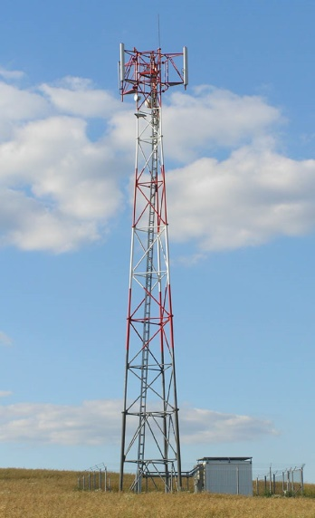


Some similarities
Network resources
Workload
Network sites
Notes:
If we look carefully, there are several similarities, and of course some differences between these networks. Let’s focus on geo-diverse data centers and cellular networks. In cellular networks, user traffic needs to be handled. Data centers also handle user traffic. Abstractly, we can refer to these as workload. Similarly, the workload handling logic is hosted in cell sites, whereas in the other scenario, user workload is handled in data centers. A “larger” network site can handle more traffic. A larger site, at the same time, would be more expensive and might consume more electrical power, too. So, if you want to serve more users, you would need to appropriately equip the network sites. The workload handling capacity of a cell site is determined by the number of TRXs installed at it. Similarly, the workload handling capacity of a data center is determined by the number of servers installed in it. We can generically refer to these elements of workload handling as “network resources”.
Naturally, these sites costs money, so let’s get a feel for the kind of numbers we’re looking at.

Slide 6

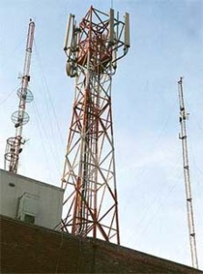
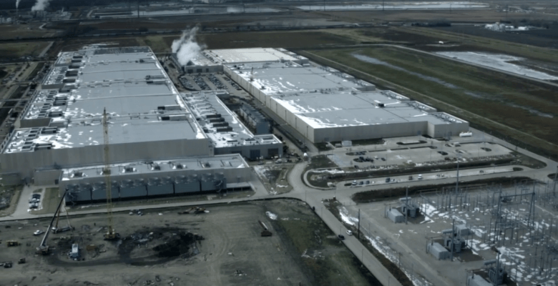
The capital cost
$ 550,000
$ 400 Million
Notes:
Especially when it comes to services on the Internet, we are used to a plethora of free services like web based email and online social networking, but deploying and running the networks that enable these services costs a significant amount of money. According to a study conducted in 2010, a typical cell site can cost as much as $ 550,000. In 2013, Google announced building a data center in Iowa at a cost of $400 Million. But that’s just the capital cost of establishing the network infrastructure. The recurring operations cost is significant, too.

Slide 7


The operations cost
2009 data center space lease: $50 Million
Data center electricity cost: 15%
Typical Pakistani Cellular operator:
$9.19 Million
Telecom Italia: $81 Million
Notes:
For instance, Facebook spent $50 Million on lease of its data centers’ space in the year 2009. Electricity cost is also a significant fraction, at about 15%, of data center operations cost. For a typical cellular operator with 7000 cell sites across Pakistan, if we estimate a 1.5 kWh per cell site and a cost of Rs. 10/kWh, the annual cost of electricity stands at $9.19 Million. For Telecom Italia, the electricity consumption in 2012 was 1.793 GWh, which at 0.04 Euros/kWh comes to an annual electricity cost of about $81 Million. The problem here is that whereas users are charged per usage, the power consumption is pretty inelastic while the workload is quite variable.

Slide 8
Lowering electricity cost
Reduce bill by using
Less electricity
Cheaper electricity
Energy Consumed (e) | 285 Million kWh
Unit Price (p) | $0.7
Total Bill = e x p | $200 Million
Notes:
Electricity cost is the product of unit price of electricity and the amount of electrical energy consumed. The latter is an accumulation or integration of the power consumption. So, we could reduce electricity consumption by using cheaper electricity or by reducing the amount of electricity consumed. Let’s see how we may do each of these one by one.

Slide 9
Lowering electricity usage
Hardware consolidation
May cut electricity consumption by upto 80% []
Upgrading to energy efficient hardware
Resource pruning
Notes:
We can save a lot of energy if we turn everything off, but that’s not a feasible solution because we are compromising completely on workload. Can we lower electricity consumption without compromising on workload?
Hardware virtualization allows us to consolidate hardware. For instance, applications hosted on two separate physical servers may often be run on two virtual machines on the same physical server. This reduces the power consumption significantly. This exploits the fact that applications may be statistical multiplexed. With high likelihood, the combined instantaneous workload for two applications would be much less than the sum of their peak workload. It has been reported that server consolidation may reduce the electricity consumption by as much as 80%.
Researchers in circuits, networks and computer architecture keep innovating to improve the energy efficiency of hardware. In order to reduce energy consumption, you could replace your existing hardware with equipment that is energy efficient. The drawback in this approach is that it requires capital investment.
There’s another approach, which we call resource pruning. We’ll talk about it in a short while.
So, what about using cheaper electricity to lower electricity cost?

Slide 10
Using cheaper electricity
Electricity price
1
2
3
Sites
Notes:
Suppose that the network operator has three network sites. These sites could be data centers or they could be cell towers or some other type of site depending on the type of network you consider. These sites are geographically distributed as they generally are. Let’s use circles spread horizontally to represent the sites. Electricity price exhibits geo-diversity, so let’s use the y-axis to indicate the electricity price. Now, the way to save electricity cost by using cheaper electricity is as follows. Network workload is known to have diurnal cycles with peak that has a short duration and much lower trough. So, when you have low workload, you wouldn’t need all of the sites. So, you assign workload preferably to the site with the cheapest electricity. If that site reaches capacity and you still have some more workload, you’ll assign it to the site with the next cheapest electricity. And so on and so forth. Since workload only peaks for a short duration, chances are you will be using relatively cheaper electricity for a significant fraction of time.
But the problem with this approach is that networks lack energy proportionality which diminishes the benefits of smartly distributing workload to save electricity cost. What does that mean?

Slide 11
Lack of energy proportionality
Our playground when using cheaper electricity
Real Network
Couldn’t do anything about this
Power consumption (Watt)
Ideal Network
Workload
Network power consumption is much higher than ideal except when workload peaks
Workload is much lower than peak most of the time
Networks are mostly under-utilized and have a high energy overhead compared to ideal
Energy inefficiency
Notes:
It turns out that networks such as cellular networks and geo-diverse data centers lack energy proportionality. As shown in this figure, the network power consumption is nearly independent of workload. Ideally, the network should consume zero power when there is zero workload. However, real life is far from ideal. So, as we assign workload to use cheaper electricity, we are playing with the limited swing available in the real network’s profile. We are reducing power consumed purely due to workload at sites with more expensive energy. We are not reducing the idle power consumption, which is quite significant.
Notice that if the network operated at a workload nearly equal to peak capacity, it doesn’t matter whether power consumption is “practical” or “ideal”. However, workload is quite variable and peaks for a short duration only, before falling to a much lower trough. To meet the “rush hour” demand, the network must be provisioned according to peak workload, but its capacity is under-utilized most of the time. Thus, the network power consumption is much higher than ideal. Ideally, the network should be completely energy proportional, i.e., instantaneous power consumption should follow the same pattern as the customer workload, but the swing in power consumption is quite limited. Due to the significant overhead in power consumption, we say that today’s networks are energy inefficient.

Slide 12
Desirable
Real Network
Power consumption (Watt)
Ideal Network
Workload
Notes:
So, realistically speaking, if the peak workload, and hence the peak power consumption remain fixed, we want to lower the y-intercept of the power consumption profile so that the network is as close to energy proportional as possible. This will lower the average power consumption of the network. Lowering of power consumption results in lowering of electricity cost.

Slide 13

Resource pruning
Turn equipment off when workload is low
Power consumption
Workload
Notes:
One way to achieve coarse grained energy proportionality is to turn off excess network equipment when the workload is low. As an analogy, in this picture, when there are two occupants in the room, you’ll need to turn on both lights, but when there is only one occupant, you can make do with just one light to save energy. We call this strategy, RP. By turning off some equipment, we are lowering the no-load power consumption, i.e., the y-intercept of the power consumption profile.
So, when there is no workload, you can keep all your network resources off, resulting in zero power consumption. As a matter of fact, the power consumption wouldn’t be zero when all resources are off because some equipment (IT or non IT) can’t ever be turned off. Anyway, when you get some workload, you can turn some of your resources on. You’ll have a power consumption profile as shown here and you’ll be operating at a low workload capacity. Later on, as workload rises, you can turn more resources on, resulting in increases workload capacity as well as higher idle and peak power consumption. Because each set of resources lacks energy proportionality, it has a non zero idle power consumption. So, when we turn on additional circuits to handle more workload, the idle power consumption increases. The slope of the line represents the power consumed per unit workload. We assume that all resources are identical and hence the slope of the power consumption profile does not change when more circuits are turned on.
Again, as workload increases even further, we can turn on even more resources which results in further increase in workload capacity as well as power consumption.
So, that was about reducing electricity consumption. How about saving electricity cost by using cheaper electricity?

Slide 14
A better strategy
Electricity price
1
2
3
Sites
Notes:
An improved way of cutting electricity cost while using cheaper electricity is to prune the resources that are presently not needed. So, first we assign workload to site number 2 while the other sites are pruned from the network. When site number 1 is needed, it is activated and workload is assigned to it. When site number 3 is also needed, it is activated and assigned workload.
Finer control over network resources may be available. That is, instead of activating or deactivating entire network sites, a subset thereof may be activated or deactivated. For instance, individual racks may be controlled independently, or each TRX may be controlled independently.
But there’s another problem. Electricity prices exhibit geo-temporal diversity. So, the relative merit of electricity prices keeps changing with time.

Slide 15
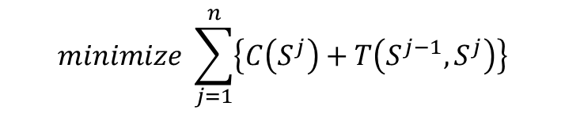
Problem formulation
$$minimize \sum_{j=1}^{n}{\left\{C\left(S^{j}\right)+T\left(S^{j−1},S^{j}\right)\right\}}$$
Joint workload relocation and resource pruning
Electricity price
1
2
3
Time intervals
Notes:
So, we’ll need to bring a time axis into play here. Electricity prices change only at discrete intervals, so we can consider the time axis to be slotted into time intervals. The sites are all placed horizontally in the same order for each time interval in the above figure. Now, we need to assign workload to each network site. This assignment can be done in a number of ways for each interval and due to geo diversity in electricity price, each assignment for a given interval can have a different electricity cost associated with it. In other words, we need to pick a state for all the network sites during each interval, where each state has a certain cost associated with it.
When going from one state to another in consecutive intervals, workload assigned to one site may need to be shifted over to another to consolidate the workload better to conserve power. We call this workload relocation
Due to workload relocation, there may also be some cost of transition between adjacent states. The optimal electricity cost, over the given time horizon, would correspond to finding the set of states for each interval such that the sum of state and transition costs is minimum.
This sort of optimization could be applied to any network as long as: the electricity cost for a network site during an interval is a convex function of the workload assigned to it and network sites or resources within them can be turned on/off during low workload.
Mathematically, it can be given as this optimization objective function. What constraints would this optimization be subject to?

Slide 16

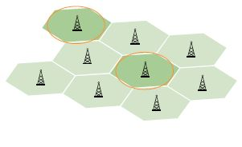

Constraints
To each cell its own
Honor workload capacity of resources
All workload must be handled
Notes:
Well, first off, there’s the capacity constraint. That is, each network site has a workload handling capacity, which must be respected. Then, we must also ensure that all workload that is offered to the network is assigned to one network site or another. A particular network may have other constraints specific to it. For instance, in case of cellular networks, a call may not be assigned to a far off cell site.
Now that we know the problem qualitatively, let’s see how we can mathematically model it.

Slide 17
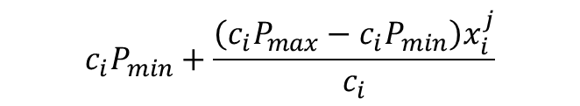

Mathematical model – State cost
P_{max}(P_{min}): Network’s max (min) power consumption
c_{i}: Normalized capacity of site i
c_{i}P_{max}(c_{i}P_{min}): Max (min) power consumption for site i
x_{i}^{j}: workload assigned to site i during interval j
Power consumption at site i during interval j
$${c_{i}P}_{min}+\frac{{\left(c_{i}P_{max}−c_{i}P_{min}\right)x}_{i}^{j}}{c_{i}}$$
Divide by Pmax to get normalized power consumption
Substitute f = P_{min}/P_{max}
$$fc_{i}+\left(1−f\right)x_{i}^{j}$$
Idling power
Workload dependent power
Notes:
This model relates to the cost of state in the optimal state trajectory formulation. Let the power consumption of the entire network under peak workload be Pmax and that under no load be Pmin. Let the workload capacity of network site i normalized over the peak expected workload be ci. Since a site’s power consumption increases linearly with workload, each site has a contribution ciPmax to the network’s peak power consumption and similarly for the idle power consumption. If a fraction of workload xij is assigned to site i during interval j, then the site’s power consumption will be given by the above formula, which is the equation of a straight line in the slope intercept form. We don’t need absolute numbers for power consumption, so divide this expression by Pmax and substitute Pmin/Pmax = f gives us the simplified expression here which has two parts. One is the factor that is workload dependent and the other is the idle power consumption.

Slide 18

Mathematical model – State cost
Power incurred only if site is active
l: sets of resources that can be independently turned on/off
p_{i}^{j} resource sets active at site i during interval j
Computational power depends on workload only
But idling power depends on number of active resource sets (p_{i}^{j})
$$fc_{i}\frac{p_{i}^{j}}{l}+\left(1−f\right)x_{i}^{j}$$
Notes:
The power consumption expression just derived applies to the network’s power consumption only if the site is active. So, we will multiply the expression with a term that ensures that an inactive site contributes nothing to the overall power consumption and an active site contributes to the overall power consumption according to the number of active sets of resources and the workload assigned to it. Let l be the number of resource sets that can be independently turned on/off at a site. Let pij be the number of resource sets that are presently active, then fraction pij/l of the maximum idling power for the site is contributed to the overall power consumption. Later on, we will show that the optimization problem will ensure that xij is non zero only if a site is on.
So, that covers the state costs. Now, let’s see how we may model the transition costs.

Slide 19
Transition costs
Any costs associated with shift in workload assignment to sites
Activation/deactivation overheads
Scenario specific costs
Will cover later in case studies
A normalized measure is useful instead of actual magnitudes
Notes:
Any costs that are incurred to shift workload between sites would be factored into transition costs. Examples include power overheads in turning on/off network resources. The type and magnitude of transition costs depend on the specific network. Therefore, we will talk about these in detail when we describe specific case studies.
Just as we normalized the network’s power consumption when modeling state costs, we will consider a normalized measure of transition costs. What this enables us to do is to see how the electricity cost saving changes when the transition costs vary as a fraction of the state costs.

Slide 20
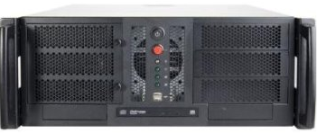
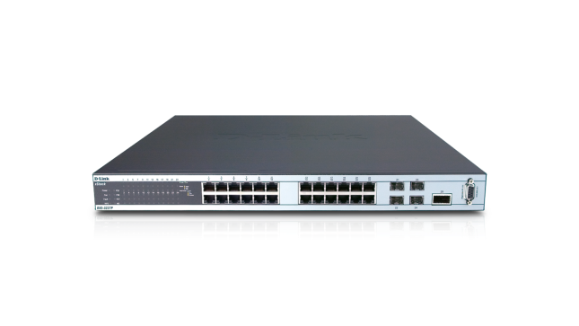


Case study I
Geo-distributed data centers

Slide 21
Case study I – Data centers
Network sites -> Data centers
Network resources -> IT equipment
State cost -> Electricity cost of operation
Transition cost -> WR + RP

Slide 22
Workload relocation
Modify DNS load balancing
Change routing table entries
Resource pruning
Turn off/Sleep/Hibernate IT equipment
Some equipment takes very long to turn on
Example: Network

Slide 23
Dataset
33 locations across the US
Day ahead electricity prices
Hourly granularity

