Slide 1
RED-BL

Slide 2
Agenda
Background and Motivation
Problem Statement and Formulation
Results
Conclusions and Future Work

Slide 3
High Network Electricity Costs
Facebook spent well over $1M / month on electricity bills in 2008 [TechCrunch]
Telecom Italia’s annual electricity bill was $81M in 2012
Electricity prices are rising
Costs expected to increase further
Can we reduce the electricity cost of these networks?
Notes:
Electricity costs are a significant fraction of the operations cost. About 15% for data centers [Greenberg CCR 2009] and from 18-50% for cellular networks [GREENNETS]. Can we reduce the electricity cost of these networks?

Slide 4
Reducing Electricity Cost
Reduce bill by using
Less electricity
Cheaper electricity
Energy Consumed (e) | 285 Million kWh
Unit Price (p) | $0.7
Total Bill = e x p | $200 Million
How can we reduce network energy consumption?
Notes:
Electricity cost = energy x unit price. So, either reduce the amount of energy consumed or use cheaper electricity, or both. Let’s look at the former, first

Slide 5
Reducing Energy Consumption - I
Clean slate: Upgrade to energy efficient hardware
Con: capital intensive
Incremental approach
Hardware consolidation
Turning off equipment when not needed
What kind of equipment are we talking about?

Slide 6
Electrical Load in Networks
Example: Data centers
Geographically diverse sites
Electricity consumption:
IT Load | Non-IT Load
Servers | Lighting
Storage | Cooling
Network | Power distribution
What is the nature of network power consumption?
Notes:
Companies such as Google, Microsoft and Amazon deploy data centers. In terms of electricity consumption, a data center has IT as well as non IT equipment. IT equipment includes servers, storage, network switches, while examples of non-IT equipment are airconditioning and power distribution. Some of the data center equipment may not be turned off to save power, for instance, airconditioning, networking and cooling. Some critical servers and storage might also need to be always on. We call such equipment, Inelastic load, whereas other load that may be turned off is called elastic load.

Slide 7
Reducing Data Center Energy Consumption
Data center power consumption
Workload is mostly low
Turn off equipment when not needed
Resource Pruning (RP)
Real
Power consumption (Watt)
Ideal
Houston, we have a problem!
Real is close to ideal
Real is far from ideal
Average CPU Utilization
Depends on workload
How about using cheaper electricity?
Notes:
Energy consumption increases with workload. Examples of workload in different scenarios are user traffic for Internet applications or telephone calls. However, many of today’s networks lack energy proportionality. This means that they consume almost the same amount of energy when idling as they do when operating at peak workload. Since the workload is much lower than the peak most of the time, today’s networks have a high energy overhead. We estimate around 50% reduction in energy consumption by base stations in a cellular network can be achieved. One of the aims of this thesis is to reduce this overhead.

Slide 8

Using Cheaper Electricity
When workload rises even more …
Data Center
Workload
Workload relocation (WR)
As workload rises…
Data Center 3 most expensive
Electricity price
Data Center 2 least expensive
1
2
3
Data Centers
Beware of cost overheads due to WR or RP
Notes:
We said that the second way to reduce electricity costs is to use cheaper electricity. This is made possible because different network sites are located at different places and the presence of diversity in electricity price between different locations. When workload is lower than the peak, which is most of the time, for the networks that we studied, we can map workload to locations with cheaper electricity to reduce electricity cost.

Slide 9
Questions that we wish to answer
Can we use WR and RP to reduce electricity costs?
What factors influence the electricity cost savings?
How do the electricity cost savings vary with the above factors?
Can we generalize the electricity cost optimization problem?
For instance, apply it to cellular networks
Notes:
The following questions should come to mind:
1- Can we reduce electricity costs by turning off resources when not needed and using cheaper electricity? The answer is yes, for instance, see Asfandyar’s work in SIGCOMM 2009.
2- What factors influence the amount of energy savings?
3- How does the amount of energy savings vary with these parameters?
4- Can we apply a generalized optimization to achieve energy savings in different types of networks?

Slide 10
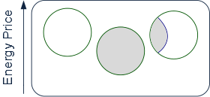
Case Study I – Data Centers
Total workload = 1.3 x Data center capacity
Network State
State Electricity Cost = Sum of Data Center Electricity Cost
Data Center Electricity Cost = unit electricity price x time x power consumption
Depends on workload

Slide 11
Workload Relocation
Temporal diversity in electricity prices
No location is cheapest all the time
Multi-interval Planning Window:
Dynamically shift workload between data centers according to current electricity price
Relocate Energy Demand to Cheaper Locations (RED-CL)
Image source: Qureshi et. al., SIGCOMM 09
Notes:
However, electricity prices exhibit temporal diversity as well. Which means that no single location is always the cheapest, thus we must keep changing workload mapping from time to time to achieve electricity cost savings. We call this workload relocation (WR). When different workload mapping is used in consecutive intervals, some overheads might be incurred in changing with workload mapping. These costs must be represented as transition costs in an optimal state trajectory representation.

Slide 12
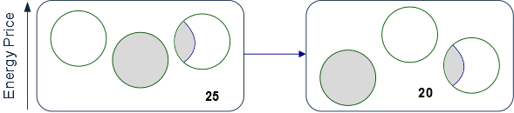
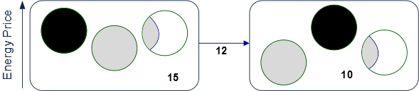
Reducing Idling Costs
Significant Idle power consumption
Significant Idle power consumption
We could de-activate data centers with no workload
Data center 1 activation
Data center 1 activation
Data center 2 de-activation
Data center 1 activation
State cost
State cost
State transition cost
Time
Reduced state costs
Reduced state costs
Sometimes idling might be better than deactivation
Local Optimal ≠ Global Optimal
This motivates an optimal state trajectory problem
Notes:
The idling overhead is significant, so electricity cost savings through WR alone are small. We must also turn off elastic load at data centers when it is not needed to handle workload. We call this resource pruning (RP). However, any overheads associated with turning on/off elastic load must also be modeled as transition costs in the optimal state trajectory problem.

Slide 13
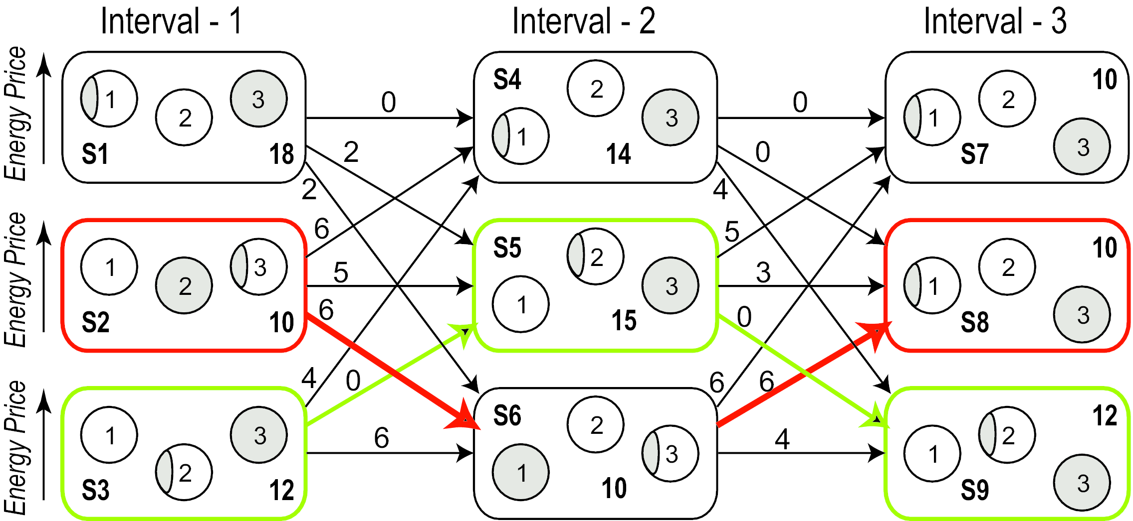
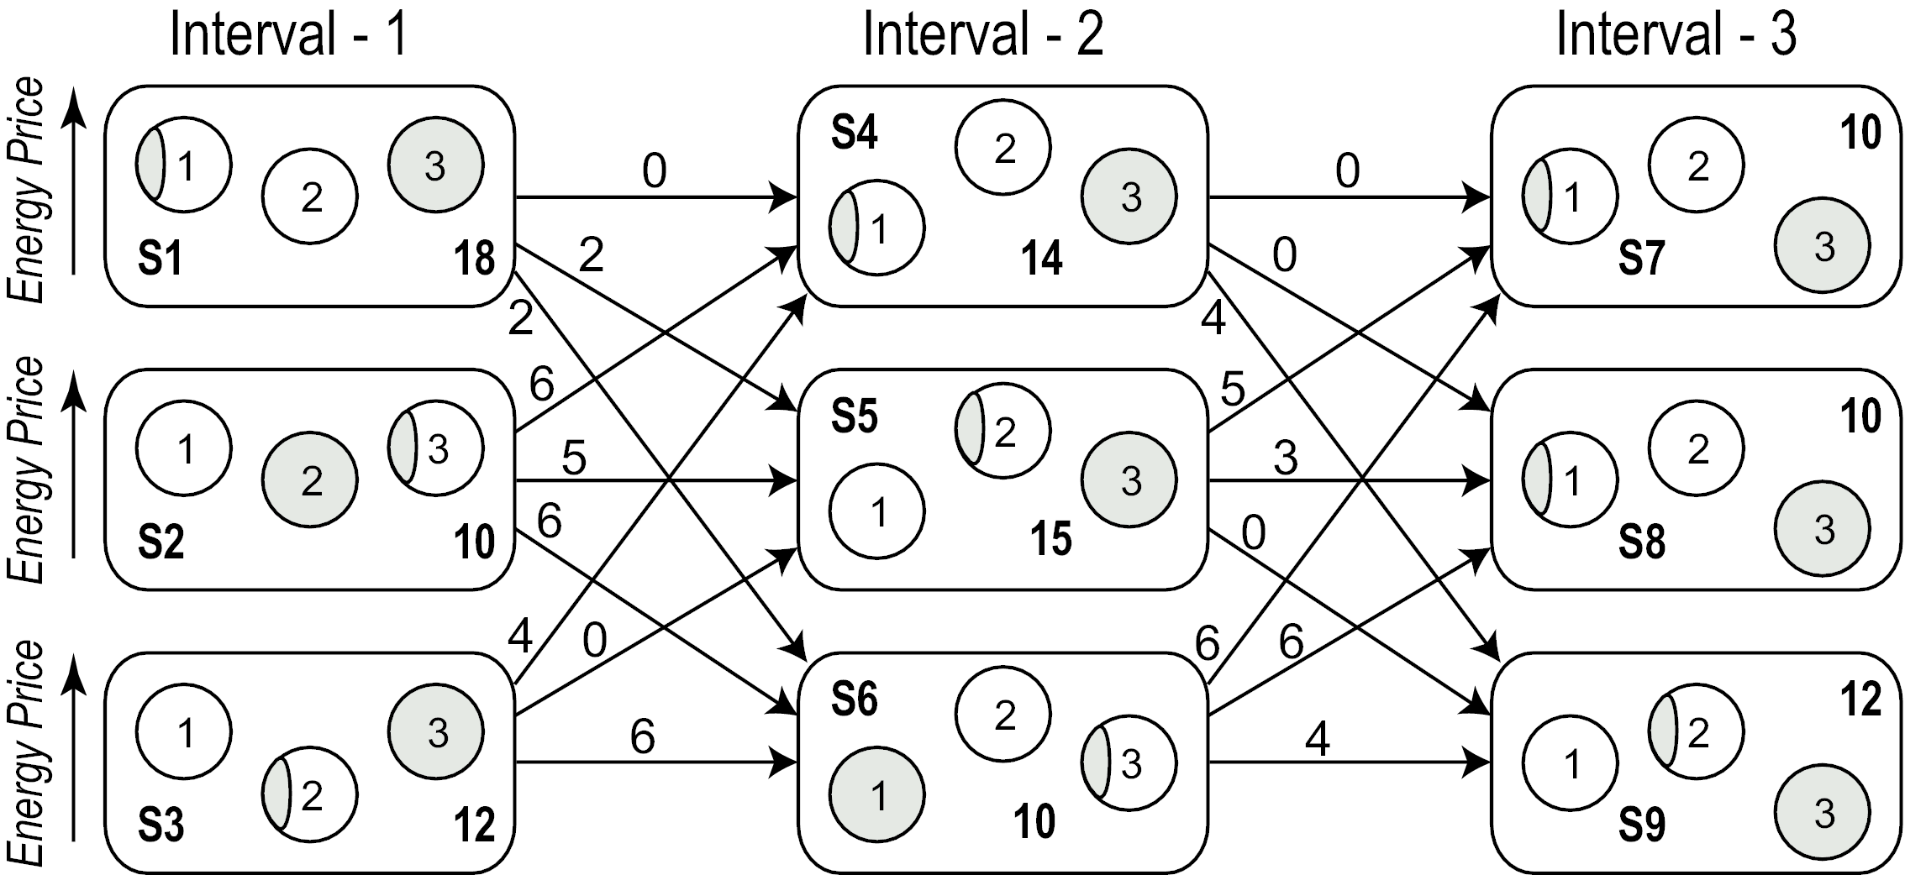
A Simple Example
Total cost:
Local optimal: 42
Global optimal: 39
Our work: RED-BL
Prior work: RED-CL [1, 2, 3]
Cheaper
Better
Qureshi et. al., Hotnets 08
Qureshi et. al., SIGCOMM 09
Rao et. al., Infocom 10

Slide 14

Optimization Formulation
Fraction of data center that is active
Workload assigned to data center i during interval j
0/1 variables: data center i is (de)activated in interval j
Unit price of electricity
0/1 variables: data center i is (de)activated in interval j
Data center i’s capacity
Activation/deactivation energy
Sum over all intervals
Sum over all data centers
State energy
Subject to several constraints (please see the thesis)
Notes:
Give the objective function and the constraints

Slide 15
Experimental Setup
Workload from 3 popular Facebook apps
Electricity prices from 33 US locations
Simulated a week-long deployment plan
Compared RED-BL against various algorithms
Notes:
To evaluate RED-BL for geo-diverse data centers, we performed a simulation study which had the following setup. We used workload from three popular Facebook applications and normalized the cumulative workload. We verified that the characteristics of the cumulative workload resemble that of the workload for thousands of servers in a Google data center. We collected day-ahead electricity prices for 33 locations across the USA and simulated a weeklong deployment plan for the data centers situated at these locations. We compared RED-BL against a number of algorithms.

Slide 16


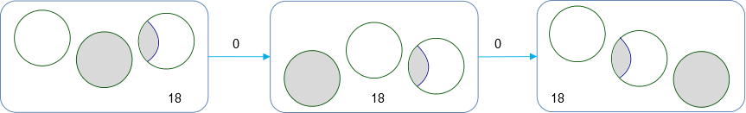
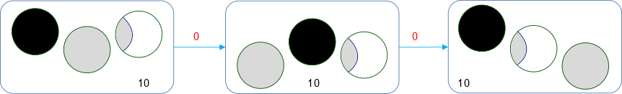
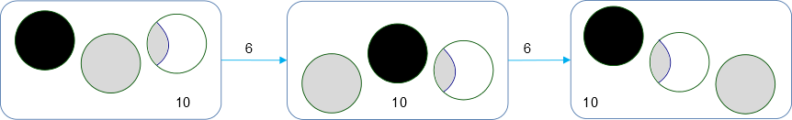
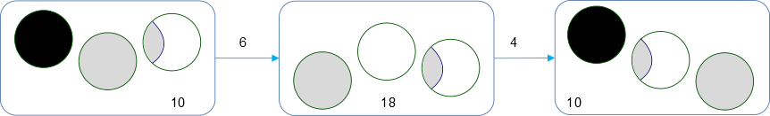
Algorithms
UNIFORM: Equally distribute workload
STATIC_MIN: Least average price
LI: Local Optimal with Idling
LO: LI ignoring transition costs
LD: Local Optimal with Deactivation
LS: Local Optimal with Selection
Notes:
Let’s represent a deactivated data center using a dark circle and shading to represent the workload mapped to a data center. As a baseline, we used UNIFORM, which distributes workload equally amongst all data centers and does not deactivate any data centers. STATIC_MIN assumes one large data center at the location which has the least average price over the planning horizon and assigns all workload to it. LI/LO/LD/LS are greedy algorithms that distribute workload amongst the sites based on electricity price, in a “cheapest site first” policy. LI keeps sites with no workload idling. LO deactivates sites that are idle but does not factor the transition cost while calculating the total electricity cost of the solution. LD always deactivates idle sites, whereas LS picks the cheaper of the two choices: whether to deactivate an idle site or keep it idling.

Slide 17
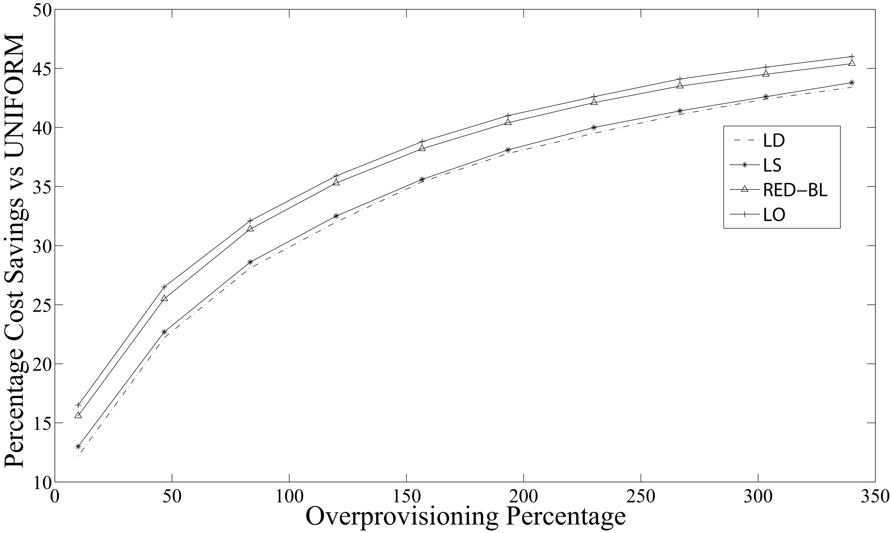
Cost Savings vs Over-provisioning
RED-BL close to ideal savings
Actual savings 10.35% lower
Falsely predicts high savings
50% over provisioning => 26% Savings

Slide 18
Electricity Cost vs Transition Cost
Notes:
As the magnitude of transition overheads compared to the cost of handling workload increases, we see that the percentage savings in electricity cost decrease for all algorithms. RED-BL achieves close to the ideal lower bound electricity cost savings, whereas the best variants of the greedy algorithm scale worse than RED-BL.

Slide 19
Granular (De)activation
Cost savings over full data center (de)activation
Opportunity for greater savings
Can only (de)activate entire data center
Can (de)activate half a data center
Notes:
Now, let’s see how RED-BL energy savings would improve if we allowed independent (de)activation of fixed size fractions of a data center. The extreme right handside of this graph represents the case where you can only (de)activate an entire data center at a time. This is 0% better than the standard “all or nothing” RED-BL, because it is the same thing. If we were able to (de)activate half a data center at a time, we could do about 2.5% better than standard RED-BL. If we were able to independently (de)activate 10% of a data center at a time, we could do 5% better than standard RED-BL. So, there is opportunity for greater savings with granular (de)activation and it has a linear trend.

Slide 20
DVFS Instead of Deactivation
Notes:
If, instead of shutting down an entire data center, we switch the servers into lower-power mode using DVFS techniques, the power savings might reduce, but the scheme would be more agile to workload variations. Here, we see that the power consumption drops linear as the power consumption is lowered with DVFS. If the server power consumption drops to 10% of the peak, the data center power consumption would be reduced by about 70%. Another data point is that if we put all “idle” servers at 50% power consumption, we achieve about 20% power reduction.

Slide 21
Reserve Margin
Notes:
To be prepared for some stray workload at data centers which we planned to deactivate, we’ll keep some servers on as reserve. As we increase the amount of serving capacity in reserve mode, the difference in power consumption will increase compared to the scenario where we did not keep any reserve capacity.
Exactly how much “stray” traffic we receive can’t be predicted. In this chart, the lower line shows the situation where we don’t receive any stray traffic at all. The power consumption in that case is purely due to servers idling. The upper line represents the situation where we need all the reserve capacity for handling stray traffic. The actual situation may be somewhere in between.

Slide 22
Summary – Case Study I
Significant cost savings are possible using RED-BL
Finer granularity of resource (de)activation increases savings
Low-power mode instead of shutdown also helps considerably
Cost savings decrease sharply with reserve margin

Slide 23

Case Study II Cellular Networks
15%-80% of total power consumption
TRXs
Power amplifiers
Air conditioning
BSC
Built-in power saving mode (RP)
MSC
BSC
Notes:
Give the motivating example to show that WR and RP can be used in cellular networks as well.

Slide 24
Does workload relocation help?
Power saving
Power saving
Power saving
Handing off some calls may enable greater power savings
Assume that power saving is enabled if upto two calls are being served

Slide 25
Is Workload Relocation Possible?

Slide 26
Drawing Parallels With Case Study I
Parameter | Cellular network | Data centers
Network resource
TRX
Servers
Workload relocation
Call hand off
Client redirect
Resource pruning
Server shutdown / idle / hibernate
BTS Power Saving
(De)activation overheads
Transition costs
Negligible
Notes:
Identify the similarities and differences between the two networks and observe how abstractions can be made.

Slide 27

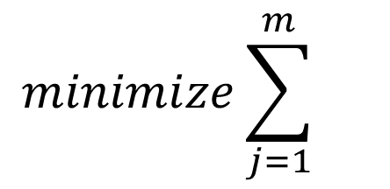
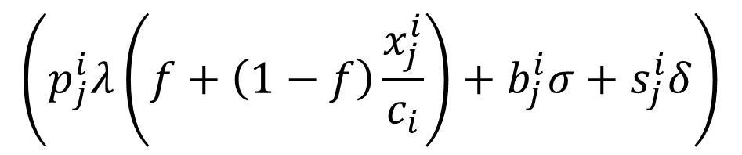




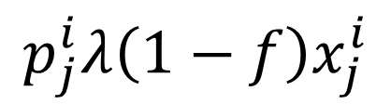
Optimization Formulation
Constant
Assume homogeneity
$$minimize\sum_{j=1}^{m}{}$$
$$\sum_{i=1}^{n}{}$$
$$\left(p_{j}^{i}λ\left(f+\left(1−f\right)\frac{x_{j}^{i}}{c_{i}}\right)+b_{j}^{i}σ+s_{j}^{i}δ\right)$$
$$p_{j}^{i}λ\left(f+\left(1−f\right)\frac{x_{j}^{i}}{c_{i}}\right)$$
$$p_{j}^{i}$$
$$p_{j}^{i}λ\left(1−f\right)x_{j}^{i}$$
$$c_{i}$$
$$e_{i}^{j}$$
Electricity price diversity may be ignored
Contributes a constant
(De)activation overheads negligible
Constant
Constant

Slide 28
Experimental Setup
Call volume traces for 2 days at 26 urban BTSs
Trace driven simulation:
Periodically obtain optimal call placement
Place BTSs with low-traffic in power-saving mode

Slide 29
BTS Power Consumption Models
Parameter | Value
 | Model 1 | Model 2 | Model 3
Idle Power (W) | 1425 | 2401.8 | 2341.5
Peak Power (W) | 1500 | 3887.5 | 2973.9
Power Saving per TRX (W) | 20 | 50 | 100

Slide 30
Results: Power-Saving Feature Only
Energy savings | Model 1 | Model 2 | Model 3
Percentage | 4.73% | 5.43% | 12.89%
Daily energy savings (kWh) | 43.28 | 109.68 | 217.12
Country-wide daily savings -31000 sites (MWh) | 51.6 | 130.77 | 258.87

Slide 31
Results: Power-Saving + Handoff Absolute Energy Savings (%)

Slide 32
Results: Power-Saving + Handoff Absolute Energy Savings (kWh)

Slide 33
Effect of Granular Deactivation
Granularity | Model 1 | Model 2 | Model 3
2-state | 5.38% | 6.29% | 14.94%
3-state | 6.81% | 7.73% | 18.62%
6-state | 8.70% | 9.65% | 23.37%

Slide 34
A Randomized Algorithm
Pick this
Nope
While there are BTSs in high-power mode
Pick a random BTS
For each call being handled by this BTS
Hand-over to a candidate BTS in low-power mode
Nope
Power saving
Yup!
Power saving

Slide 35
Performance of Heuristic Algorithm

Slide 36
Effect of Late Deactivation

Slide 37
Case Study II - Summary
Traffic has limited geo-flexibility compared to data centers
No geo-diversity in electricity prices
Mere activation of power savings feature supported in hardware helps
RED-BL achieves greater savings even for relatively conservative settings

Slide 38
Conclusions
Abstracted data centers and cellular networks
Similarity:
May be modeled as sets of geo-diverse resources
Contrasts:
Availability of geo-diversity in electricity prices
Geo-flexibility in traffic
Magnitude of transition costs

Slide 39
Conclusions
Mapping of workload to resources => Network state
Network state has bearing on electricity cost
Model electricity cost minimization as an optimal state trajectory problem
Showed the problem to be NP-Complete in the two case studies
Studied the sensitivity of the problem to various parameters

Slide 40
Future Work
Factor in the cost of change in latency
Factor in the cost of increase in call blocking probability
Implementation on software BTS
Consider expensive diesel-generated power in cellular BTSs
Adaptation to recent generations of cellular networks

Slide 41
Questions and Answers

Slide 42
List of Papers
Published:
A simulation study of GELS for Ethernet over WAN, GLOBECOM 2007
RED-BL: Energy solution for loading data centers, INFOCOM Mini-Conference, 2012
Electricity cost efficient workload mapping, INFOCOM Computer Communications Workshop, 2013
Low-Carb: Reducing energy consumption in operational cellular networks, GLOBECOM 2013
RED-BL: Evaluating dynamic right sizing for data centers, Computer Networks, vol. 72, 2014
Submitted:
Low-Carb: A practical scheme for improving energy efficiency in cellular networks

