Slide 1
Cutting Electricity Cost For Service Provider Networks
Muhammad Saqib Ilyas

Slide 2
Agenda
Background and motivation
Problem statement and formulation
Two case studies
Conclusions and future work

Slide 3










Background
Brought to you by…
Image source: darciec.com
Notes:
Change background details

Slide 4


Motivation
Annual DC Opex
Electricity Cost
$951 M
$143 M
Electricity Bill
15%
Electricity Bill
18%
Electricity Bill
50%
Electricity Cost 2012
$81 M
Significant electricity costs
Source: Greenberg et. al, CCR 2009
Source: datacenterknowledge.com
Source: GREENNETS

Slide 5
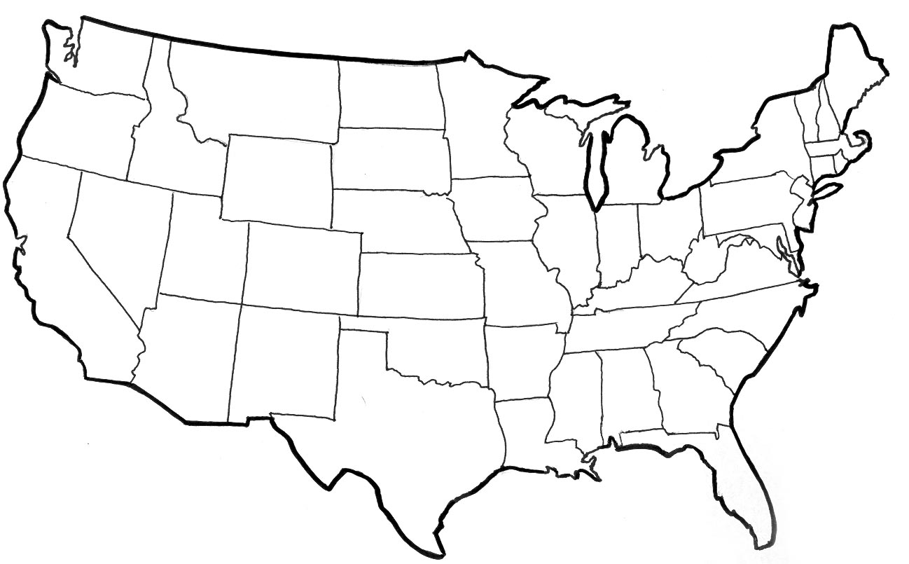



Example – Google Search
Electricity Price Diversity
User
Data center
$0.32
Arriving traffic is data center workload
Traffic is distributed amongst data centers
1
$0.13
$0.25
2
3
Sure. But, how?
How does this relate to data center electricity cost?
Where would you like to consume the most energy?

Slide 6
Data Center Energy Consumption
Energy: Accumulation of power consumption
Consume power where electricity is cheaper
Data center power consumption depends on:
Its workload capacity
Workload assigned to it
Fixed
Controllable

Slide 7
Example – Google Search
$0.32
Workload: 0
1
$0.13
Power consumption also 0?
$0.25
2
Workload: 0
3
Power consumption also 0?
Workload Relocation (WR): Cuts electricity costs

Slide 8
High Idling Power
Data centers are not energy proportional
Idle power 75%-85% of peak
Because even idling equipment consumes power
Opportunity:
Deactivate idle equipment to cut power
Source: Emerson, “Energy Logic: Reducing Data Center Power Consumption…”

Slide 9
High Idling Power: A remedy
$0.32
Workload: 0
1
$0.13
Deactivate some equipment
$0.25
2
Workload: 0
3
Deactivate some equipment
Resource Pruning (RP): Cuts electricity costs even further

Slide 10
This Thesis
Cut network electricity costs by:
Using cheaper electricity
Workload Relocation (WR)
Reducing idling power consumption
Resource Pruning (RP)
Towards a generic framework for electricity cost reduction
Possible application to different networks
We investigated:
Data Centers
Cellular networks

Slide 11
Case Study – I : Background
Data center operator
Geographically distributed data centers
Data center equipment
Workload handled by servers
Causes power consumption
IT Load | Non-IT Load
Servers | Lighting
Storage | Cooling
Network | Power distribution

Slide 12
Case Study – I : Background
Real
Power consumption (Watt)
Ideal
Workload
Electricity Cost =
Energy
x Electricity Price
Workload => Power
=>

Slide 13
Problem Model
Data Center 3 most expensive
Electricity price
Workload
1
2
3
Data Center 2 least expensive
Data Centers
Time
Consume most energy at cheapest location
Relocate Energy Demand to Cheaper Locations (RED-CL)

Slide 14
Problem Model
Data center deactivation
Interval - 1
Interval - 2
Interval - 3
1
2
2
Electricity Price
3
8
6
2
3
1
1
3
12
10
10
State cost higher than RED-CL
Transition cost
State cost higher than RED-CL
Total cost: 46
State cost higher than RED-CL
State Cost
Data center activation
Network State
Optimal State Trajectory Problem
Transition costs lower than RED-CL
RED-CL might not be optimal
Total cost: 42
1
2
2
3
4
3
0
1
2
1
3
14
12
12
Relocate Energy Demand to Better Locations (RED-BL)

Slide 15

Optimization Formulation
Fraction of data center that is active
Unit price of electricity
Workload
Data center capacity
Sum over all intervals
Sum over all data centers
State energy
Transition energy
Subject to several constraints (please see the thesis)
Notes:
Give the objective function and the constraints

Slide 16
Experimental Setup
Workload from 3 popular Facebook apps
Electricity prices from 33 US locations
Simulated a week-long deployment plan
Compared RED-BL against various algorithms
Notes:
To evaluate RED-BL for geo-diverse data centers, we performed a simulation study which had the following setup. We used workload from three popular Facebook applications and normalized the cumulative workload. We verified that the characteristics of the cumulative workload resemble that of the workload for thousands of servers in a Google data center. We collected day-ahead electricity prices for 33 locations across the USA and simulated a weeklong deployment plan for the data centers situated at these locations. We compared RED-BL against a number of algorithms.

Slide 17
Comparison Benchmarks
1
3
0
2
0
2
UNIFORM: Equally distribute workload
3
1
2
1
3
15
15
20
1
3
0
2
0
2
LI: Local Optimal with Idling
3
1
2
20
1
18
18
3
1
3
8
2
6
2
LD: Local Optimal with Deactivation
3
1
2
12
1
10
10
3
1
3
4
2
6
2
LS: Local Optimal with Selection
3
1
2
15
1
10
10
3

Slide 18
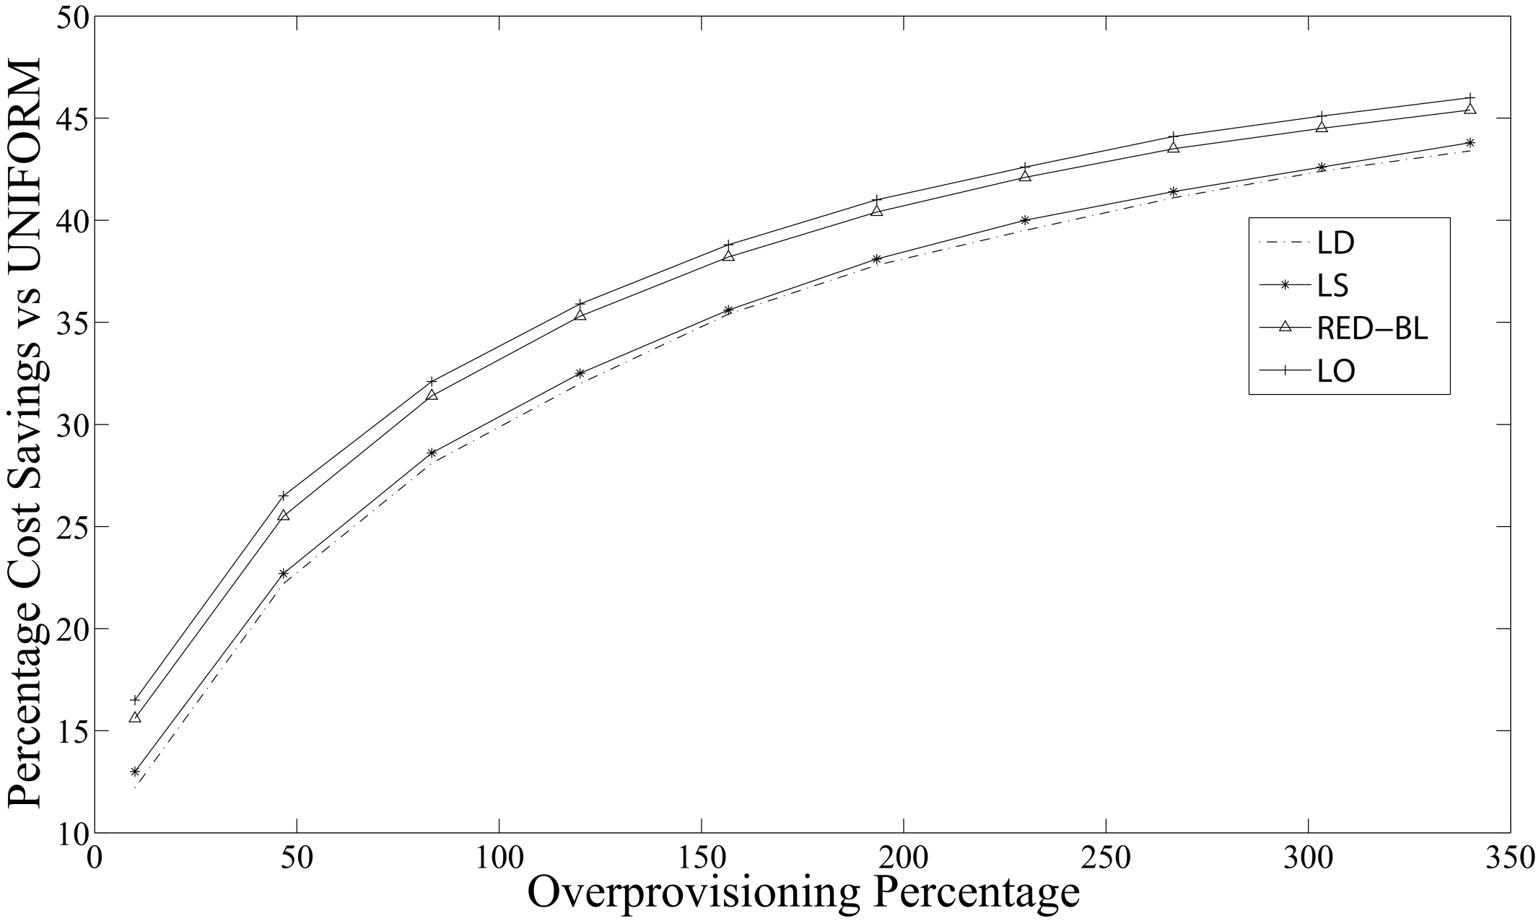
Cost Savings vs Over-provisioning
RED-BL close to ideal savings
Actual savings 10.35% lower
Falsely predicts high savings
50% over provisioning => 26% Savings

Slide 19
Electricity Cost vs Transition Cost
Gap widens rapidly
Near optimal savings
No transition costs
(De)activation overhead = energy cost
Notes:
As the magnitude of transition overheads compared to the cost of handling workload increases, we see that the percentage savings in electricity cost decrease for all algorithms. RED-BL achieves close to the ideal lower bound electricity cost savings, whereas the best variants of the greedy algorithm scale worse than RED-BL.

Slide 20
Granular (De)activation
Cost savings over full data center (de)activation
Opportunity for greater savings
Can only (de)activate entire data center
Can (de)activate half a data center
Notes:
Now, let’s see how RED-BL energy savings would improve if we allowed independent (de)activation of fixed size fractions of a data center. The extreme right handside of this graph represents the case where you can only (de)activate an entire data center at a time. This is 0% better than the standard “all or nothing” RED-BL, because it is the same thing. If we were able to (de)activate half a data center at a time, we could do about 2.5% better than standard RED-BL. If we were able to independently (de)activate 10% of a data center at a time, we could do 5% better than standard RED-BL. So, there is opportunity for greater savings with granular (de)activation and it has a linear trend.

Slide 21
DVFS Instead of Deactivation
Notes:
If, instead of shutting down an entire data center, we switch the servers into lower-power mode using DVFS techniques, the power savings might reduce, but the scheme would be more agile to workload variations. Here, we see that the power consumption drops linear as the power consumption is lowered with DVFS. If the server power consumption drops to 10% of the peak, the data center power consumption would be reduced by about 70%. Another data point is that if we put all “idle” servers at 50% power consumption, we achieve about 20% power reduction.

Slide 22
Reserve Margin
Notes:
To be prepared for some stray workload at data centers which we planned to deactivate, we’ll keep some servers on as reserve. As we increase the amount of serving capacity in reserve mode, the difference in power consumption will increase compared to the scenario where we did not keep any reserve capacity.
Exactly how much “stray” traffic we receive can’t be predicted. In this chart, the lower line shows the situation where we don’t receive any stray traffic at all. The power consumption in that case is purely due to servers idling. The upper line represents the situation where we need all the reserve capacity for handling stray traffic. The actual situation may be somewhere in between.

Slide 23
Summary – Case Study I
Significant cost savings are possible using RED-BL
Finer granularity of resource (de)activation increases savings
Low-power mode instead of shutdown also helps considerably
Cost savings decrease sharply with reserve margin
Can we apply this optimization “machinery” to other networks?

Slide 24

Case Study II Cellular Networks
15%-80% of total power consumption
TRXs
Power amplifiers
Air conditioning
BSC
Built-in, optional power saving mode => RP
MSC
BSC
Notes:
Give the motivating example to show that WR and RP can be used in cellular networks as well.

Slide 25
Power Consumption Model and RP
If traffic < 50%,
deactivate half TRXs
Power consumption (Watt)
Number of calls
Great! RP Works
But, what about WR?

Slide 26
Does workload relocation help?
Power saving
Power saving
Power saving
Handing off some calls may enable greater power savings
Assume that power saving is enabled if upto two calls are being served

Slide 27
Is Workload Relocation Possible?

Slide 28
Drawing Parallels With Case Study I
Parameter | Cellular network | Data centers
Network resource
TRX
Servers
Workload relocation
Call hand off
Client redirect
Resource pruning
Server shutdown / idle / hibernate
BTS Power Saving
(De)activation overheads
Transition costs
Negligible
Notes:
Identify the similarities and differences between the two networks and observe how abstractions can be made.

Slide 29

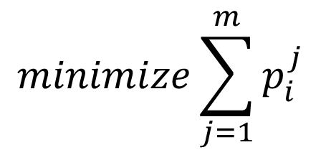
Optimization Formulation
$$minimize\sum_{j=1}^{m}{p_{i}^{j}}$$
Simple optimization formulation
For every interval, minimize # TRXs
NP-Hard

Slide 30
Complexity
Minimum cardinality subset that covers J
Modified Dominating Set
J
K
Callers
BTSs

Slide 31
Experimental Setup
Call volume traces for 2 days at 26 urban BTSs
Trace driven simulation:
Periodically obtain optimal call placement
Place BTSs with low-traffic in power-saving mode

Slide 32
BTS Power Consumption Models
Parameter | Value
 | Model 1 | Model 2 | Model 3
Idle Power (W) | 1425 | 2401.8 | 2341.5
Peak Power (W) | 1500 | 3887.5 | 2973.9
Power Saving per TRX (W) | 20 | 50 | 100

Slide 33
Results: Power-Saving Feature Only
Energy savings | Model 1 | Model 2 | Model 3
Percentage | 4.73% | 5.43% | 12.89%
Daily energy savings (kWh) | 43.28 | 109.68 | 217.12
Country-wide daily savings -31000 sites (MWh) | 51.6 | 130.77 | 258.87

Slide 34
Results: Power-Saving + Handoff Absolute Energy Savings (%)

Slide 35
Results: Power-Saving + Handoff Absolute Energy Savings (kWh)

Slide 36
Effect of Granular Deactivation
Granularity | Model 1 | Model 2 | Model 3
2-state | 5.38% | 6.29% | 14.94%
3-state | 6.81% | 7.73% | 18.62%
6-state | 8.70% | 9.65% | 23.37%

Slide 37
A Randomized Algorithm
Pick this
Nope
While there are BTSs in high-power mode
Pick a random BTS
For each call being handled by this BTS
Hand-over to a candidate BTS in low-power mode
Nope
Power saving
Yup!
Power saving

Slide 38
Performance of Heuristic Algorithm

Slide 39
Effect of Late Deactivation

Slide 40
Case Study II - Summary
Traffic has limited geo-flexibility compared to data centers
No geo-diversity in electricity prices
Mere activation of power savings feature supported in hardware helps
RED-BL achieves greater savings even for relatively conservative settings

Slide 41
Conclusions
Abstracted data centers and cellular networks
Similarity:
May be modeled as sets of geo-diverse resources
Contrasts:
Availability of geo-diversity in electricity prices
Geo-flexibility in traffic
Magnitude of transition costs

Slide 42
Conclusions
Mapping of workload to resources => Network state
Network state has bearing on electricity cost
Model electricity cost minimization as an optimal state trajectory problem
Showed the problem to be NP-Complete in the two case studies
Studied the sensitivity of the problem to various parameters

Slide 43
Future Work
Factor in other forms of transition costs:
Cost of change in latency
Cost of replication
Cost of increase in call blocking probability
Implementation on software BTS
Adaptation to recent generations of cellular networks
Consider expensive diesel-generated power in cellular BTSs

Slide 44
Questions and Answers

Slide 45
List of Papers
Published:
A simulation study of GELS for Ethernet over WAN, GLOBECOM 2007
RED-BL: Energy solution for loading data centers, INFOCOM Mini-Conference, 2012
Electricity cost efficient workload mapping, INFOCOM Computer Communications Workshop, 2013
Low-Carb: Reducing energy consumption in operational cellular networks, GLOBECOM 2013
RED-BL: Evaluating dynamic right sizing for data centers, Computer Networks, vol. 72, 2014
Submitted:
Low-Carb: A practical scheme for improving energy efficiency in cellular networks

