Slide 1
RED-BL

Slide 2
Overview
Background and motivation
Problem statement and formulation
Case studies
Conclusion

Slide 3

Introduction
Notes:
How much of this looks unfamiliar to you? So many services have become pervasive. Behind the scenes, Networks – of one type of another - , enable these services. What different types of networks, lurking behind these services, can we think of?

Slide 4









Different types of networks
Notes:
We’ve got Internet Cellular Network Operators that provide cellular telephony and data services. We’ve got Internet Service Providers that provide connectivity to the Internet. But there are other networks behind the scenes, too. For instance, web applications are hosted in large geo-distributed data centers run by data center operators like Amazon, Micoroft, Google and Facebook. Then, there are companies that replicate content across the globe with the objective of reducing client latency, such as Akamai, Edgecast and Internap. The bottom line is that different types of networks enable services that are critical to our personal and professional lives. One commonality amongst all these networks is that they are really expensive to deploy and maintain. In this thesis, we focus on cellular networks and geo-diverse data center networks.

Slide 5

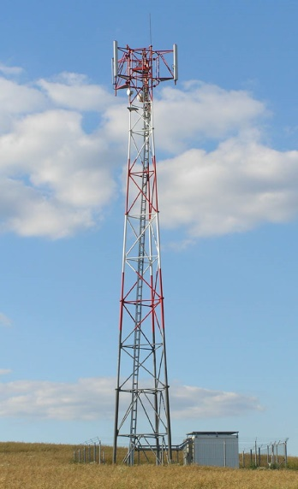
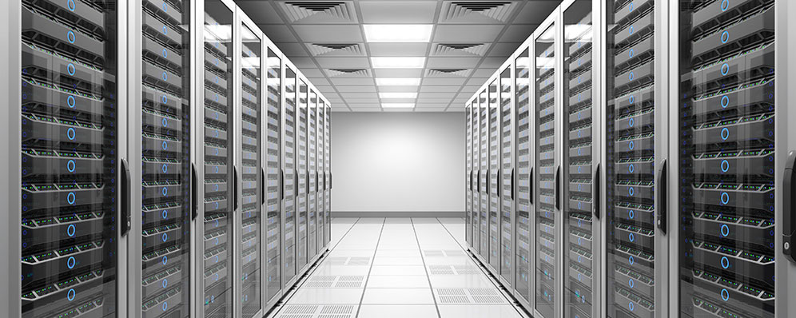

Some similarities
Network resources
Workload
Network sites
Notes:
If we look carefully, there are several similarities, and of course some differences between these networks. Let’s focus on geo-diverse data centers and cellular networks. In cellular networks, user traffic needs to be handled. Data centers also handle user traffic. Abstractly, we can refer to these as workload. Similarly, the workload handling logic is hosted in cell sites, whereas in the other scenario, user workload is handled in data centers. A “larger” network site can handle more traffic. A larger site, at the same time, would be more expensive and might consume more electrical power, too. So, if you want to serve more users, you would need to appropriately equip the network sites. The workload handling capacity of a cell site is determined by the number of TRXs installed at it. Similarly, the workload handling capacity of a data center is determined by the number of servers installed in it. We can generically refer to these elements of workload handling as “network resources”.
Naturally, these sites costs money, so let’s get a feel for the kind of numbers we’re looking at.

Slide 6

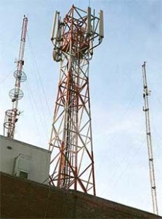
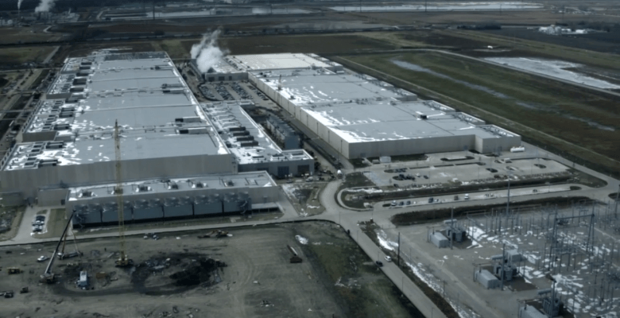
The capital cost
$ 550,000
$ 400 Million
Notes:
Especially when it comes to services on the Internet, we are used to a plethora of free services like web based email and online social networking, but deploying and running the networks that enable these services costs a significant amount of money. According to a study conducted in 2010, a typical cell site can cost as much as $ 550,000. In 2013, Google announced building a data center in Iowa at a cost of $400 Million. But that’s just the capital cost of establishing the network infrastructure. The recurring operations cost is significant, too.

Slide 7


The operations cost
2009 data center space lease: $50 Million
Data center electricity cost: 15%
Typical Pakistani Cellular operator:
$9.19 Million
Telecom Italia: $81 Million
Notes:
For instance, Facebook spent $50 Million on lease of its data centers’ space in the year 2009. Electricity cost is also a significant fraction, at about 15%, of data center operations cost. For a typical cellular operator with 7000 cell sites across Pakistan, if we estimate a 1.5 kWh per cell site and a cost of Rs. 10/kWh, the annual cost of electricity stands at $9.19 Million. For Telecom Italia, the electricity consumption in 2012 was 1.793 GWh, which at 0.04 Euros/kWh comes to an annual electricity cost of about $81 Million. The problem here is that whereas users are charged per usage, the power consumption is pretty inelastic while the workload is quite variable. Let’s see what the components of power consumption are for a couple of networks.

Slide 8
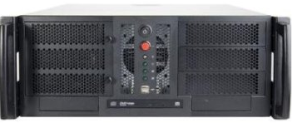
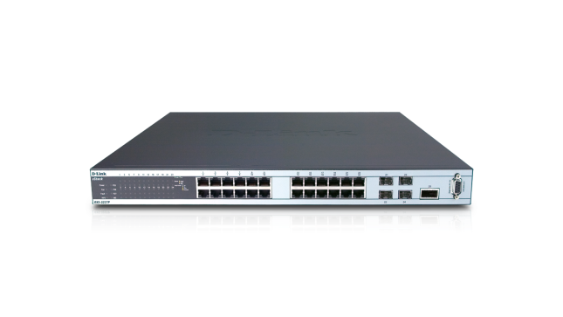


Case study I
Geo-distributed data centers
….
Notes:
Our first case study is a network of geo-distributed data centers. So, let’s see what is there inside a data center with regard to power consumption. A server, of course, is the basic entity. One server can serve only so much traffic, so we’ll need a number of servers. These are interconnected by means of a switch. Typically there is network attached storage that these servers share. A power chassis distributes power to all of this equipment and all of this is installed in a rack. A data center has many of these racks. The switches shown here, called top of rack (TOR) switches, provide interconnectivity between servers and storage within a rack. Servers and storage in different racks might need to interconnect, so TOR switches need to be interconnected.

Slide 9
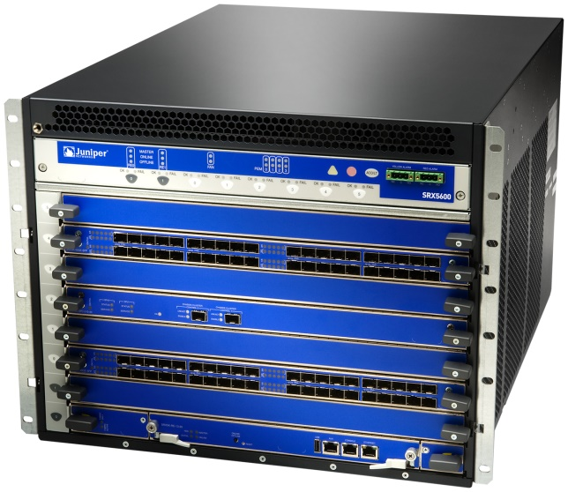
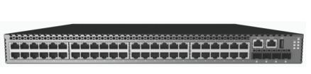

…
…
…
…
Notes:
A hierarchical interconnection is common. TOR switches in a number of racks are interconnected by means of an aggregation switch. Aggregation switches are interconnected by core switches which connect to the Internet through a border router. All of this as well as cooling and power distribution equipment goes inside a single data center. An operator typically has multiple data centers at different sites. By using DNS, IP routing, application layer load balancing or a combination thereof, a multi-data center operator directs each client request to a specific server in a particular data center.

Slide 10
Data center operations cost breakup
Cooling and power distribution -> 25%
Servers and storage -> 45%
Network -> 15%
Electricity costs -> 15%
Notes:
Now, if we put things into perspective in terms of amortized costs, the cooling and power distribution equipment accounts for 25% of the operations cost of a data center. Server and storage amortized costs account for 45%, whereas network equipment, links and transit costs make up another 15%. Last but not the least, electricity costs account for 15% of the operations cost.

Slide 11
Data center power consumption model
Power consumption (Watt)
Average CPU utilization
Or workload
Notes:
It is well known that data center power consumption can be well approximated as an affine function of average CPU utilization. Since average CPU utilization is determined by the workload, we can label the x-axis as workload well.

Slide 12
Data center workload
Diurnal cycles
Peak is quite high compared to trough
Notes:
Another observation is that user traffic has diurnal cycles. It rises every morning to its peak before falling off to a much lower trough. Now let’s see what the picture looks like for another network: the cellular network

Slide 13

Cellular Network – Major Components
LEGEND
BSC
Mobile Station (MS)
MSC
Base Transceiver Station (BTS)
BSC
Base Station Controller
BSC
Mobile Switching Center
MSC
Account for 60-80% of total network power consumption [M. Marsan et, al. ICC 2009]
Notes:
Let’s see what a cellular network consists of. Of course, there are end user devices called mobile stations. These devices connect to the cellular network through cell sites also termed as BTSs. A BTSs job is radio signal transmission and reception. Several BTSs in geographic proximity are coordinated and controlled by a BSC. The BSC assigns radio frequencies to the BTSs. Several BSCs are interconnected through MSCs, which do call routing. It turns out that most of the power consumption in a cellular network takes place at BTSs. So, let’s dig deeper into the BTSs.

Slide 14
BTS components
Key BTS components in terms of power consumption:
Transceiver (TRX)
Power amplifier (PA)
Baseband unit (BBU)
Notes:
The key components of a BTS are TRXs, PAs and BBUs. The TRXs determine the traffic capacity as well as peak and idle power consumption of the BTS. Let’s look at what the power consumption of a BTS looks like.

Slide 15
BTS Power consumption model
Power consumption (Watt)
Traffic
For both of these networks, power consumption is an affine function of workload
Notes:
It turns out that BTS power consumption is also an affine function of customer traffic or workload. So, we may model the power consumption of both of these networks as an affine function of “workload”. Can we take this generalization any further?

Slide 16
Traffic (Workload)
Diurnal cycles
Peak is quite high compared to trough
Notes:
Cellular network traffic has diurnal cycles just like data center traffic does. Also, the peak is much higher than the trough. The network must be dimensioned according to the peak traffic.

Slide 17
Typical BTS Configuration
Capacity of 8*6*3 concurrent calls
So much capacity isn’t always needed
6 TRXs
6 TRXs
6 TRXs

Slide 18
Commonalities
Network sites: Data centers / BTSs
Sites consist of resources: Servers / TRXs
Resources determine:
Workload capacity
Peak / idle power consumption
Power consumption is an affine function of workload
Workload has diurnal cycles
Peak much higher than trough
Energy inefficiency

Slide 19
Lowering electricity cost
Reduce bill by using
Less electricity
Cheaper electricity
Energy Consumed (e) | 285 Million kWh
Unit Price (p) | $0.7
Total Bill = e x p | $200 Million
Notes:
Electricity cost is the product of unit price of electricity and the amount of electrical energy consumed. The latter is an accumulation or integration of the power consumption. So, we could reduce electricity consumption by using cheaper electricity or by reducing the amount of electricity consumed. Let’s see how we may do each of these one by one.

Slide 20
Lowering electricity usage
Hardware consolidation
May cut electricity consumption by upto 80% []
Upgrading to energy efficient hardware
Resource pruning
Notes:
We can save a lot of energy if we turn everything off, but that’s not a feasible solution because we are compromising completely on workload. Can we lower electricity consumption without compromising on workload?
Hardware virtualization allows us to consolidate hardware. For instance, applications hosted on two separate physical servers may often be run on two virtual machines on the same physical server. This reduces the power consumption significantly. This exploits the fact that applications may be statistical multiplexed. With high likelihood, the combined instantaneous workload for two applications would be much less than the sum of their peak workload. It has been reported that server consolidation may reduce the electricity consumption by as much as 80%.
Researchers in circuits, networks and computer architecture keep innovating to improve the energy efficiency of hardware. In order to reduce energy consumption, you could replace your existing hardware with equipment that is energy efficient. The drawback in this approach is that it requires capital investment.
There’s another approach, which we call resource pruning. We’ll talk about it in a short while.
So, what about using cheaper electricity to lower electricity cost?

Slide 21
Using cheaper electricity
Electricity price
1
2
3
Sites
Notes:
Suppose that the network operator has three network sites. These sites could be data centers or they could be cell towers or some other type of site depending on the type of network you consider. These sites are geographically distributed as they generally are. Let’s use circles spread horizontally to represent the sites. Electricity price exhibits geo-diversity, so let’s use the y-axis to indicate the electricity price. Now, the way to save electricity cost by using cheaper electricity is as follows. Network workload is known to have diurnal cycles with peak that has a short duration and much lower trough. So, when you have low workload, you wouldn’t need all of the sites. So, you assign workload preferably to the site with the cheapest electricity. If that site reaches capacity and you still have some more workload, you’ll assign it to the site with the next cheapest electricity. And so on and so forth. Since workload only peaks for a short duration, chances are you will be using relatively cheaper electricity for a significant fraction of time.
But the problem with this approach is that networks lack energy proportionality which diminishes the benefits of smartly distributing workload to save electricity cost. What does that mean?

Slide 22
Lack of energy proportionality
Our playground when using cheaper electricity
Real Network
Couldn’t do anything about this
Power consumption (Watt)
Ideal Network
Workload
Network power consumption is much higher than ideal except when workload peaks
Workload is much lower than peak most of the time
Networks are mostly under-utilized and have a high energy overhead compared to ideal
Energy inefficiency
Notes:
It turns out that networks such as cellular networks and geo-diverse data centers lack energy proportionality. As shown in this figure, the network power consumption is nearly independent of workload. Ideally, the network should consume zero power when there is zero workload. However, real life is far from ideal. So, as we assign workload to use cheaper electricity, we are playing with the limited swing available in the real network’s profile. We are reducing power consumed purely due to workload at sites with more expensive energy. We are not reducing the idle power consumption, which is quite significant.
Notice that if the network operated at a workload nearly equal to peak capacity, it doesn’t matter whether power consumption is “practical” or “ideal”. However, workload is quite variable and peaks for a short duration only, before falling to a much lower trough. To meet the “rush hour” demand, the network must be provisioned according to peak workload, but its capacity is under-utilized most of the time. Thus, the network power consumption is much higher than ideal. Ideally, the network should be completely energy proportional, i.e., instantaneous power consumption should follow the same pattern as the customer workload, but the swing in power consumption is quite limited. Due to the significant overhead in power consumption, we say that today’s networks are energy inefficient.

Slide 23
Desirable
Real Network
Power consumption (Watt)
Ideal Network
Workload
Notes:
So, realistically speaking, if the peak workload, and hence the peak power consumption remain fixed, we want to lower the y-intercept of the power consumption profile so that the network is as close to energy proportional as possible. This will lower the average power consumption of the network. Lowering of power consumption results in lowering of electricity cost.

Slide 24

Resource pruning
Turn equipment off when workload is low
Power consumption
Workload
Notes:
One way to achieve coarse grained energy proportionality is to turn off excess network equipment when the workload is low. As an analogy, in this picture, when there are two occupants in the room, you’ll need to turn on both lights, but when there is only one occupant, you can make do with just one light to save energy. We call this strategy, RP. By turning off some equipment, we are lowering the no-load power consumption, i.e., the y-intercept of the power consumption profile.
So, when there is no workload, you can keep all your network resources off, resulting in zero power consumption. As a matter of fact, the power consumption wouldn’t be zero when all resources are off because some equipment (IT or non IT) can’t ever be turned off. Anyway, when you get some workload, you can turn some of your resources on. You’ll have a power consumption profile as shown here and you’ll be operating at a low workload capacity. Later on, as workload rises, you can turn more resources on, resulting in increases workload capacity as well as higher idle and peak power consumption. Because each set of resources lacks energy proportionality, it has a non zero idle power consumption. So, when we turn on additional circuits to handle more workload, the idle power consumption increases. The slope of the line represents the power consumed per unit workload. We assume that all resources are identical and hence the slope of the power consumption profile does not change when more circuits are turned on.
Again, as workload increases even further, we can turn on even more resources which results in further increase in workload capacity as well as power consumption.
So, that was about reducing electricity consumption. How about saving electricity cost by using cheaper electricity?

Slide 25
A better strategy
Electricity price
1
2
3
Sites
Notes:
An improved way of cutting electricity cost while using cheaper electricity is to prune the resources that are presently not needed. So, first we assign workload to site number 2 while the other sites are pruned from the network. When site number 1 is needed, it is activated and workload is assigned to it. When site number 3 is also needed, it is activated and assigned workload.
Finer control over network resources may be available. That is, instead of activating or deactivating entire network sites, a subset thereof may be activated or deactivated. For instance, individual racks may be controlled independently, or each TRX may be controlled independently.
But there’s another problem. Electricity prices exhibit geo-temporal diversity. So, the relative merit of electricity prices keeps changing with time.

Slide 26
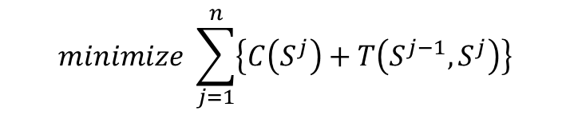
Problem formulation
$$minimize \sum_{j=1}^{n}{\left\{C\left(S^{j}\right)+T\left(S^{j−1},S^{j}\right)\right\}}$$
Joint workload relocation and resource pruning
Electricity price
1
2
3
Time intervals
Notes:
So, we’ll need to bring a time axis into play here. Electricity prices change only at discrete intervals, so we can consider the time axis to be slotted into time intervals. The sites are all placed horizontally in the same order for each time interval in the above figure. Now, we need to assign workload to each network site. This assignment can be done in a number of ways for each interval and due to geo diversity in electricity price, each assignment for a given interval can have a different electricity cost associated with it. In other words, we need to pick a state for all the network sites during each interval, where each state has a certain cost associated with it.
When going from one state to another in consecutive intervals, workload assigned to one site may need to be shifted over to another to consolidate the workload better to conserve power. We call this workload relocation
Due to workload relocation, there may also be some cost of transition between adjacent states. The optimal electricity cost, over the given time horizon, would correspond to finding the set of states for each interval such that the sum of state and transition costs is minimum.
This sort of optimization could be applied to any network as long as: the electricity cost for a network site during an interval is a convex function of the workload assigned to it and network sites or resources within them can be turned on/off during low workload.
Mathematically, it can be given as this optimization objective function. What constraints would this optimization be subject to?

Slide 27

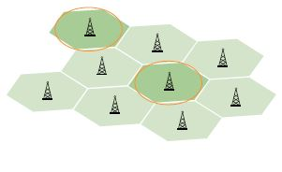

Constraints
To each cell its own
Honor workload capacity of resources
All workload must be handled
Notes:
Well, first off, there’s the capacity constraint. That is, each network site has a workload handling capacity, which must be respected. Then, we must also ensure that all workload that is offered to the network is assigned to one network site or another. A particular network may have other constraints specific to it. For instance, in case of cellular networks, a call may not be assigned to a far off cell site.
Now that we know the problem qualitatively, let’s see how we can mathematically model it.

Slide 28
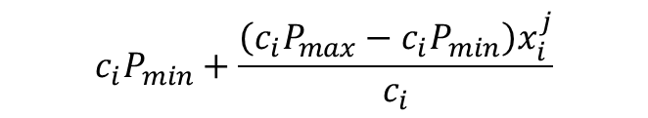

Mathematical model – State cost
P_{max}(P_{min}): Network’s max (min) power consumption
c_{i}: Normalized capacity of site i
c_{i}P_{max}(c_{i}P_{min}): Max (min) power consumption for site i
x_{i}^{j}: workload assigned to site i during interval j
Power consumption at site i during interval j
$${c_{i}P}_{min}+\frac{{\left(c_{i}P_{max}−c_{i}P_{min}\right)x}_{i}^{j}}{c_{i}}$$
Divide by Pmax to get normalized power consumption
Substitute f = P_{min}/P_{max}
$$fc_{i}+\left(1−f\right)x_{i}^{j}$$
Idling power
Workload dependent power
Notes:
This model relates to the cost of state in the optimal state trajectory formulation. Let the power consumption of the entire network under peak workload be Pmax and that under no load be Pmin. Let the workload capacity of network site i normalized over the peak expected workload be ci. Since a site’s power consumption increases linearly with workload, each site has a contribution ciPmax to the network’s peak power consumption and similarly for the idle power consumption. If a fraction of workload xij is assigned to site i during interval j, then the site’s power consumption will be given by the above formula, which is the equation of a straight line in the slope intercept form. We don’t need absolute numbers for power consumption, so divide this expression by Pmax and substitute Pmin/Pmax = f gives us the simplified expression here which has two parts. One is the factor that is workload dependent and the other is the idle power consumption.

Slide 29

Mathematical model – State cost
Power incurred only if site is active
l: sets of resources that can be independently turned on/off
p_{i}^{j} resource sets active at site i during interval j
Computational power depends on workload only
But idling power depends on number of active resource sets (p_{i}^{j})
$$fc_{i}\frac{p_{i}^{j}}{l}+\left(1−f\right)x_{i}^{j}$$
Notes:
The power consumption expression just derived applies to the network’s power consumption only if the site is active. So, we will multiply the expression with a term that ensures that an inactive site contributes nothing to the overall power consumption and an active site contributes to the overall power consumption according to the number of active sets of resources and the workload assigned to it. Let l be the number of resource sets that can be independently turned on/off at a site. Let pij be the number of resource sets that are presently active, then fraction pij/l of the maximum idling power for the site is contributed to the overall power consumption. Later on, we will show that the optimization problem will ensure that xij is non zero only if a site is on.
So, that covers the state costs. Now, let’s see how we may model the transition costs.

Slide 30
Transition costs
Any costs associated with shift in workload assignment to sites
Activation/deactivation overheads
Scenario specific costs
Will cover later in case studies
A normalized measure is useful instead of actual magnitudes
Notes:
Any costs that are incurred to shift workload between sites would be factored into transition costs. Examples include power overheads in turning on/off network resources. The type and magnitude of transition costs depend on the specific network. Therefore, we will talk about these in detail when we describe specific case studies.
Just as we normalized the network’s power consumption when modeling state costs, we will consider a normalized measure of transition costs. What this enables us to do is to see how the electricity cost saving changes when the transition costs vary as a fraction of the state costs.

Slide 31
Case study I Data centers: WR and RP
Workload relocation
Modify DNS load balancing
Change routing table entries
Resource pruning
Turn off/Sleep/Hibernate IT equipment
Some equipment takes very long to turn on
Example: Network
Notes:
So, let’s look at the situation from the terms that our thesis uses. An operator changes workload assignment to data centers by means of a change in DNS entries. Clients are known to violate DNS TTL values, and thus a data center may continue to receive some user traffic during an interval even though its workload was meant to be handled elsewhere. So, some servers might need to be kept online to handle any unexpected workload. The electricity cost incurred by these servers and storage can be considered a transition cost in our optimal state trajectory representation of the problem. Also, the operator may relocate workload by changing routing table entries. Again, this requires some often unpredictable convergence time. The electricity cost incurred while the routing tables converge can also be considered a transition cost.
The resource pruning strategies include turning off, hibernating or putting equipment in low-power mode. Some equipment may be turned off whereas others might not. Let’s classify equipment on this basis.

Slide 32
Elastic vs inelastic load
Servers
Storage
Power distribution
Cooling
Network
Some servers
Notes:
Some electric load in a data center may not be switched off and is called inelastic. For instance, power needs to remain available everywhere so that elastic load may be switched on as needed. If cooling were shut down, it would take on the order of an hour to bring the facility’s ambient temperature back to acceptable levels. So, it is not advisable to shut off cooling. If we turned off the network equipment and brought it back up again, it would take several minutes for the network to converge. Furthermore, the servers that remain online to handle unexpected workload would require the data center network equipment to be up and running. Other servers and associated server may be turned off, hibernated or put to sleep mode to save power. Note that these power saving strategies have diminishing power saving value. On the other hand, the time required to bring the resource back up improves. Thus, the transition cost associated with turn off are highest whereas that for low-power mode is lowest, hibernate being intermediate.

Slide 33
Data centers from this thesis’ lens
Network sites -> Data centers
Network resources -> IT equipment
State cost -> Electricity cost of operation
Transition cost -> WR + RP
Notes:
So, to summarize in terms that we use in our thesis, the network sites are data centers. Network resources that may be deactivated to save power are servers and storage. The cost of a state in our state transition problem formulation is the electricity cost of operating the data center. The transition costs are the overheads associated with workload relocation and resource pruning.

Slide 34
Experimental Setup
Workload from 3 popular Facebook apps
Electricity prices from 33 US locations
Simulated a week-long deployment plan
Compared RED-BL against various algorithms

Slide 35
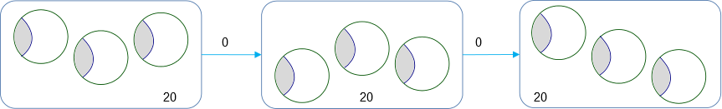
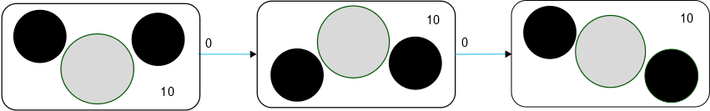
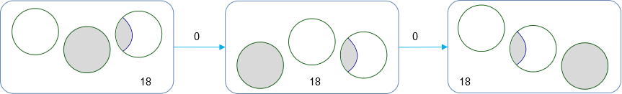
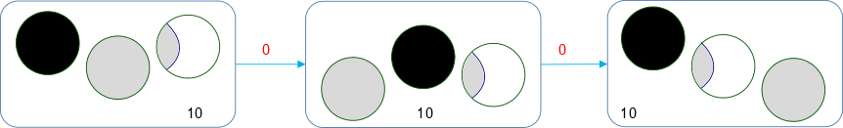
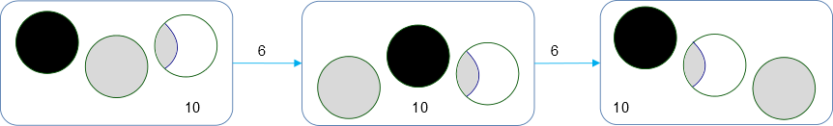
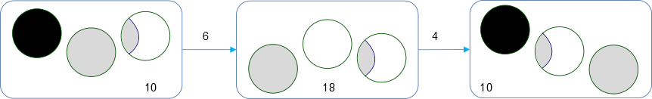
Algorithms
UNIFORM: Equally distribute workload
STATIC_MIN: Least average price
LI: Local Optimal with Idling
LO: LI ignoring transition costs
LD: Local Optimal with Deactivation
LS: Local Optimal with Selection

Slide 36
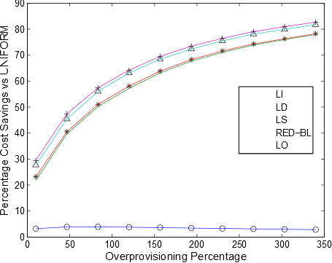
Cost savings vs extent of over-provisioning
RED-BL close to ideal savings
Falsely predicts high savings
Intuition:
over-provisioning
savings
Actual savings 19% lower
50% over provisioning => 50% Savings
Greedy only slightly better

Slide 37
Electricity cost vs transition cost
Local optimal cost scales linearly
RED-BL => Better scaling

Slide 38
Granular (de)activation
Cost savings over full data center (de)activation
Can only (de)activate entire data center
Opportunity for savings
Diminishing returns
Can (de)activate half a data center

Slide 39
Cost vs workload prediction error
97.5th percentile error 10% of peak workload
RED-BL prediction error smaller

Slide 40
Conclusions – Case Study I

Slide 41
Case Study II
Network site -> BTS
Network resources -> TRXs
Workload relocation -> Call handoff
Resource pruning -> TRX shutdown

Slide 42
Prior work
Shutdown BTSs [Marsan et. al., C. Peng et. al.]
Risk of user churn
Shutdown some frequencies [D. Tipper et. al.]
Similar to our approach

Slide 43
Motivating Example
Power saving
Power saving
Power saving
Handing off some calls may enable greater power savings
Assume that power saving is enabled if upto two calls are being served

Slide 44
Alternate Serving BTSs

Slide 45
A randomized algorithm
Pick this
Nope
While there are BTSs in high-power mode
Pick a random BTS
For each call being handled by this BTS
Hand-over to a candidate BTS in low-power mode
Nope
Power saving
Yup!
Power saving

Slide 46
Experimental setup
Call volume traces for 2 days at 26 urban BTSs
Three BTS models from prior work
Trace driven simulation:
Periodically obtain optimal call placement
Place BTSs with low-traffic in power-saving mode

Slide 47
Results: Power-Saving Feature Only
Energy savings | Model 1 | Model 2 | Model 3
Percentage | 4.73% | 5.43% | 12.89%
Daily savings (kWh) | 43.28 | 109.68 | 217.12

Slide 48
Results: Power-Saving + handoff Absolute energy savings

