Slide 1
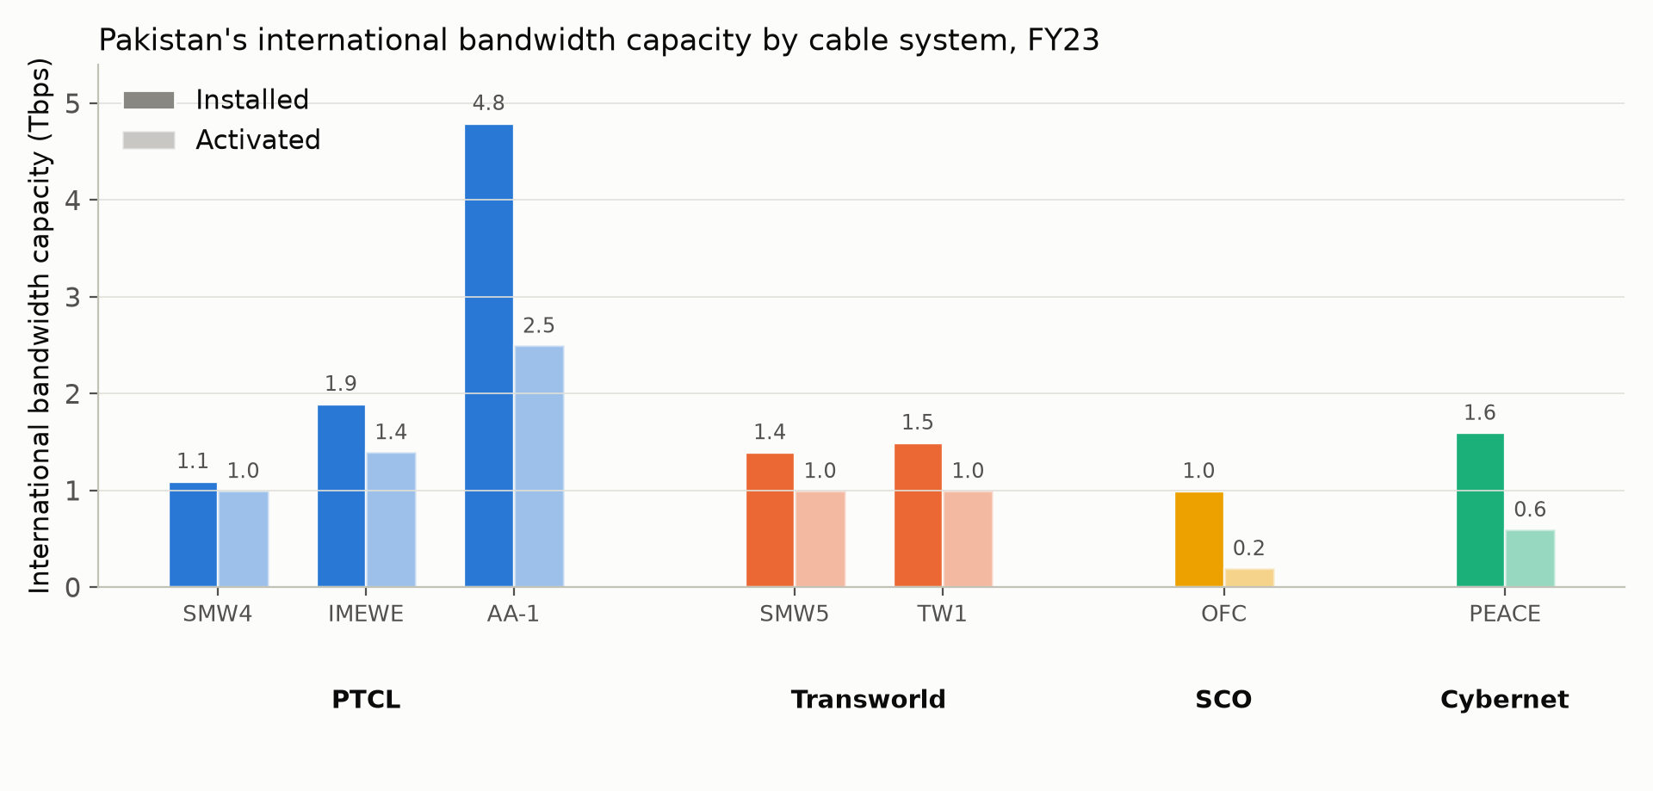
Introduction
150 million+ broadband users, carried mostly over seven submarine cables. Eight faults reported since 2024.
Two IXPs, PKIX (2017) and PIE Karachi (2024), claim latency drops from 100–144 ms to 1–31 ms.
Whether that actually happens has never been measured from a neutral vantage point.

