Slide 1
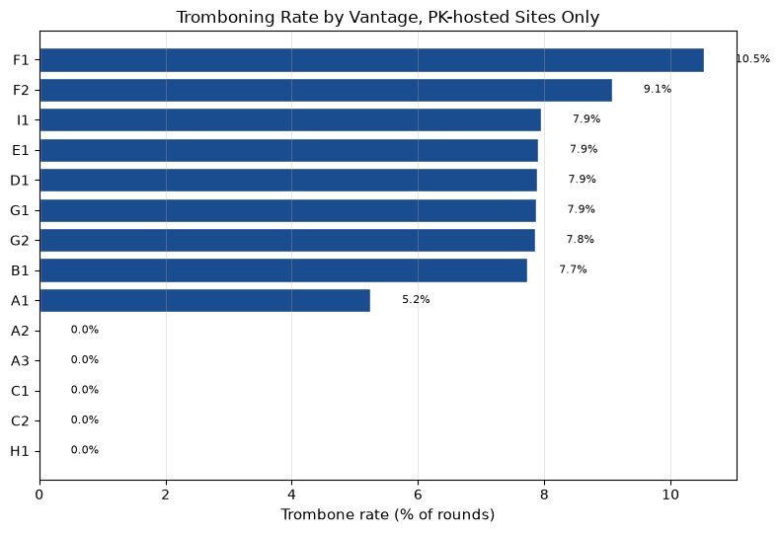
RQ3
Tromboning Rate:
A naive classifier flags 27.7% of requests as tromboned. Excluding Shaw Communications and Cogent IPs confirmed physically inside Pakistan drops this to 7.3%. Excluding foreign-labeled hops under 40 ms drops it to 7.5%. Both filters together give 5.5%, confirmed tromboning, well below the 13% reported for Brazil, 50% for Kenya, and 66.8% for intra-African paths.
5.5%
confirmed tromboning rate, PK-hosted sites, vs 13-66.8% elsewhere
Of 4,170 confirmed tromboned traces, 90.6% have an attributable domestic hand-off, carried mostly by ISP H (43.8%), F (22.8%), and G (12.1%); 89.7% of exits pass through Equinix Singapore. Tromboning concentrates almost entirely in Financial Services (58.3%) and Government Services (14.6%); every other sector sits at 1.4% or below.

