Slide 1
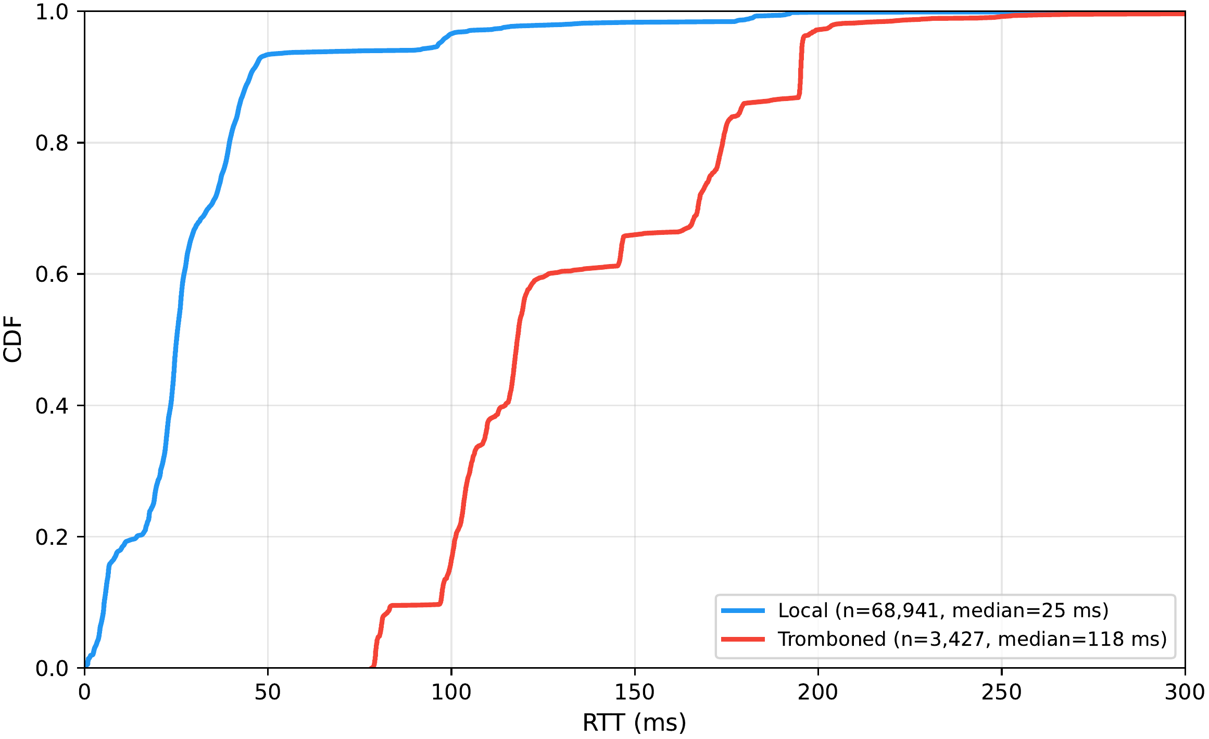
RQ3
Tromboning Cost:
Local traces to Pakistani-hosted sites run a median 25.1 ms; tromboned traces to the same class run 118.0 ms. This pools two different site populations, so it isn't a causal estimate. For the 4 sites reached both locally and via detour by different vantage points, avoiding the detour would cut RTT by 56%, a median saving of 75 ms, across 12 comparable pairs.
25.1 / 118.0 ms
local vs tromboned median RTT
-56% / -75 ms
median saving if the detour is avoided (4 comparable sites)
The rate is stable, not congestion-driven: 5.3-5.9% across hours of the day, 5.3-5.8% across days of the week, with no weekday-to-weekend difference.

