Slide 1
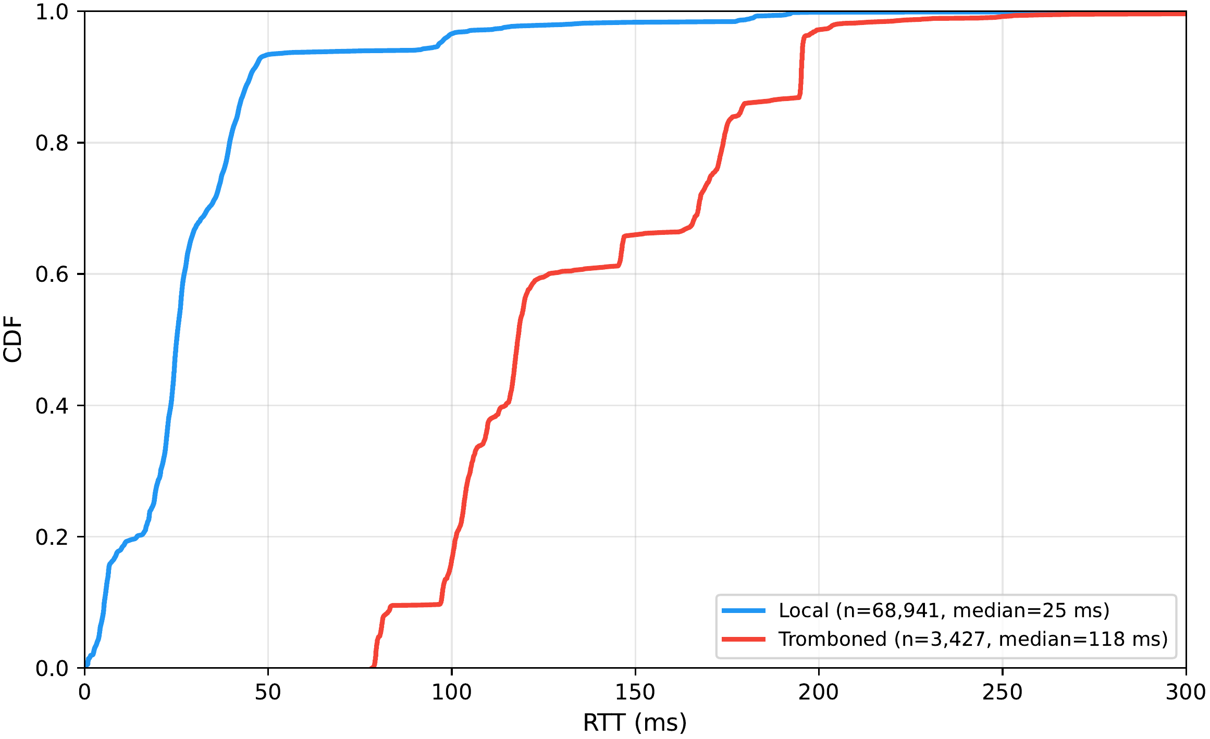
RQ3
Tromboning Cost:
The 56% average leans toward efulife.com, the site with the most tromboning pairs to average over.
efulife.com
43% faster, 8 pairs
networld.pk
88% faster, 2 pairs
kknetworks.com.pk
84% faster, 1 pair
zcomnetworks.com.pk
66% faster, 1 pair
Weighted by how many pairs each site contributes, the result is 56% faster, a median 75 ms saved.
25.1 / 118.0 ms
local vs tromboned median RTT
pooled across all sites, not a paired comparison
-56% / -75 ms
median saving if the detour is avoided (4 comparable sites)
same-site comparison, 4 sites, 12 tromboning pairs
The rate is stable, not congestion-driven: 5.3-5.9% across hours of the day, 5.3-5.8% across days of the week, with no weekday-to-weekend difference.

