Slide 1
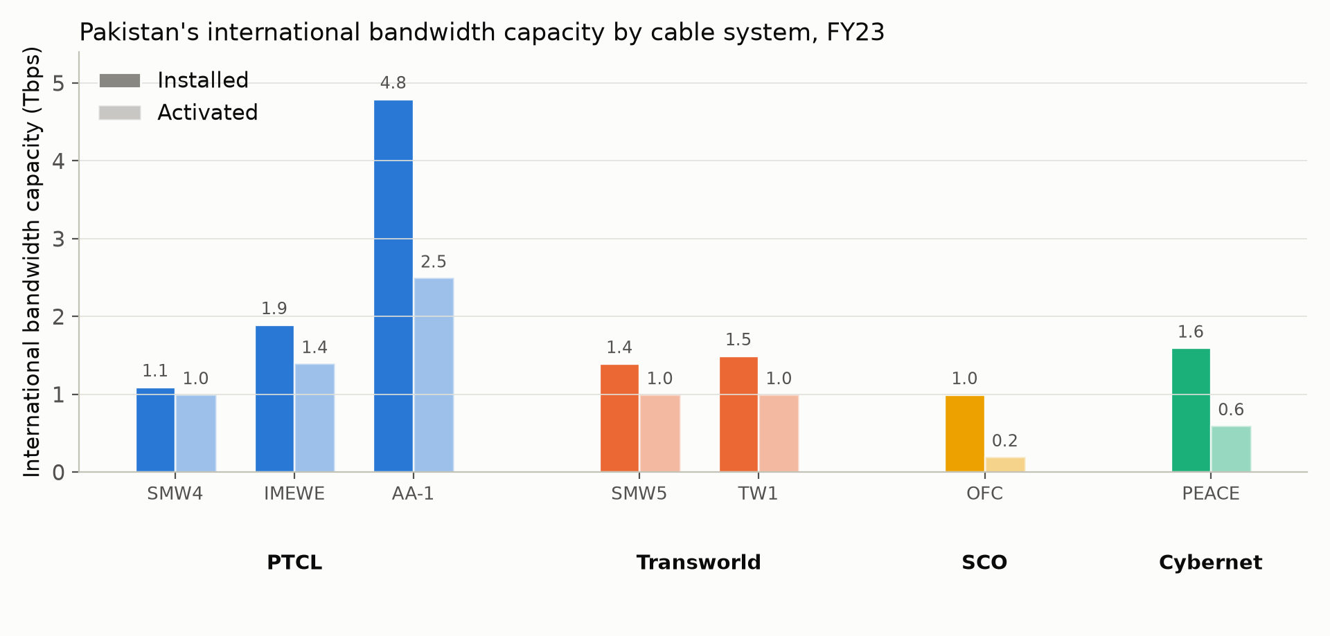
Background:
150M+ broadband users, 7 submarine cables
8 cable faults reported since 2024.
77 registered ISPs, 4 exchange points
PKIX (Lahore, Karachi, Islamabad) plus PIE Karachi on DE-CIX. Peering cuts inter-ISP latency from 100 to 144 ms down to 1 to 31 ms.
PREVIEW OF OUR FINDING
SMW5 cable fault, 2 Jul 2026
PTA confirmed the fault. RIPE Atlas anchor data shows the impact directly.
Sources: PTA "Pakistan Peering Roadshow" (Ahmed Bakht Baloch, Director Cybersecurity PTA, 12 May 2026) · PTA "List of Operators" (pta.gov.pk, accessed 30 Aug 2026) · PACRA FY23 gateway capacity report · RIPE Atlas anchor mesh, 28 Jun–4 Jul 2026 (Exp 06.1.1)

