Slide 1
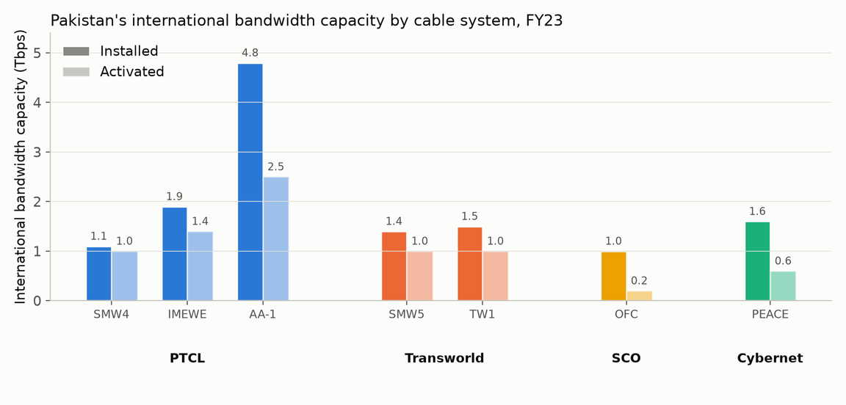
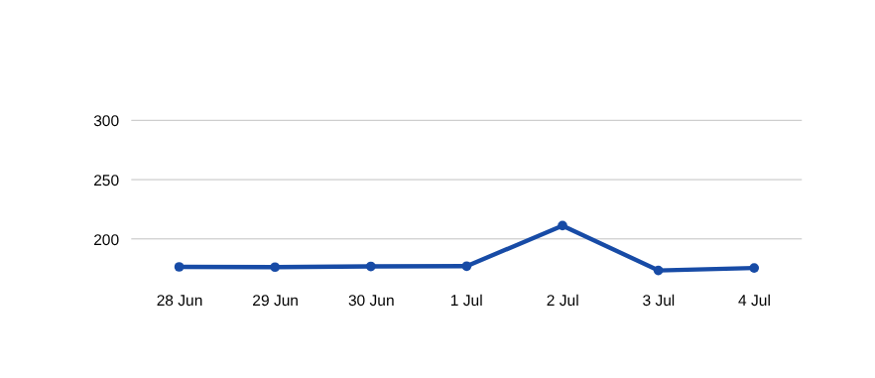
Background:
150M+ broadband users, 7 submarine cables
8 cable faults reported since 2024.
77 registered ISPs, 4 exchange points
PKIX (Lahore, Karachi, Islamabad) plus PIE Karachi under
DE-CIX.
SMW5 cable fault, 2 Jul 2026
PTA confirmed fault with RIPE Atlas anchor data showing the impact.
Sources: PTA "Pakistan Peering Roadshow" (Ahmed Bakht Baloch, Director Cybersecurity PTA, 12 May 2026) · PACRA FY23 gateway capacity report · RIPE Atlas anchor mesh, 28 Jun–4 Jul 2026 (Exp 06.1.1)

