Slide 1
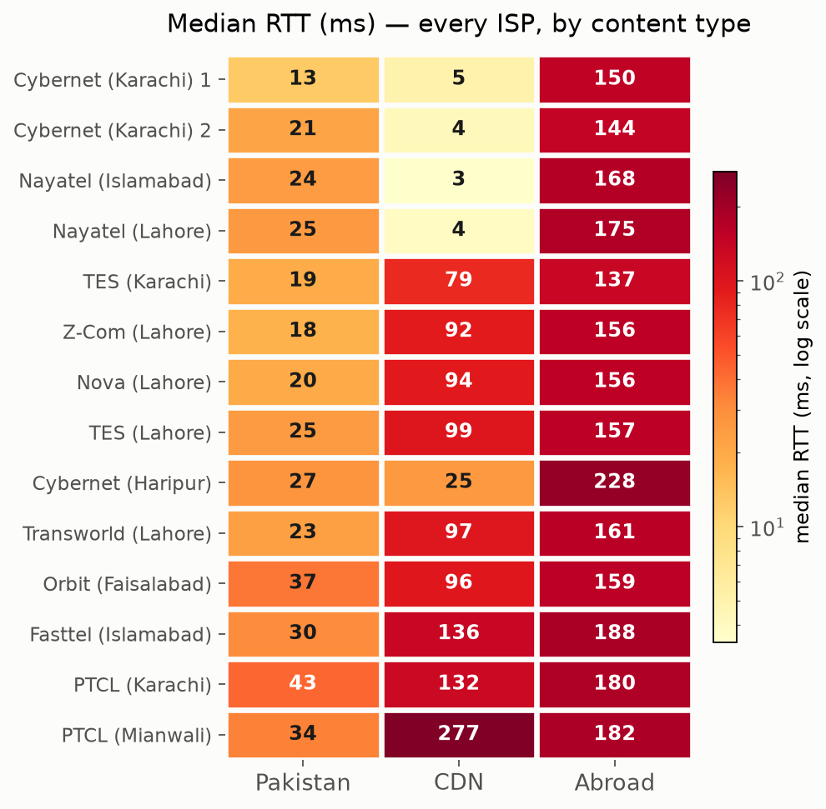
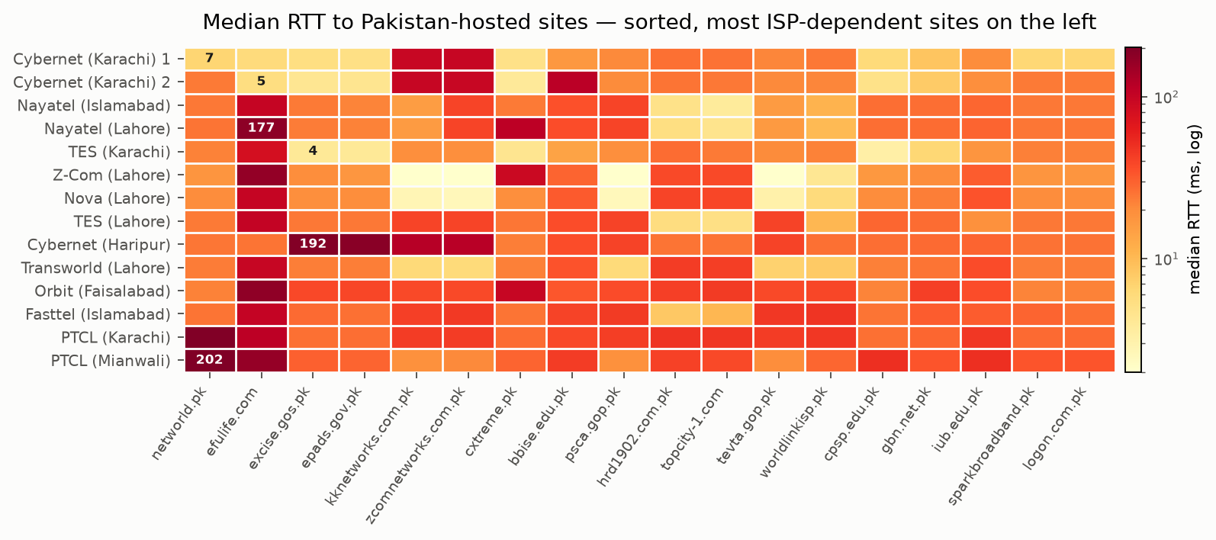
RTT EVERY PROBE, EVERY CONTENT TYPE
Where does ISP choice actually matter?
Median ping RTT, all 14 probes. Domestic and foreign content land in a narrow band for everyone — CDN content doesn't, and neither does the handful of Pakistani sites on the right.
EVERY ISP, BY CONTENT TYPE
PAKISTAN-HOSTED SITES, SORTED BY ISP DISAGREEMENT
THE PATTERN
Left grid: Pakistan and Abroad columns stay consistent for every ISP; CDN swings from 3 ms to 277 ms. Right grid: most Pakistani sites are uniform too — except a handful (efulife.com, networld.pk) where one ISP reaches them fast and everyone else pays 5–40× more.

