Slide 1
The Local Path Not Taken
Traffic Tromboning and Routing Inefficiency in Pakistan
Experiment 07 — status update

Slide 2
02 THE EXPERIMENT
Does Pakistani traffic actually stay in Pakistan?
PTCL, Transworld, and Cybernet are Pakistan's only licensed international gateway operators. Every other ISP buys connectivity from one of them — and since the gateway operators don't peer with each other either, traffic between two Pakistani networks can still be sent abroad and back. This is traffic tromboning.
We ran RIPE Atlas traceroutes and pings from every connected Pakistani probe to a fixed, 100-site sample for one week to answer three questions:
RQ1
Extent & attribution
How much Pakistani traffic trombones through foreign networks, and which ISPs / transit paths are responsible?
RQ2
Cost & stability
What is the RTT cost of tromboning — and is the penalty stable, or does it vary by time of day / week?
RQ3
Does a local path exist?
For sites that trombone, do routing verdicts flip between local and hairpinned — proving a domestic path exists?
02 / 08

Slide 3
03 DESIGN
Every connected probe, one frozen sample, seven days.
VANTAGE POINTS — 14 PROBES, 9 ISPs, 7 CITIES
PROTOCOL
Cybernet ×3
PTCL ×2
Nayatel ×2
TCP/80 Paris traceroute — hourly, path only (ICMP is heavily filtered)
ICMP ping ×3 — every 30 min, min-of-N RTT
RTT-physics detector — a reply faster than light-in-fibre allows proves the claimed location wrong (§3.1)
TES ×2
Transworld ×1
Nova ×1
Orbit ×1
Fasttel ×1
Zcom ×1
17 probes scheduled, 16 returned data; 2 more excluded (mislabelled ASN, 90% packet loss) — leaving the 14-probe analysis roster above. Both gateway-licensed operators plus 7 downstream ISPs, across Lahore, Karachi, Islamabad, Rawalpindi, Faisalabad, Mianwali and Haripur.
100 SITES — SAMPLED 40/40/20, PHYSICS-CORRECTED TO 37/40/23
Pakistan
37
CDN
40
Abroad
23
222,944
traceroute rows collected
445,749
ping rows collected
204,384 / 313,276
analysed after cleaning (14 probes)
03 / 08

Slide 4
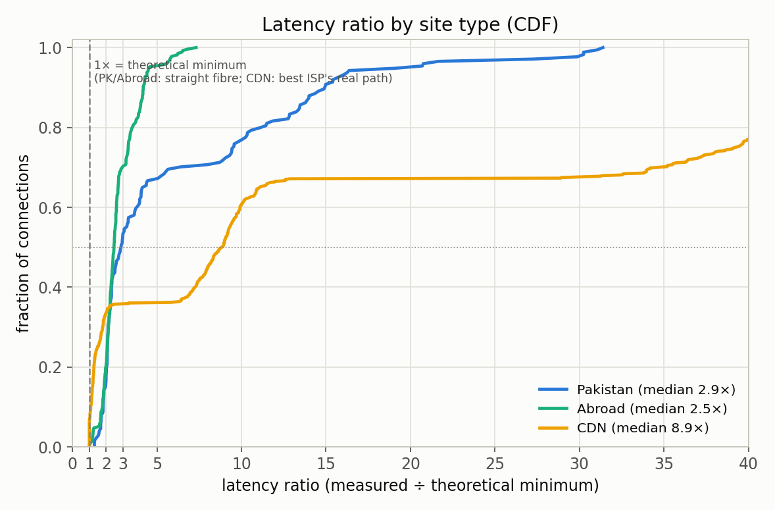
04 RESULT — THE LATENCY RATIO
International routing is near-perfect.
Domestic isn't.
Every RTT normalised by the speed-of-light minimum for that distance. 1× is physically optimal.
2.88×
Pakistan median — 24% of pairs exceed 10×, reaching 31×
2.46×
Abroad median — none beyond ~7×
27% / 23%
CDN is bimodal: ≪1.5× for the best-peered ISP, >40× for the worst
LATENCY RATIO = MEASURED RTT ÷ PHYSICS MINIMUM, CDF BY CLASS
IT ISN'T DISTANCE
A class-wise regression of RTT on geodesic distance: Abroad R²=0.55 (latency tracks how far the packet travels); Pakistan R²=0.04 (distance explains almost nothing). Domestic delay is a routing choice, not geography.
04 / 08

Slide 5
05 RESULT — WHO TROMBONED
15.1% of Pakistani traffic leaves Pakistan
to reach a Pakistani website.
TROMBONE RATE BY SOURCE ISP
85.6%
Financial Services trombone — state agricultural bank alone: 86%
Transworld
3.2%
Nayatel
9.7%
TES · Nova · Z-Com · Orbit
10–13%
Cybernet · Fasttel
22–25%
PTCL
30.6%
27.6%
Government Services — driven almost entirely by one federal housing site (89%)
SAME ISP, DIFFERENT CITY
PTCL: 46% (Mianwali) vs 27% (Karachi). Cybernet: 34% (Haripur) vs 11% (Karachi) — customers of the same operator get materially different routing by city.
<2%
Communications & Healthcare — sectors that run their own networks
05 / 08

Slide 6
06 RESULT — THE EXCHANGE
Traces that crossed PKIX's peering fabric, all week:
0
out of 222,944 traceroutes · PKIX Lahore + PIE Karachi
11,756 traces to Pakistani-hosted sites detoured through Singapore or the US and back instead — traffic the exchange exists to serve.
TWA 2,773
hairpins carried (of resolvable hand-offs)
PTCL 1,721
hairpins carried
Singapore 3,740
of resolvable exits (US 1,750, HK 167)
06 / 08

Slide 7
07 CASE STUDY
EFU Life: one domestic door — most ISPs reach it by leaving the country first.
efulife.com — its own ASN (AS141008), Karachi. Every ISP's traffic enters through the same Cybernet edge; the only difference is how far each one travels to get there.
Cybernet
(2 vantages)
Cybernet, direct → 5.4 ms · 1.0×
PTCL
GSL / Omantel
(Oman)
Cybernet edge
AS9541
EFU Life
AS141008 · Karachi
PTCL via Oman (GSL/Omantel) → 113.5 ms · 21×
Nova · Z-Com
· others
Transworld →
Equinix Singapore
Nova/Z-Com via Transworld → Singapore → 100–177 ms · 18–33×
NOT AN ISOLATED CASE
This is the tromboning thesis in one destination: no domestic peering path exists into Cybernet's network, so every other ISP's fallback is to leave Pakistan and re-enter at the same edge. Pattern-wide, 83% of all probe–site pairs that ever hairpin are also served domestically elsewhere in the week.
07 / 08

Slide 8
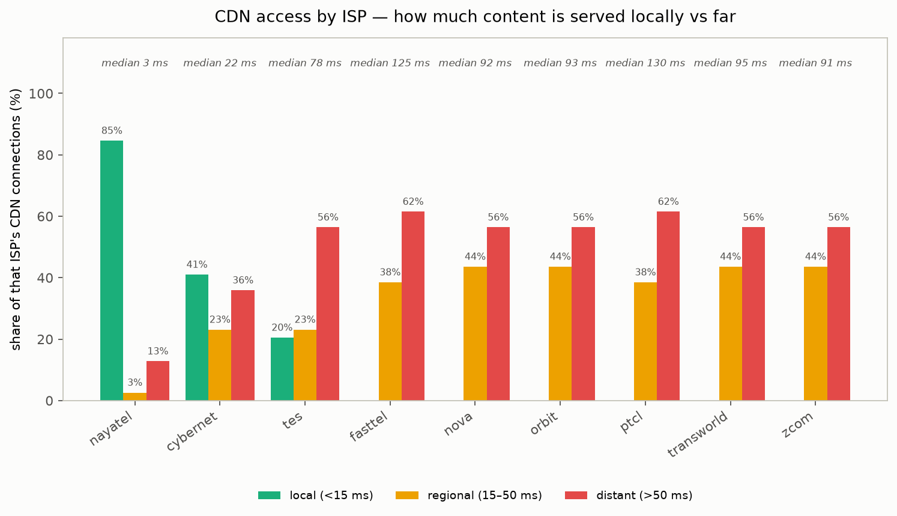
08 RESULT — THE CDN LOTTERY
Same website, same city — up to 12.7× slower
depending on your ISP.
85%
best-peered ISP reaches CDN content locally — 2.7 ms median
0%
the largest operator reaches essentially none locally — 91–130 ms median across the rest
12.7× – >40×
median–worst-quartile cost of not peering, same content
CDN ACCESS BY ISP: LOCAL / REGIONAL / DISTANT SHARE OF THE SERVING POP
08 / 08

