Slide 1

Analysis Sales
Eng./ Mariam Ashraf
5/2/2023

Slide 2
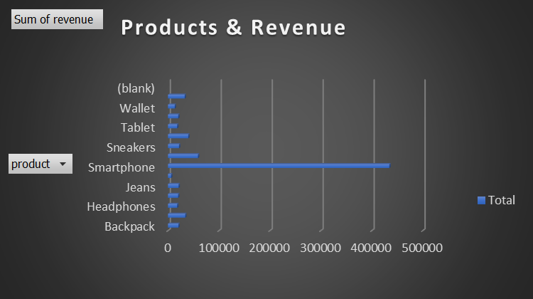
Observation
-The smartphone is the most product has the most product.
Row Labels | Sum of revenue
Backpack | 20400
Coat | 33800
Headphones | 18000
Hoodie | 19800
Jeans | 20650
Laptop | 6000
Smartphone | 434400
Smartwatch | 58800
Sneakers | 21600
Speaker | 39680
Tablet | 18000
T-Shirt | 20100
Wallet | 13200
Watch | 32700
Grand Total | 757130
- What was the total revenue generated by the company over the course of the year?
757130$
-Which product had the highest revenue? How much revenue did it generate?
Smartphone , 434400$

Slide 3
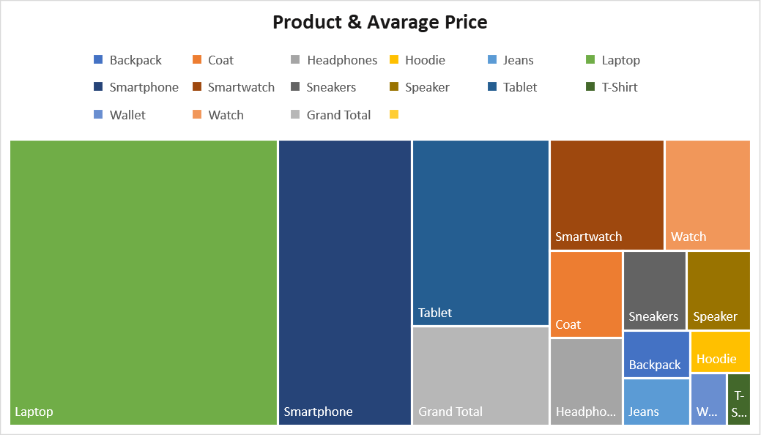
Observation
- The laptop the most expensive in all products.
What was the average price of a product sold by the company?
Row Labels | Average of price
Backpack | 50
Coat | 100
Headphones | 100
Hoodie | 40
Jeans | 50
Laptop | 1200
Smartphone | 600
Smartwatch | 200
Sneakers | 80
Speaker | 80
Tablet | 400
T-Shirt | 20
Wallet | 30
Watch | 150
Grand Total | 211.6939891

Slide 4
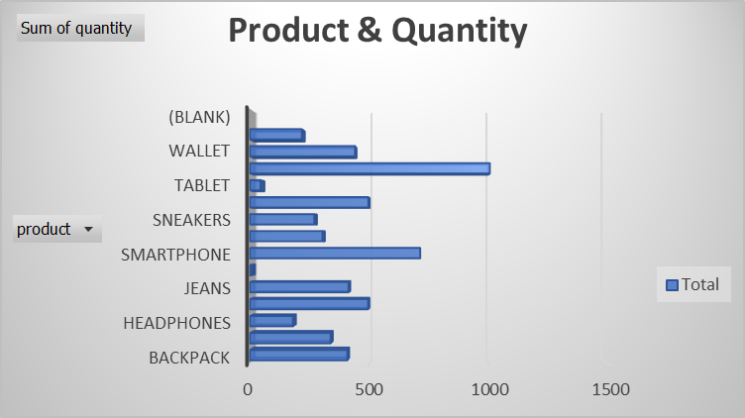
Observation
- The most product has the highest quantity is T-shirt.
Row Labels | Sum of quantity
Backpack | 408
Coat | 338
Headphones | 180
Hoodie | 495
Jeans | 413
Laptop | 5
Smartphone | 713
Smartwatch | 304
Sneakers | 270
Speaker | 496
Tablet | 45
T-Shirt | 1005
Wallet | 440
Watch | 218
Grand Total | 5330
-What was the total quantity of products sold by the company?
5530

Slide 5
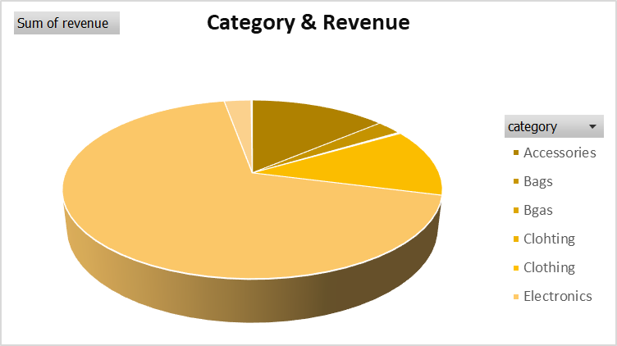
Observation
- The most Category has the most revenue is accessories.
Row Labels | Sum of revenue
Accessories | 104700
Bags | 19500
Bgas | 900
Clohting | 1200
Clothing | 93150
Electronics | 516080
Shoes | 20640
Shoeses | 960
Grand Total | 757130

Slide 6
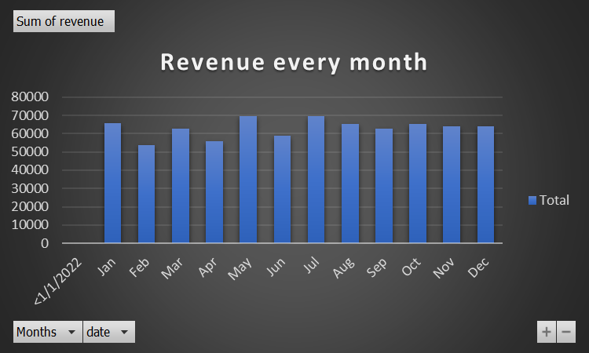
Revenue In Every month
Row Labels | Sum of revenue
<1/1/2022
Jan | 65800
Feb | 53740
Mar | 62560
Apr | 55800
May | 69510
Jun | 58660
Jul | 69510
Aug | 65260
Sep | 62910
Oct | 65260
Nov | 64110
Dec | 64010
Grand Total | 757130

Slide 7
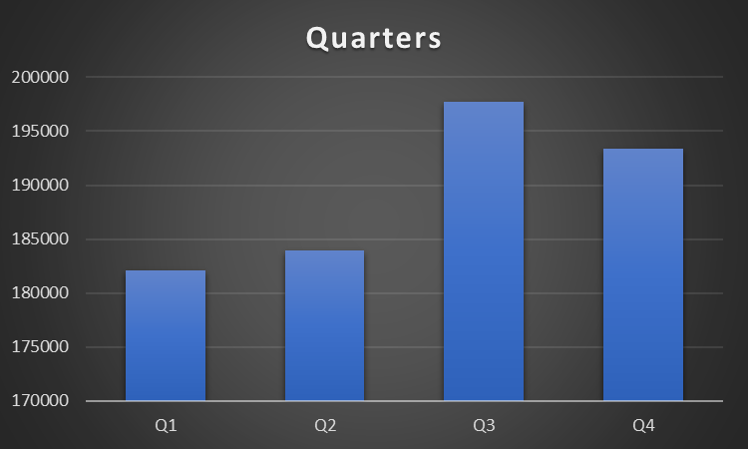
Revenue in every quarter
Quarter1 | Quarter2 | Quarter3 | Quarter4
182100 | 183970 | 197680 | 193380

