Slide 1
Identifying Fraudulent Credit Card Transaction Marjan Rezvani Ayub ali Sarker Maryam Akrami
Spring 2020

Slide 2
Outline:
Problem statement
Data (Exploratory data analysis – EDA)
Model development
Result discussion

Slide 3
Problem statement:
Using Card transaction data, we would like to develop a machine learning model to identify fraudulent transactions (i.e. Fraud Detection)

Slide 4
Data exploration
Numerical attributes:
availableMoney
creditLimit
…..
Categorical attributes:
merchantName
transactionType
…..
Number of records | Number of features (attributes, columns)
641,914 (~ 650k) | 29

Slide 5

Handling missing values:
We have few attributes which totally have missing values.
echoBuffer
merchantCity
merchantState
merchantZip
posOnPremises
recurringAuthInd
Since all the values for attributes above are missing, we can not do any impute to fill NAs. So, we dropped these attributes.
We have some attributes which have few missing values (e.g. acqCountry )
Handling missing values:
We have few options:
Totally drop those attributes from data.
Drop those records (remove rows where these attributes are missing)
Set the missing to some values.
For numerical attributes, we can set them to the mean/median.
For categorical attributes we can set them to the most frequent category.

Slide 6
Data
Basis statistical summary for numerical attributes
 | availableMoney | creditLimit | currentBalance | transactionAmount
count | 641914 | 641914 | 641914 | 641914
mean | 6652.828573 | 10697.21061 | 4044.382035 | 135.162497
std | 9227.132275 | 11460.35913 | 5945.510224 | 147.053302
min | -1244.93 | 250 | 0 | 0
25% | 1114.97 | 5000 | 502.4425 | 32.32
50% | 3578.165 | 7500 | 2151.86 | 85.8
75% | 8169.185 | 15000 | 5005.89 | 189.03
max | 50000 | 50000 | 47496.5 | 1825.25
Notes:
Table below shows some basic summary statistics for numerical features.

Slide 7
For categorical attributes: We can look at count (frequency) of each value.
count of unique values of acqCountry:
US 632303
MEX 2626
CAN 1870
PR 1202
count of unique values of cardPresent :
False 340453
True 301461
count of unique values of isFraud :
False 630612
True 11302
This is our response variable. It is clear that we have an unbalanced data. This could make a problem when we are training our classifier. Later, we will fix this issue.
count of unique values of transactionType :
PURCHASE 608685
ADDRESS_VERIFICATION 16478
REVERSAL 16162
Notes:
Table shows some of the categorical features.

Slide 8
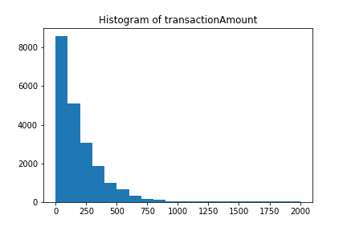
Data Analysis
Let’s dig more in some of the numerical attributes like transaction amount.
Do we observe any specific pattern in its distribution in the plot?
Few highlights:
It has right-skewed distribution.
Most of the transactions are concentrated around small values
(in the range of [0,100]) and we have few observations
for large value of transactions (amount >1000).
Statement above makes sense, since most of our daily purchases (like visiting a dinning, grocery) are in small amounts compared to some large transactions (visiting Coach, buying fancy stuff) which occur less frequent.
Notes:
we Plot a histogram of the processed amounts of each transaction, the transactionAmount column.

Slide 9
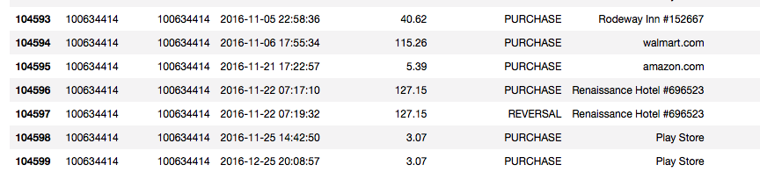
Data analysis
Identifying Duplicate transactions:
We might have two types of duplicate transactions:
Reversed transaction, where a purchase is followed by a reversal.
Multi-swipe, where a vendor accidentally charges a customer's card multiple times within a short time span.
Reversed-transactions:
Using ‘transactionType’ attribute in our data sets, we can filter out for ‘REVERSAL’ and look at the data.
Some statistics:
Total number of reversed transactions=16162 (~ 16k)
Dollar amount of reversed transactions=$2,242,915.1 (~ 2M)
Also for each reversed transaction, there should be one purchase transaction as well. So, estimate for the dollar amount should be around 2*2,242,915.1 (roughly $4million)
An example of reversed transaction

Slide 10
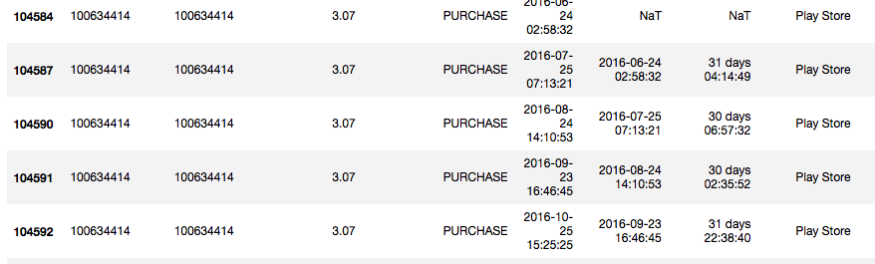
Duplicate transactions:
Multi-swipe
Approach: In a short time span(e.g 3 minutes), if we have transactions with same 'customerId’, 'accountNumber', 'transactionAmount','transactionType', 'merchantName’, we flag them as multi-swipe transactions.
Table above, we observe transactions which have same 'customerId’, 'accountNumber', 'transactionAmount','transactionType', 'merchantName’, but the frequency that they are happening is around 1 month. So, they are like subscription fee. (In this example, a customer is being charged $3.07 every month by Play Store.
So, to identify multi-swipe transactions, we apply another filter on the table above using time_difference less than 3 minutes.
Notes:
(Please refer to the notebook for the implementation)

Slide 11
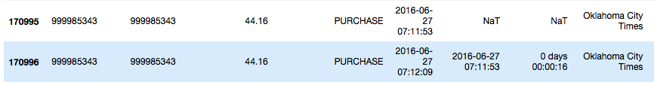
Duplicate transactions:
An example of multi-swipe transaction
The period time between two transactions is about 16 seconds.
Some statistics:
total number of multi swipe transaction is 6178 and total dollar amount is $886,953.58 (~ 900k)
Notes:
You can see that time between two transactions is about 16 seconds.

Slide 12
Model
In this problem (Fraud Detection), we are dealing with a classification problem. We can look into some supervised classification algorithms such as Logistic Regression, KNN, Random Forest and VotingClassifier to solve this problem.
Used for training model
Machine Learning
Algorithm
Training Data
70%
Data
Full Sample
Using for testing model performance
Finalized
Machine Learning
Algorithm
Test Data
30%

Slide 13
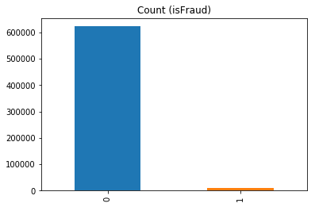
Data Preparation for Model Development
Categorial features(10)
Label encoder is used to convert numeric value
Datetime features(4)
Divide into several features(year, month, day, hours, min, sec)
After converting all features to numeric we have target values are
Not Fraud: 622954
Fraud: 10892
So, our data is imbalance. If we feed this data in our model, we will get incorrect result.

Slide 14
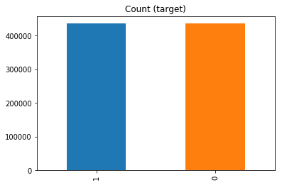
We did an experiment with our imbalanced data.
We feed imbalanced data with all features to XGBClassifier and we got accuracy score 98.25%
We feed same classifier with just only one feature and we got accuracy score 98.25%
Which is totally misleading accuracy score
So we resampled our data to make it balanced by
Undersample 'Not Fraud' class by 70%
Then oversample 'Fraud' class to Large class ('Not Fraud')
Now our balance dataset contains same number of target class and our data is balanced
Lastly scaled dataset by StandardScaler

Slide 15
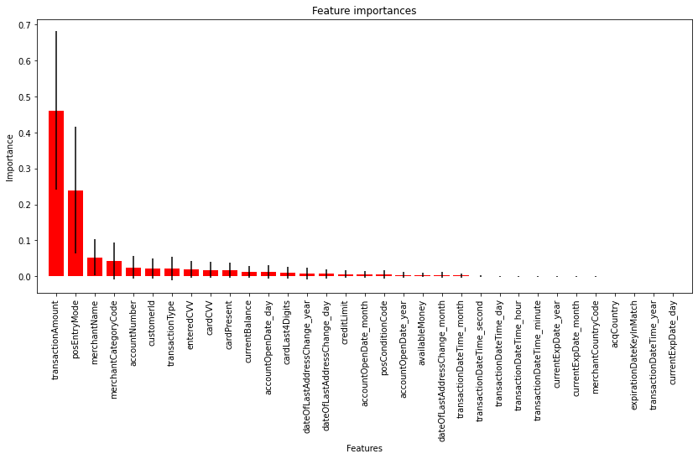
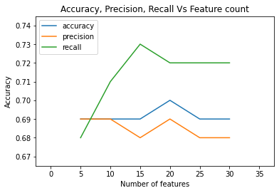
Feature Selection
We used RandomForestClassifier to find the most important features
Feed the model with 6 different sets of important features [5, 10, 15, 20, 25, 30]
Accuracy, precision and recall for each 6 sets are almost the same. but the set with 20 most important features has highest accuracy

Slide 16
20 Feature Importance :
transactionAmount (0.461284)
posEntryMode (0.238895)
merchantName (0.052225)
merchantCategoryCode (0.042508)
accountNumber (0.024675)
customerId (0.022490)
transactionType (0.021297)
enteredCVV (0.018811)
cardCVV (0.017843)
cardPresent (0.016107)
currentBalance (0.012183)
accountOpenDate_day (0.011294)
cardLast4Digits (0.010590)
dateOfLastAddressChange_year (0.007816)
dateOfLastAddressChange_day (0.007122)
creditLimit (0.006090)
accountOpenDate_month (0.005907)
posConditionCode (0.005774)
accountOpenDate_year (0.003972)
availableMoney (0.003922)

Slide 17
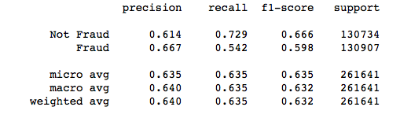
Model Logistic Regression
After tuning hyperparameter for logistic regression using gridsearchcv in Python
param_grids = {'penalty' : ['l1', 'l2'],
'C' : [0.01,0.1,1,10],
'solver' : ['liblinear'],
'fit_intercept':[True,False]}
Best Model parameters are as below:
{'C': 1, 'fit_intercept': True, 'penalty': 'l1', 'solver': 'liblinear’}

Slide 18
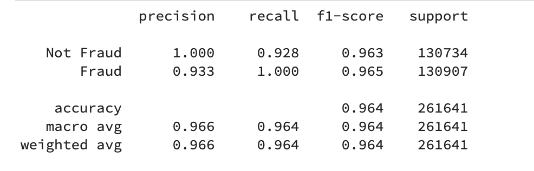
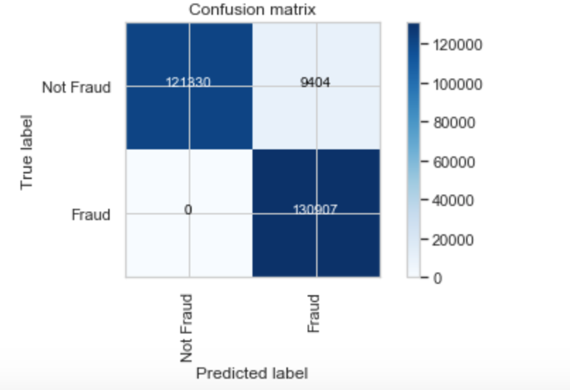
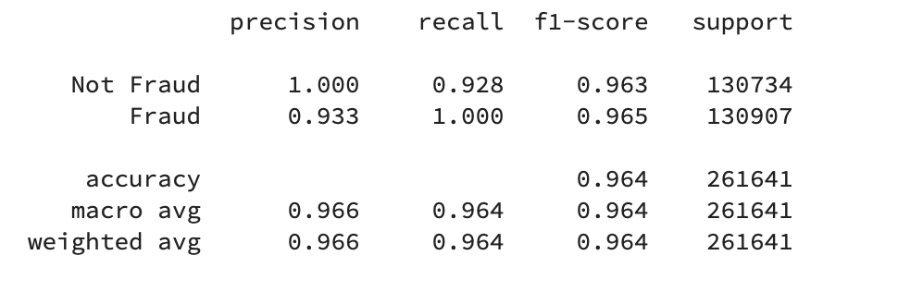
Model KNN
10-fold Cross validation score: 96%
Best score: 96.003%
Best parameters: {'leaf_size': 2, 'n_neighbors': 5}
Classification report with scaled features
Classification report with best model by GridSearch

Slide 19
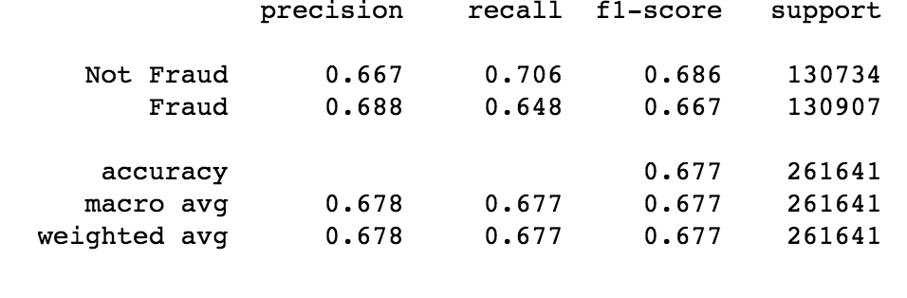
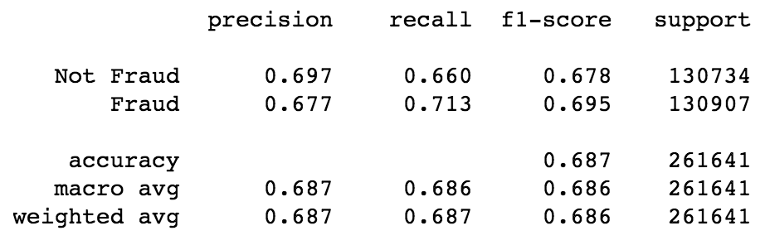
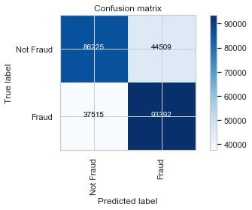
Model DecissionTreeClassifier
Classification report with scaled features
Classification report with best model by GridSearch
10-fold Cross validation score 67.70%
Best score: 68.72%
Best parameters: {'criterion': 'gini', 'max_depth': 6, 'max_features': 25, 'splitter': 'best'}
Confussion matrix with best model By GridSearch

Slide 20
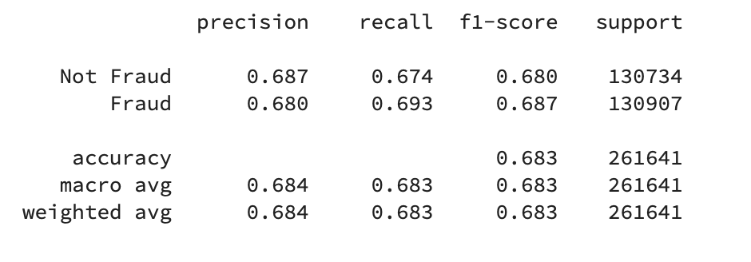
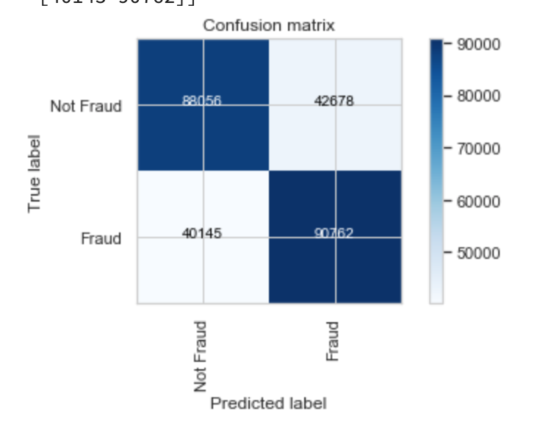

Model AdaBoost Classifier
10-fold Cross validation score : 68.2%
After tuning hyperparameter for AdaBoost Classifier using gridsearchcv in Python
param_grids = { 'n_estimators': [25,50] }
Best Model parameters are as below:
Best parameters: {'n_estimators': 50}
Best score: 0.6884610140839726
Classification report with scaled features

Slide 21
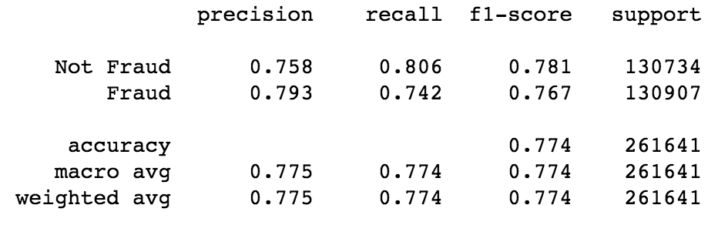
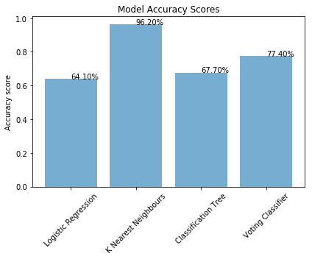
Model VotingClassifier
Our Voting classifier consist of three classifier
LogisticRegression
DecisionTreeClassifier
KNeighborsClassifier
VotingClassifier score 77.4 %
Why KNN is 96.2% ?
May be because of data. The way we resampled.

Slide 22
Summary
Since we have unbalanced data, we need to make it balanced. We have few options:
Down sample majority class.
Up sample minority class.
Before developing a model there are some steps that we need to take in order to prepare data:
Split data into train and test
Fill missing values
Scale numerical attributes
Encode categorical attributes
We tried some classifiers such as Logistic Regression, Tree and Random Forest, Knn, AdaBoost , Voting Classifier . Then we chose the one which has better performance and start to tune its hyperparameter to see if we can improve its performance further.
To evaluate a classifier, we used various metrics such as precision, recall, F1score and AUC to do our evaluation.

Slide 23
Result Discussion
 | Use test data (out of sample)
 | metric
Classifier | AUC | F1Score
Random Forest | 0.69 | 0.65
Logistic Regression | 0.63 | 0.59
Tree | 0.68 | 0.67
KNN | 0.96 | 0.96
Ada Boost | 0.68 | 0.68
Voting Classifier | 0.77 | 0.77
 | After hyperparameter tuning
Logistic Regression | metric
 | AUC | F1Score
before | 0.63 | 0.59
after | 0.66 | 0.63

Slide 24
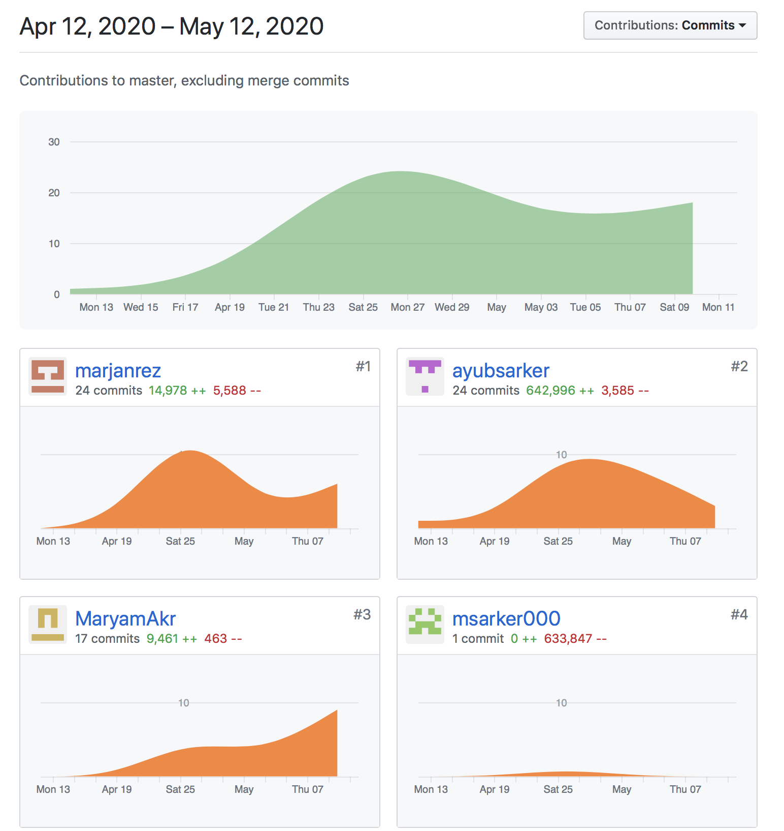
Github

Slide 25
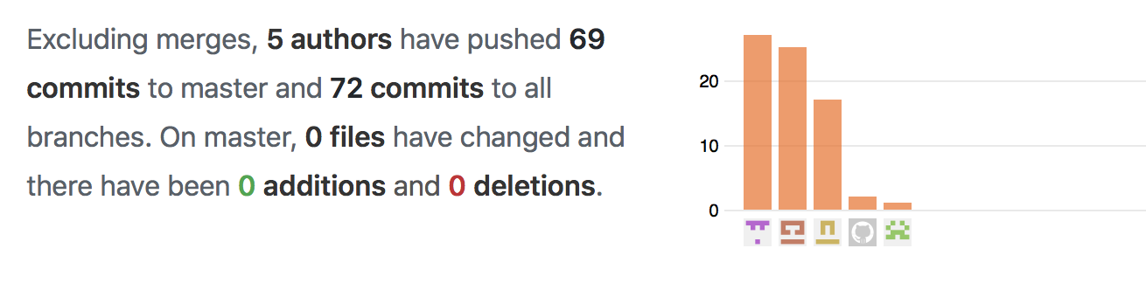
Git contribution
Ayub
maryam
marjan

Slide 26
Thank you

