Slide 1

A COMPARATIVE STUDY ON SCHOOLS ACROSS THE STATE OF TAMIL NADU & KARNATAKA
Mentor:
P V Subramanian
Great Learning
Chennai, TN
Presented By:
Dheeraj
Manas Sarmah
M Ali Raza

Slide 2
Agenda
Objective and Scope
Problem Statement
Analytical Approach
Data cleaning and preparation
Exploratory Data Analysis
Conclusion and Project Outcome
Model Selection and Validation

Slide 3
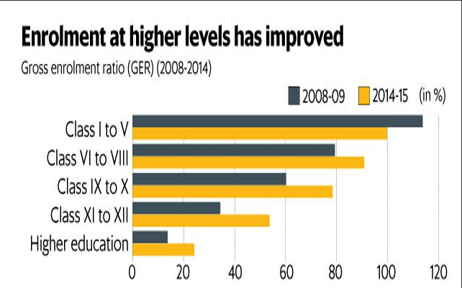
Introduction
India has one of the most complex education systems with more than 1.5 million schools with approximately 315 million students
An amendment has been introduced to the Right to Education (RTE) Act to permit detentions after class V and class VIII after a test, remedial education and a retest
Comparison of enrolment of students for different
classes over a period of 2 years

Slide 4
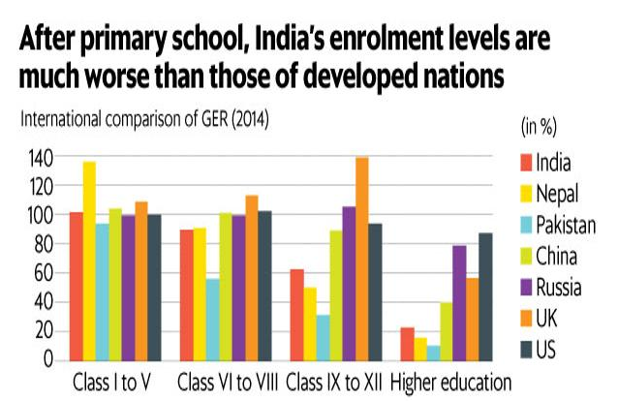
While universal enrolment has been achieved at the elementary level (class I-VIII), the enrolment consistently falls with successive levels of education.
India’s enrolment rate in primary education (class I-V) is comparable to that of developed countries. However, it falls behind these countries after class VI.
In higher education, India’s enrolment rate stands at 23%, as against about 87% in the US, 57% in the UK and 39% in China.

Slide 5
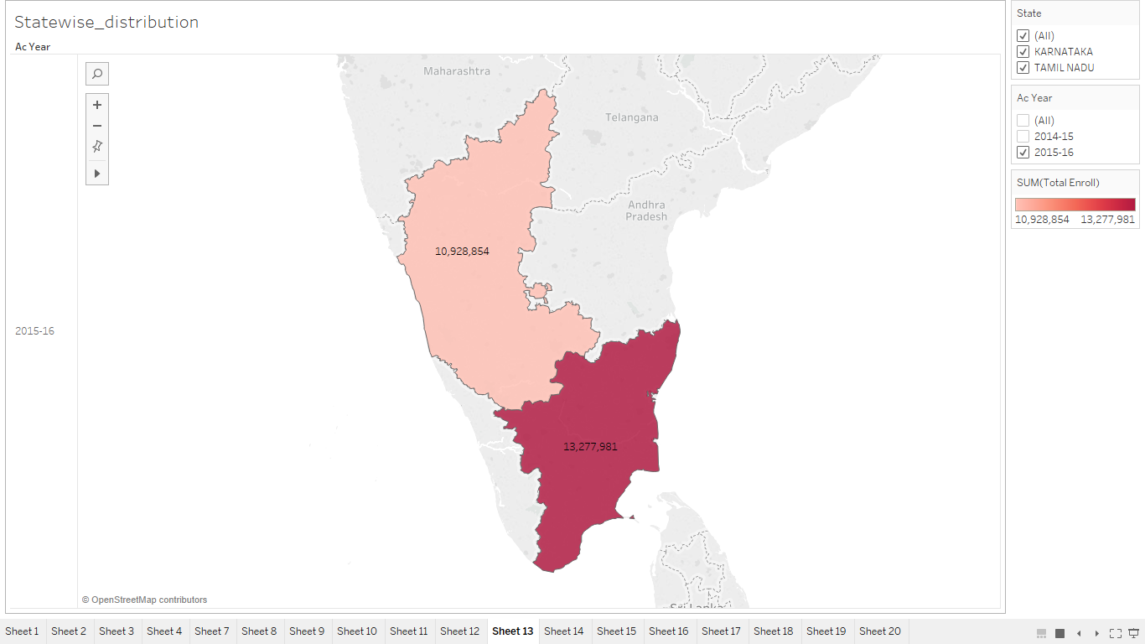
Objective of the Project
Study the enrolment of students at schools across Tamil Nadu and Karnataka.
Identify the key factors that influences and dominates the enrolment of students
Explore the possibility of developing a Predictive Model(s) for predicting the enrolment of students

Slide 6
Data Source
The two main sources of educational statistics are the educational institutions and households.
The educational institutions provide the data on enrolment and number of teachers whereas information on aspects like literacy, educational level of population, private expenditure on education etc., is available only from households.
We collected datasets for the year of 2014-2015 and 2015-2016
Data Source
NUEPA
DISE
EMIS
National University of Educational Planning and Administration
District Information System for Education
Educational Management Information System Department

Slide 7
Analytical Approach
Understand the domain and define the Business Problem
Exploratory Data Analysis Using Tableau
Cleaning and Preparation of the Data
Collection of the data from the Secondary Data Source
Feature Engineering to reduce the number of Variables
Model Development using MLR and Random Forest
Model Validation using test and Out of validation Dataset

Slide 8


Data Preparation
2,65,292 X 77
>50% NA
2,65,292 X 74
dropped16%
Rows with NA
2,21,242 X 74
Removed columns which were Sparse
2,21,242 X 60
Columns with more than 50% missing values were removed
Dropping all the rows with missing values present in them
Dropped columns which had more than 70% data as 0’s
DATA TRANSFORMATIONS: There were other transformations made
Two columns were added into 1 making it 59 columns
6 columns like school name, school code, village name were not added making it 53 columns for modelling.
For, modelling we were left with 2,21,242 X 53
6
Ankita

Slide 9
Exploratory Data analysis
BOXPLOTS
HISTOGRAMS
CORRELATION
FEATURE ENGINEERING
Univariate Analysis:
Box plot to understand outlier treatment and removal
Histogram to understand normality and distribution
Bivariate Analysis:
Correlation
Feature Engineering:
Ac_year was removed as we spilt dataset into training and Validation, based on the Academic year
We had 221242x53 variables at the end of this step
Dependent variable is continuous, so we decided to use Regression techniques for our analysis
Ankita

Slide 10
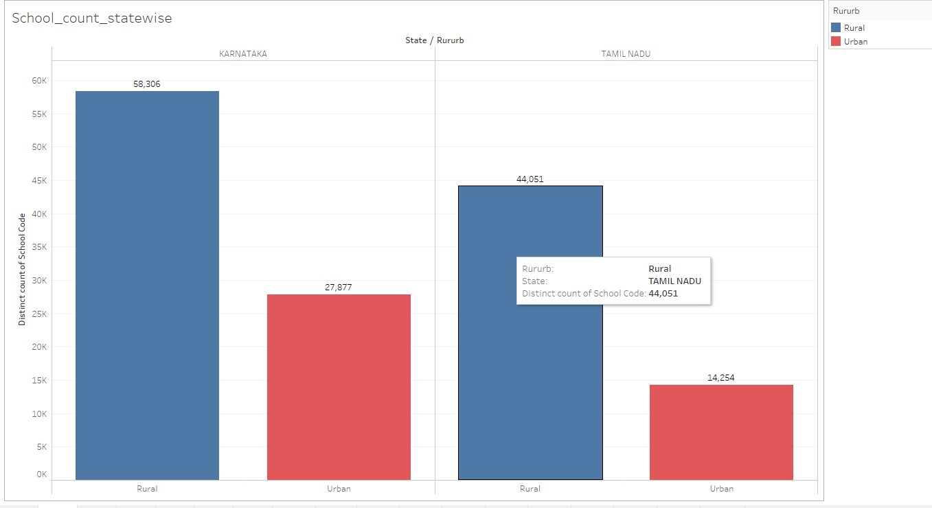
Tamil Nadu has the highest number of enrolments with enrolment of 13,277,981 students.
Karnataka has enrolments of 10,928,854 students.
Here, Karnataka has the highest number of schools when compared to the Tamil Nadu state. Karnataka has 86,183 schools while Tamil Nadu has 58,315.
Region wise, in both the states, there are more number of schools in the rural region than in the urban region.

Slide 11
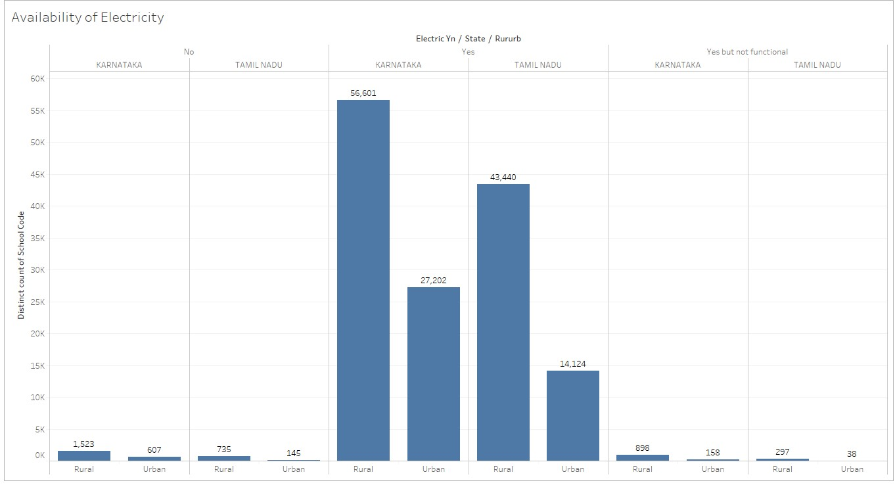
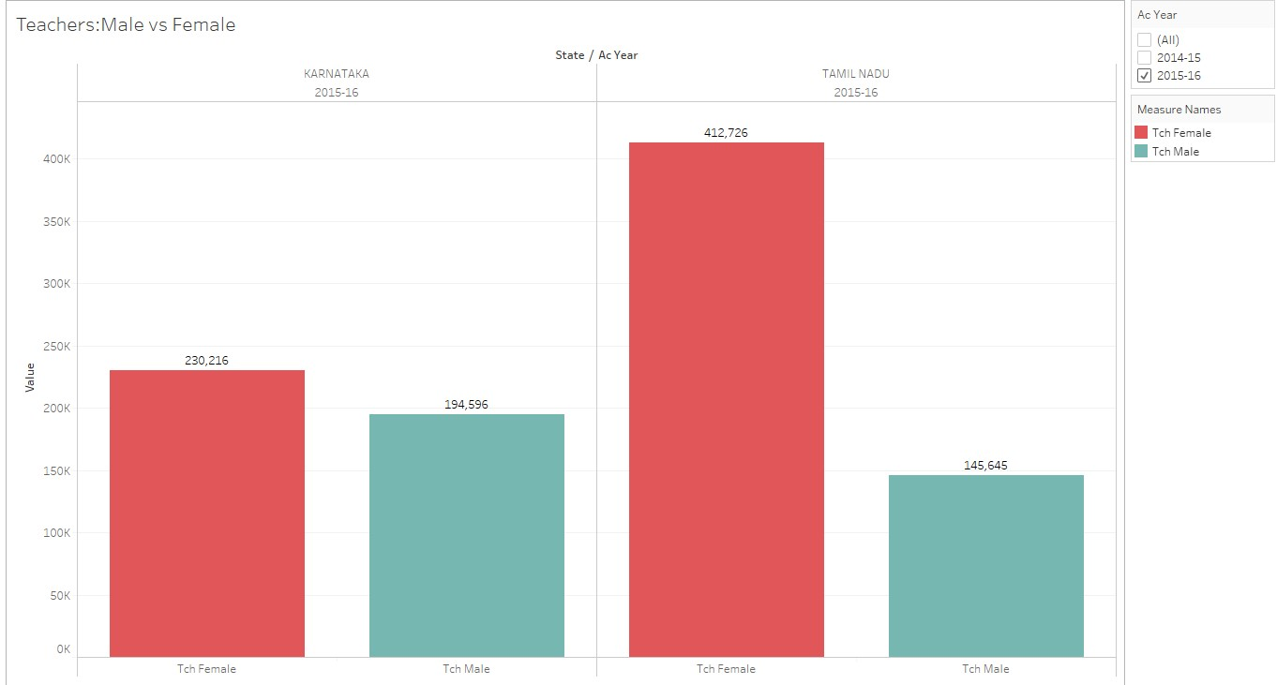
In Karnataka rural areas has more number of schools with no electricity when compared with the urban areas.
In Tamil Nadu has less number of schools where “there is electricity but not functional” when compared to Karnataka.
Over all Tamil Nadu has the highest number of teachers around 5.5Laksh.
In Karnataka there are around 4.25 lakh teachers.
In Tamil Nadu and in Karnataka there are more Female teachers than the Male teachers.

Slide 12
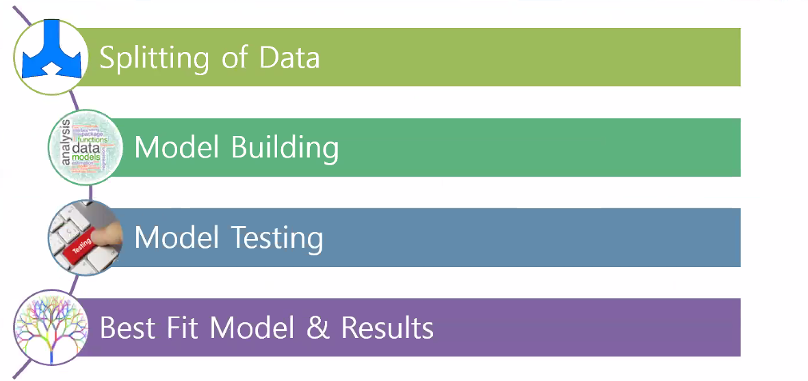
Model Development

Slide 13
SPLITTING OF THE DATA
DATA
2014-2015 Academic Year
70% Train
30% Test
2015-2016 Academic Year
Out of Validation data

Slide 14
Model Building
Data has both continuous and categorical predictor variables with continuous dependent variable, i.e. Total Enrolment. So this is regression problem.
Models explored for both capped outliers and removed outliers
At first level, a MLR model was built with all the variables to arrive at baseline values
MLR model with significant variables were retained (p<0.05)
Suspecting non-linearity, polynomial regression model was also built
Finally, RF model was also built

Slide 15
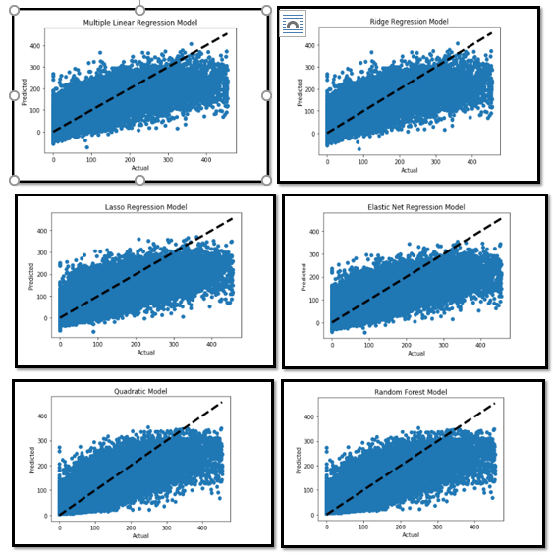
Model Testing
With outliers removed:
The models were tested on test dataset as well as out of validation dataset
R² and RMSE are calculated for each model
Beyond 350, we see that the predicted values are far away from the fitted line
We get highest R² for RF model and also the lowest RMSE

Slide 16
Results
Model results when outliers have been removed:
Models | R² | Adjusted R² | RMSE_Train | RMSE_Test | RMSE_Validation
Linear Model | 66.02% | 65.99% | 46.58 | 46.24 | 45.75
Quadratic Model | 73.11% | 72.51% | 41.44 | 43.25 | 79
Ridge Regression | 66.02% | 66.025% | 46.58 | 46.24 | 45.75
Lasso Regression | 65.07% | 65.05% | 47.23 | 46.96 | 47.34
Elastic Net | 64.53% | 64.53% | 47.59 | 47.33 | 46.77
Random Forest | 79.31% | 79.30% | 36.35 | 41.04 | 41.11
LMS Model | R² | Adjusted R² | RMSE_train | RMSE_test | RMSE_Validation
Considering Top 14 variables | 63.50% | 63.49% | 48.28 | 48.01 | 46.65
Considering Top 27 variables | 65.39% | 65.38% | 47.01 | 46.71 | 45.48
Only significant variables | 66.01% | 65.99% | 46.58 | 46.25 | 46.02
Considering All the variables | 66.02% | 65.99% | 46.58 | 46.24 | 45.75

Slide 17
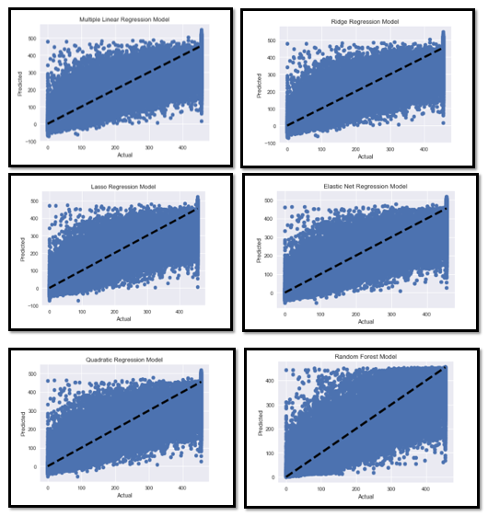
Model Testing
With capped outliers:
The models were tested on test dataset as well as out of validation dataset
R² and RMSE are calculated for each model
Beyond 400, we see that the predicted values are far away from the fitted line
We get highest R² for RF model and also the lowest RMSE

Slide 18
Results
Model results when outliers have been capped:
Models | R² | Adjusted R² | RMSE_Train | RMSE_Test | RMSE_Validation
Linear Model | 79.04% | 79.03% | 62.74 | 62.17 | 60.81
Quadratic Model | 82.98% | 82.70% | 56.54 | 57.72 | 57.22
Ridge Regression | 79.04% | 79.03% | 62.74 | 62.17 | 60.81
Lasso Regression | 78.65% | 78.50% | 63.34 | 62.78 | 60.93
Elastic Net | 78.46% | 78.40% | 63.60 | 63.04 | 60.66
Random Forest | 87.18% | 87.10% | 49.06 | 55.49 | 53.22
LMS Model | R² | Adjusted R² | RMSE_train | RMSE_test | RMSE_Validation
Considering Top 9 variables | 77.52 % | 77.52% | 64.98 | 64.38 | 61.53
Considering Top 25 variables | 78.65% | 78.64% | 63.33 | 62.73 | 60.25
Only significant variables | 79.01% | 79.02% | 62.79 | 62.19 | 60.85
Considering All the variables | 79.04% | 79.03% | 62.74 | 62.17 | 60.81

Slide 19
Validation of Regression Assumptions
With outliers removed
Linearity: Most of the variables have either negative or positive correlation so we are assuming linearity
Auto-Correlation: From Durbin-Watson test d=2.004, which confirms no auto-correlation present in residuals
Homoscedasticity: Residual vs. Fitted graph is additive in nature which confirms homoscedasticity
Multi-Collinearity: There are 7 variables whose VIF value is above 5, so we went with L1 and L2 regularization to nullify this effect.
Normality: From normality test, we find that the residuals are not normally distributed which suggests that there are a few unusual data points which must be studied closely to make a better model

Slide 20
Validation of Regression Assumptions
With outliers capped
Linearity: Most of the variables have either negative or positive correlation so we are assuming linearity
Auto-Correlation: From Durbin-Watson test d=1.996, which confirms no auto-correlation present in residuals
Homoscedasticity: Residual vs. Fitted graph is additive in nature which confirms homoscedasticity
Multi-Collinearity: There is only 1 variable whose VIF value is above 5. We can drop that variable but we have still gone on with L1 and L2 regularization
Normality: From normality test, we find that the residuals are not normally distributed which suggests that there are a few unusual data points which must be studied closely to make a better model

Slide 21
Conclusion
Enrolment of Students
Total Teachers who are graduate and above
Total Teachers with Professional Qualifications
Category of the School
Amount of School Development Grant Received
School Building Status
Number of books in Library
Funds from other Sources Receipts and Expenditure
Board of Secondary or Higher Secondary Sections
Location of School
Presence of Playground
Status of Mid-Day meal
Number of Good Classrooms
Number of classrooms and number of Male and Female teachers
Number of Computers
These are the variables which dominate and influence the enrolment of students

Slide 22

Thank You! P.V. Subramanian, Mentor – Great Learning All teaching and non-teaching members Great Learning PGPDSE May 2018

