Slide 1
Diagnosing the Opioid Epidemic
Nithish Bolleddula
Matt Sarmiento

Slide 2
Sources
CDC Wonder
European Monitoring Center for Drugs and Drug Addiction

Slide 3
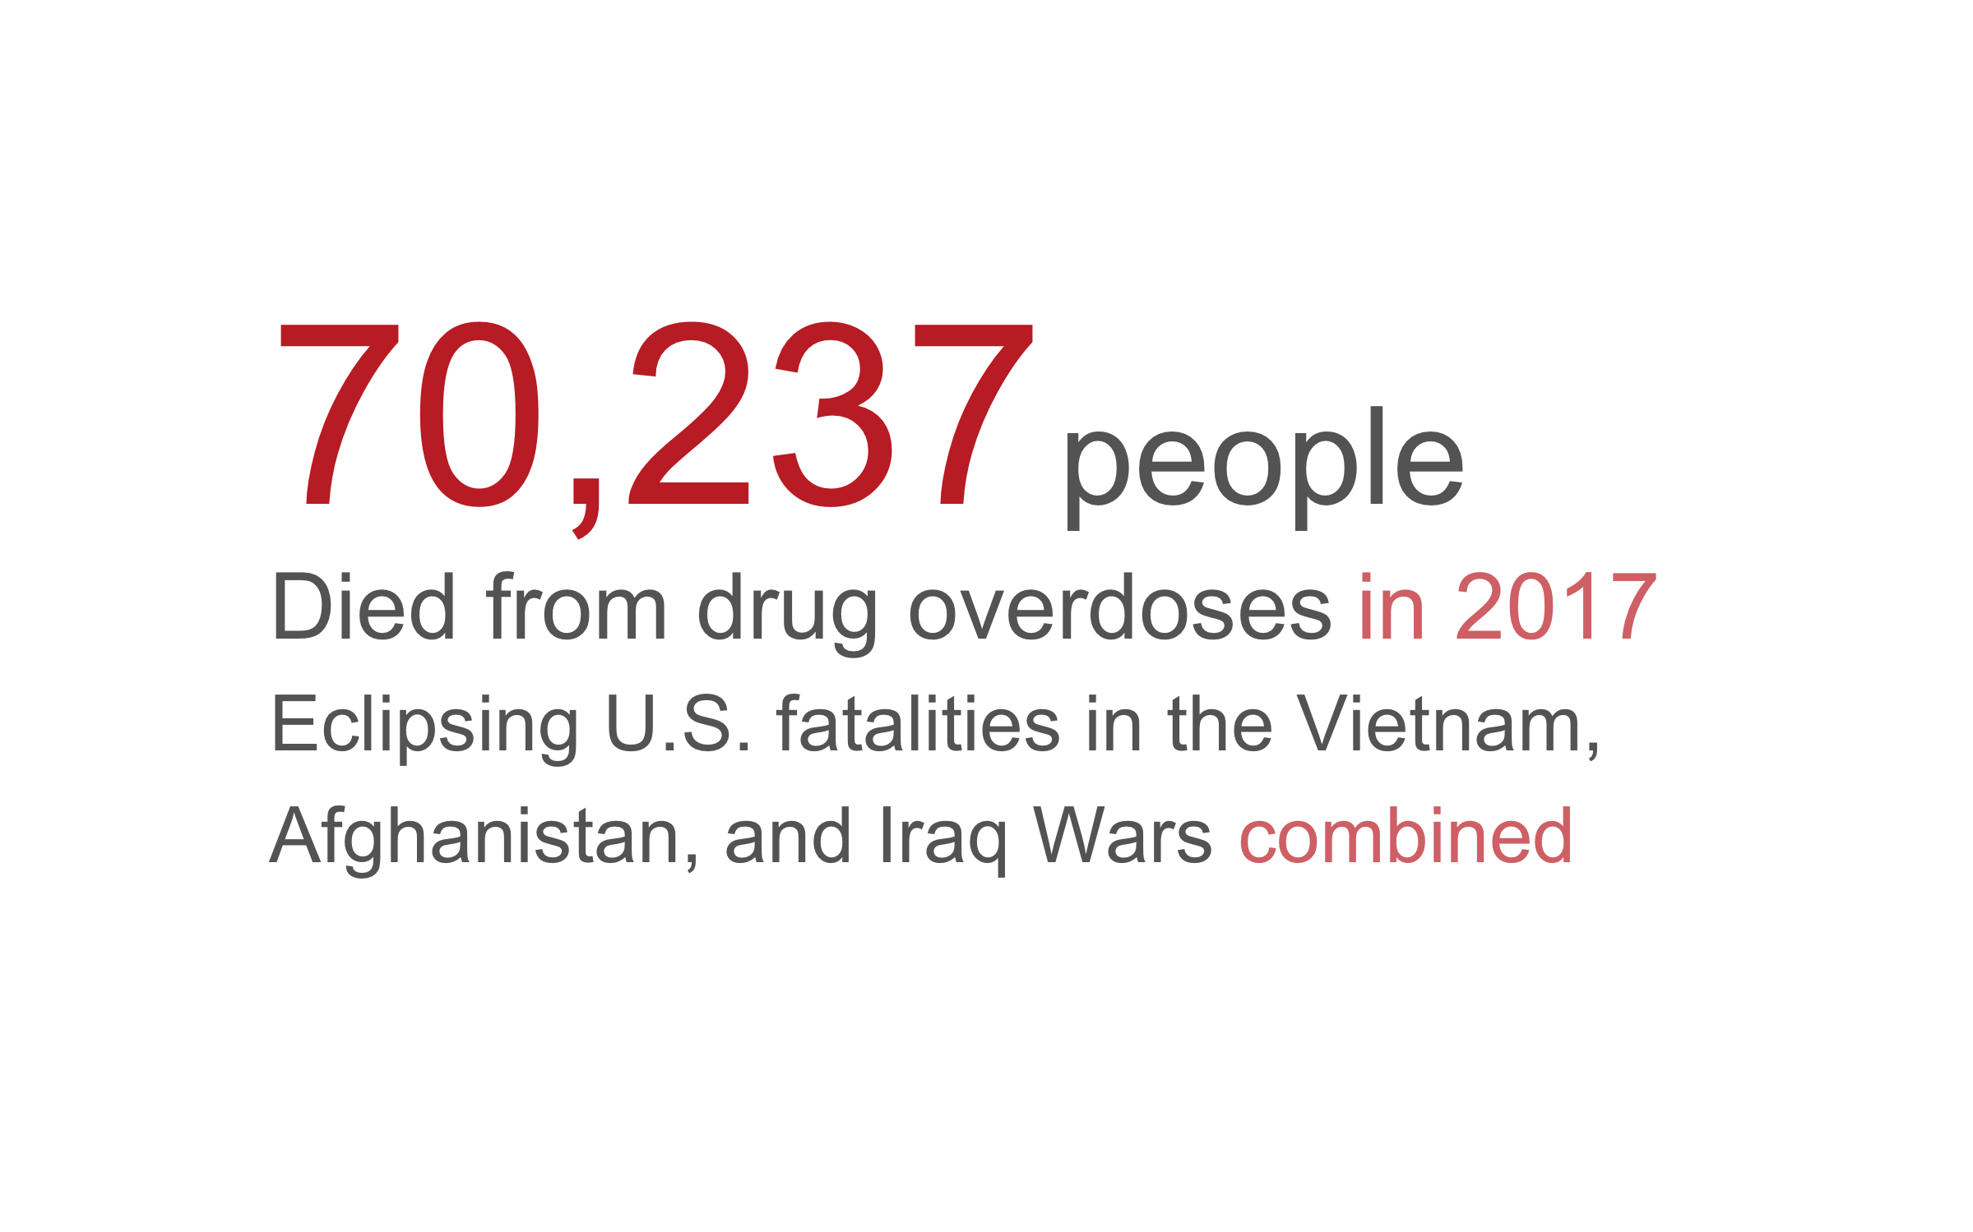

Slide 4
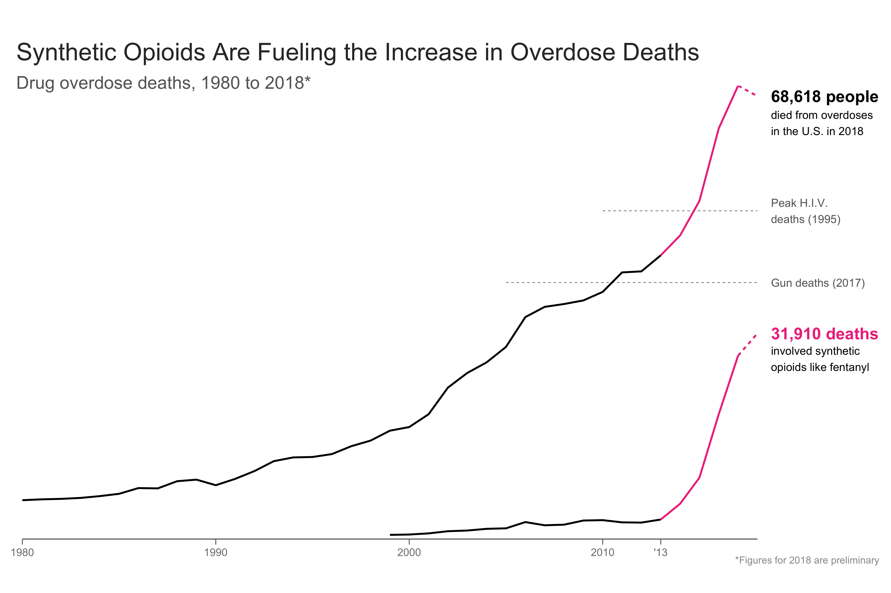

Slide 5
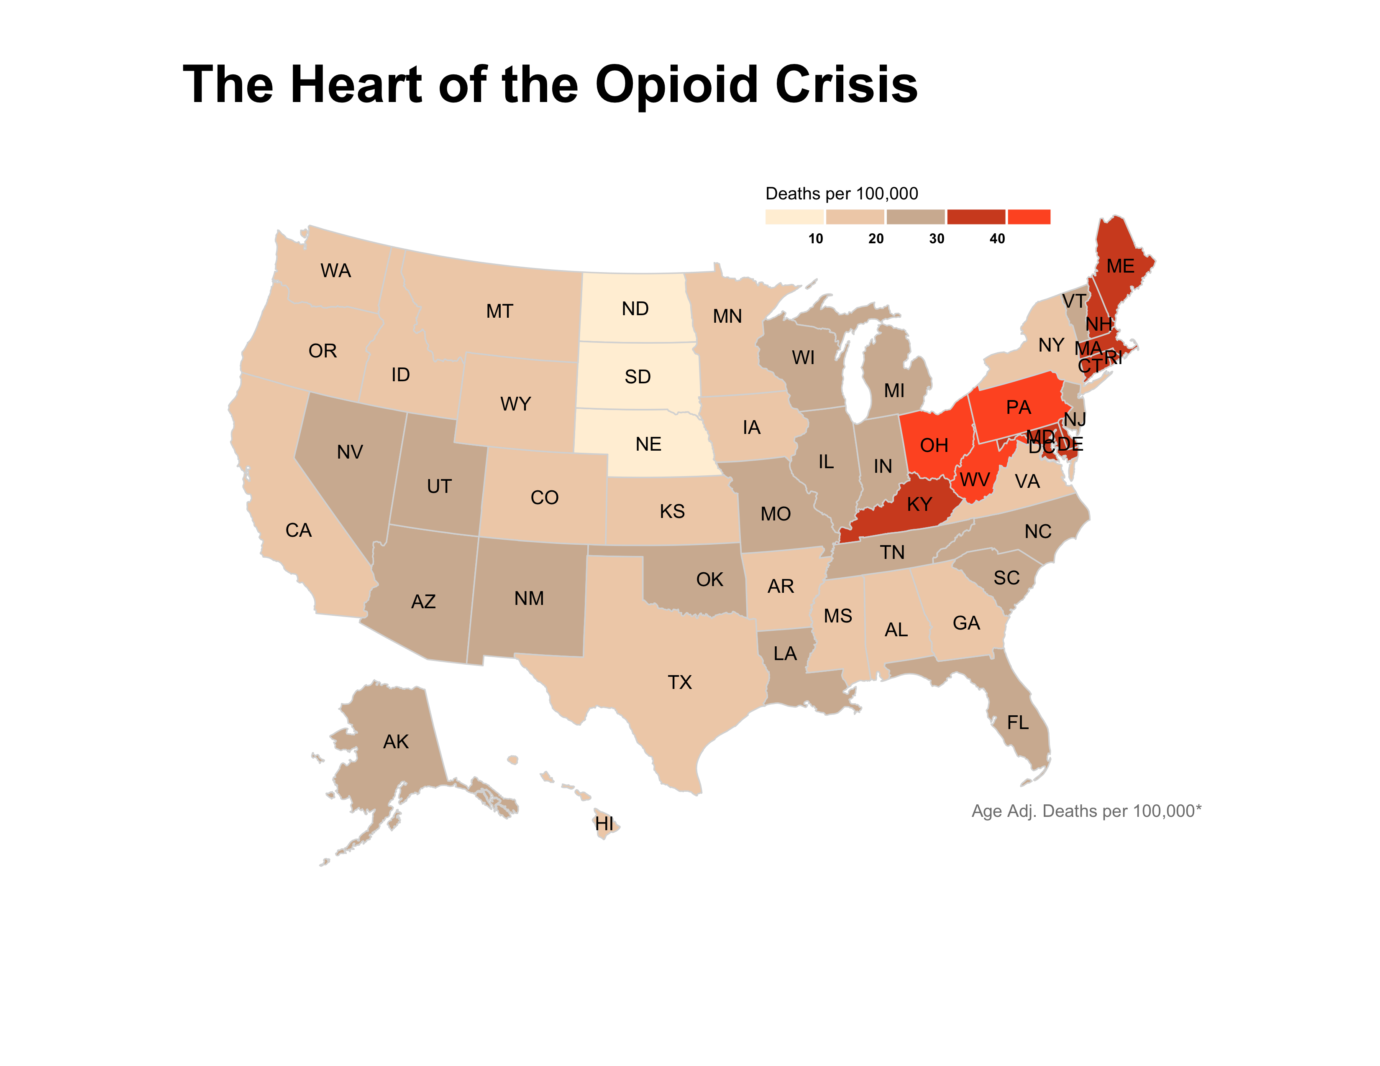

Slide 6
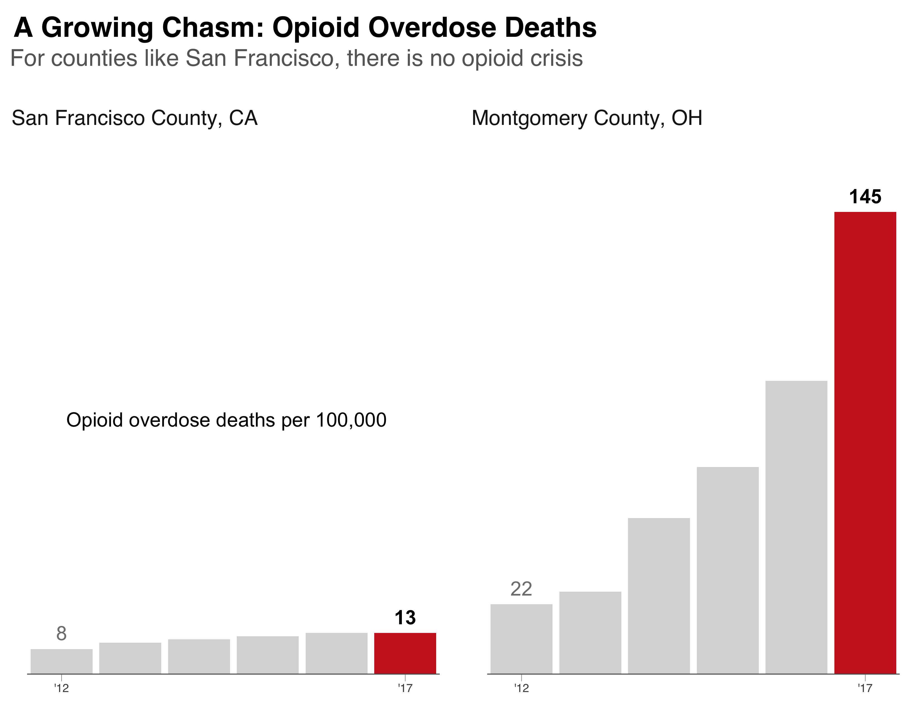

Slide 7
