Slide 1
STAT 628: MODULE 2​ Body Fat Project​
Group 18​
Midhun Satheesh​
Jiaqi Xia​
Yulong Zhao​

Slide 2
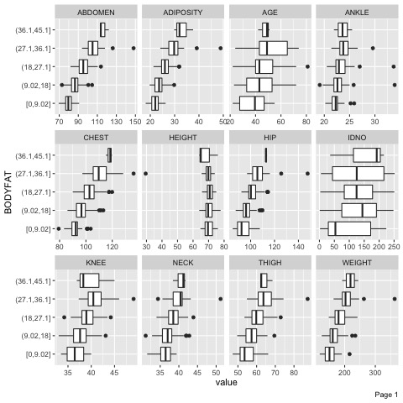
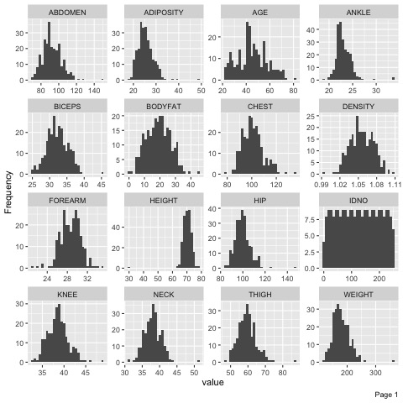
Data Review

Slide 3
Summary of Data Cleaning
We deleted four outliers
Final Cleaned Data: n=248 (from n=252)
Predictors: Weight, Abdomen
Individual (IDNO) | Original Obs.
39 | 33.8
41 | 33.1
226 | 12.8
252 | 30.7

Slide 4
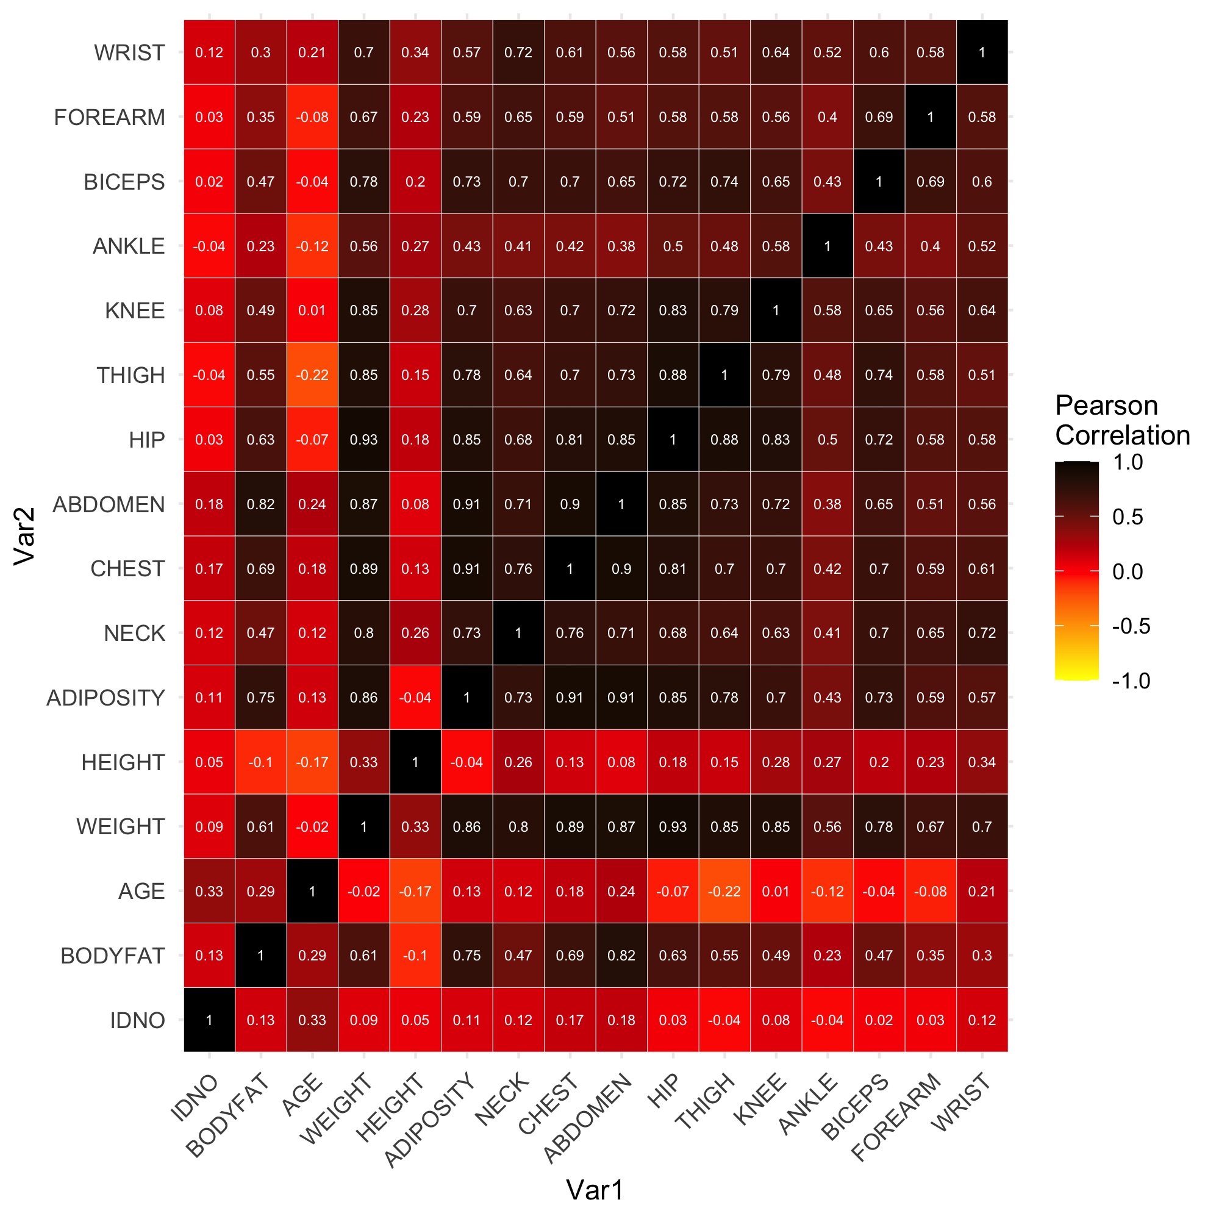
Correlation between variables

Slide 5
Finding Best Model for Body Fat
Metric for Model Performance: We’ll define the “best” model based on the following criteria
R^2
Number of Predictors
Candidate Models:
Y ~ WEIGHT + AGE + HIP + ABDOMEN
Y ~ WEIGHT + ABDOMEN
Y ~ WEIGHT + THIGH + ABDOMEN + I(ABDOMEN^2)
4. Y ~ ABDOMEN + I(ABDOMEN^2)
We used AIC, BIC and R^2 evaluated each candidate model’s performance

Slide 6
Results
Model | R squared | AIC | BIC
Y ~ WEIGHT + AGE + HIP + ABDOMEN | 0.7202 | 1408.528 | 1429.609
Y ~ WEIGHT + ABDOMEN | 0.7195 | 1405.156 | 1419.209
Y ~ WEIGHT + THIGH + ABDOMEN + I(ABDOMEN^2) | 0.7248 | 1404.36 | 1425.441
Y ~ ABDOMEN + I(ABDOMEN^2) | 0.6766 | 1440.448 | 1454.502

Slide 7
Final Model
BODYFAT = -43.6366 -0.1211 * WEIGHT + 0.9110 * ABDOMEN
Some description of the final model in words
Bodyfat will increase as men’s weight decreases and abdomen increases. Here, that weight decreases leads to bodyfat increases seems to be counterintuitive. Our explanation is that if one’s abdomen keeps unchanged, weight increases means the increase in muscle, which in turn will cause the decrease of bodyfat.
Example Usage
A man with 180 lbs and 90 cm of abdomen circumference is expected to have a body fat % of 16.55 based on our model, which is healthy according to Bodyfat Percentage Chart.

Slide 8
Why chose the final model
All variables are easy to obtain.
We understood the relationships between variables and we found that bodyfat is linear correlated with variables we chose, so we think multiple linear regression is reasonable.
Other models with other more variables, THIGH for example, have similar performance with the final model.
Considering the model simplicity, we choose our final model with only WEIGHT and ABDOMEN
Rule of Thumb: BODYFAT = -44 + 0.9* ABDOMEN -0.1*WEIGHT

Slide 9
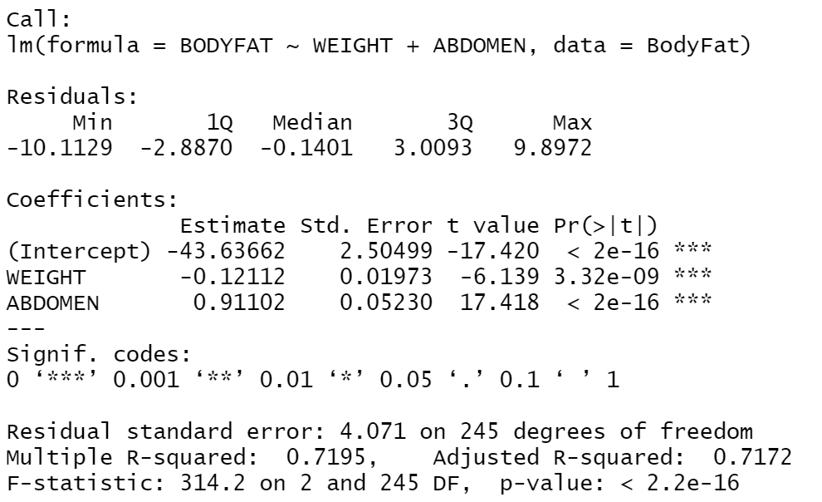
Statistical Properties of Final Model
Describe some important, statistical properties of the model
Example 1: Coef are all significant at 0.05 based on two-sided t-test with p-values
Example 2: Overall model is significant at 0.05 based on F-test with p-value
Example 3: R^2 =0.7195.
The summary of the model

Slide 10
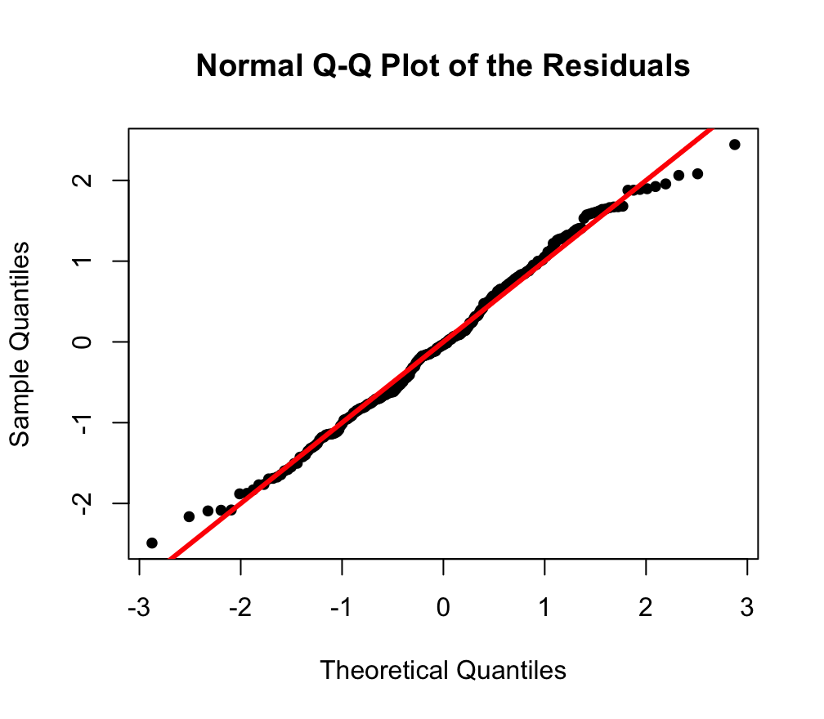
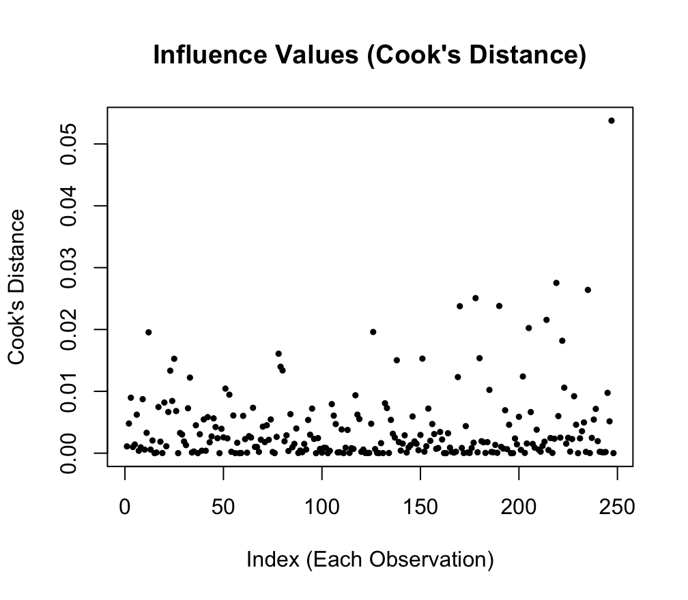
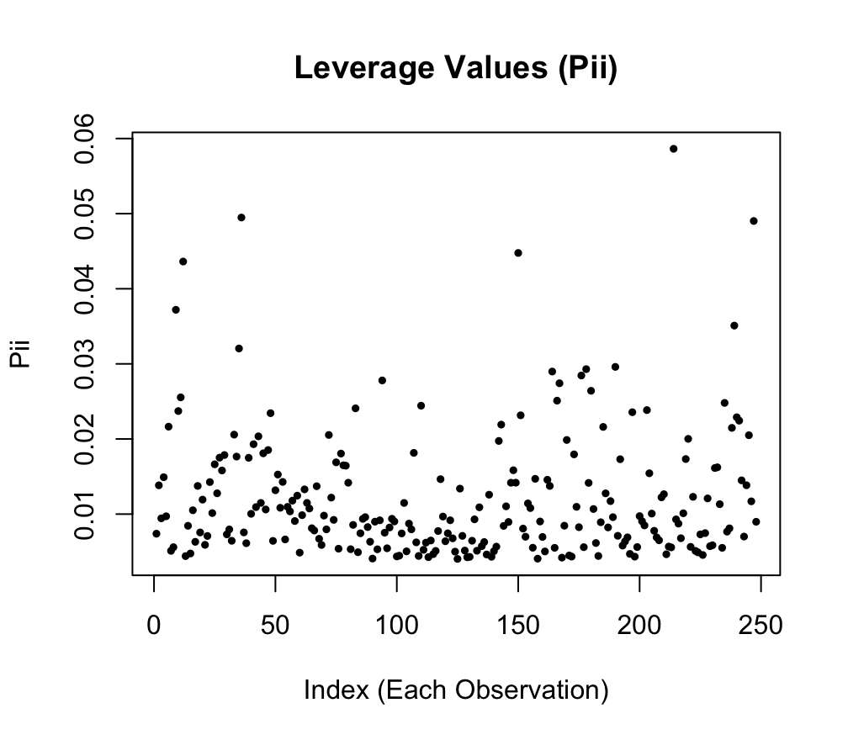
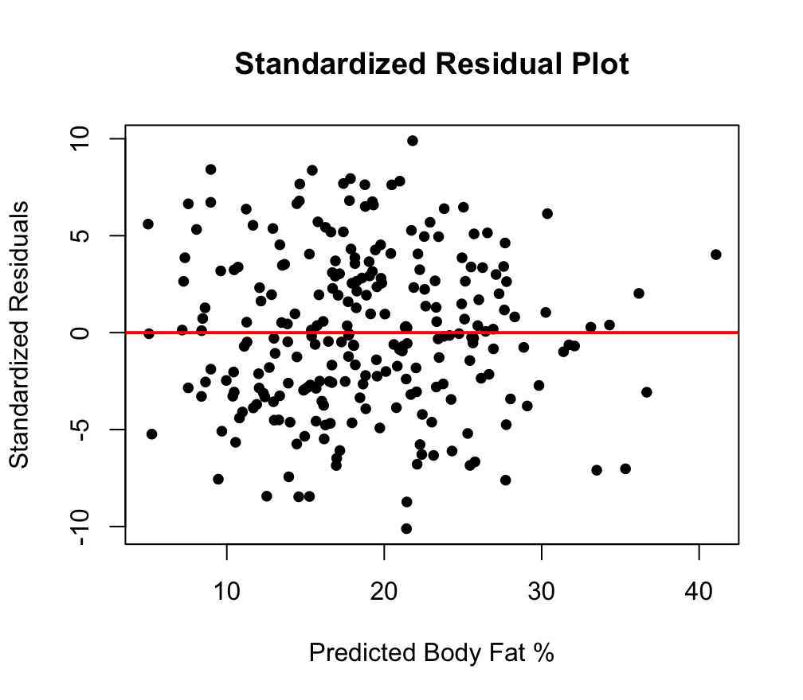
Model Diagnostics

Slide 11
Strengths and Weaknesses
Final Model:
BODYFAT = -43.6366 -0.1211 * WEIGHT + 0.9110 * ABDOMEN
Strengths
Model simplicity
Model assumptions
Weaknesses
Constant effects
Relatively low R-square

Slide 12
Conclusion
A very simple way of predicting the body fat % purely based on only weight and abdomen circumference
MLR assumptions (linearity, homoscedasticity and normality) are plausible
Not any leverage points and influential points after removing outliers.
The constant effect assumption is likely violated

