Slide 1
Predicting a Startup’s Acquisition Status
MEGA SATISH

Slide 2
INTRODUCTION
Startups are newly formed companies created by entrepreneurs.
However, startups might succeed, but they can also fail and get acquired by other big firms.
The aim of this project is to figure out whether we can predict a startup’s acquisition status based on its financial situation.
In order to avoid using under/over sampling for the biased data, a new model is proposed.
The model should yield higher accuracy with higher precision.

Slide 3
DATASET & FEATURES
Dataset used is Kaggle Dataset ‘Crunchbase 2013 - Companies, Investors, etc. Each row of the dataset contains financial information about a company and is labeled with its current status(Operating, Closed, IPO, Acquired).
To extract the features, we will have to perform Exploratory Data Analysis (EDA) so that we can transform the data into a quantitative dataset. - Dates are converted from string to integers and Locations are converted from string to float. - Scaling and Normalization are performed to remove any bias. After preprocessing, the dataset is split 60/20/20 between training data, validation data and test data.
Feature selection is done using forward selection to optimize the features as different combination of features are used for different models. Choosing important features is primordial for the model to give the desired results.

Slide 4
MODELS
Baseline Model:
As the dataset is biased, it will output ‘Operating’ no matter what the input will be.
Accuracy is high but precision is low.
Ensemble Technique:
It is the combination of Quadratic Discriminant Analysis and Random Forest Classifier models.
QDA model focuses on the precision while the Random Classifier prioritizes the accuracy.
By merging these two models, we can get higher accuracy and higher precision.
Quadratic Discriminant Analysis:
Identify the subset of Operating classes with high precision to balance the remaining data.
Give priority to precision by increasing threshold as recall can be achieved by the second model.
Random Forest Classifier:
Classify the remaining subset as input data is sampled from a more balanced distribution of classes which results in higher precision.

Slide 5
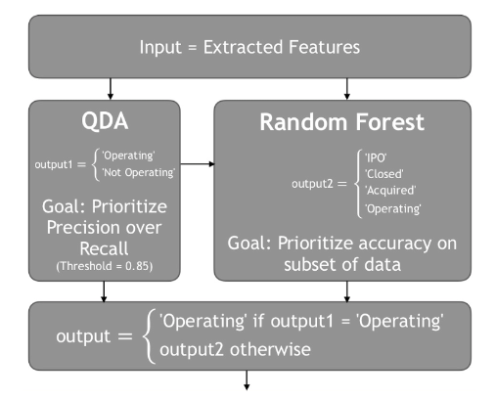
MODELS
Flow diagram for prediction of output

Slide 6
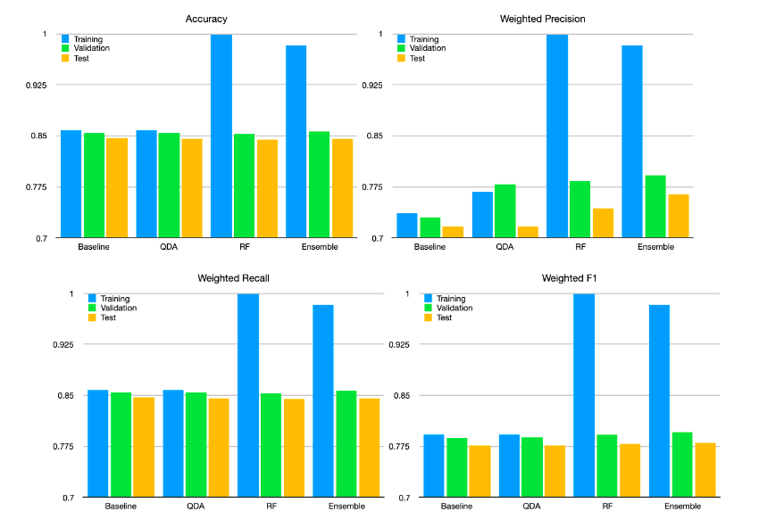
RESULTS
Comparison of performance for different models:
Ensemble technique yields better results than other models.
QDA can’t increase the model’s accuracy.
RF model increases the precision but overfits the training the data.
Baseline model gives good accuracy however the precision is very much low.
(Source from Paper)

Slide 7
CONCLUSION & FUTURE WORK
Ensemble technique’s results seems promising although further work can be done in this by opting other models and combining them together.
Regarding the RF model, tuning it in a general way might give desired output.

