Slide 1

DYNAMIC PLANNING AND CONTROL METHODOLOGY
Submitted By
HARAPRIYA SENAPATI
1703040010
CSE-1

Slide 2
Dynamic planning and control methodology
A dynamic planning and control methodology is developed by integrating the applications of axiomatic design concepts, concurrent engineering concepts, the graphical evaluation and review technique (GERT), and the system dynamics modeling technique.
The goal of the proposed methodology is to help create a dynamic project plan for design/build fast-track civil engineering and architectural projects where unforeseen changes can be absorbed in the project schedule without creating major interruptions.

Slide 3
Continue...
The axiomatic design concepts are applied to formulate and evaluate various work methodologies, and to create a project plan based on the selected work methodology.
The concept of concurrent engineering is adapted to develop a fast-tracking framework based on the task production rate, the upstream task reliability, and downstream task sensitivity to the upstream error.
The GERT diagramming scheme is used to calculate the project duration probabilistically by incorporating the possible branches and loops in the project.

Slide 4
Continue…
The system dynamics modeling technique is applied to analyze the causality links of relevant factors in the construction system, and further identifies the important variables that determine the success of a particular overlapping strategy.
Consequently, with a rigorous and systemized methodology to help project planning, potential problems can be addressed early before construction.
The overall increase in productivity and efficiency as a result of a better planning process can consequently promote the competitiveness of the construction industry.

Slide 5
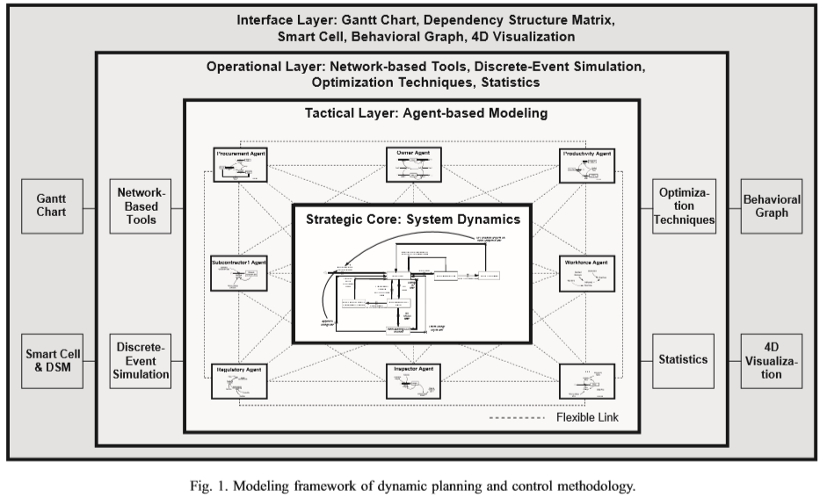
MODELING FRAMEWORK OF DPM

Slide 6
Strategic core
The strategic core is the main simulation engine that provides the overall project behaviour for strategic project management and adopts system dynamics as the main modelling language.
System dynamics was developed to apply control theory to the analysis of industrial systems and helps study complex systems as a whole by focusing on the feedback processes of the different components in the system.
Emphasizing the system structure as a cause of dynamic behaviour, system dynamics is capable of identifying the behaviour and pattern of complex systems.

Slide 7
Continue…
The system dynamics model implements generic construction processes by concentrating on the project dynamics caused by feedback processes.
Examples of the project dynamics are the impacts of different policies (e.g., overtime and flexible headcount control), iterative cycles caused by errors and changes, and schedule pressure on productivity.
Another important feature of this model is in that the model is pre-structured so that the user can focus on representing the project in the same manner as with CPM/ PERT.

Slide 8
Tactical layer
Although the above feature could aid in a model’s ease of use, the model’s ability to provide an accurate representation may be questioned.
In other words, when the generic construction process model is applied for a specific project, the fact that the model uses generic structures with customizable inputs may generate some concerns on how well the model represents the unique characteristics of the project.
In addition, dynamically changing model structure in a system dynamics model can be very difficult and thus, cannot be easily adapted to a new environment, although new valuable information is obtained during simulation.

Slide 9
Continue…
In order to overcome these difficulties, an agent-based modelling technique is proposed at the tactical layer in order to provide the system dynamics model with a flexible model structure.
The core of the agent-based modelling perspective includes the assumption that complexity arises from the interaction of individuals (i.e., agents).
While system dynamic focuses on the feedback processes among components, the agent-based modelling technique concentrates on rules that explain the behaviour of interacting individuals (i.e., agents).

Slide 10
Operational layer
The strategic core is able to represent the overall project behaviour and patterns. However, by the strategic core’s focus being on the overall behaviour, it may lack the capability to provide a detailed operational analysis.
The operational layer, which wraps the strategic core and the tactical layer, is proposed to improve the operational aspect of DPM.
The operational layer includes network-based tools and can be extended to incorporate discrete-event simulation, optimization techniques, and statistics.

Slide 11
Continue…
The powerful concepts of network-based tools, such as critical path, precedence relationships, and probabilistic duration estimation, are employed.
The simulation result from the strategic core is translated onto a network. This can be illustrated in an example of how applying an overtime policy would affect the critical path and the precedence relationships.
By implementing this scheme, the user can benefit, since complex results are converted to familiar network concepts. In addition, the distinct operational layer enables the implementation of the flexible architecture that would allow for the expansion of the system by creating mechanisms to incorporate discrete-event simulation, optimization techniques, and statistics.

Slide 12
Interface layer
The interface layer is responsible for communication between the three inner layers (i.e., the strategic core, the tactical layer, and the operational layer) and the users.
Since the methods adopted in DPM use different input and output formats, how to communicate and translate information among these formats becomes a critical issue.
In this context, the interface layer aims to create and utilize simple and visual techniques to help ease information sharing.

Slide 13
Continue…
Specifically, the Gantt chart is used as a basic schedule representation and comparative tool.
If the simulation result from the strategic core indicates that there is a delay from the original schedule, a Gantt chart can represent the simulated schedule and compare it with the original schedule.

Slide 14
THANK YOU

