Slide 1
Lesson 1
Digital Electronics Review Part 1
Mohd Saufy Rohmad
Technical Trainer and Consultant

Slide 2
Gates
Lets start with the concept of gates/logic gates.
Think of this blocks as the fundamental digital blocks that you will use to design a digital circuit.
The basic three gates are known as NOT, AND and OR.
They can be used to construct other types of gates.
NOT Gate: NOT gate simply inverts the input.
The NOT gate takes only one input that is a single bit, either 0 or 1.
If the input of 0, it gives an output of 1 and vice-versa.
The symbol of a NOT gate is the following:

Slide 3
Gates
AND Gate: This gate takes two input bits.
The output of an AND gate always zero until all the input values are 1.
We will use something called "truth table" to understand how a gate behaves.
A truth table shows how a logic circuit's output responds to various combinations of the inputs.
All permutations of the inputs are listed on the left, and the output of the circuit is listed on the right.
The desired output can be achieved by a right combination of bits at the input of the logic gates.
The truth table for the AND gate is the following:

Slide 4
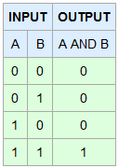
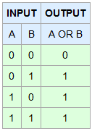
Gates
You can see from the table that when the input A is 0 and B is 0, the output is 0.
The output remains zero as long as both A and B are 1.
The truth table is very helpful to visualise how gates behave.
OR Gate: The output of OR gate will be 1 (high) if any of the inputs are 1. The truth table of the OR gate is given below:

Slide 5
Gates
We can create other logic gates like NAND (combination of NOT and AND), NOR, XOR, XNOR by combining the basic three logic gates.
You can use "Boolean Algebra" and "Karnaugh Maps" to simplify the combination of gates.
The interested readers can just Google these terms and know about more.
We are not going to write gate level VHDL code, thats why we will not go into detail about this topic.

Slide 6
Combinational Logic
We use gates to design a logic block. There can be two types of logics.
1. Combinational logic
2. Sequential logic
Sequential logic has memory elements.
Combinational logic has no memory elements. We give a few examples of combinational logic in this section.

Slide 7
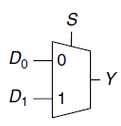
Multiplexer
Multiplexers are among the most commonly used combinational circuits.
They choose an output from among several possible inputs based on the value of a select signal.
A multiplexer is sometimes affectionately called a mux.
A simple 2:1 multiplexer figure looks like below.

Slide 8
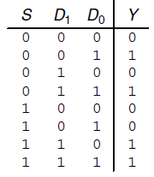
Multiplexer
The below figure shows the schematic and truth table for a 2:1 multiplexer with two data inputs, D0 and D1, a select input, S, and one output, Y.
The multiplexer chooses between the two data inputs based on the select: if S .=0, Y .=D0, and if S .=1, Y .=D1.
S is also called a control signal because it controls what the multiplexer does.

Slide 9
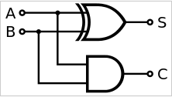
Adder
In electronics the adder is a digital circuit that perform addition of numbers.
They are important for numerical data processing.
There are mainly two types of adder are used.
They are Half adder and Full adder.
Half Adder: It can add two binary bits.
The below figure is the simplest construction of half adder.

Slide 10
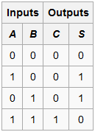
Adder
The half adder adds two input bits and generates a carry and sum, which are the two outputs of a half adder.
The input variables of a half adder are called the augend and addend bits.
The output variables are the sum and carry.
The truth table for the half adder is:

Slide 11
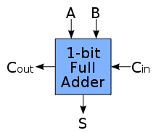
Adder
Full Adder: A full adder adds binary numbers and accounts for values carried in as well as out.
A one-bit full adder adds three one-bit numbers, often written as A, B, and Cin;
A and B are the operands, and Cin is a bit carried in from the previous less significant stage.

Slide 12
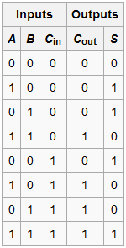
Adder
The circuit produces a two-bit output, output carry and sum typically represented by the signals Cout and S, where
Sum =2 x Cout + S
And the truth table is

