Slide 1
Lesson 10
Combinational Logic
Mohd Saufy Rohmad
Technical Trainer and Consultant

Slide 2
Simple Combinational Logic
Any section of logic that doesnt have any memory elements is considered as a combinational logic.
So the simplest combinational logic represents a wire, for example,
wire1 <= wire2;
It means wire2 is connected to wire1.
As mentioned in the previous lesson, we can create logic gates in the following way (lesson 5),
Q <= AB + BC(B+C);
We can visualize this logic here. Note that, A, B, C and Q are all translated as ports/wires.

Slide 3
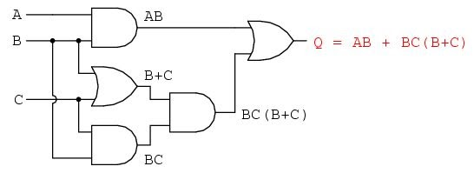
Simple Combinational Logic
We can also write simple arithmetic units in this fashion (Hour 8),
C <= resize(A+B,9);
Here, A and B both have 8 wires to support 8-bit inputs. C has 9 wires for 9-bits.

Slide 4
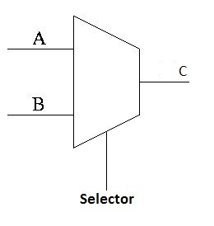
Conditional Statements
We will encounter scenarios where we need a conditional statements.
How can we use conditional statements as combinational logic? We will see that in this section.
As an example, we will create the most basic 2:1 multiplexers with several conditional statements.
Lets assume our multiplexer is selecting between inputs A and B based on the value of "Selector". If Selector is 0, the output will be A and if Selector is 1, the output will be B.

Slide 5
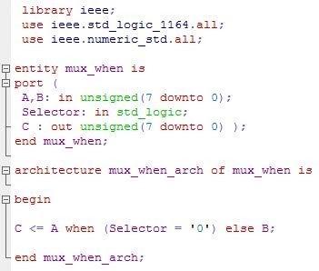
When / Select
It is possible the design the multiplexer with when-select keyword. The code is given below,

Slide 6
When / Select
When-select is very useful for writing short codes. Another example of the when-select is,
C <= "1000" when selector = "00" else
"0100" when selector = "01" else
"0010" when selector = "10" else
"0001" when selector = "11";

Slide 7
With/Select/When
It is possible the design the multiplexer with with-select keyword.
It is very similar to When-Select. The code is given below,
Library ieee;
use ieee.std_logic_1164.all;
use ieee.numeric_std.all;
entity mux_with is
port(
A,B: in unsigned(7 downto 0);
Selector: in std_logic;
C: out unsigned(7 downto 0));
end mux_with;
architecture mux_with_arch of mux_with is
begin
with selector select
C <= A when '0',
B when others;
end mux_with_arch;

Slide 8
With-select-when can also be very useful, for example,
with selector select C <=
"1000" when "00",
"0100" when "01",
"0010" when "10",
"0001" when "11";

Slide 9
Process (if else statement)
We will introduce a very important construct for the VHDL language called process. Any if-else or case statement should be inside the process construct.
Any process should have the following structure,
process(sensitivity_list)
begin
VHDL_code (if-else and case statements goes here)
end process;
A 2:1 multiplexer can also be written with if-else inside a process as,

Slide 10
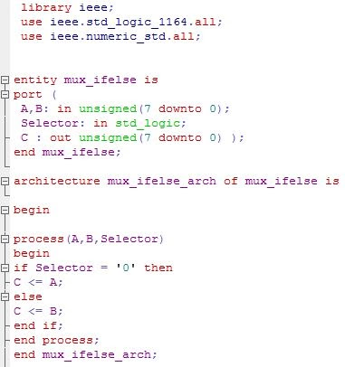
Process (case statement)

Slide 11
Thank You

