Slide 1
Lesson 14
Testbench (Sequential Logic)
Mohd Saufy Rohmad
Technical Trainer and Consultant

Slide 2
Sequential Testbench
We have already seen how to build a testbench for combinational logic in lesson 13.
What needs to be added for a testbench of sequential logic? A clock.
We will test the 8-bit register with asynchronous reset in this section.
The 8-bit registers' code is given below.

Slide 3
library IEEE;
use IEEE.STD_LOGIC_1164.ALL;
entity regis is
port(
clk: in std_logic;
rst: in std_logic;
d_in: in std_logic_vector(7 downto 0); -- input1
d_out: out std_logic_vector(7 downto 0)); -- output, 1 bit wider
end regis;
architecture arch1 of regis is
signal d_R: std_logic_vector(7 downto 0); -- output register
begin
process(clk, rst)
begin
if rst = '0' then
d_R <= (others => '0');
elsif clk'event and clk = '1' then
d_R <= d_in;
end if;
end process;
d_out <= d_R;
end arch1;
Register code

Slide 4
library IEEE;
use IEEE.STD_LOGIC_1164.ALL;
entity regis_tb is
end regis_tb;
architecture regis_arch_tb of regis_tb is
signal clk: std_logic := '0';
signal rst: std_logic := '0';
signal d_in: std_logic_vector(7 downto 0) := (others=>'0');
signal d_out: std_logic_vector(7 downto 0) := (others=>'0');
constant clk_period : time := 10 ns;
component regis is
port(
clk: in std_logic;
rst: in std_logic;
d_in: in std_logic_vector(7 downto 0); -- input1
d_out: out std_logic_vector(7 downto 0)); -- output, 1 bit wider
end component;
Testbench Code

Slide 5
begin
dut: regis port map(
clk => clk,
rst => rst,
d_in => d_in,
d_out => d_out);
clk_process :process
begin
clk <= '0';
wait for clk_period/2;
clk <= '1';
wait for clk_period/2;
end process;
stim_process:process
begin
wait for 1 ns;
rst <= '1';
wait for 27 ns;
d_in <= "00001111";
wait;
end process;
end regis_arch_tb;
Testbench Code

Slide 6
Code Analysis
Here, we created a clock, that is positive for half of the duration of the clock period and negative for the other half.
clk_process :process
begin
clk <= '0';
wait for clk_period/2;
clk <= '1';
wait for clk_period/2;
end process;

Slide 7
Code Analysis
We created another process, called the stimulus process.
The process includes the reset and d_in value.
After 1 ns, the reset becomes 1 and after 27ns d_in gets its value.
The clocked process and stimulus process runs in parallel.
If you run the testbench architecture (regis_arch_tb) similarly which is shown in details on lesson 13 you will get the waves as below.

Slide 8
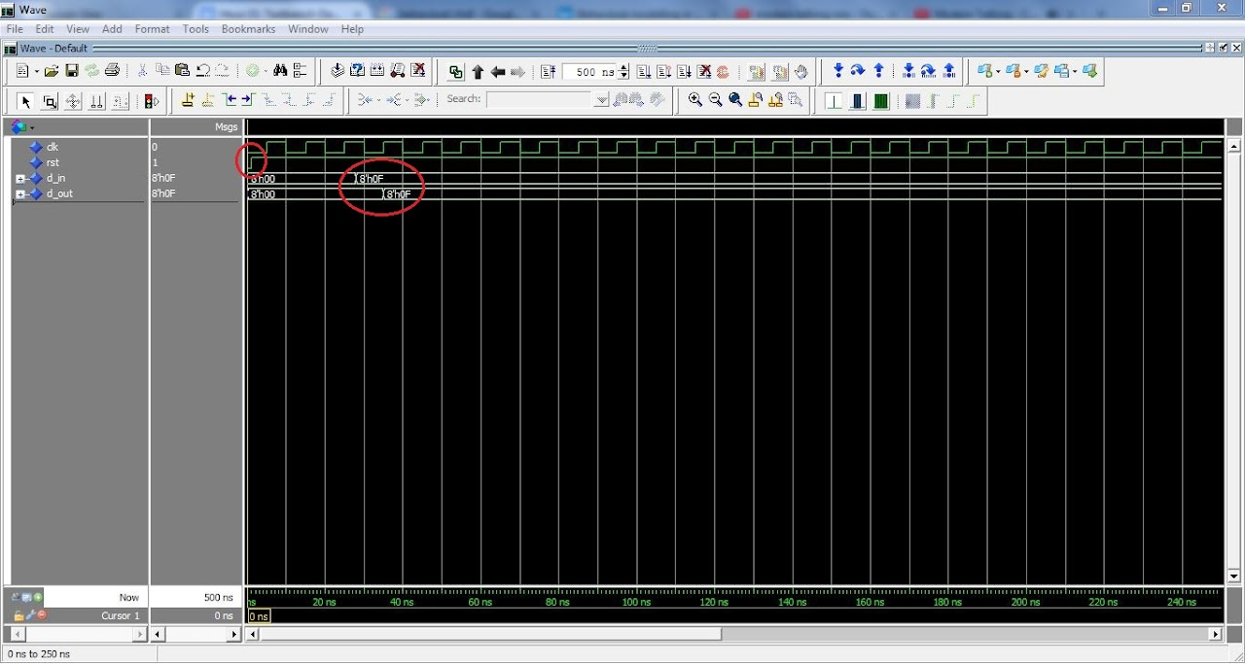
Simulation

Slide 9
Simulation
In the beginning of the simulation, all the signals are zero as we declared them right after the architecture syntax.
When reset is zero, the output is also zero.
The reset becomes 1 after 1ns.
See the change of reset wave after 1 ns (small circle) and the input/output wave changes on big circle.
You can see that the d_out is changed only on the positive edge of the clock.

Slide 10
Thank You

