Slide 1
Lesson 18
Finite State Machine
Mohd Saufy Rohmad
Technical Trainer and Consultant

Slide 2
FSM
Rather than going through VHDL examples of mealy and moore machines, I would like to show you an example how it is done.
We will take a look at a divide-by-3 finite state machine.
First, I would like to explain what is a divide-by-3 counter.
A divide-by-3 counter has one output and no inputs.
The output divides the frequency of the clock by 3.
The waveform and the state diagram is shown below.

Slide 3
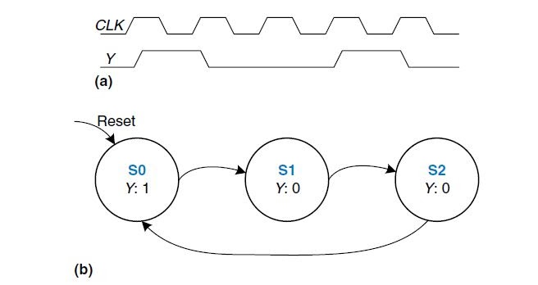
FSM

Slide 4
FSM
If you cant remember the Mealy and Moore machines please revisit Hour 3.
Regardless of the types, FSMs generally consist of three parts.
1. Register (that saves the states)
2. Logic to compute next state
3. Output logic
The parts of an FSM is shown below.

Slide 5
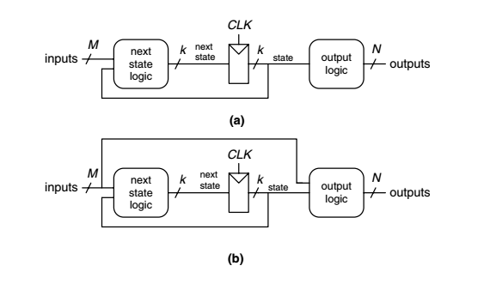
FSM
Moore (a) and mealy (b) machine

Slide 6
library IEEE;
use IEEE.STD_LOGIC_1164.all;
entity FSM_example1 is
port (clk, reset: in STD_LOGIC;
y: out STD_LOGIC);
end;
architecture synth of divideby3FSM is
type statetype is (S0, S1, S2);
signal state, nextstate: statetype;
begin
— — state register
process (clk, reset) begin
if reset = ‘1’ then state <= S0;
elsif clk’event and clk = ‘1’ then
state <= nextstate;
end if;
end process;
— — next state logic
nextstate <= S1 when state = S0 else
S2 when state = S1 else
S0;
— — output logic
y <= ‘1’ when state = S0 else ‘0’;
end;

Slide 7
FSM
The code also has three parts, state register, next state logic and output logic.
A new enumeration data type, statetype is declared with three states S0, S1 and S2 which is similar to the states defined in the figure above.
S0 is the reset state and an asynchronous reset is used in the VHDL code.

Slide 8
Thank You

