Slide 1
Lesson 19
Data Path and Control Path
Mohd Saufy Rohmad
Technical Trainer and Consultant

Slide 2
Finite state machine is the brain of digital circuit.
It can be viewed as a control of the circuit.
Typically, the datapath is controlled with a FSM.
In this hour, we will take a look at an example of an adder that can add 4-values.
Lets assume, we want to add, a, b, c, d.
If the output is s, the code can be written as,
s <= ( ( a + b ) + c ) + d ;
However, this results in a large circuit because the circuit will have 3 adders as shown in the figure,

Slide 3
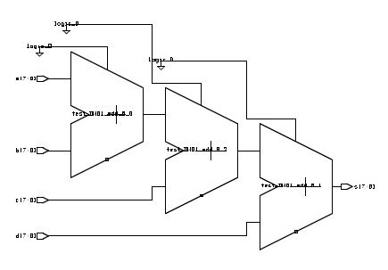
Data Path Control Unit

Slide 4
Data Path Control Unit
We want to use one adder and use it sequentially to add up all the four values.
This is when we will need FSM/a control path.
Lets take a look how the circuit might look like,

Slide 5
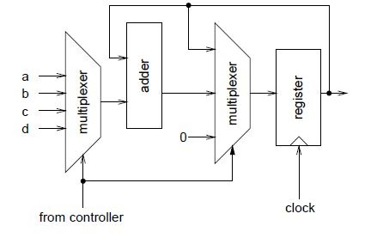
Data Path Control Unit

Slide 6
First a package is used to define the states just like the last FSM that we learned in lesson 18.
-- subtype used in design
library ieee ;
use ieee.std_logic_1164.all ;
use ieee.std_logic_arith.all ;
package averager_types is
subtype num is unsigned (7 downto 0) ;
type states is (clr, add_a, add_b, add_c,
add_d, hold) ;
end averager_types ;

Slide 7
Datapath
Next we have the datapath which does all the necessary works based on the 2-bit input sel and 1-bit inputs load and clear from the control path.

Slide 8
-- datapath
library ieee ;
use ieee.std_logic_1164.all ;
use ieee.std_logic_arith.all ;
use work.averager_types.all ;
entity datapath is
port (
a, b, c, d : in num ;
sum : out num ;
sel : in std_logic_vector (1 downto 0) ;
load, clear, clk : in std_logic
) ;
end datapath ;
architecture rtl of datapath is
signal mux_out, sum_reg, next_sum_reg : num ;
constant sum_zero : num :=
conv_unsigned(0,next_sum_reg’length) ;
datapath

Slide 9
begin
-- mux to select input to add
with sel select mux_out <=
a when "00",
b when "01",
c when "10",
d when others ;
-- mux to select register input
next_sum_reg <=
sum_reg + mux_out when load = ’1’ else
sum_zero when clear = ’1’ else
sum_reg ;
-- register sum
process(clk)
begin
if clk’event and clk = ’1’ then
sum_reg <= next_sum_reg ;
end if ;
end process ;
-- entity output is register output
sum <= sum_reg ;
end rtl ;
datapath

Slide 10
-- controller
library ieee ;
use ieee.std_logic_1164.all ;
use work.averager_types.all ;
entity controller is
port (
update : in std_logic ;
sel : out std_logic_vector (1 downto 0) ;
load, clear : out std_logic ;
clk : in std_logic
) ;
end controller ;
architecture rtl of controller is
signal s, holdns, ns : states ;
signal tmp : std_logic_vector (3 downto 0) ;
begin
controller

Slide 11
-- select next state
with s select ns <=
add_a when clr,
add_b when add_a,
add_c when add_b,
add_d when add_c,
hold when add_d,
holdns when others ;
-- hold
-- next state if in hold state
holdns <=
clr when update = ’1’ else
hold ;
-- state register
process(clk)
begin
if clk’event and clk = ’1’ then
s <= ns ;
end if ;
end process ;
-- controller outputs
with s select sel <=
"00" when add_a,
"01" when add_b,
"10" when add_c,
"11" when others ;
load <= ’0’ when s = clr or s = hold else ’1’ ;
clear <= ’1’ when s = clr else ’0’ ;
end rtl ;
Control unit

Slide 12
The controller and the datapath are placed in a package. We will discuss about the package more in the next hour.

Slide 13
-- package for datapath and controller
library ieee ;
use ieee.std_logic_1164.all ;
use work.averager_types.all ;
package averager_components is
component datapath
port (
a, b, c, d : in num ;
sum : out num ;
sel : in std_logic_vector (1 downto 0) ;
load, clear, clk : in std_logic
) ;
end component ;
component controller
port (
update : in std_logic ;
sel : out std_logic_vector (1 downto 0) ;
load, clear : out std_logic ;
clk : in std_logic
) ;
end component ;
end averager_components ;
package

Slide 14
-- averager
library ieee ;
use ieee.std_logic_1164.all ;
use ieee.std_logic_arith.all ;
use work.averager_types.all ;
use work.averager_components.all ;
entity averager is port (
a, b, c, d : in num ;
sum : out num ;
update, clk : in std_logic ) ;
end averager ;
architecture rtl of averager is
signal sel : std_logic_vector (1 downto 0) ;
signal load, clear : std_logic ;
-- other declarations (e.g. components) here
begin
d1: datapath port map ( a, b, c, d, sum, sel, load,
clear, clk ) ;
c1: controller port map ( update, sel, load,
clear, clk ) ;
end rtl ;
Top module

Slide 15
Thank You

