Slide 1
Lesson 22
Good VHDL Coding Style
Mohd Saufy Rohmad
Technical Trainer and Consultant

Slide 2
Comment
Comment is essential to write good codes in any programming language.
VHDL is already a complicated language.
So, without comments, it becomes more cryptic and impossible to understand.
There can be 3 types of comments
(1) Comment should be written before every entity that states the author name, creation date etc. A template of such comment is given here
(2) Every process should start with a comment, that summarizes what the process do. This is a very good practice as it is quite easy to forget why the process was written.
(3) Finally, inline comments. You must have them everytime you feel they are necessary.

Slide 3
(1)
---------------------------------------------------------------------------------------------------------
-- Title : Real Arithmetic Library
-- Project : Comit
----------------------------------------------------------------------------------------------------------
-- File : realArithmetic.vhd
-- Author : Shahriar Shahabuddin (shahriar.shahabuddin@oulu.fi)
-- Company : Centre for Wireless Communications, University of Oulu
-----------------------------------------------------------------------------------------------------------
-- Description: This package contains a set of functions that carries out
-- real arithmetic operations
-----------------------------------------------------------------------------------------------------------
-- Copyright (c) Centre for Wireless Communications, University of Oulu
-----------------------------------------------------------------------------------------------------------
-- Revisions :
-- Date Version Author Description
-- 2012 1.0 sshahabd Created
-- 11/02/2012 1.1 sshahabu First Release
-- 07/01/2012 1.2 sshahabu bug fixes
-- 11/05/2012 1.3 sshahabu Major revision
------------------------------------------------------------------------------------------------------------

Slide 4
(2)
--------------------------------------------------------------------------
-- comb_proc : this process creates a multiplexer
--------------------------------------------------------------------------
comb_proc : process(state)
begin
if state = "001" then
cs <= "01";
elsif state = "010" then
cs <= "10";
elsif state = "100" then
cs <= "11";
end if;
end process;

Slide 5
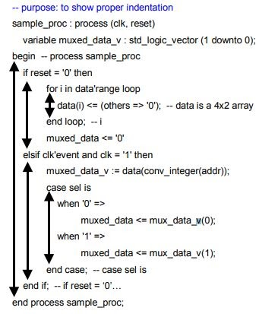
Identation
This is also a general rule for any programming language.
Use an editor that can do proper indentation automatically.
Here is an example of good indentation taken from Xilinx's coding style guideline.

Slide 6
Naming Convention
The naming of signals, entities, constants or variables should follow a guideline rather than having arbitrary names. This makes a VHDL code more readable.
Hubert Kaeslin explained a naming convention in his book.
He compiled a number of attributes for making a signal's nature evident.
signal_identifier ::= signal_name "x" signal_attributes
signal_name ::= upper_case_letter { letter | digit}
signal_attributes ::= class_char [ signal_waveform ] state_char trist_mode actve_low_char io_mode
class_char ::= "R" | "A" | "C" | "S" | "D" | "T"
signal_waveform ::= "Q" | "M" | "G"
state_char ::= "N" | "P" | ""
trist_mode ::= "Z" | ""
active_low_char ::= "B" | ""
io_mode ::= "I" | "O" | "IO" | ""

Slide 7
Example
Examples
‣ FOOxC identifies a clock signal.
‣ BARxD indicates this is a regular data signal within some clock domain. As opposed to this, the name BARxA refers to the same signal
before its being synchronized to the local clock and, hence, subject to toggle at any time.
‣ REXTFxRB refers to some asynchronous active-low reset signal.
‣ ADDRCNTxSP and ADDRCNTxSN are names for the present and next state of an address counter.
‣ IRQxAMI identifies an interrupt request input that emanates from a foreign clock domain and that is meant to be stored in a
positive-edge-triggered flop-flop until it is serviced.
‣ CarryxDB denotes an active-low carry signal.
‣ GeCntxDZO denotes an output-only data signal with high impedance capability.
‣ ScanModexT stands for an active-high scan enable signal within some clock domain.

Slide 8
Ten Commandments of VHDL
All state machine outputs shall always be registered
Thou shalt use registers, never latches
Thy state machine inputs, including resets, shall be synchronous
Beware fast paths lest they bite thine ankles
Minimize skew of thine clocks
Cross clock domains with the greatest of caution. Synchronize thy sig- nals!
Have no dead states in thy state machines
Have no logic with unbroken asynchronous feedback lest the ﬂeas of myriad Test Engineers infest thee
All decode logic must be crafted carefully—eschew asynchronicity
Trust not thy simulator—it may beguile thee when thy design is just

Slide 9
Thank You

