Slide 1
Lesson 4
VHDL Intro and IDE
Mohd Saufy Rohmad
Technical Trainer and Consultant

Slide 2
What is VHDL
VHDL stands for VHSIC Hardware Description Language
VHSIC = Very High Speed IC

Slide 3
What is VHDL
First we need to know what is a hardware description language (HDL) and why it was used in the first place.
A few reasons to use HDLs are:
1. Time needed for a digital circuit design reduces dramatically.
2. Its painful to draw schematic diagrams.
3. No need of optimization using Karnaugh Maps etc.
4. Design is portable.
5. TECHNOLOGY INDEPENDENT.
VHDL is a HDL/programming language to build digital electronic circuits.
We can write VHDL codes to create digital circuits, for example, from simple ripple-carry adder to complicated processor.

Slide 4
Level of Abstraction
Its important to understand in which abstraction level are we gonna use VHDL.
The typical level of abstractions for any design is:
1. Algorithmic level
2. System level.
3. Register Transfer level.
4. Gate level.
5. Transistor level.
We are going to use RTL level designs in this tutorial site, Where exactly are we going to design can be explained by some nice diagram drawn by Professor Christopher Batten

Slide 5
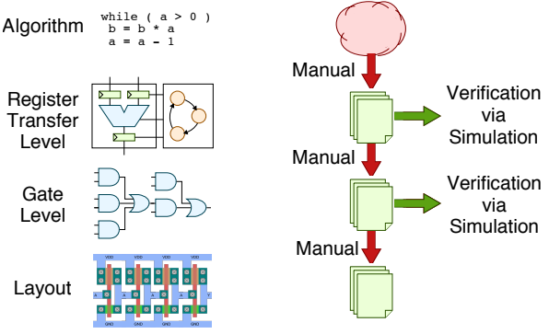
Level of Abstraction
Originally designers used manual translation and breadboards for verification
Hardware description languages enabled gate-level verification via simulation
Designers began to use HDLs for RTL level verification and design exploration

Slide 6
Tools
Modelsim for simulation
Vivado for synthesis on xilink fpga

Slide 7
Thank You

