Slide 1
Lesson 5
Entity, Architecture and Signals
Mohd Saufy Rohmad
Technical Trainer and Consultant

Slide 2
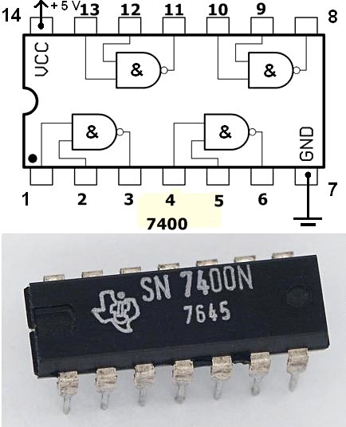
Think In Hardware
Think about an IC, for example, a 7400N IC.
It includes four NAND gates inside, while its provided in a black package.
Lets say we want to write the VHDL code of the 7400N IC

Slide 3
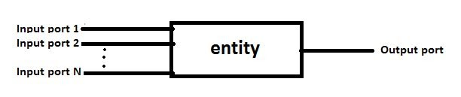
Think In Hardware
It is easier to think that you are designing a black box when you are writing any VHDL code.
This black box has inputs and outputs and something in between.
This black boxes are called entity.

Slide 4
Think In Hardware
For 7400N IC's VHDL code, we will call this black box aka entity as IC7400. The entity IC7400 should have 8 input ports and 4 output ports corresponding to the input and outputs of the original 7400N IC.
This is how the VHDL code of IC7400 might look like

Slide 5
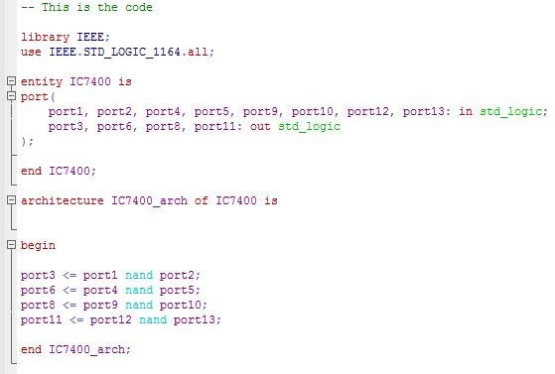
Think In Hardware

Slide 6
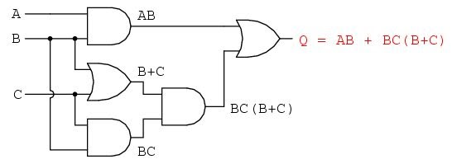
Architecture
Every entity can have different architecture.
Think about it in this way that any digital circuit can have different architectures, i.e. different logic, different number of gates etc.
For example, The output of the following circuit have a boolean expression of AB + BC(B+C) which can be simplified as B(A+C).
The VHDL code of the unoptimized architecture, i.e. AB + BC(B+C) can be written as

Slide 7
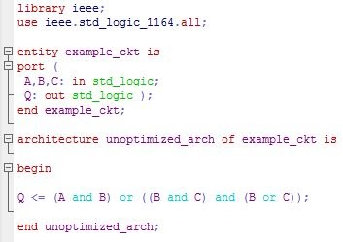
VHDL for 7400N
The VHDL code of the unoptimized architecture, i.e. AB + BC(B+C) can be written as,

Slide 8
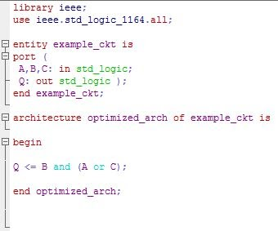
VHDL for 7400N
And the optimized architecture can be written as,

Slide 9
Signal
So far we have only seen how to write input and output ports.
We only learned to think the entity as a blackbox where the input and output ports are coming out of the box.
But what happens when we have to write some ports or wires inside the blackbox.
For example, consider the following circuit.
The final output is (A or B) and C.
It is possible to write the whole thing in a single sentence.
But we might have a complex design where its not possible.
We have to breakdown the entire operation then.
In this case, lets say, we want to break down (A or B) and C into (A or B) first and then use the output to AND with C.
This is where we introduce the concept of signals.

Slide 10
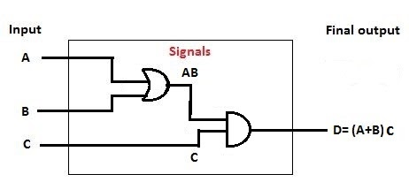
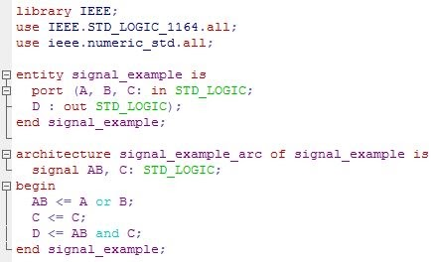
Signal
The VHDL code of this circuit is written here.
The signal here is AB that works as an intermediate signal inside the blackbox.
We have to declare the signal after architecture and before begin.

