Slide 1
Lesson 6
Literals and Operators
Mohd Saufy Rohmad
Technical Trainer and Consultant

Slide 2
Literals
You probably already know different numbering systems like binary, hexadecimal, octal etc.
In this section, we will discuss how to express them in VHDL.
It is possible to declare binary or hexadecimal numbers in VHDL in the following way,
Binary: B"11000100"; Hexadecimal: X"FF";
Or in the following way,
Binary: 2#11000100#;
Hexadecimal: 16#FF#;
For readability its possible to use _ in betweeen. It will have no effect, for example,
Binary: B"1100_0100";

Slide 3
Literals
You can also declare integer or real data types, like,
constant FREEZE : integer := 32; constant TEMP : real := 32.0;
However, the real and integers are tricky to use as you dont know how they will be translated into a hardware.
It is very important to know about different number systems and fixed point data types. Please go through the lectures provided in the link,
https://sites.google.com/site/shahriarshahabuddin/teaching#TOC-Lecture:
The lecture 2 about fixed point implementation will give you an idea about different data formats and how they can be applied for digital designs.

Slide 4
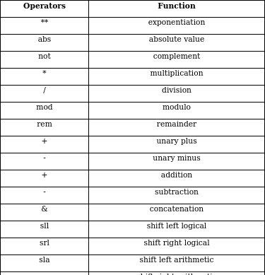
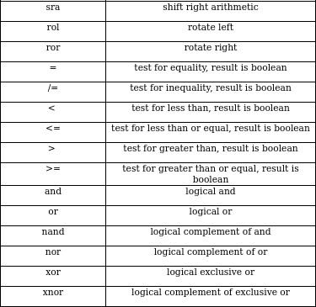
Operator
Operators are means for constructing expressions, a list of basic operators are given here:

Slide 5
Thank You

