Slide 1
Lesson 8
Components
Mohd Saufy Rohmad
Technical Trainer and Consultant

Slide 2
Components
Its nearly impossible to put every VHDL code inside one entity while designing a huge design.
Its also not a clever idea as a modular design helps to debug and ease the development.
So how can we divide a huge design in smaller parts and connect them together.
Perhaps you have already guessed it?
Yes, we will design smaller components of the bigger design as separate entities and connect them with a top entity

Slide 3
Components
Lets assume it is difficult to design nand and and gate together in a single entity (which is certainly not true :p, but for the sake of understanding just assume its right).
We can develop two separate entities first.
One for the nand gate and another for the and gate.
For example, an entity for the nand gate can be written as:

Slide 4
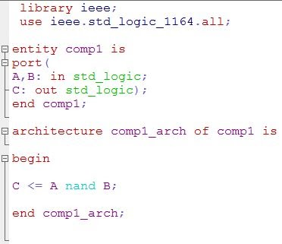
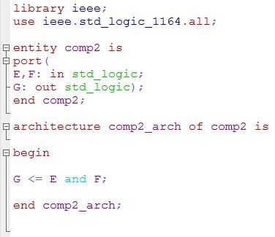
Components
And another entity for the AND gate can be written as,

Slide 5
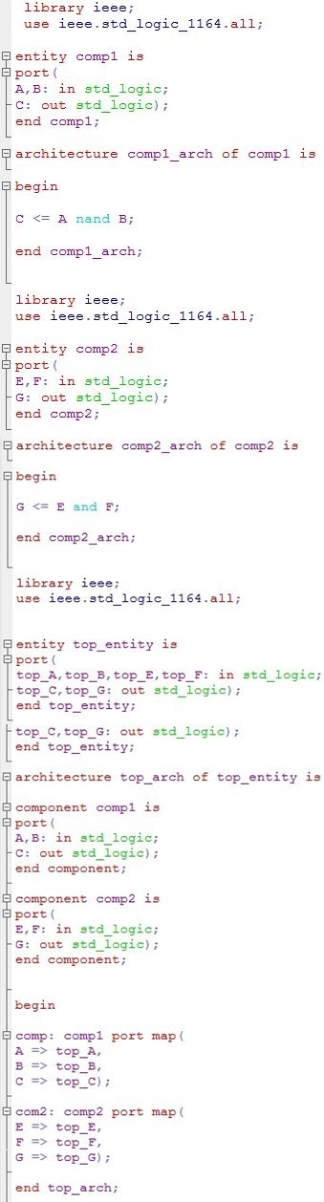
Components
Now we want to put them together inside a top entity. The top entity would contain this two entities as components.
Full code in lab

Slide 6
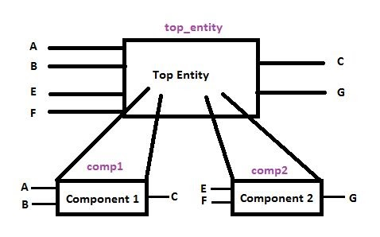
Components
It might look intimidating in the beginning, but don’t be scared.
Its actually a pretty simple code.
What we are doing here can be better understood by this diagram

Slide 7
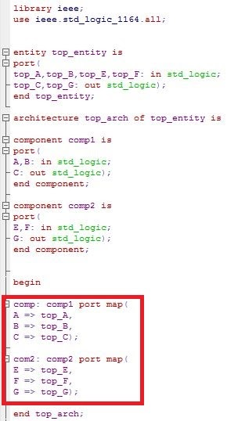
Component port map:
Now the biggest task is still left. We decided to use this smaller entities as components, but we have to connect the input and output ports of the smaller entities to some signal or ports of the top entity.
You can actually visualize it in this way.

Slide 8
Components
It's just like plugging ICs into a breadboard.
For example, we can plug a 7400 IC (NAND) and 7408 IC (AND) gate in a breadboard in this similar way as shown in the figure above.
We could also instantiate the components in this way, however the order of the instantiation is very important in that case.
Otherwise the one part will be binded to another undesired part.

