Slide 1
Lesson 9
Structural, Behavioral and RTL
Mohd Saufy Rohmad
Technical Trainer and Consultant

Slide 2
Structural, Behavioral and RTL
To put it simply, Behavioral VHDL code just shows you the behavior how the desired circuit might work.
In other words, it mimics the behavior of how the actual circuit might work.
So you cant synthesize a behavioral block.
The behavioral block might be used to represent an analog block, a place holder code (when RTL is not ready of that part) and testbench code.
For example, the following code,

Slide 3
Example
always begin
if (!clk_en && clk==1'b1) begin
wait (clk_en);
end
#5 clk = ~clk;
end

Slide 4
Behavioral Modelling
Behavioral VHDL codes give the timings directly, such as, #5 clk = ~clk; or alarm_siren <= '1' after 5ns; directly where the periods of the clock pulses are given in the code itself.
These type of behavior are very important for testing a synthesizable VHDL block.
Thats why we will see this type of codes in the testbench.

Slide 5
RTL Modeling
We have already seen RTL modeling in lesson 4. It is called the register transfer level.
The term "RTL" is doenst only represent the abstraction level here, it also represents a synthesizable code unlike the Behavioral modeling.
In short,
We design our digital circuit with RTL VHDL and test it with Behavioral VHDL.

Slide 6
Structural Modeling
It describes how the components are connected.
They are assumed to exist in local working directory or in a library.
Structural modeling facilitate the use of hierarchy and abstraction in modeling complex systems.
This model can be integrated into models that also use processes.
Example: Let's consider a structural model of 2:1 multiplexer as the following figure.

Slide 7
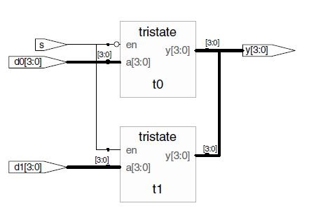
Structural Modeling

Slide 8
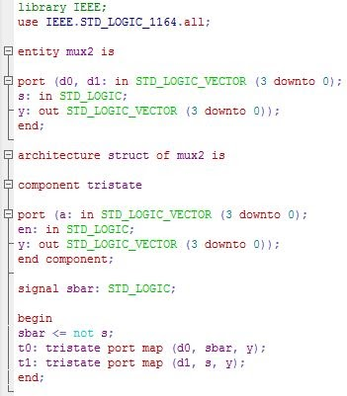
We can represent the VHDL structural code as below.

Slide 9
Structural
In general, the topmost synthesizable entity is normally written with structural modeling.
The structural model at the top includes all the entities that are written with RTL and connected together with port mappings.

Slide 10
Thank You

