Slide 1
Design and Optimization of a CDS Circuit
Mahmoud Sawaby

Slide 2
Project Definition Summary
Spec | Value
Technology | 0.18µm CMOS
Supply | 1.8V
Dynamic Range | 74dB (12bits)
Settling Time (0.1%) | <33ns
OTA DC Gain | 79dB
Power | Minimize!
Tactics for minimizing power:
Minimize noise contributors without sacrificing swing (using adaptive compensation)
Use gain enhancement techniques and still use small ‘L’ signal devices (CLS)

Slide 3
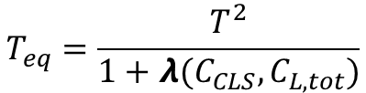
Correlated Level Shifting (CLS) [Moon, 2008]
☺ Smaller ‘L’ can be used. [ (g_{m}r_{o})² amplifier with min ‘L’ is enough!]
☹ Slightly faster amp, to settle in tighter durations.
Estimation Phase
Level Shift Phase
$$T_{eq}=\frac{T^{2}}{1+λ(C_{CLS},C_{L,tot})}$$
Two Stage Implementation

Slide 4
Amp Topology
The following are possible candidates for the OTA:
Telescopic/folded cascode:
Current reuse.
Miller-compensated two stage:
Higher swing (~1.4x), meaning less capacitance (a factor of ~ 2), and less currents.
Better contingency, in case CLS did not work. (would add cascades to the first stage, with minimal tweaks)
Went with the Miller-compensated two stage.

Slide 5
Design Parameters Reduction
We can use min. ‘L’ for signal transistors.
Plenty of ‘f_{T}’ to spare. Use current efficiencies of 20 for signal devices.
Use larger ‘L’ for load transistors (500nm)
As long as headroom is not an issue.
Only interested in drain capacitance.
Assume duty cycle of CLS clocking is 70% / 30%.
All the slewing is in the estimation phase
LS phase only takes care of the error.
Set C_{L} = C_{S}/4, minimum implied by project requirements.
Assume the C_{CLS} to be equal to C_{L}
Slight sacrifice in effective loop gain, without much loading at estimation phase.

Slide 6
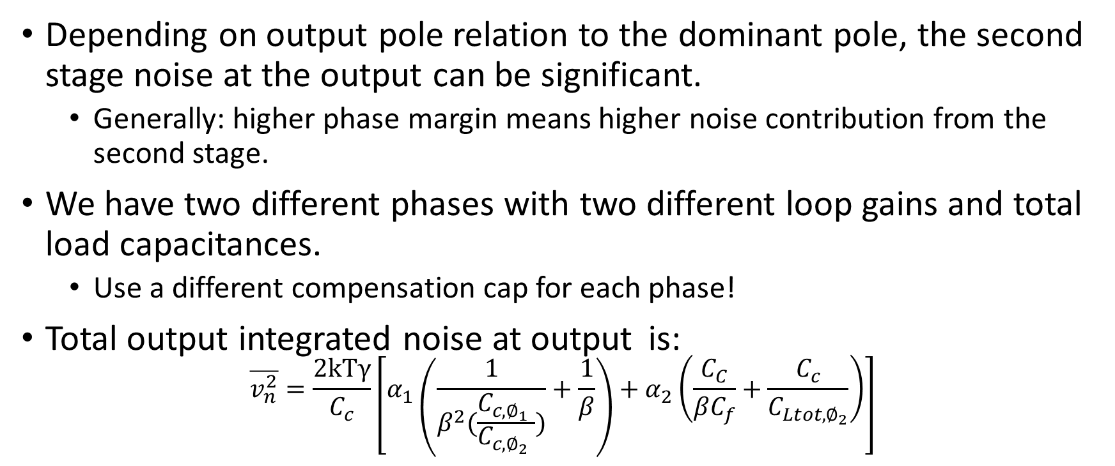
Two Stage Noise, Key equation
Depending on output pole relation to the dominant pole, the second stage noise at the output can be significant.
Generally: higher phase margin means higher noise contribution from the second stage.
We have two different phases with two different loop gains and total load capacitances.
Use a different compensation cap for each phase!
Total output integrated noise at output is: $\overline{v_{n}^{2}}=\frac{2kTγ}{C_{c}}\left[α_{1}\left(\frac{1}{β^{2}(\frac{C_{c,∅_{1}} }{C_{c,∅_{2}} })}+\frac{1}{β}\right)+α_{2}\left(\frac{C_{C}}{βC_{f}}+\frac{C_{c}}{C_{Ltot,∅_{2}}}\right)\right]$
Main design nobs

Slide 7
Design Methodology, MATLAB Optimization

Slide 8
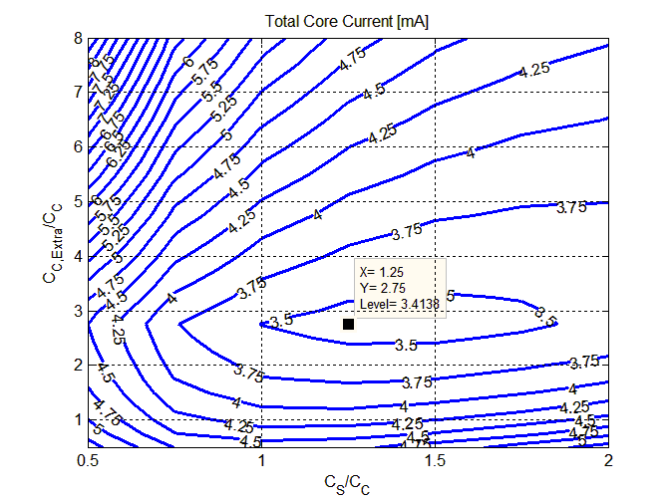
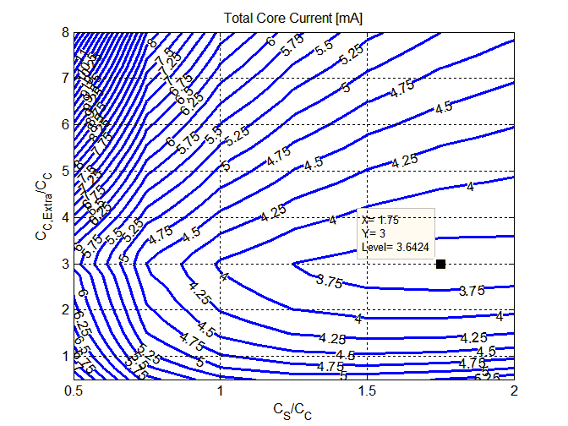
MATLAB Output
NMOS input pair
PMOS input pair

Slide 9
Circuit Model
MATLAB design was loaded to Cadence.
Gain, noise specs were a good match.
Settling issues due to:
Slewing more than anticipated.
Drain cap at internal output node interaction with CLS.
Iterating on Cadence:
Reducing the current efficiency of M5/M6
Increasing the current slightly.

Slide 10
Implementation Considerations
CLS does NOT enhance the CM loop gain. Special care is paid to minimize systematic offsets around the loop.
‘Constant VDS’ current mirrors.
CMFB placement to prevent latching.

Slide 11
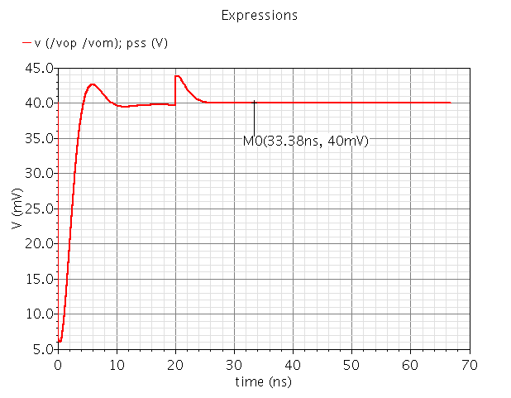
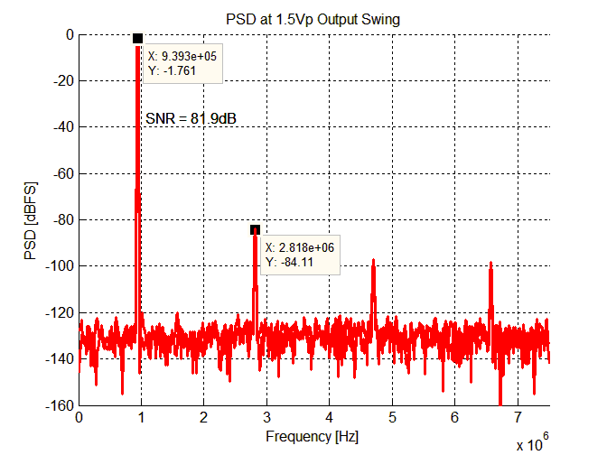
Results
DR of 73.9 at 1.5Vp output.
Settling < 33ns.
Effective gain about 81dB.

Slide 12
Summary
CLS is good for low supply desings.
Here a cascode would still work.
Noise in two stage OTA is high for designs with different loading/phase
Using variable Cc solves the issue.
Circuits is fun!

Slide 13
That’s It
Thanks!
Questions?

