Slide 1
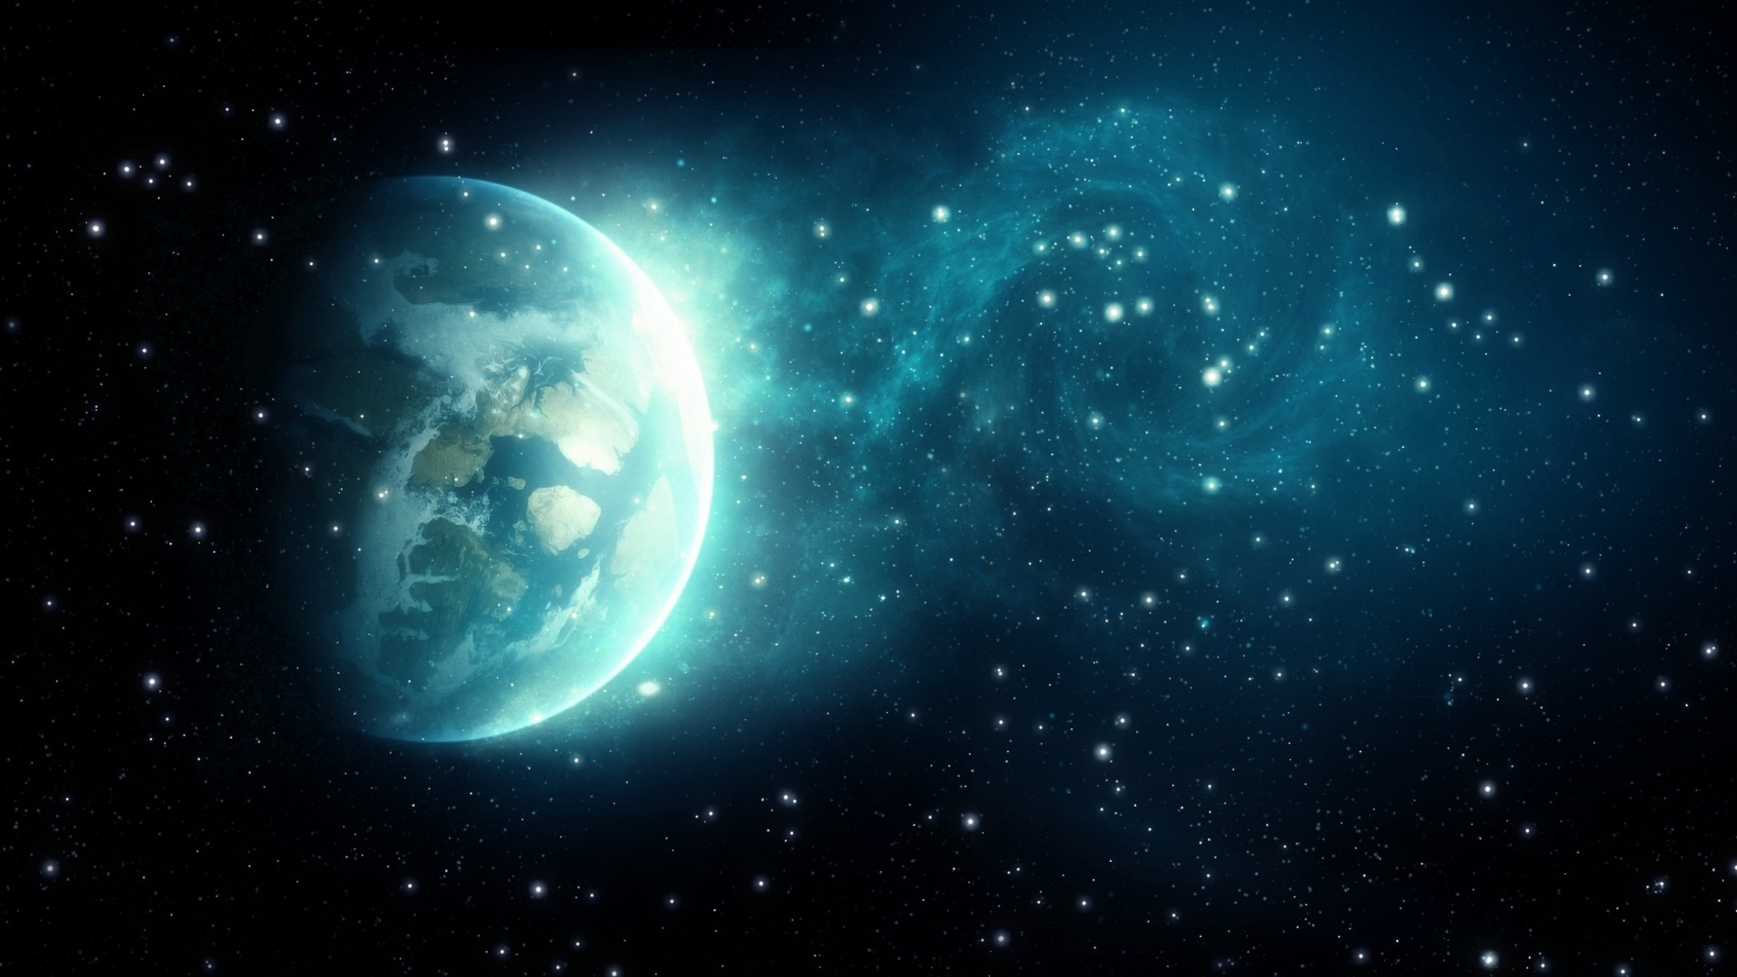
Level 1: Instructions
Press Space to launch yourself
Make use of Mars’s gravity
Land on the moon! Keep track of Time To Moon
Good luck!

Slide 2
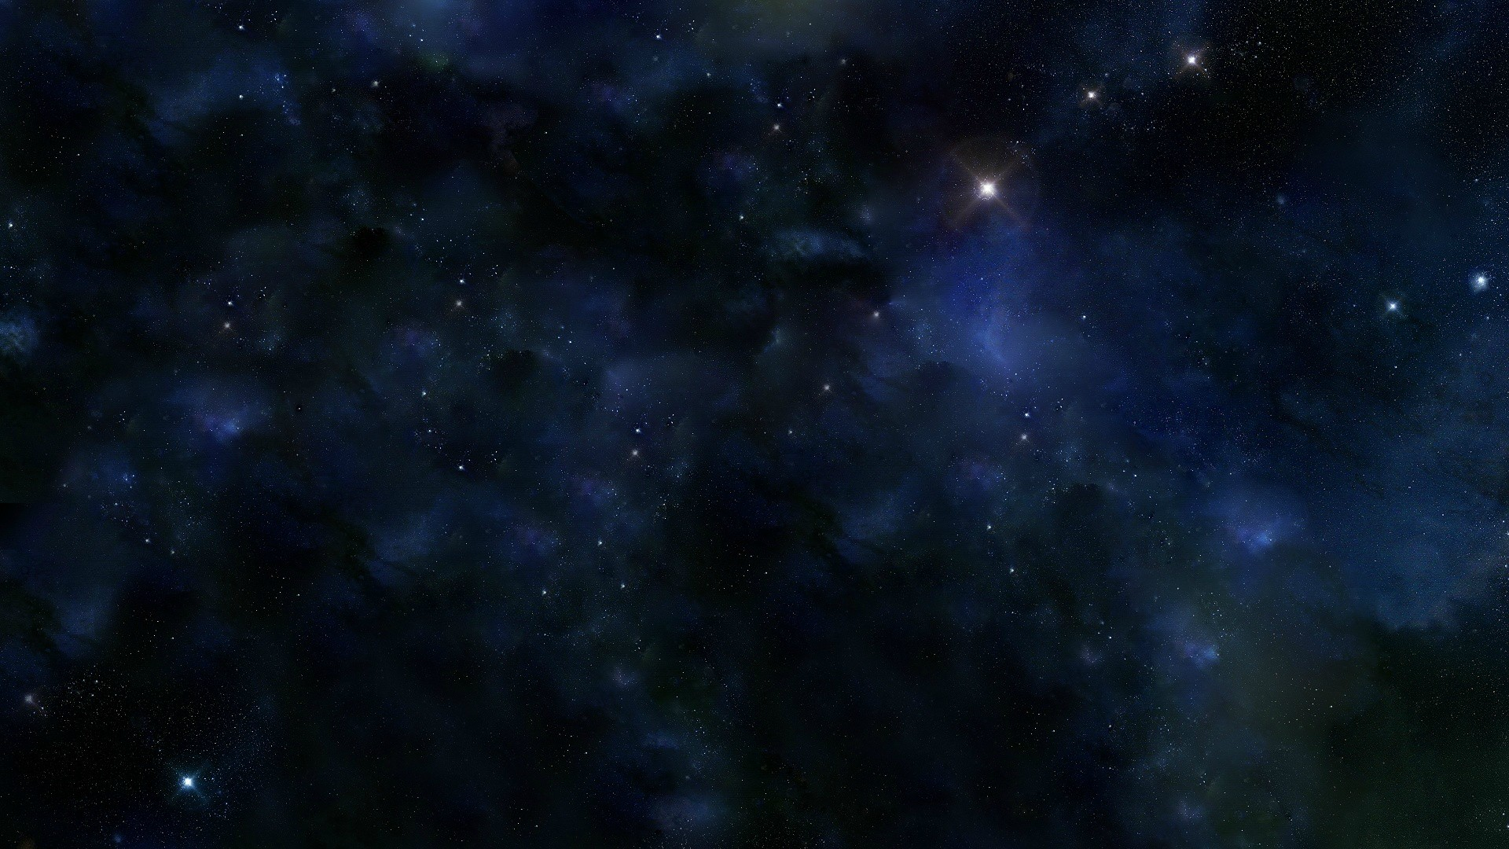
Welcome To Level2!
Enter the planets without getting stuck in their orbits!
Every time you hit a planet with fuel on it, fuel score goes up by 50
Every time you hit a planet, score increases by 10 fuel points
While the ship flies, it loses fuel.
If you get stuck in an orbit, you’re flying due to its gravity and therefore not losing fuel!
Try to fill up the tank!

Slide 3
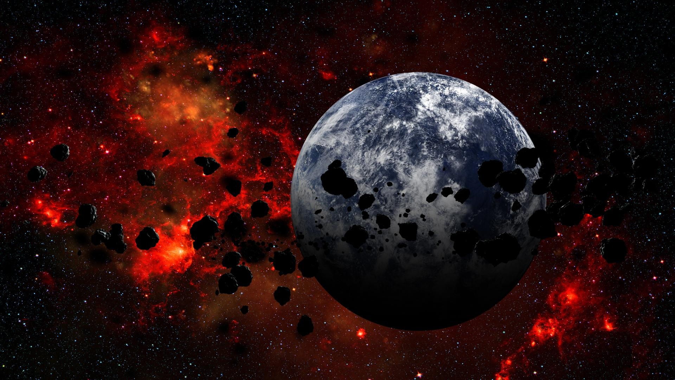
Level3: Save the Earth
Shoot the asteroids by pressing Space Bar
Save the Earth from disintegrating!
Some asteroids will become bigger when shot! Be careful ☺
Good luck!

