Slide 1
Ekstazi
Practical Regression Test Selection with Dynamic File Selection (ISSTA ‘15)
Milos Gilgoric, Lamyaa Eloussi, and Darko Marinov

Slide 2
Motivations – Why do Regression Test Selection?
Regression Testing (RT) has significant costs:
80% of Testing Budget
50% of Maintenance cost
Total time for RT increases non-linearly with size of codebase
Google observed linear increases in software changes and test-suit execution time.
Quadractic increase in total test suite execution time
Regression Test Selection (RTS) promising approach to solve problems with RT

Slide 3
Challenges
Usefulness – Total RTS time < Non-RTS execution time
pre-execution analysis to select tests + execution + post-execution data collection must be faster than non-RTS execution
Correctness – Selected tests must include all tests affected by changes
Ideally need a formal proof of correctness
Integration – RTS must work well with testing frameworks.
Must be easy for Projects using Junit, TestNG to adopt RTS
Parametric Tests – Safe selection of subset of parameters for a test

Slide 4
Contributions
Ekstazi (pronounced “ecstasy” /'ɛkstəsi/) – a lightweight Regression Test Selection (RTS) Suite
Lightweight – Uses file dependencies. Efficient pre-execution analysis
Safe – Selects more tests. Safer and faster end to end
In future, authors intend to add a formal proof of safety
Robust Implementation - Integrates with Junit, Ekstazi already used in Apache Camel, Apach Commons Math, Apache CXF
Extensive Evaluation – Favorable results when compared to state of the art in RTS

Slide 5
Background
RTS typically has three phases -
Analysis - Select test to run based on changes
Execution - Run selected tests
Collection – Emit/gather information for subsequent RTS runs
A tool tracks mappings of test entities to dependencies
For e.g., test methods or Test Classes are test entities. Selection Granularity (SG) is granularity of test entities.
Files, basic blocks used by the entity are dependencies. Dependency Granularity (DG) is granularity of dependencies.

Slide 6
Example - Selection + Dependency Granularities
SG Method + DG Method
t1 -> C.m()
t2 -> C.m()
t3 -> C.p()
t4 -> D.p()
class TestM {
void t1() {
assert new C().m() == 1;
}
void t2() {
assert new D().m() == 1;
}
…
class TestP {
void t3() {
assert new C().p() == 0;
}
void t4() {
assert new D().p() == 4;
}
…
class C {
int m() {
/** No function calls**/
}
int p() {
/** No function calls**/
}
…
class D extends C {
@override
int p() {
/** No function calls**/
}
…

Slide 7
Example - Selection + Dependency Granularities
SG Method + DG Class
t1 -> C, TestM
t2 -> C, D, TestM
t3 -> C, TestP
t4 -> C, D, TestP
class TestM {
void t1() {
assert new C().m() == 1;
}
void t2() {
assert new D().m() == 1;
}
…
class TestP {
void t3() {
assert new C().p() == 0;
}
void t4() {
assert new D().p() == 4;
}
…
class C {
int m() {
/** No function calls**/
}
int p() {
/** No function calls**/
}
…
class D extends C {
@override
int p() {
/** No function calls**/
}
…

Slide 8
Esktazi’s Technique
Traditional tools use methods for both SG and DG
Fewer tests lead to fast execution
But slow analysis and collection
Ekstazi uses Methods or Classes for SG and Files for DG
More tests lead to slow execution
But fast analysis and collection
Faster end-to-end than no-RTS and other RTS approaches

Slide 9
RTS Phases
Analysis (A)
Select tests for changes
Execution (E)
Run selected tests
Collection (C)
Collect Data for next iteration

Slide 10
Esktazi Implementation
Codebase
Test Suite
Dependency File
D1
Hash(D1)
Hash(D2)
Hash(D3)
D2
T1
D3
Dependency File
T2
D4
Hash(D4)
Hash(D5)
D5

Slide 11
Esktazi Analysis (A) Phase
Codebase
Test Suite
Dependency File
D1
Hash(D1)
Hash(D2)
Hash(D3)
D2
T1
Selected
D3
Dependency File
T2
D4
Rejected
Hash(D4)
Hash(D5)
D5

Slide 12
Esktazi Analysis (A) Phase
Maintains a dependency file for each test entity
During analysis of an entity:
Checks if checksum of all dependency files are same
Doesn’t require analysis of the old version revision
Changes in sources that don’t affect executables discarded. For e.g. renaming variables/formatting won’t change executable, hence ignored by Ekstazi
Works naturally for new test entities. If dependency file is missing, entity is selected

Slide 13
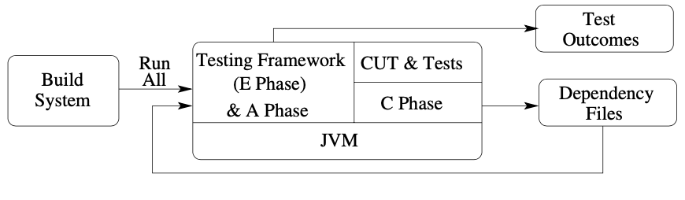
Estazi Execution (E) Phase (Tight Integration)
Build system invokes test-target with all classes
Ekstazi only runs selected entities
Classes loaded / JVM spawned for each entity (including rejected tests)
Simpler setup – “testingframework.jar” with “esktazi.jar”

Slide 14
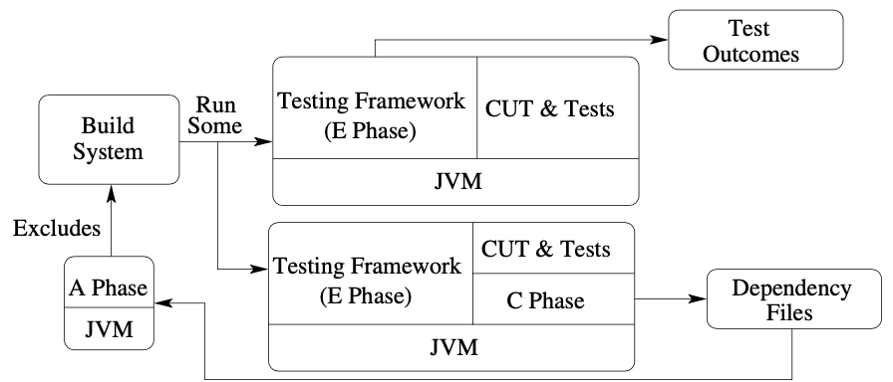
Estazi Execution (E) Phase (Loose Integration)
Separate analysis phases generates “excludes” list
Excludes list of classes passed to build system
Excluded classes not loaded in execution phase
Involves higher setup cost

Slide 15
Estazi Execution (E) Phase
Tight Integration with Ekstazi –
In tight Integration approach, testing framework replaced by Ekstazi-enabled version
Build system find all classes and invokes test framework assuming all tests will run
Ekstazi checks each entity and decided whether to run or not
Easier to setup – requires changing the testing framework jar with ekstazi jar.
Uses more resources as all entities loaded into JVM, even ones that are skipped

Slide 16
Estazi Execution (E) Phase
Loose Integration with Ekstazi –
In A phase, ecstazi decides all entities that must not be run
Build system invokes test framework on all tests
Ekstazi checks each entity and decided whether to run or not
Build script is then instructed to exclude classes that must not be run
Saves resources, as classes are never loaded into JVM
Not as straightforward to setup as tight integration

Slide 17
Ekstazi Collection (C) Phase
C Phase
JVM
Collection Phase updates dependency file for next iteration
One Pass - Collection runs alongside (A + E)
Double Pass – Collection run as separate parallel process
Results of AE Phase dispatched as soon as available

Slide 18
Esktazi Collection (C) Phase
Accessed File Type
Explicitly (non class files)
Files accessed via java.io functions
Dynamically instrument methods that open files (e.g. FileInputStream)
Implicitly (class files)
Maintain set of java.lang.Class instances
For each class, find where it was loaded from
If loaded from disk, track source
If dynamically created, don’t track
Can only change if generator changes
Instrument constructors, static initializers, use of class literal, etc

Slide 19
Ekstazi Dependency File Format
One file per test entity named after entity
For Selection Granularity method, files named TestA.test1, …
Trade-off space for concurrent execution
Larger files would need synchronization on updates

Slide 20
Smart Checksums
Dependency files track class files
Ignores semantically equivalent changes
E.g. , i += 1 and i++ may produce same bytecode
Ignores irrelevant parts of class files in most contexts
E.g., Compile time annotations, debug section
A and C Phases slower but E Phase faster as fewer tests selected

Slide 21
Evaluation Setup
32 open source projects from Github, Google Code, Apache, etc
Run tool on 20 subsequent versions of chosen project
Use unmodified for any project
The standard build+test lifecycle for underlying tool is used:
mvn test (for maven) or ant junit-test (for ant)

Slide 22
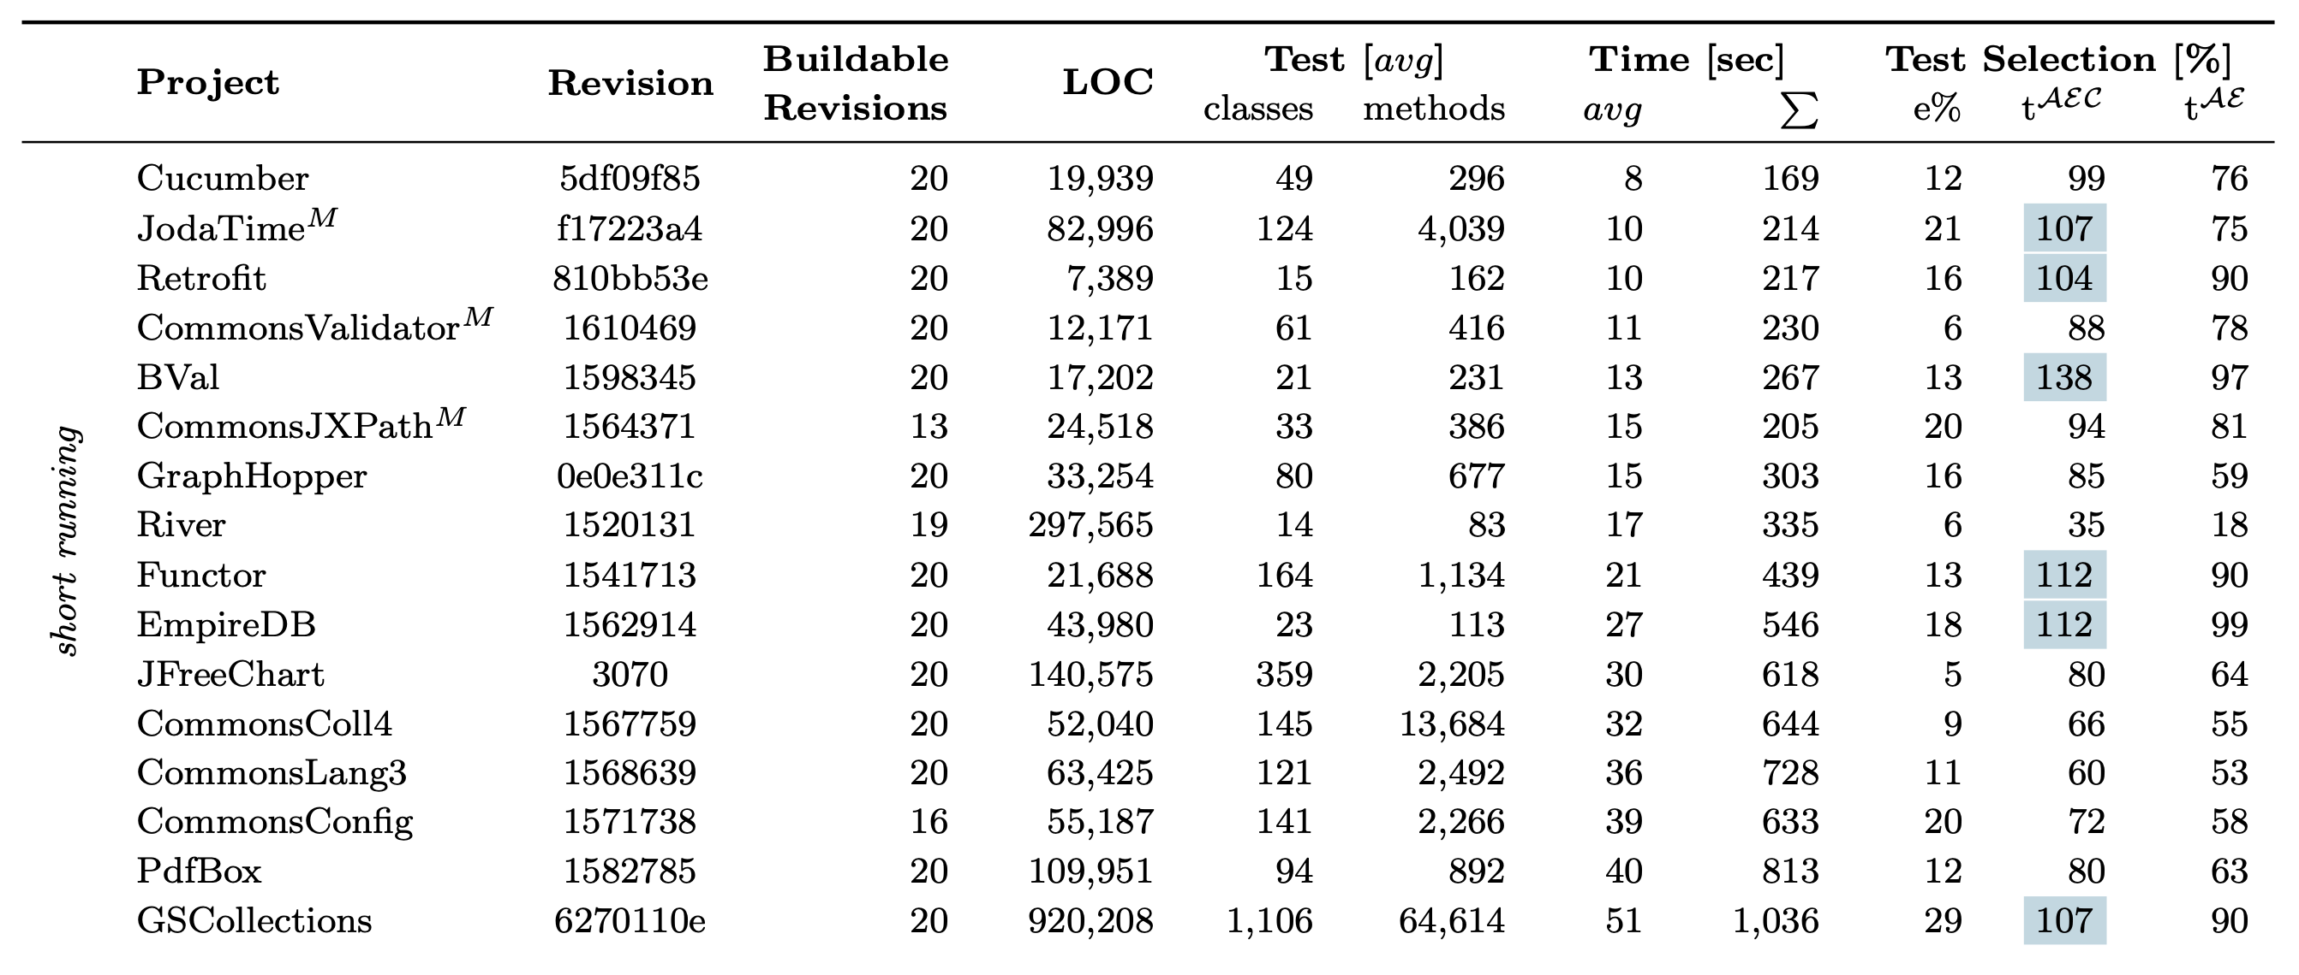
Evaluation – Short Running Tests (< 1 min)

Slide 23
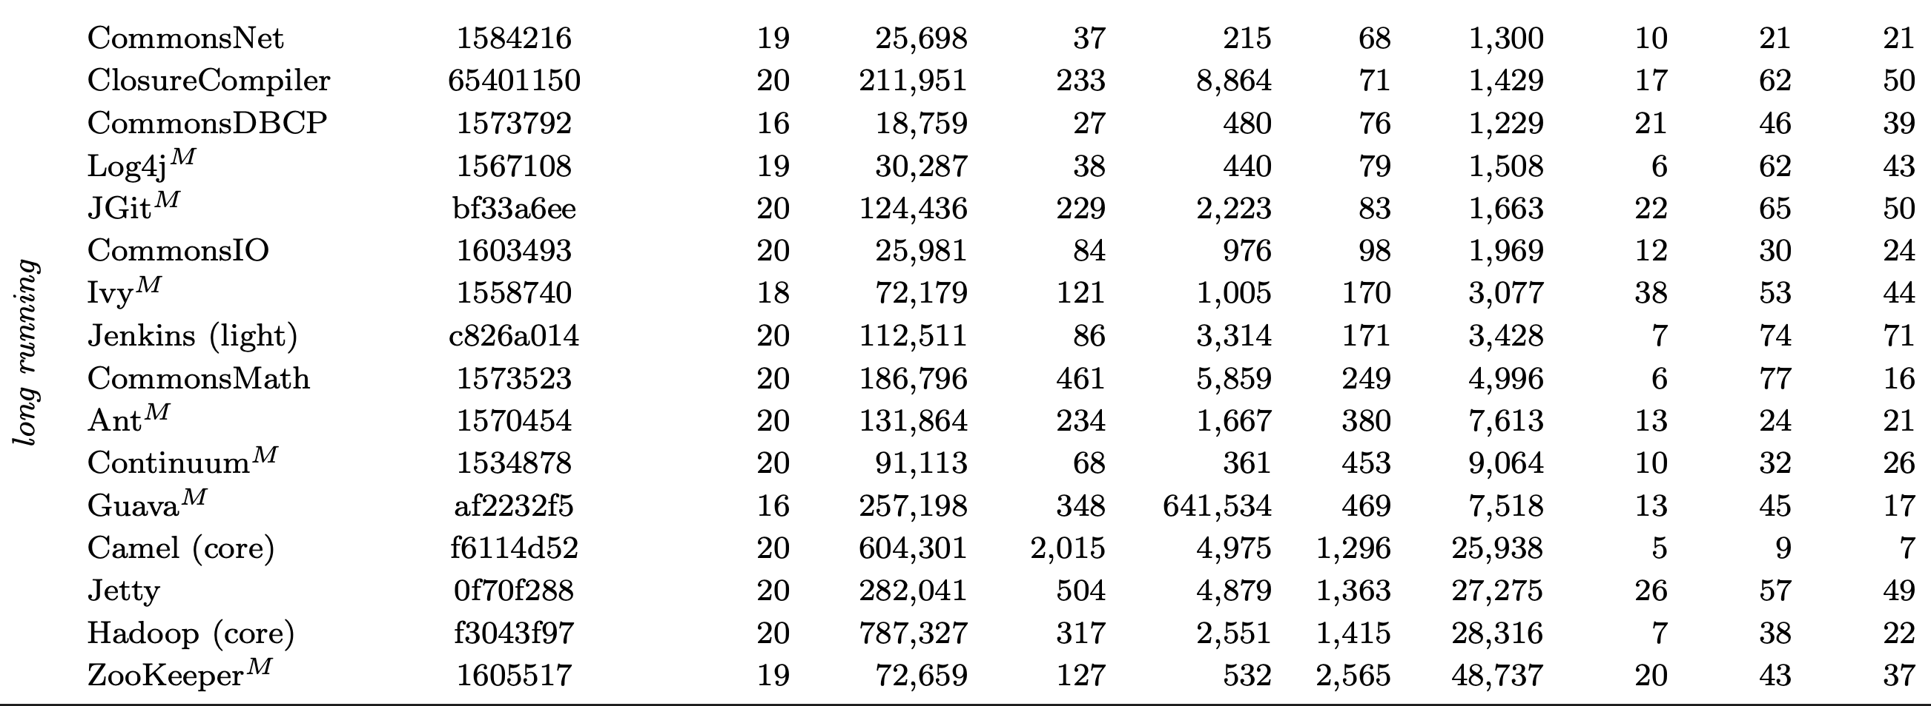
Evaluation – Long Running Tests ( > 1 min)

Slide 24
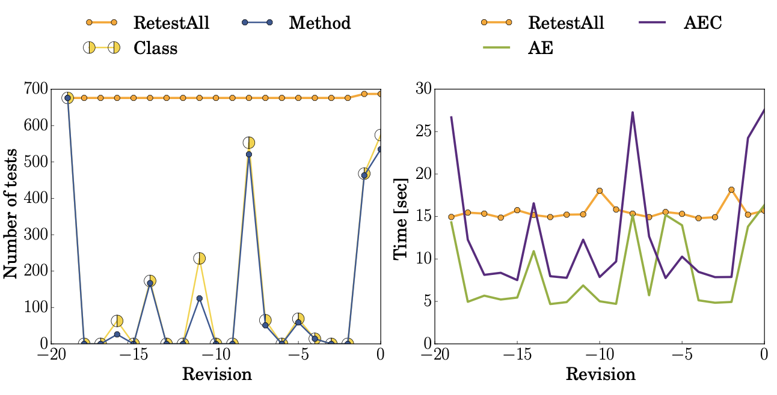
Evaluation - GraphHopper

Slide 25
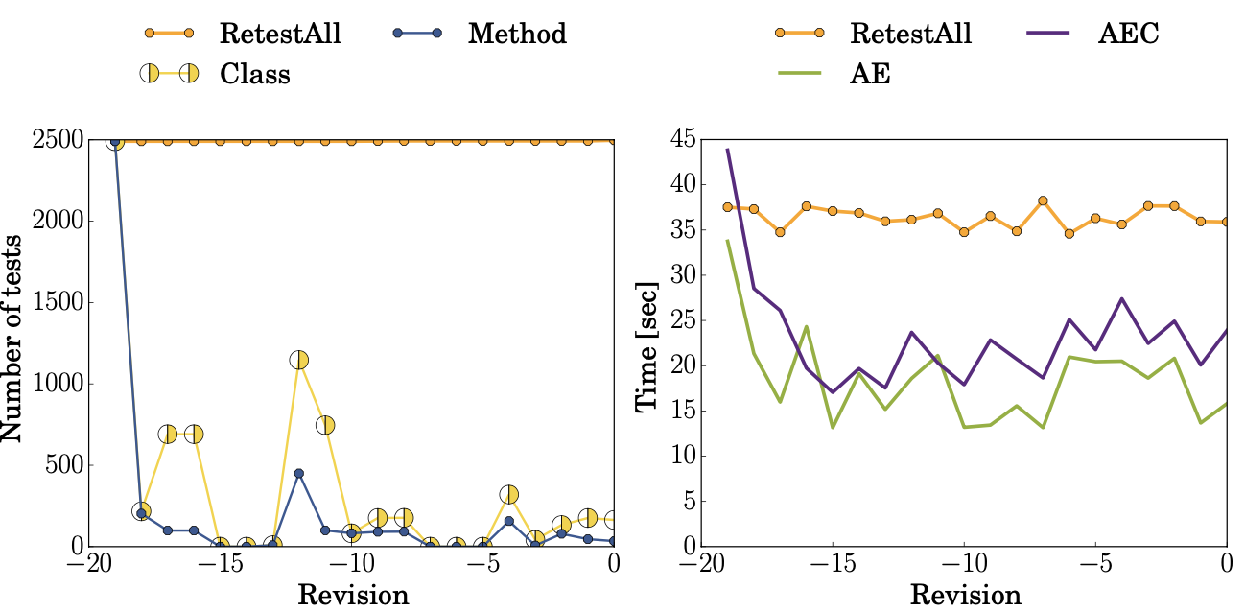
Evaluation – CommonsLang3

Slide 26
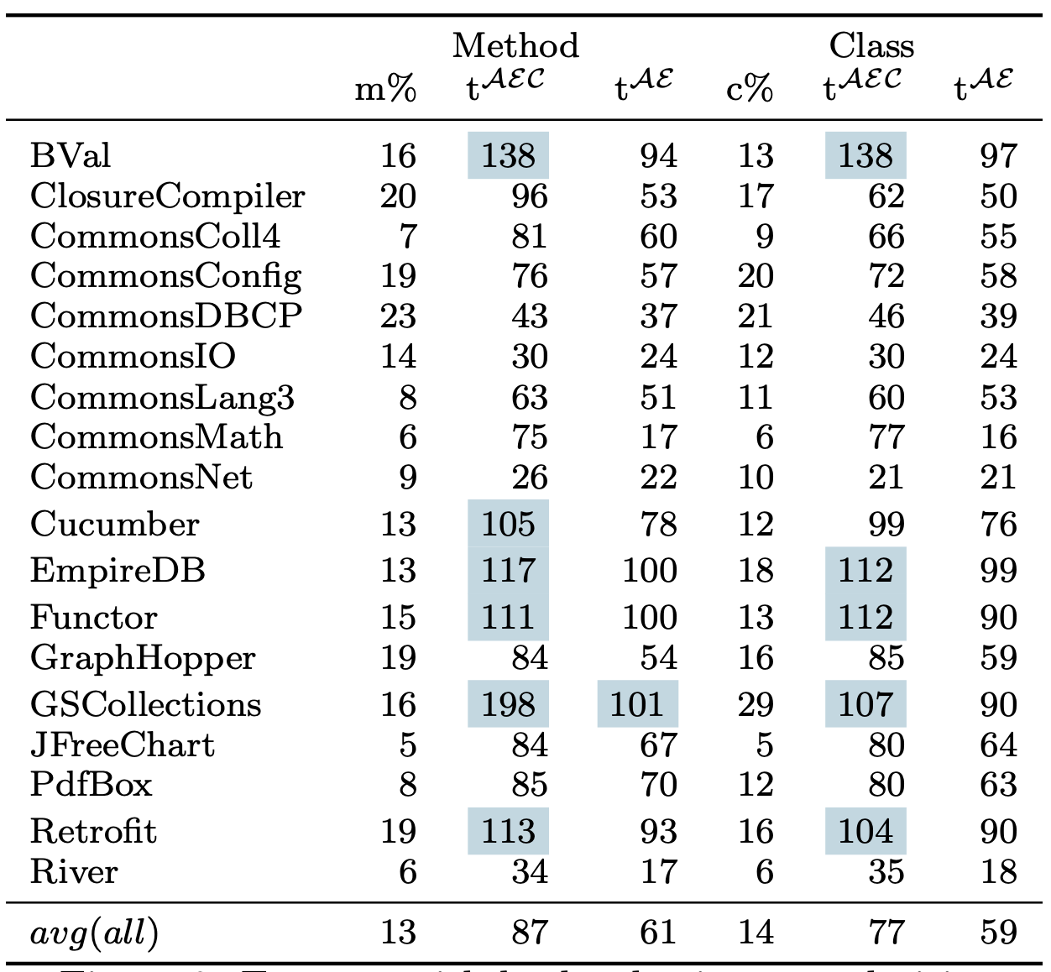
Evaluation – Selection Granularity
In most cases, classes outperform methods
In other cases, classes are only slightly worse

Slide 27
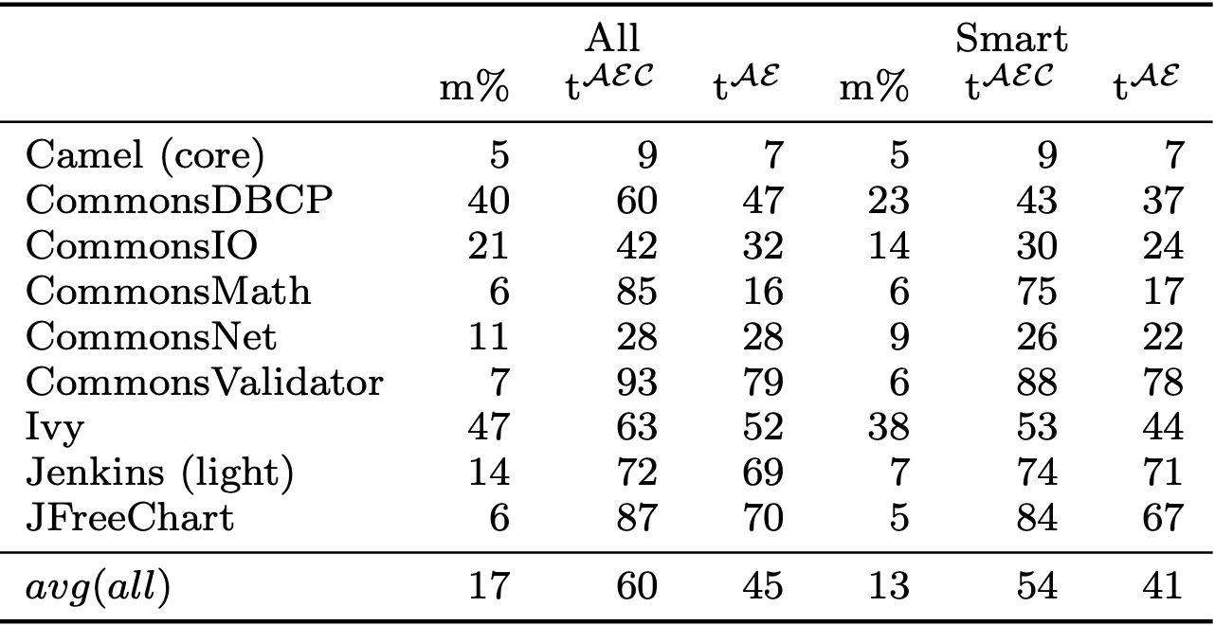
Evaluation – Smart Checksums

Slide 28
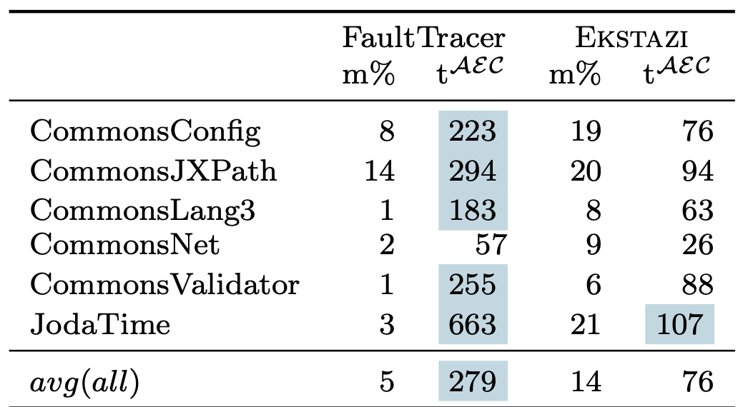
Evaluation – Versus Other RTS
FaultTracer uses Extended Control Flow Graph for each test method
Comparing actual versions instead of checksum takes longer
Selects fewer tests but AC time negate E benefits

Slide 29
Potential Issues
Parameterized Tests – Ekstazi runs all parameters for selected tests
External Resources – Dependencies like databases and web services may lead to missed tests
Safety – Ekstazi codebase not verified. Manual inspection of selected tests may be insufficient justification for safety

Slide 30
Conclusion
Ekstazi – lightweight and effective RTS
Robust implementation – well integrated with Junit
In use with teams like Apache CXF, Common Math and Camel

