Slide 1



CYBER CRIMES IN SAUDI ARABIA
Group Members :
- Raghad Almeataz - Ahmed Altowairqi - Mohammed Albesher
- Abdullah Albutih - Abdulrahman Aljubaylan

Slide 2

Business Understanding

Slide 3
Overview
Cyber crime cases are drastically increasing in Saudi Arabia. At present, Saudi Arabia is one of the top 10 countries in significant cyber attacks.
In addition, according to specialists in information security, the financial loss estimated by Saudi companies as a result of piracy and electronic sabotage ranges from SR 300,000 to more than SR1 million for each case, with bank losses, estimated at more than a billion US dollars.

Slide 4
Overview
Banks Financial Losses
4.5B
The 2030 VISION OF SAUDI ARABIA seeks to Increase the Country Income that is not based on Oil that include Information Technology Sector where decreasing the Internet Security Threats to save the lost Money and to use the lost money in other beneficial areas such as investments and Organizations Development and other.
300K-1.2M
Companies Financial Losses per Case
3.6M
Number of Victims in 2016
All Financial Losses are in SAR Currency - SAUDI RIYALS

Slide 5
Project Objective
measure the awareness of Saudi people about the danger of cyber crimes.
find out the major factors for becoming a potential victim.
give Solutions for the Main faced issue .
measure the Risk factors and decrease it .

Slide 6
Stakeholders
The Target Audience
Cyber security companies
Saudi Federation for Cybersecurity, Programming and Drones Institute (SAFCSP)
Businesses (organizations) that want to measure the awareness of their employees
Any company that is working remotely, needs to check security applications of their own
employees to ensure consistent work

Slide 7

Data Collection & Preparation

Slide 8

Dataset Overview
It is a survey conducted using Google forms on Saudis whose age is above than 18. It consists of 64 questions, which indicates the number of columns and 1230 number of responses which indicates the number of rows.
64 Questions
1230 Responses
Rows : 1230 | Columns : 64

Slide 9
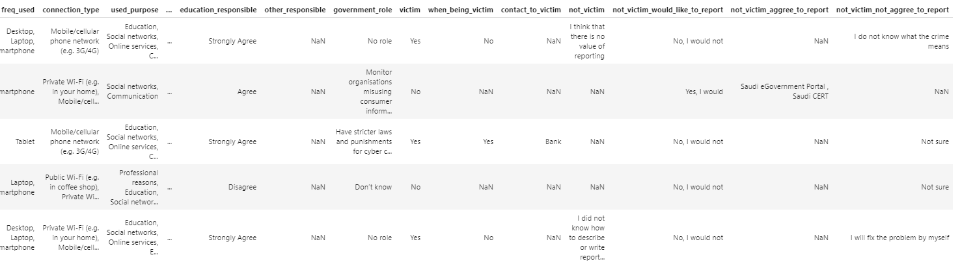

Data Preprocessing
The applied Approaches :
- Filling with zeros
- Filling with Values
- Dropping The Null Values
- Filing with Forward Filling
- Filling with Backward Filling
After conducting the different approaches, we continue with the best fit which is the Dropping The Null values.

Slide 10
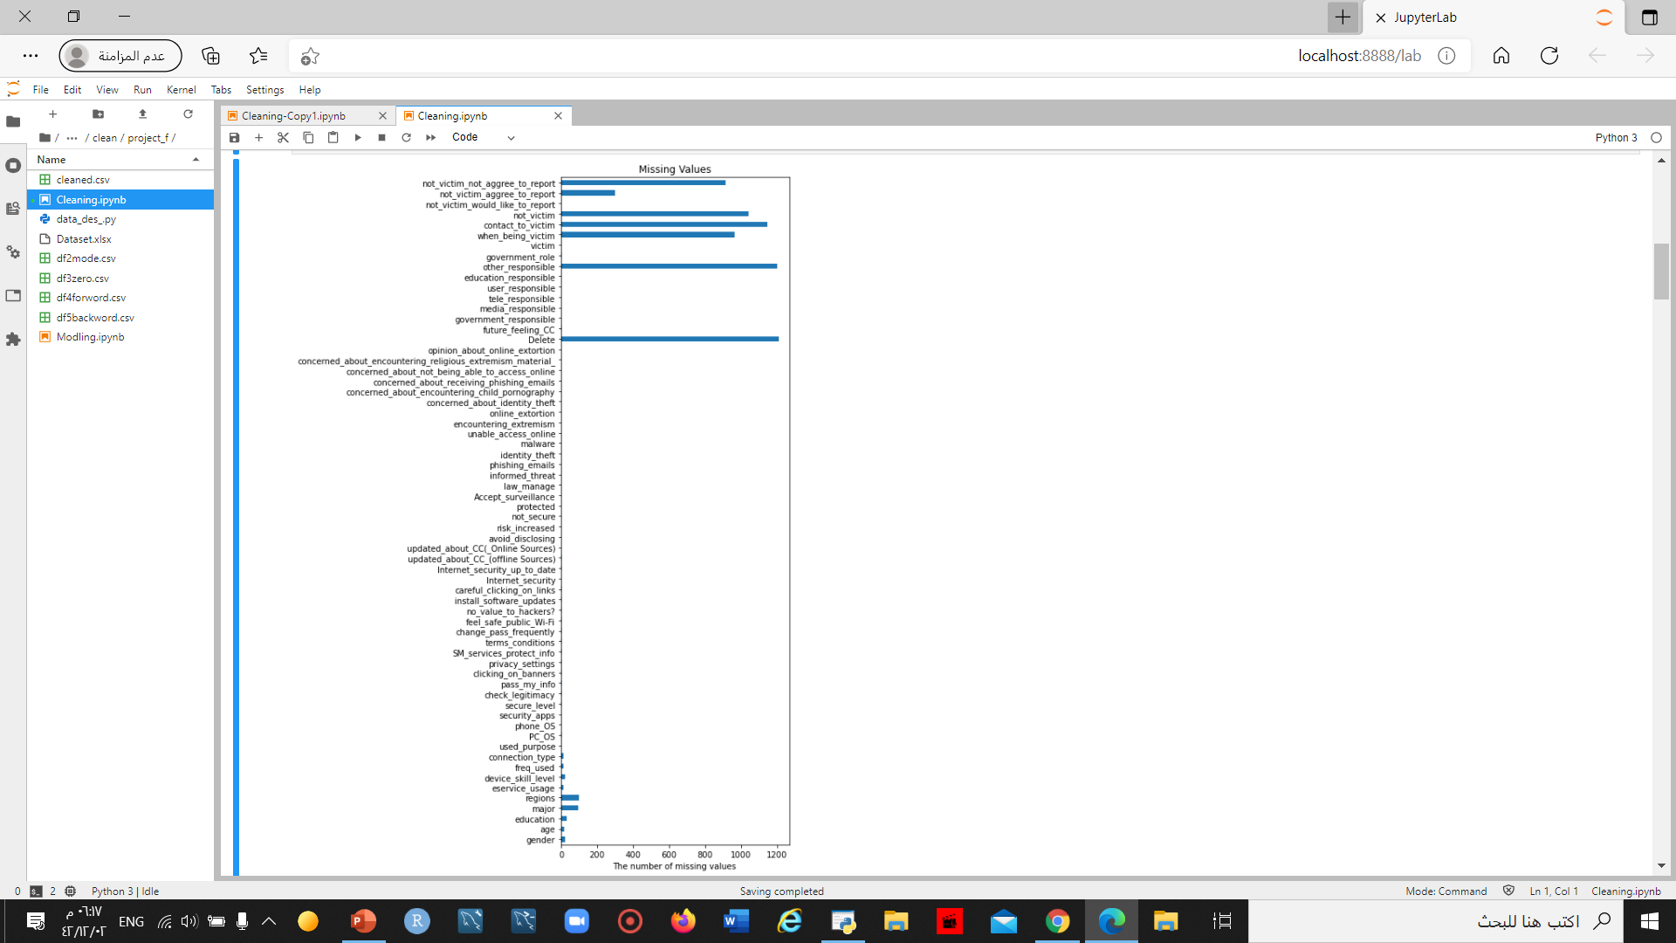
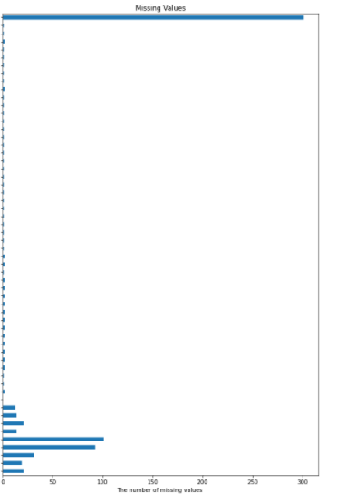
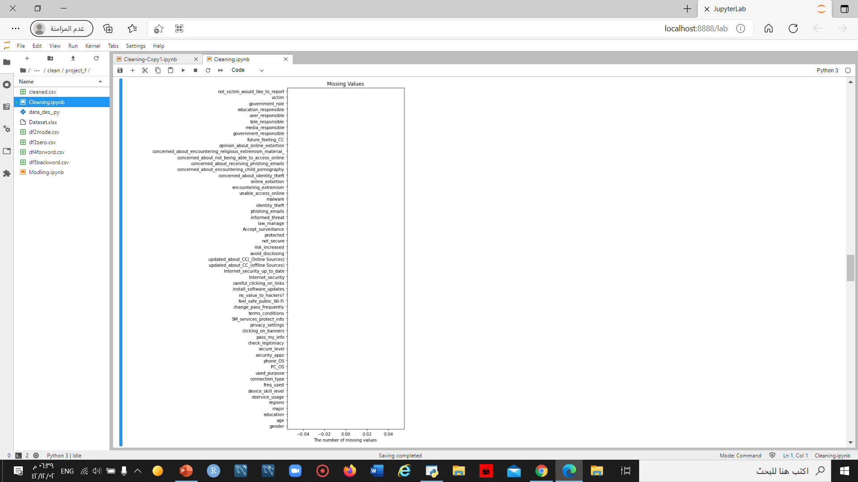
Data Preprocessing
we dropped the columns that with 60% missing values and more , because they do not have enough data
The Original Dataset
60*1231 => 73860 / 100 => 739
Dropping Null Values

Slide 11
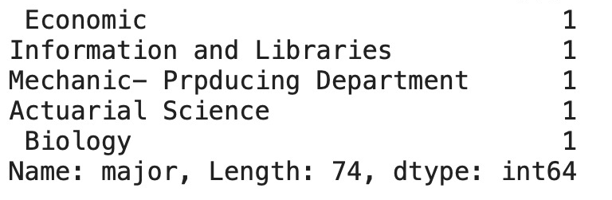
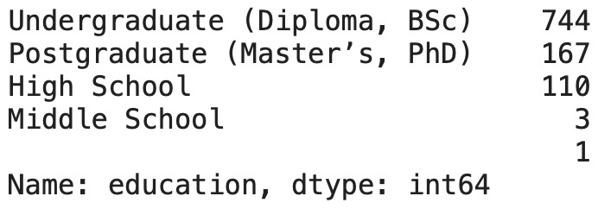
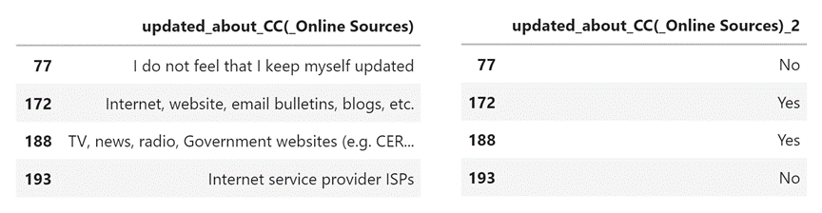
Data Preprocessing
Trim white spaces, imputing empty values and extracting new columns out of existing ones.

Slide 12

Exploratory Data Analysis

Slide 13
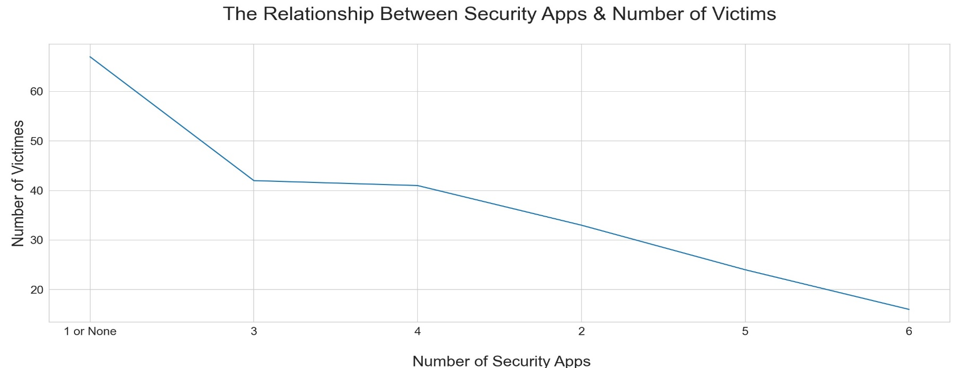
EDA (Factors)
Insight :
The less security apps the more potential of becoming victim.

Slide 14
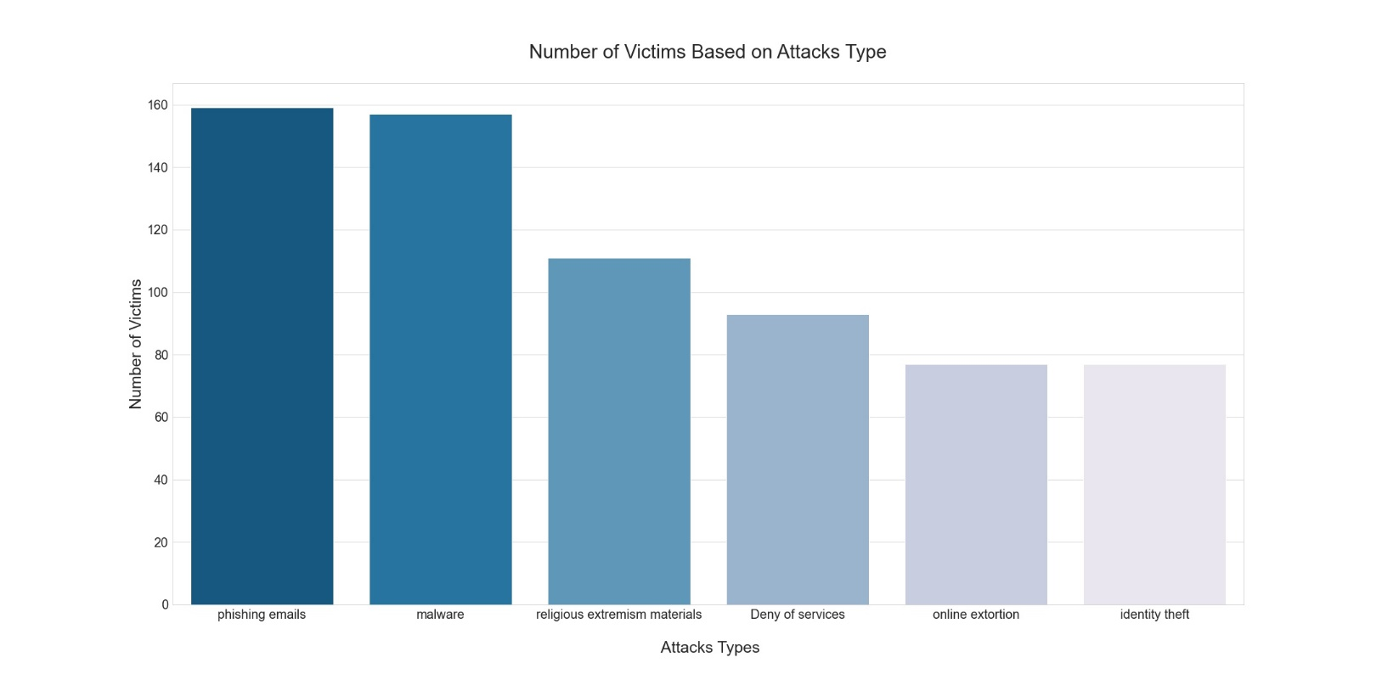
EDA (Factors)
Insight :
Which type of attacks has the most effect on becoming a victim?

Slide 15
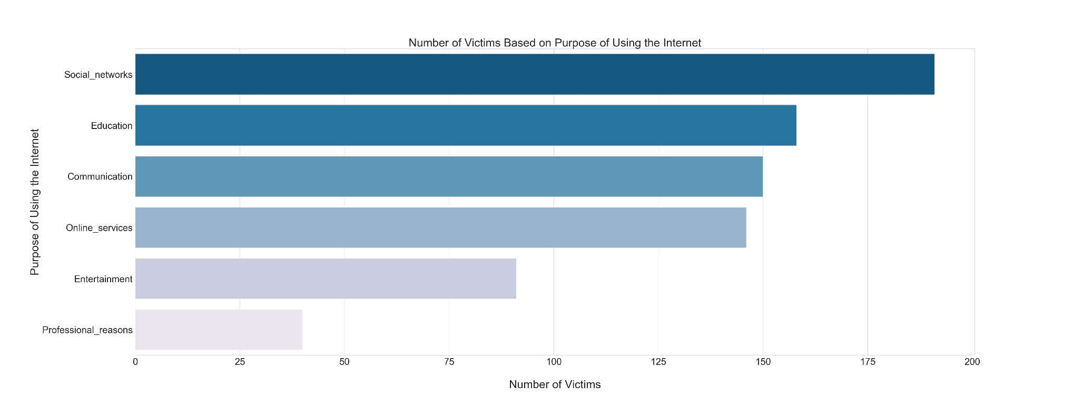
EDA (Factors)
Insight :
Which purpose has the most effect on becoming a victim?

Slide 16
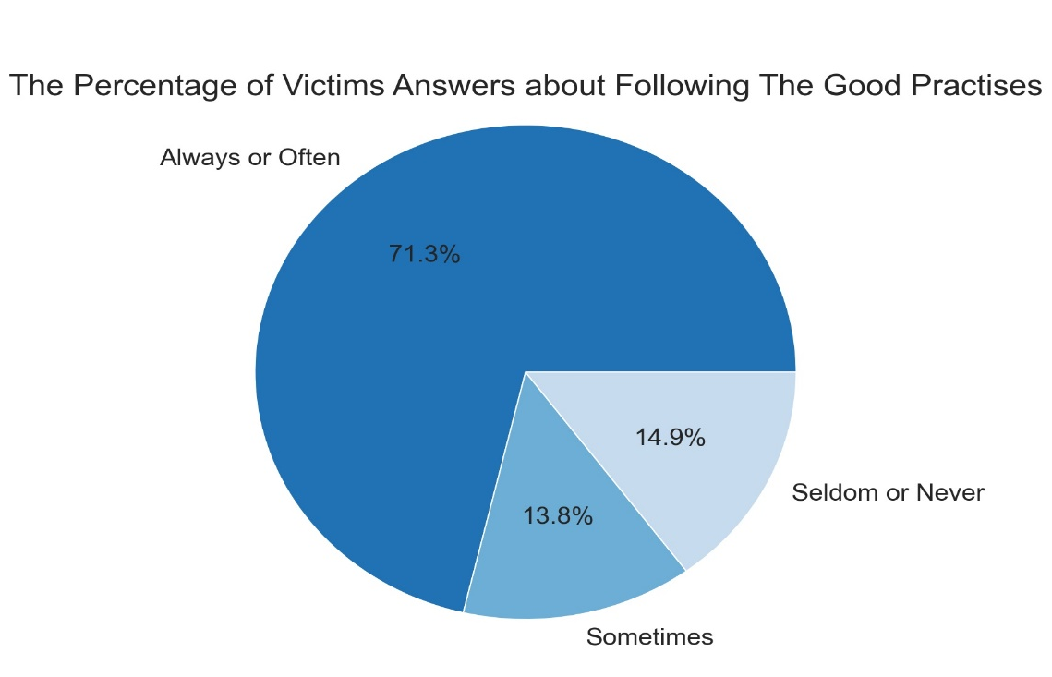
EDA (Factors)
Insight :
The more good practices you follow the less potential of becoming a victim
Good Practices:
Careful clicking on links
Install software updates
Change pass frequently
Terms conditions
Privacy settings
Check legitimacy

Slide 17
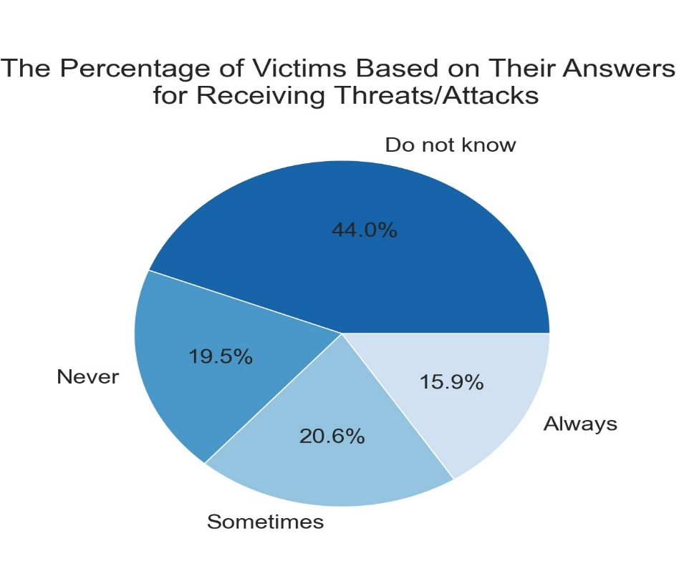
EDA(Awareness)
Insight :
People always receive threats/attacks

Slide 18
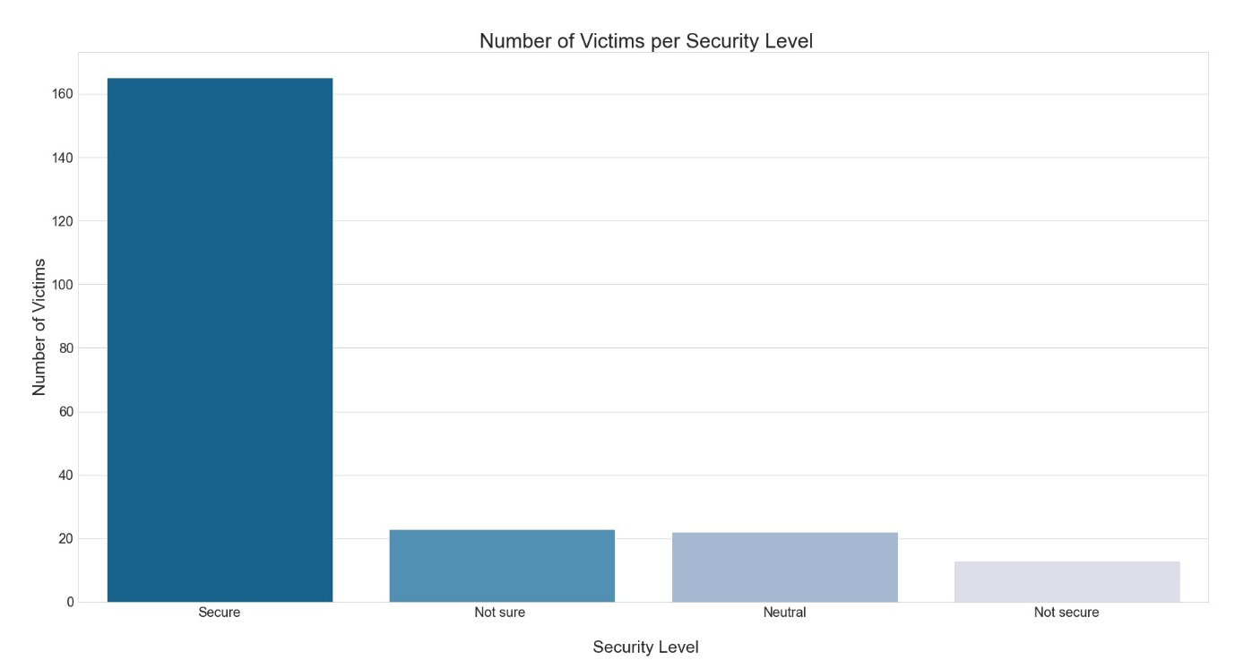
EDA(Awareness)
Insight :
The more security level the less potential of becoming victim

Slide 19
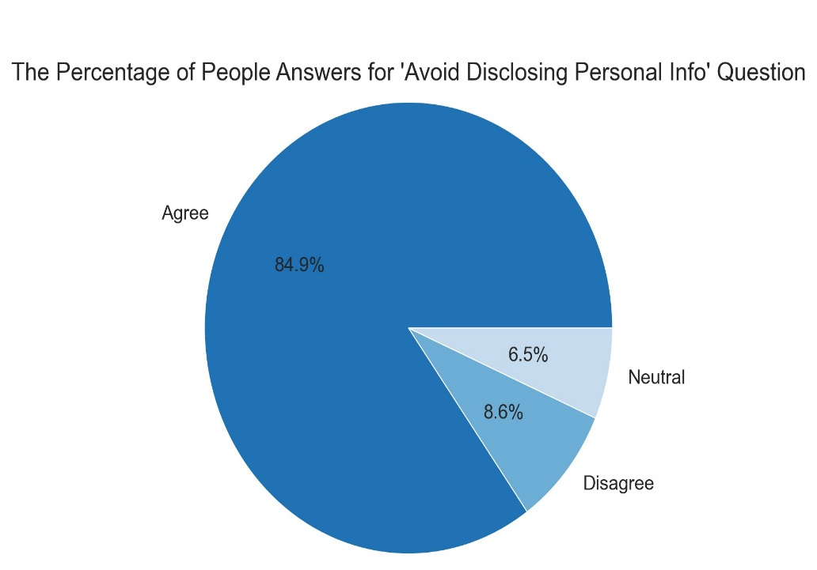
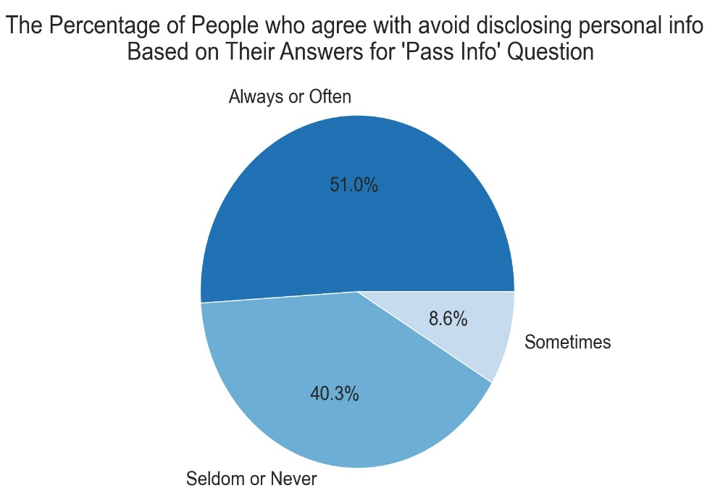
EDA(Awareness)
Insight :
Most people agree with avoiding disclose personal information.

Slide 20
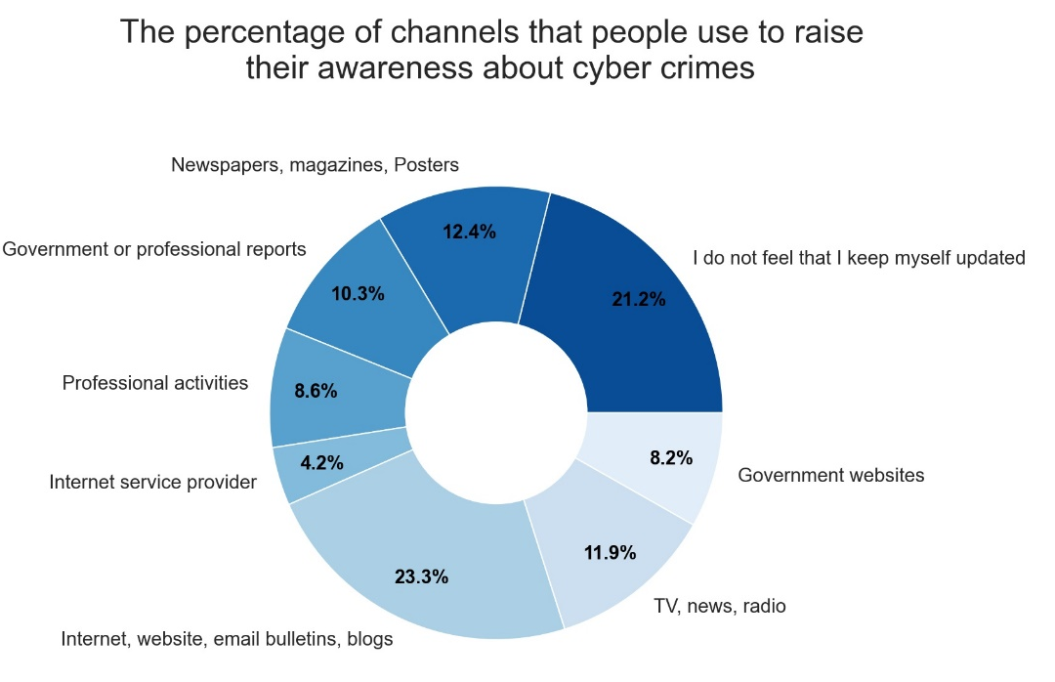
EDA(Awareness)
Insight :
What are the top channels that people use to raise their awareness on cyber crimes?

Slide 21
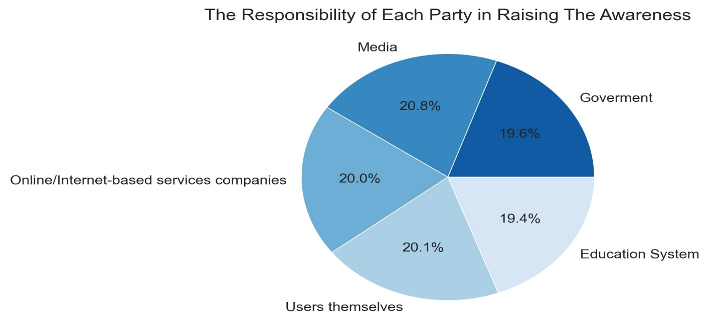
EDA(Awareness)
Insight :
Which party is more responsible for raising the awareness of cyber crimes?

Slide 22

Modeling

Slide 23
Modeling Overview
Cyber crimes | The Dataset Name
Have you been a victim of a cyber crime ? | The Target Label
Supervised Learning | The Machine Learning Type
Classification | The Modeling Category Type
Python | The Programming Language
Scikit-learn | The Main Library

Slide 24
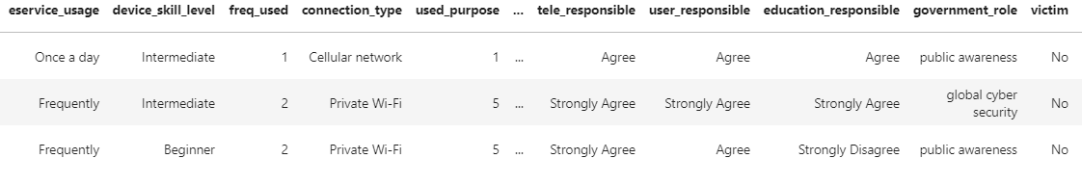
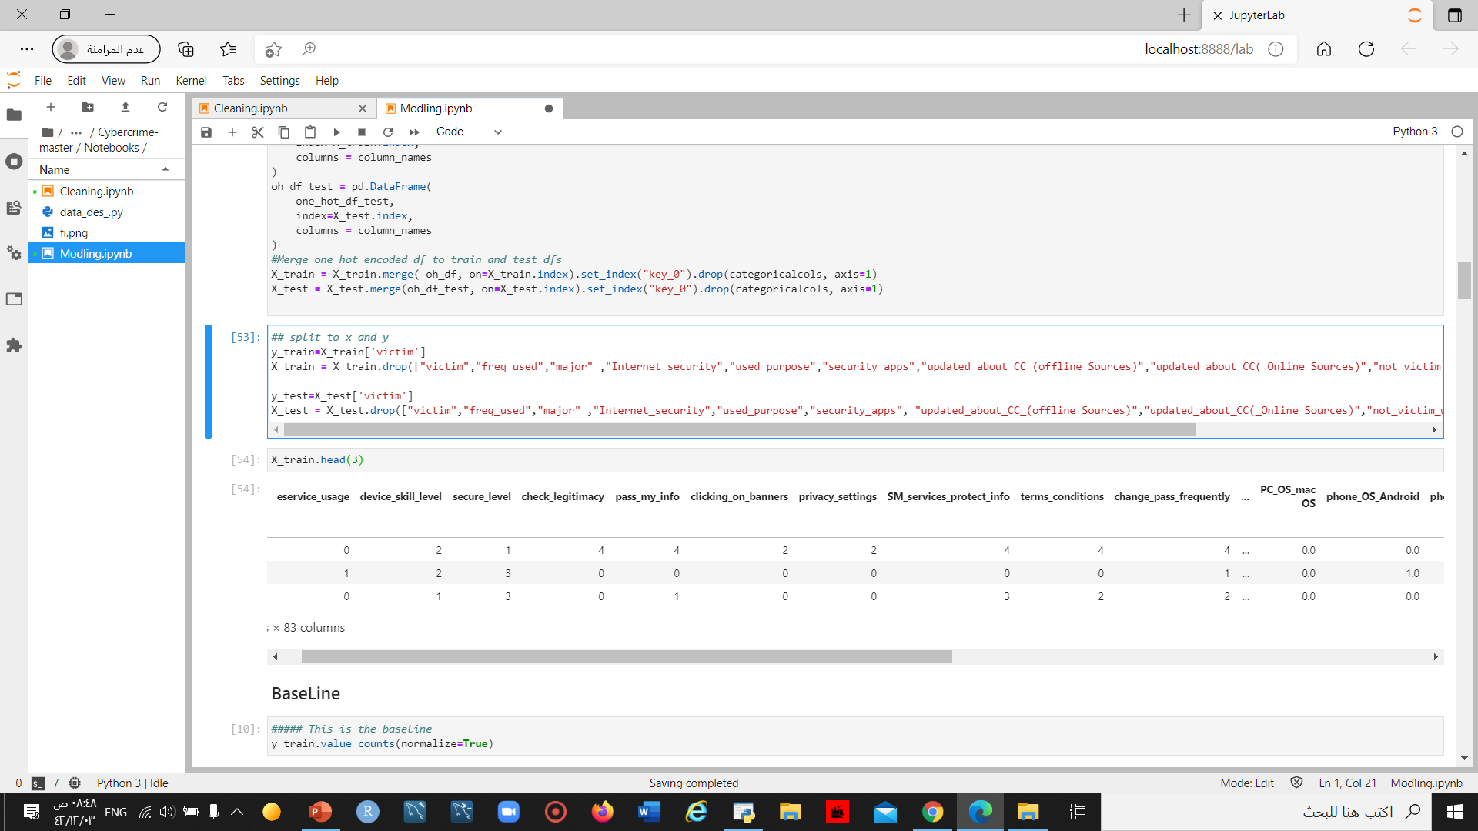
Feature Engineering
The applied Mechanisms :
- Mapping
- Label encoding
- One Hot encoding
After conducting the different mechanisms and try them all, we continue with the best fit which is mix between the Label encoding and one hot encoding.

Slide 25
Challenges & Solutions
The Challenges :
The label Imbalance.
The Dataset Complexity.
beating the baseline model.
The Solution :
After Conducting many methods to fix the faced issues, we found out that the best solution is to remove around 200 records from the dataset because going with this method would not just resolve the missing values issue but also would resolve the bias in the dataset and makes it more suitable and equivalent. Beating the baseline model in the start was a rough process but after removing the specified records and decreasing the bias in the dataset now the data classes gap minimized which makes more sense.

Slide 26
Models
The Models Results :
0.7707317073170732 | The Baseline
0.824390243902439 | The Logistic Regression
0.824390243902439 | The Decision Tree
0.8146341463414634 | The Random Forest
0.824390243902439 | The SVC

Slide 27
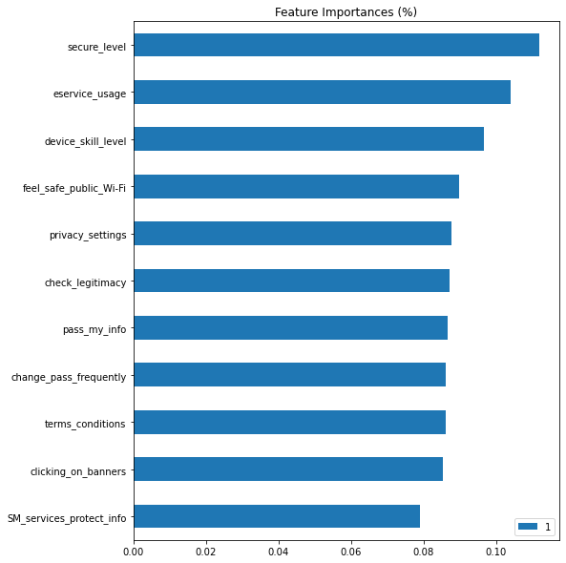
Models
Why did we chose this specific Model ?
The Random Forest model characterized by Low risk of overfitting and runs efficiently on a large dataset.
We chose the Random Forest model because it’s the best model to represent Great accuracy with Strong reliable almost parallel features that all the entered features contributing to the prediction.

Slide 28

Tableau Dashboard
The Dashboard

Slide 29


Conclusion
We proposed a cybercrime Dataset that:
Filled with Messy Data
Filled with biased Data
Lack of Specification
After we finished the project , we could :
Measure The awareness of people
Get The Main factors that Couse cybercrimes
Determine if a person is going to be a cybercrime victim or not

Slide 30

Future Work
In the near future :
Add the project into Different blogs.
We Share The Results with the Local Community
We seek to continue to develop the project.
Publish The work and add more Data.

Slide 31
Acknowledgement
Mr. Mikio Harman for his time, effort and dedication to helping us. We learned a lot from him and enjoyed working with him.
Saudi Digital Academy for supporting us and provide us with this wonderful Data Science Bootcamp that gave us the Strong Background we need so we can take our Careers to the Next level.
Coding dojo for supporting us and provide us with all the Resources we need to Increase our knowledge and work practically with different creative new projects.

Slide 32
THANK YOU
Any Questions ?

