Slide 1
Electricity Consumption Insight
GridSense Energy Services
Business Question:
What temporal and environmental factors influence electricity consumption?
• Identify high- and low-demand periods
• Analyze weather–consumption relationships
• Compare customer segments and geographical areas
• Investigate weekday/weekend and tariff-period patterns
• Train and evaluate a regression model
SYNTHETIC DATA — Not official GridSense data. For practice purposes only.

Slide 2
Dataset and Preparation
Datasets
Data Quality Issues & Fixes
• meter_readings: 229,658 rows (timestamp, customer, consumption)
• customers: 80 rows (segment, area, connection_type, tariff_category)
• weather: 2,868 rows (temperature, humidity, rain)
• calendar: 120 rows (date, weekday, holiday, season)
• tariff: 72 rows (tariff_category, hour, peak_period, tariff_rate)
• Coverage: 2025-01-01 to 2025-04-30 | 80 customers
• Exact duplicate rows → removed
• Conflicting customer+timestamp keys → kept higher consumption
• Negative consumption values → removed (synthetic errors)
• Inconsistent segment labels → normalized (strip + title-case)
• Missing weather measurements → forward/back-filled
• Missing consumption → excluded from ML training
• All joins validated (many-to-one); row count preserved
SYNTHETIC DATA — Not official GridSense data. For practice purposes only.

Slide 3
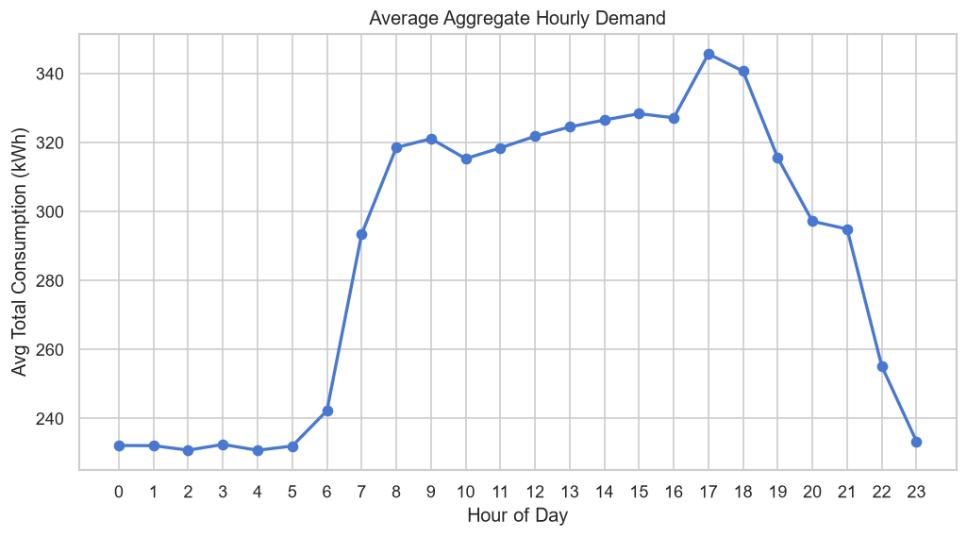
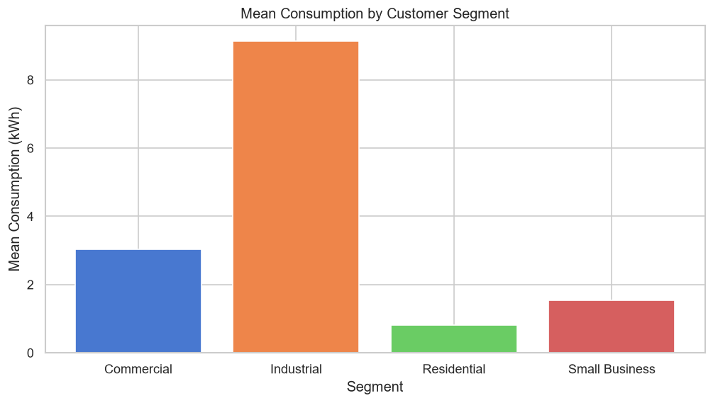
EDA Findings
Finding 1 — Peak Demand Hour: 17:00
Finding 2 — Segment Differences (Top: Industrial)
Peak aggregate demand occurs at 17:00.
Low demand occurs at 4:00.
Peak avg demand: 345.7 kWh
Low avg demand: 230.8 kWh
Implication: Grid operators should schedule maintenance and demand-response
programs around the 17:00 peak window.
Highest mean consumption: Industrial (9.132 kWh/reading)
Temp–demand correlation: r = 0.6807
Humidity–demand correlation: r = -0.2119
Implication: Targeted energy-efficiency programs should prioritise
the Industrial segment. Weather-linked demand suggests HVAC usage
is a key driver.
SYNTHETIC DATA — Not official GridSense data. For practice purposes only.

Slide 4
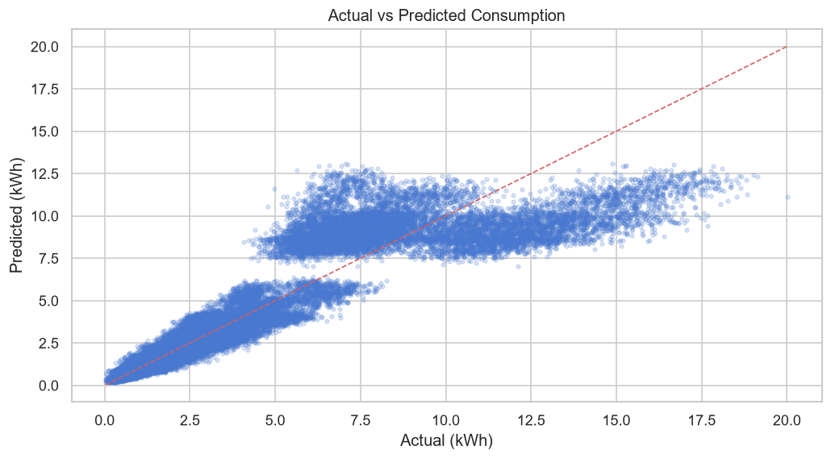
Machine Learning Model
Algorithm: Random Forest Regressor (100 trees, seed=42)
Features (18 total):
Numeric: hour, day_of_week, month, is_weekend, hour_sin, hour_cos, month_sin, month_cos, temperature, humidity, rain, holiday, tariff_rate
Categorical: segment, area, connection_type, tariff_category, peak_period
Target: consumption (kWh)
Split: Chronological (80% train / 20% test)
Train rows: 182,663
Test rows: 45,668
Split at: 2025-04-07
Evaluation Metrics
Metric Baseline RandomForest
MAE 2.9156 0.9010
RMSE 3.7699 1.4887
R² -0.0036 0.8435
SYNTHETIC DATA — Not official GridSense data. For practice purposes only.

Slide 5
Business Recommendations
1. Demand-Response at Peak Hour (17:00)
Evidence: Peak aggregate demand is 345.7 kWh vs low of 230.8 kWh at 4:00.
Action: Implement time-of-use incentives to shift flexible loads away from 17:00.
2. Targeted Efficiency for Industrial Segment
Evidence: Industrial has the highest mean consumption (9.132 kWh/reading).
Action: Offer energy audits and smart-meter upgrades to Industrial customers first.
3. Weather-Linked Forecasting
Evidence: Temperature correlation r=0.6807 with aggregate demand.
Action: Integrate weather forecasts into grid planning to anticipate demand spikes.
4. Model Deployment
The Random Forest model (R²=0.8435, MAE=0.901) outperforms the mean baseline
(R²=-0.0036) and can support short-term consumption forecasting.
Limitations: Synthetic data; results are illustrative only. Real deployment requires
validation on actual meter data and regulatory review of tariff recommendations.
SYNTHETIC DATA — Not official GridSense data. For practice purposes only.

